Slide 1

B.Tech. | BCSE497J – Project-I
AI-Driven Post-Quantum Cryptography Migration Framework
Team members:
ARPIT MITTAL (23BCI0044)
PRIYANSHU SEN (23BCT0040)
VEDANSH TRIVEDI (23BCT0056)
Faculty guide:
BADRINATH N, Associate Professor Grade 2
Team ID: 20106UG02

Slide 2

Approval Mail From Guide
Get the approval for the following points from your guide through mail before 21-10-2026.(sample attached below)
All the above aspects are addressed and updated by the project team.

Slide 3
Aim
To automate the migration of classical public-key cryptography in existing Python software to NIST-standardised post-quantum algorithms, and to prove the migrated code still works.
  Detect every use of RSA, ECC and Diffie-Hellman in a codebase
  Recommend the correct NIST replacement for each occurrence
  Rewrite the source automatically onto ML-KEM and ML-DSA
  Verify the result by executing the migrated application
  Report the measured cost of migration in size and time

Slide 4
Abstract
Shor's algorithm breaks RSA, ECC and Diffie-Hellman; NIST standardised the replacements in August 2024 (FIPS 203, 204, 205).
Standardising algorithms solved only half the problem — migrating existing codebases is still slow, manual and needs cryptographic expertise.
We built an end-to-end framework: AST detection → purpose inference → NIST recommendation → rule-based rewriting → functional verification → reporting.
Evaluated on a 29-module labelled benchmark with 38 annotated sites: precision 1.00 and recall 1.00 over 31 in-scope sites, purpose accuracy 1.00, zero false alarms on 6 clean modules.
9 of 9 sites migrated across 3 sample applications; the migrated RSA and ECDSA applications execute successfully under real ML-KEM and ML-DSA.
Measured cost: ML-KEM-768 keys are 4.03× RSA-2048; ML-DSA-65 signatures are 46.6× ECDSA P-256.

Slide 5
Literature Review
Paper / Source | Objective | Methodology | Pros / Cons | Findings
NIST FIPS 203, 204, 205 (2024) | Standardise quantum-resistant KEM and signature schemes | Multi-round public evaluation of lattice and hash-based candidates | Pro: settles which algorithms to adopt. Con: silent on migrating existing code | ML-KEM, ML-DSA and SLH-DSA with defined parameter sets per security category
NCCoE, NIST SP 1800-38 — Migration to PQC | Define a migration programme for enterprises | Practice guidance centred on cryptographic discovery and inventory | Pro: establishes discovery as the first step. Con: produces an inventory only | Knowing where crypto lives does not say what should replace it
Stebila & Mosca, Open Quantum Safe (SAC 2016); kyber-py, dilithium-py | Make post-quantum primitives usable in real software | Open-source reference and optimised implementations | Pro: production-quality primitives available. Con: supplies the destination, not the journey | Primitives are available and interoperable well ahead of adoption
Chen et al., Evaluating LLMs trained on code (2021) | Assess model-driven source-to-source transformation | Benchmark generated code against functional tests | Pro: handles code shapes rules cannot match. Con: output requires human verification | A plausible patch is indistinguishable from a correct one without execution
Mosca (2018); Barker et al., NIST white paper (2021) | Frame the urgency and organisational readiness problem | Risk analysis of the harvest-now-decrypt-later threat | Pro: justifies acting before quantum hardware exists. Con: no technical migration path | Long-lived data is already exposed; migration cannot wait for the threat

Slide 6
Research Gap
Discovery tools identify cryptography but do not recommend replacements.
Standards specify replacements but do not transform code.
Implementations provide primitives but do not migrate anything.
Transformation research changes code but does not verify the result.
No existing system connects detection → decision → transformation → verification into one workflow.
Verification is the widest part of the gap: cryptographic correctness is not visible by inspection — it must be demonstrated by execution.

Slide 7


Objectives
Detect RSA, ECC and DH usage with file, line, algorithm and library.
Classify each occurrence as key encapsulation, key exchange or signature.
Recommend a specific NIST parameter set with a written justification.
Rewrite source onto PQC without modifying the originals.
Verify by round-trip tests, negative tests and executing migrated code.
Generate JSON, Markdown and HTML reports with a measured benchmark.
Evaluate detection quantitatively against a labelled benchmark.
Identified Sustainable Development Goals: SDG 9 – Industry, Innovation and Infrastructure (primary); SDG 16 – Peace, Justice and Strong Institutions (secondary)
Outcome: Conference (Scopus) — paper drafted, target venue to be finalised with the guide

Slide 8
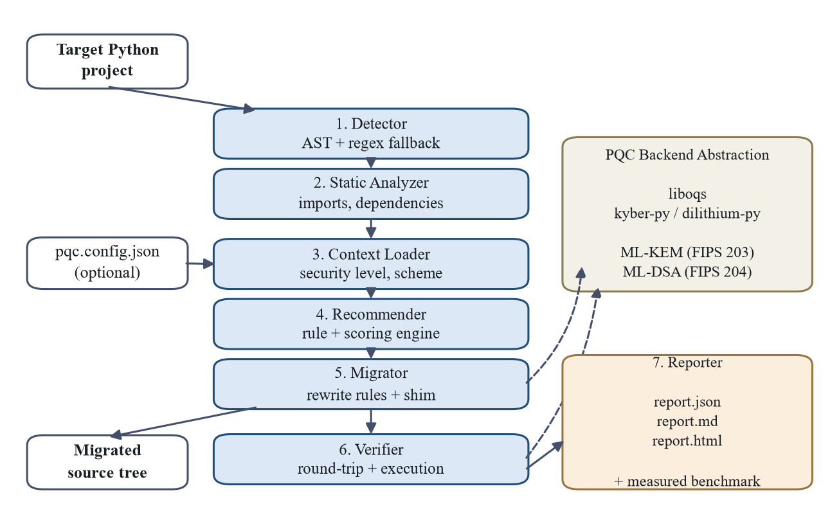
Framework/Architecture/Block Diagram
Seven independent stages; each communicates only through explicit data records, so no stage can report an outcome an earlier stage did not produce.

Slide 9
Functional Requirements
FR1 — Recursively scan a project and report every RSA, ECC and DH usage.
FR2 — Report file, line, algorithm family, library and matched construct.
FR3 — Classify each occurrence as KEM, key exchange or signature.
FR4 — Continue analysing files that fail to parse, via a textual fallback.
FR5 — Accept target security category and signature family from config or CLI.
FR6 — Recommend a NIST parameter set per finding, with a justification.
FR7 — Produce migrated copies without modifying the original source.
FR8 — Never report a finding as migrated unless a rule actually applied.
FR9 — Verify by round-trip and negative tests, and execute migrated apps.
FR10 — Generate JSON, Markdown and HTML reports with a live benchmark.

Slide 10
Modules
Detector — AST walk over every module, matched against a pattern index; alias resolution; regex fallback for unparseable files.
Purpose classifier — re-infers the role of key generation from how the key is used elsewhere in the same module.
Recommender — purpose selects the family, security category selects the parameter set, scoring raises it from classical strength signals.
Migrator — independent rewrite rules plus a compatibility shim that keeps the classical object model over ML-KEM / ML-DSA.
PQC backend — one interface over liboqs and pure-Python kyber-py / dilithium-py; unsupported algorithms raise rather than substitute.
Verifier — round-trips, negative tests, and execution of migrated apps.
Reporter — JSON, Markdown, HTML with a benchmark measured at run time.

Slide 11
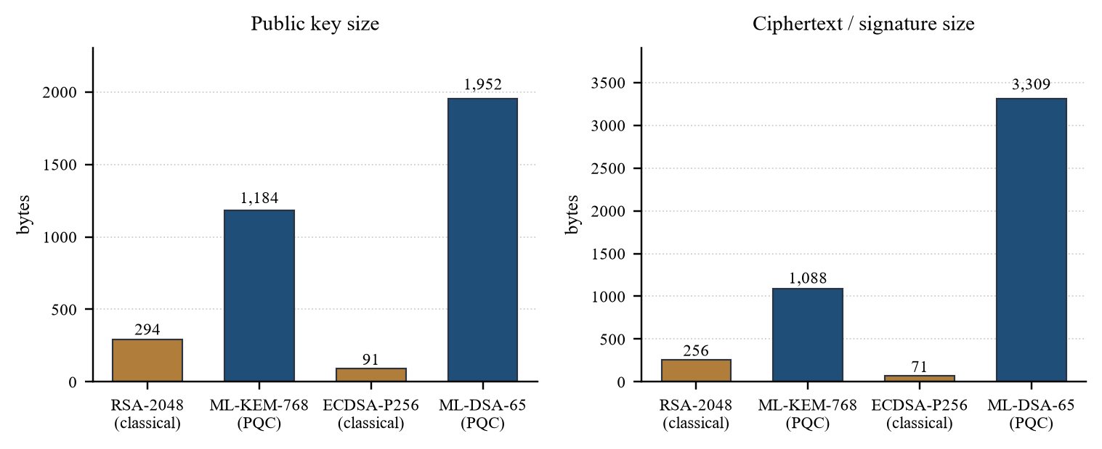
Experiments and Results
Detection benchmark — 29 modules (18 in-scope, 5 adversarial, 6 clean), 38 annotated sites.
In-scope: precision 1.000, recall 1.000, F1 1.000 over 31 sites; purpose accuracy 1.000; 0 false alarms on 6 clean modules.
Extended (adversarial): recall 0.000 of 7 — wrapper libraries, string parameters and dynamic dispatch bound syntactic analysis.
Pipeline: 9/9 sites migrated across 3 apps; migrated RSA and ECDSA apps execute successfully. 70 automated tests pass.

Slide 12
Conclusion and Future Work
PQC migration is a software-engineering problem with a cryptographic correctness criterion — not just an algorithm choice.
Delivered an end-to-end verified pipeline: detection, purpose inference, recommendation, rewriting, verification and reporting.
All seven objectives met; limitations measured and reported rather than concealed.
Future work
  LLM-assisted transformation for the 7 adversarial sites rules cannot reach — verification stage stays, so generated code must still execute.
  Protocol-level restructuring of Diffie-Hellman handshakes.
  Wrapper-library coverage, languages beyond Python, the optimisation module, and independent evaluation on real repositories.

Slide 13
Outcome Achieved
Outcome identified: International Conference Proceedings (Scopus)
Status: full paper drafted — 8 sections, 5 result tables, measured evaluation. Target venue to be finalised with the guide.
Title: “From Detection to Verified Replacement: An End-to-End Framework for Post-Quantum Cryptographic Migration of Python Codebases”

Slide 14
References
[1] National Institute of Standards and Technology, Module-Lattice-Based Key-Encapsulation Mechanism Standard, FIPS 203, Gaithersburg, MD, USA, Aug. 2024.
[2] National Institute of Standards and Technology, Module-Lattice-Based Digital Signature Standard, FIPS 204, Gaithersburg, MD, USA, Aug. 2024.
[3] National Institute of Standards and Technology, Stateless Hash-Based Digital Signature Standard, FIPS 205, Gaithersburg, MD, USA, Aug. 2024.
[4] National Cybersecurity Center of Excellence, Migration to Post-Quantum Cryptography, NIST Special Publication 1800-38, Gaithersburg, MD, USA.
[5] G. Pope, “kyber-py: A pure-Python implementation of ML-KEM (FIPS 203),” software repository, version 1.2.0.
[6] G. Pope, “dilithium-py: A pure-Python implementation of ML-DSA (FIPS 204),” software repository, version 1.4.0.
[7] W. Barker, W. Polk and M. Souppaya, Getting Ready for Post-Quantum Cryptography, NIST Cybersecurity White Paper, 2021.
[8] M. Chen et al., “Evaluating large language models trained on code,” arXiv preprint arXiv:2107.03374, 2021.
[9] M. Mosca, “Cybersecurity in an era with quantum computers: Will we be ready?,” IEEE Security & Privacy, vol. 16, no. 5, pp. 38-41, 2018.
[10] D. Stebila and M. Mosca, “Post-quantum key exchange for the Internet and the Open Quantum Safe project,” in Proc. Selected Areas in Cryptography (SAC 2016), LNCS vol. 10532, pp. 14-37.
[11] P. W. Shor, “Polynomial-time algorithms for prime factorization and discrete logarithms on a quantum computer,” SIAM Journal on Computing, vol. 26, no. 5, pp. 1484-1509, 1997.

