Slide 1
TEAM NAME

Slide 2
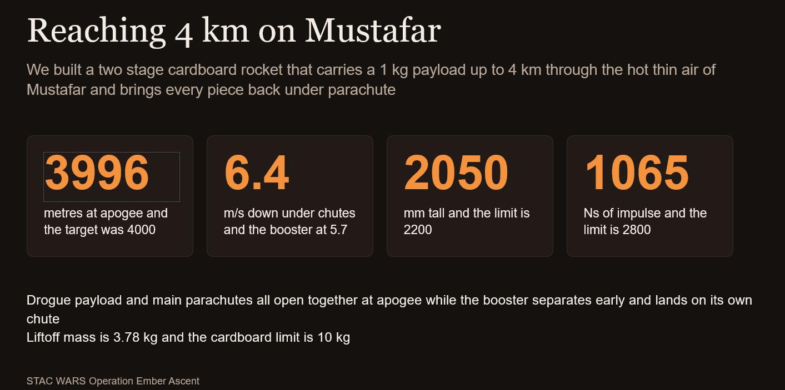
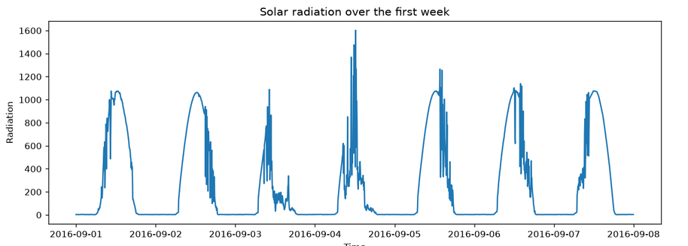
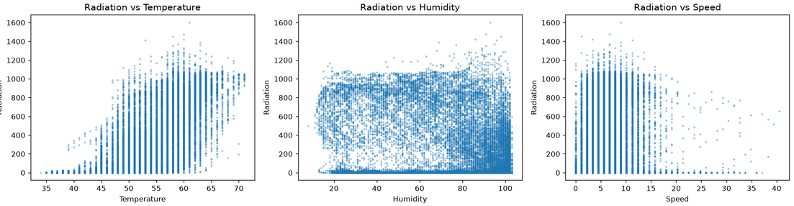
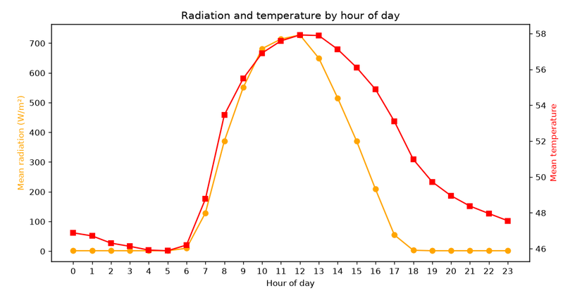
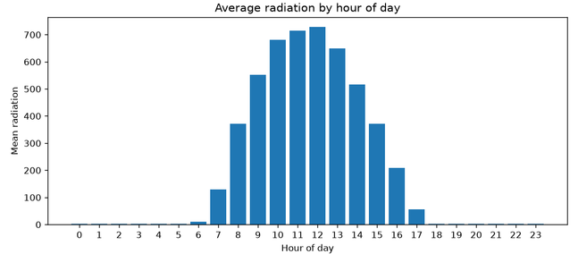
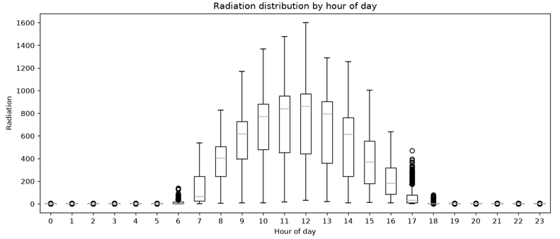
PS1
  Used pandas, numpy and matplotlib to create graphs out of the 32,000 rows of data.
  Compared different weather patterns such as radiation, temperature and humidity to see trends.
  Used plots, scatter graphs, bar graphs, twin graphs and heatmaps to relate various quantities.

Slide 3
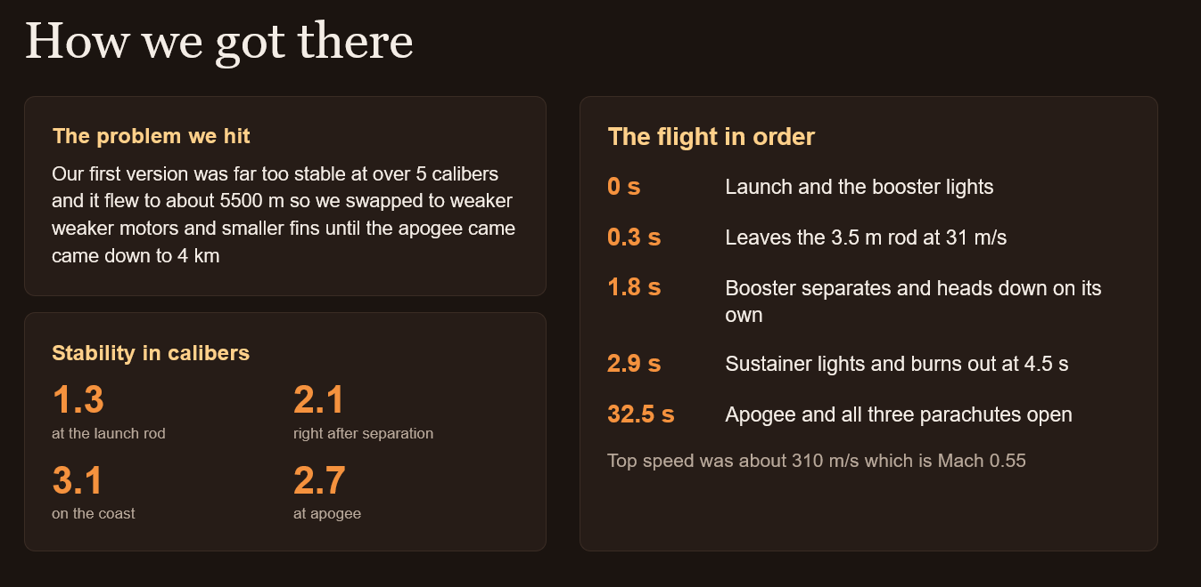
PS1
  Used pandas, numpy and matplotlib to create graphs out of the 32,000 rows of data.
  Compared different weather patterns such as radiation, temperature and humidity to see trends.
  Used plots, scatter graphs, bar graphs, twin graphs and heatmaps to relate various quantities.

Slide 4
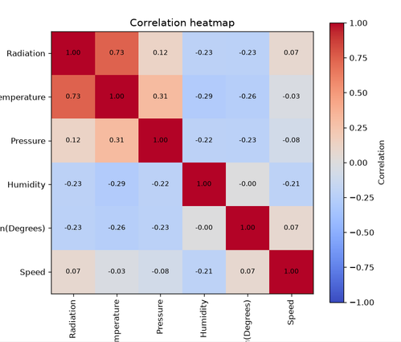
PS2
  Used pandas, numpy and matplotlib to create graphs out of the 32,000 rows of data.
  Compared different weather patterns such as radiation, temperature and humidity to see trends.
  Used plots, scatter graphs, bar graphs, twin graphs and heatmaps to relate various quantities.

Slide 5
PS2 - PART B AND C
  Solar radiation is highest around noon.
  Temperature has the strongest relationship with radiation.
  Certain days have jagged radiation peaks, which may link to solar flares.
TEMPERATURE RISES WITH RADIATION, BUT FALLS MUCH SLOWER
  Determined day of maximum radiation, and its time and weather conditions.
  Analysed the Sunrise and Sunset times of the days, and compared them with the time of maximum radiation.
  Grouped days based on average radiation, and displayed the top 5

Slide 6
PS3
THE THREE PLANETS
PLANET | YEAR LENGTH (DAYS) | BRIGHTNESS DIP | SIZE (x EARTH) | TYPE | DISTANCE FROM STAR (AU) | IDEAL DISTANCE (AU)
STAC-1b | 4.25 | 0.0030 | 5.98 | Gas Giant, like Neptune | 0.051 | 1.00
STAC-2b | 80.0 | 0.0010 | 2.76 | Big rocky or Small glassy | 0.337 | 0.63
STAC-3b | 37.5 | 0.0010 | 1.73 | Rocky Super-Earth | 0.174 | 0.28

Slide 7

PS3
WHY STAC-3b IS THE BEST PICK
1.73x
0.174
Calm
It has solid ground
Decent distance
Its star will last
At 1.73 times Earth’s size, it’s mostly rock and metal, so we can actually build on it. The other two are mostly gas.
Its star’s ideal distance is 0.28 AU. Compared to the others, STAC-3b is the closest to its ideal. STAC-1b sits way too close and gets blasted with radiation.
STAC-3 is a small, cool star (an M-dwarf). Stars like this burn for a very long time, so the base would have a safe, stable home.

