Slide 1




SMART INDIA HACKATHON 2026
    Problem Statement ID – SIH26085
    Problem Statement Title- Street-Level Urban Flood Nowcasting (0–3 h) coupling Rainfall, Terrain and Drainage with Flood-Safe Routing
    Theme- Disaster Management
    PS Category- Software
    Team ID- 171929
    Team Name (Registered on portal)- LLMao
1
1
Notes:
Team LLMao, problem statement SIH26085. Our solution is Drishti: it tells a city where water will stand on its streets up to three hours before it does, how sure we are, why, and what to do about it.

Slide 2















LLMao
Drishti — Urban Flood Digital Twin
KNOW WHERE THE WATER WILL STAND — THREE HOURS BEFORE IT DOES
0–3 h street-level forecasts • Physics + AI, not AI alone • Piloted on KIET campus, Ghaziabad
OBSERVE
RAIN
QUALITY
CONTROL
ENSEMBLE
NOWCAST
PHYSICS
DIGITAL TWIN
AI FLOOD
SURROGATE
DECIDE
& ACT
Radar, rain gauges,
GPM-IMERG feeds
Every reading tagged
VALID / STALE / FAULT
20 possible rain
futures, 0–180 min
1D drains + 2D streets,
mass-conserving
U-Net (ONNX) predicts
depth in 0.2 s
Hotspots, road status,
safe routes, alerts
CLOSED LOOP — Observe → quality-check → forecast → warn → act → observe again, every 5 minutes, every number labelled.
FIVE QUESTIONS — ONE OPERATOR SCREEN
DRAINAGE HEALTH WATCHDOG
Every flood decision reduces to five questions. Drishti answers each with a number and a confidence.
The twin compares what the drains should do with what sensors see — and names the likely culprit.
WHERE? — street-by-street flood map on a 5 m grid
Hidden blockages found
Residuals ranked pipe P-49 as likely blocked — it was one of 2 hidden blockages
WHEN? — time-to-10 cm and peak time for every road
Faulty sensors isolated
Stuck sensor S-27 drops to trust 0.28 and is ignored; the twin keeps running
HOW BAD? — P10 / P50 / P90 depth, duration, extent
Forecast corrected by live sensors
Kalman update cuts sensor-level error from 19.9 cm to 2.7 cm
WHY? — rain vs terrain vs drain surcharge vs blockage
Recommend, never auto-control
Work orders and actions wait for a human to approve them
WHAT NOW? — ranked actions + 3 alternative routes
DEGRADED-MODE HONESTY
Radar lost? Falls back to gauges, widens uncertainty and shows DEGRADED — never silently guesses.
0–180 min forecast horizon
5 m street-level grid
19 s full forecast cycle
67% cells warned in time
2
Notes:
Drishti is a digital twin of the campus drainage and streets. Rain is observed, quality-checked, turned into 20 possible rain futures, pushed through a physics model and a fast AI copy of it, and ends as decisions: which streets flood, when, how badly, why, and what to do. The loop repeats every 5 minutes. It also diagnoses the drains themselves and is honest when data fails. Numbers are from synthetic twin experiments (Level-1 demo data).

Slide 3



































LLMao
TECHNICAL APPROACH
1
SYSTEM ARCHITECTURE
4
FORECAST CYCLE — EVERY 5 MINUTES
WHY HYBRID?
PYTHON · NUMPY PHYSICS CORE
RAIN OBSERVATIONS
Full physics × 20 members ≈ 4 min
AI surrogate × 20 members ≈ 0.2 s
Physics re-runs only hotspots → 19 s
PART 01
PART 02
QUALITY CHECK
FAULT → REJECTED
TERRAIN TWIN
COUPLED PHYSICS
6
COUPLED 1D / 2D PHYSICS
PART 03
PART 04
GAUGES ONLY
= DEGRADED
RADAR USABLE?
FORECAST ENGINE
CLOSED LOOP
HORTON
CONFIG-DRIVEN · YAML · ONE REPO
PROVENANCE · LABELS · 31 TESTS
PART 05
ENSEMBLE NOWCAST
20 MEMBERS
RAIN
FIELD
2D
SURFACE
INLET
EXCHANGE
1D PIPES
& PUMPS
DECISIONS · ALERTS · API
DATA SOURCES
SCS-CN
TWIN STATE AT t₀
Weir / orifice exchange · surcharge returns to the street · mass balance ~1e-8
Copernicus DEM
OpenStreetMap
GPM-IMERG
Radar (MOSDAC)
7
CLOSED-LOOP DATA ASSIMILATION
ERROR 19.9 → 2.7 cm
PROVENANCE · LOGGED ON EVERY STEP
NumPy · SciPy
PyTorch
ONNX Runtime
HDF5
MapLibre GL
AI SURROGATE DEPTHS
Three.js
Chart.js
pytest
YAML config
Vercel static
2
AI FLOOD SURROGATE
HOTSPOT RISK?
FULL PHYSICS
REFINE
9 VIRTUAL
SENSORS
KALMAN
UPDATE
FAULT
ISOLATION
BLOCKAGE
DIAGNOSIS
U-Net
36 inputs
14 leads
0.2 s
P10 · P50
· P90
PROBABILISTIC FORECAST
residual · 270k params
rain · depth · terrain
5 → 180 min
ONNX · 1 MB
8
STEPS RAIN NOWCAST
CROSSES 10 cm?
OPTICAL
FLOW
FFT CASCADE
AR(2)
NOISE
× 20
NWP
BLEND
1
290 PHYSICS
STORM RUNS
2
6,448
WINDOWS
3
TRAIN
12 EPOCHS
4
EXPORT
TO ONNX
EARLY
WARNING
YES
SCORE vs
PERSISTENCE
CSI 0.79 vs 0.24 persistence at +180 min
IMPACT · ROUTES · ALERT
AUDIT LEDGER
5
9
PLATFORM & INTEGRATION
3
DATA HONESTY
CAP 1.2
ALERTS
REST API
· GeoJSON
RBAC
· 6 ROLES
5
TERRAIN & DRAIN NETWORK BUILD
SYNTHETIC DRAINS
LABELLED
30 m DEM TIER
SHOWN IN UI
NO ROUTE EVER
CALLED 'SAFE'
DEM
FILL SINKS
D8 FLOW
LOW POINTS
OSM LAYERS
DRAIN GRAPH
SWMM .inp
Notes:
Left: the codebase is one Python repo — terrain twin, coupled physics, forecast engine, closed-loop twin and decisions — fed by Copernicus DEM, OpenStreetMap and rainfall feeds. Centre: one forecast cycle. Rain is ingested and quality-checked; if radar is unusable we drop to gauges and say DEGRADED; STEPS makes 20 rain futures; the twin state at t0 is propagated by the AI surrogate; hotspots are re-run in full physics; the result becomes P10/P50/P90 maps, early warnings, road impact, routes and alerts. Right: the physics chain, sensor data assimilation, the STEPS algorithm and the integration layer.

Slide 4




















LLMao
1
ECONOMICS — COST TO DEPLOY
INDICATIVE
2
FEASIBILITY
RUNNING TODAY
3
VIABILITY
ONE CAMPUS / CITY WARD · INDICATIVE ESTIMATE
TECHNICAL
LAPTOP CPU · NO GPU NEEDED
THE RISK IS REAL — wettest day each year, Ghaziabad (mm), from the repo's 10-year record
COMPUTE
SENSORS
DRAIN SURVEY
SUPPORT / YR
OPERATIONAL
19 s CYCLE · 60 s BUDGET
₹1–1.5 L
₹3–5 L
₹2–4 L
₹1–2 L
ECONOMIC
OPEN DATA · ₹0 LICENCES
WHERE YOUR MONEY GOES
POLICY IS ON OUR SIDE
NDMA URBAN FLOOD GUIDELINES
Sensors & gauges
41%
REGULATORY
CAP 1.2 · NDMA ALIGNED
NOTHING TO REWRITE
SURVEYED DRAINS DROP IN
Drain survey
31%
Support / yr
15%
$ python -m forecast.run --t0 115 → cycle 19 s
✓ OPERATIONAL
Compute server
13%
THE NEXT CITY IS A CONFIG
1 → N WARDS
Licences
₹0
READINESS — self-assessed, out of 100
Technical
90
Operational
80
ALREADY ON DISK
Economic
290
1e-8
31
OPEN DATA
NO LICENCE FEES
₹0
GPU / CLOUD BILL
PER FORECAST
88
physics storm runs, 6 h each, for training
typical mass-balance error per run
automated tests passing (1 skipped)
Regulatory
78
FORECAST SKILL — CSI at 10 cm depth, held-out storms
4
CHALLENGES AND MITIGATION
ALL FOUR ANSWERED IN CODE
Drishti AI
Persistence
higher = better
THE CHALLENGE
HOW IT IS MITIGATED — IN CODE
NO DRAIN MAP
SYNTHETIC NETWORK, verified=false
SURVEY DATA DROPS IN, SAME SCHEMA
COARSE 30 m TERRAIN
DATA TIER SHOWN IN THE UI
LiDAR / DRONE DEM READY TO SWAP
RADAR CAN GO DOWN
GAUGE FALLBACK, FLAGGED DEGRADED
UNCERTAINTY WIDENED × 1.5
NO FLOOD OBSERVATIONS
TWIN EXPERIMENTS vs HIDDEN TRUTH
REPLAY & VALIDATION VIEW
Python
PyTorch
ONNX
MapLibre
Vercel
4
Notes:
Economics: an indicative deployment for one campus or ward is dominated by sensors and a drain survey; software, data and licences cost nothing and the forecast runs on a CPU. The AI surrogate beats the persistence baseline at every lead time. Feasibility: it runs today, a full cycle in about 19 seconds. Viability: the repo's 10-year rainfall record shows 57–115 mm days every year. Challenges: every data gap is labelled and has a drop-in upgrade path.

Slide 5









LLMao
Impacts And Benefits
PUBLIC SAFETY
EMERGENCY RESPONSE
INFRASTRUCTURE HEALTH
GOVERNANCE & TRUST
PLANNING & RESILIENCE
Citizens are warned street by street before water crosses ankle depth — not after the road is gone.
Ambulance and fire routes are checked against the water expected when the vehicle actually arrives.
Hidden drain blockages and faulty sensors are flagged with evidence, so crews fix the right pipe first.
Every forecast stores its inputs, model and config — any alert can be replayed and audited later.
What-if runs (rain +20%, pump failure, river backwater) show which fix cuts flooding the most.
67% OF CELLS WARNED IN TIME
5 VEHICLE CLASSES · 3 ROUTES
HIDDEN BLOCKAGE P-49 FOUND
EVERY RUN REPLAYABLE
5 WHAT-IFS · 3 ACTIONS TESTED
IMPACT & BENEFIT FLOW
1. Rain Observed
2. 3-Hour Forecast
3. Hotspot Warned
4. Human-Approved Action
5. Audit & Learn
Radar + gauges, every
reading quality-checked
20 possible futures,
P10 / P50 / P90 depth
Up to 50 min before water
crosses 10 cm
Routes diverted, crews sent,
pumps started
Sensors correct the twin;
every run replayable
LEAD TIME GAINED
SMARTER DRAIN SPENDING
SDG 11 & SENDAI ALIGNED
Streets flagged a median 20–50 min before they cross 10 cm, in replayed storms.
Action lab tests pump vs. drain-clearing in physics before money is spent.
Local early warning that serves SDG 11.5 and the Sendai Framework targets.
FEWER FALSE ALARMS
LOW COST TO RUN
WORKS WHEN DATA FAILS
2% false alarms at the T+115 forecast — warnings people keep trusting.
A full cycle runs on a laptop CPU in ~19 s — no GPU or per-query cloud bill.
Radar outage? A gauge-only forecast, clearly flagged DEGRADED — never silent.
5
Notes:
Top: five kinds of impact — public safety, emergency response, infrastructure health, governance and planning. Middle: the benefit chain from rain to an audited, human-approved action. Bottom: the measurable benefits. Lead time and false-alarm figures come from replayed synthetic storms against the hidden truth, not from observed floods.

Slide 6











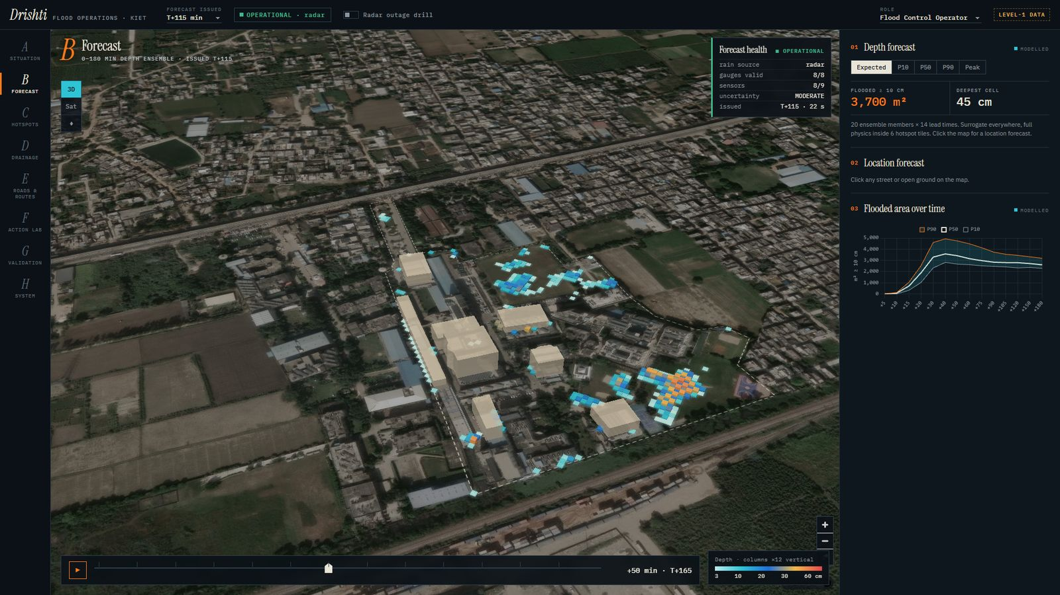
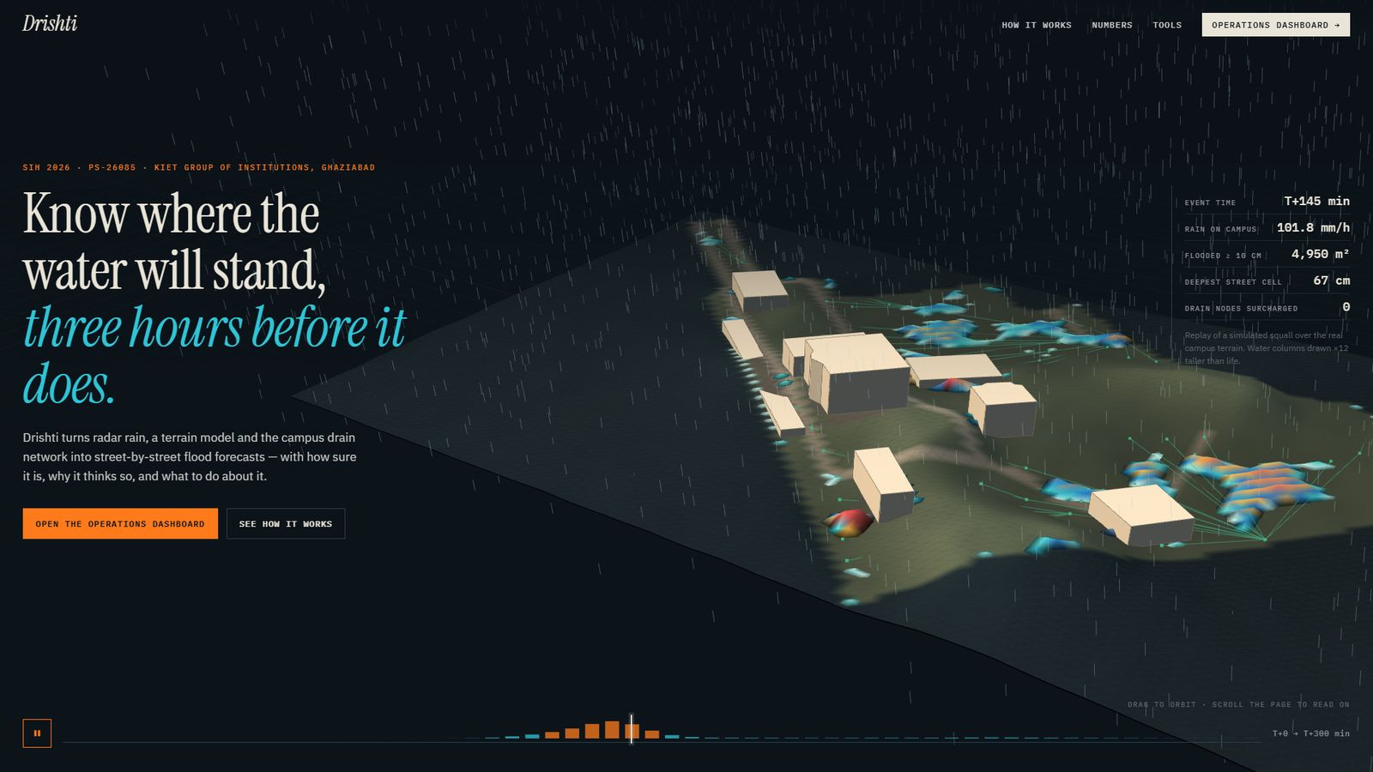



LLMao
Research and References
URBAN FLOOD HYDRAULICS
POLICY, DATA & STANDARDS
LISFLOOD-FP: storage-cell 2D flood model
SWMM 5 Reference Manual, Vol. II Hydraulics
NDMA Guidelines: Management of Urban Flooding
Copernicus DEM GLO-30
Bates & De Roo, J. Hydrology 236, 2000
Rossman, US EPA 600/R-17/111, 2017
National Disaster Management Authority, 2010
ESA / DLR / Airbus, 2021
Diffusive-wave raster model — the basis of our 2D street-surface solver.
Node-link sewer hydraulics and surcharge; our 1D network exports to .inp.
Calls for local early warning and drain inventories.
30 m global surface model — the KIET twin's terrain.
View source →
View source →
View source →
View source →
PROBABILISTIC RAIN NOWCASTING
DEFENSE IN DEPTH — HOW A FORECAST EARNS TRUST
STEPS: short-term ensemble prediction
pysteps: open-source probabilistic nowcasting
PHYSICS
PHYSICS — Mass-conserving twin
DATA
Rain in = water out + stored, to ~1e-8; 31 tests guard it.
Bowler, Pierce & Seed, QJRMS 132, 2006
Pulkkinen et al., Geosci. Model Dev. 12, 2019
DATA — Quality & trust scores
Cascade + stochastic-noise ensembles; our 20-member nowcast follows it.
Reference implementation our NumPy STEPS mirrors: optical flow, AR(2), blending.
FORECAST
Every gauge and radar frame is QC'd; faulty ones are dropped.
View source →
View source →
FORECAST — Honest probability
P10–P90 bands, DEGRADED flags, no route called 'safe'.
AI SURROGATES & DATA ASSIMILATION
TECHNOLOGY & STANDARDS
U-Net: convolutional networks for segmentation
The Ensemble Kalman Filter
ONNX Runtime
MapLibre GL
OpenStreetMap
OASIS CAP 1.2
Official docs →
Official docs →
Official docs →
Official docs →
Ronneberger et al., MICCAI 2015
Evensen, J. Geophys. Res. 99(C5), 1994
APPLICATION & VIDEO LINK
Encoder–decoder with skip links; our residual flood surrogate is a U-Net.
Sequential data assimilation — basis of the twin's sensor correction.
View source →
View source →
SOURCE CODE ↗
LIVE DASHBOARD ↗
3D STORM REPLAY ↗
EXPLAINER VIDEO ↗
github.com/arpitpandey0307
6
Notes:
Every method in Drishti traces to published work: LISFLOOD-FP and SWMM for hydraulics, STEPS and pysteps for rain nowcasting, U-Net for the surrogate, the Ensemble Kalman Filter for assimilation, and NDMA's urban flooding guidelines for the operational need. Links at the bottom open the live dashboard, the 3D replay, the explainer video and the source code.

