Slide 1
Machine Vision
Lecture 3
Professor Kok-Meng Lee
Georgia Institute of Technology
George W. Woodruff School of Mechanical Engineering
Atlanta, GA 30332-0405
Webpage: www.me.gatech.edu/me6406

Slide 2
Course Outline
Introduction and low-level processing
  Physics of digital images, histogram equalization, segmentation, edge detection, linear filters.
Model-based Vision
  Hough transform, pattern representation, matching
Geometric methods
  Camera model, calibration, pose estimation
Neural network for machine vision
  Basics, training algorithms, and applications
Color images and selected topics
  Physics, perception, processing and applications

Slide 3
Reasons for Camera Calibration
Need to recover 3D quantitative measures about the observed scene from 2D images.
Model and predict the performance or accuracy of any machine vision algorithms
Determine the camera location relative to the calibration board (or the working plane)
Basis for other calibration; robot kinematics, hand-eye relationship, geometric calibrations.
Definition:
The problem of determining the elements that govern the relationship or transformation between the 2D image that a camera sees and the 3D of the observed scene.
Two kinds of parameters defining this 2D/3D relationship:
  Intrinsic
  Extrinsic

Slide 4
Intrinsic parameters
Parameters that characterize the inherent geometric properties of the camera and optics:
  Image center
  Image X and Y scale factors
  Lens principal distance (effective focus length)
  Lens distortion coefficients
Externsic parameters
Parameters that indicates the position and orientation of the camera with respect to the world coordinate system:
  Translation (T_{x}, T_{y} and T_{z})
  Rotation about X, Y and Z axes.

Slide 5
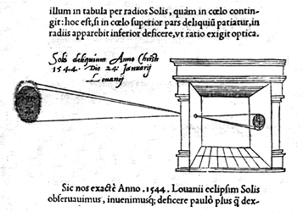
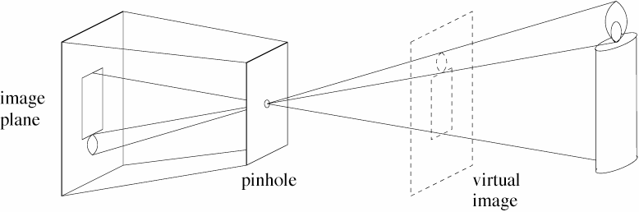
Pinhole Camera Model
f
f
z

Slide 6
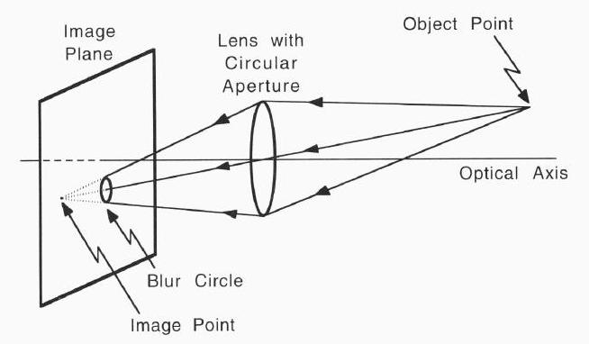
Camera Model
XYZ word coordinates
xyz camera coordinates
uv image coordinates
Image plane
z
f
u
Y
v
Object point in 3D world coordinates
y
x
Z
X
Focal (pin-hole) plane

Slide 7
Tsai’s Camera Model (Radial lens distortion assumption)
Step 1
Rigid body transformation from world frame to camera frame
Parameters to be calibrated: R, T
3D Camera
Frame (xyz)
Step 2
Perspective projection with pin hole geometry
Parameters to be calibrated: f
2D Image
(u, v)
(u_{d}, u_{d})
Step 3
Radial lens distortion correction
Parameters to be calibrated: k
Step 4
Relation between physical and computer coordinates
Parameters to be calibrated: scaling
3D World frame
(XYZ)

Slide 8
Tsai’s Camera Model
3D Camera
Frame (xyz)
Step 1
Rigid body transformation from world frame to camera frame
2D Image
(uv)
3D World frame
(XYZ)
Parameters to be calibrated: [R], T

Slide 9

Tsai’s Camera Model
Step 2
Perspective projection with pin- hole geometry
Pin-hole, c
x
y
y
2D Image
v
(u, v)
u
Similarly,
v
z
Parameter to be calibrated: f

Slide 10
Tsai’s Camera Model
Step 3: Radial lens distortion correction
Pin-hole, c
x
y
v_{d}
D_{y}
2D Image
v
(u, v)
u
D_{x}
(u_{d}, v_{d})
u_{d}
v
u
Parameter to be calibrated: k₁
z

Slide 11
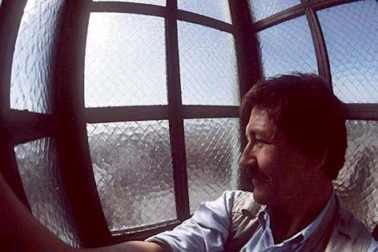
Radial Distortion(straight lines curve around the image)

Slide 12
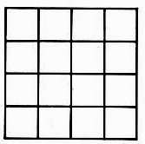
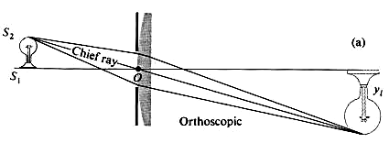
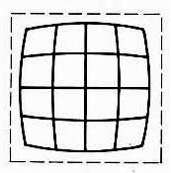
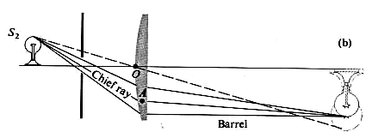
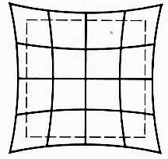
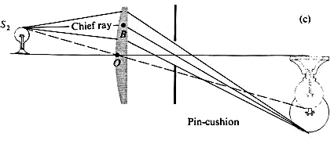
Radial Distortion(straight lines curve around the image)
No distortion
Barrel
Pin cushion

Slide 13
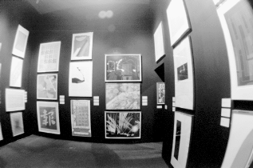
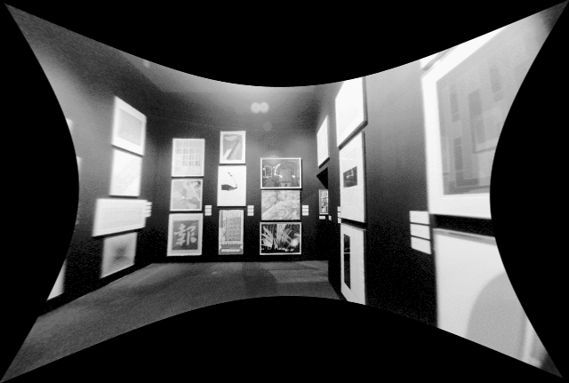
Correcting Radial Distortion (example)
Radial distortion of the image
• Caused by imperfect lenses
• Deviations are most noticeable for rays that pass through the edge of the lens
Distorted
After correction
courtesy of Shawn Becker

Slide 14
Tsai’s Camera Model
Step 4: Relation between physical and computer coordinates.
C_{x}
v
d_{y}
w_{y}
2D Image
C_{y}
d_{x}
u
(C_{x}, C_{y})
(u_{d}, v_{d})
u
v
w_{x}
Cropped image
(u’_{d}, v’_{d})
Parameter scaling

Slide 15
Tsai’s Camera Model (Step 4: cont.)
If the frame grabber is used, which has N_{fx}×N_{fy} pixels spaced at dx’ and dy’ respectively.
2D Image, N_{cx}×N_{cy}
u
(u_{d}, v_{d})
v
Parameter scaling

Slide 16
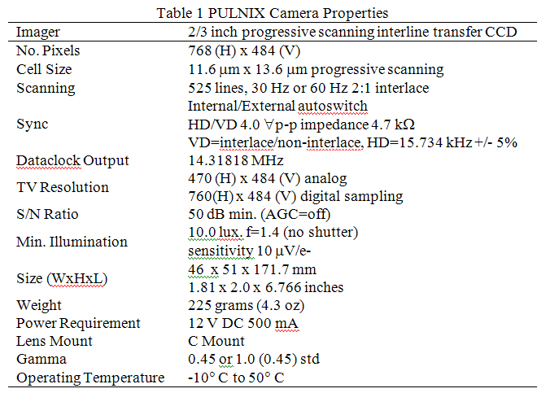
Tsai’s Camera Model (Step 4 example)

Slide 17
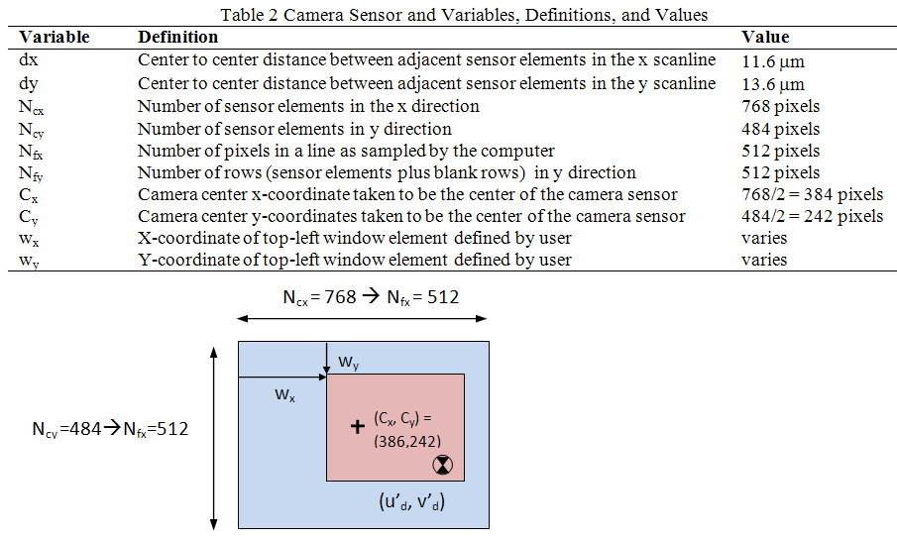
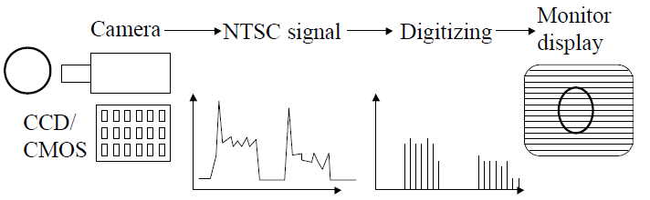
Tsai’s Camera Model (Step 4 example)

Slide 18
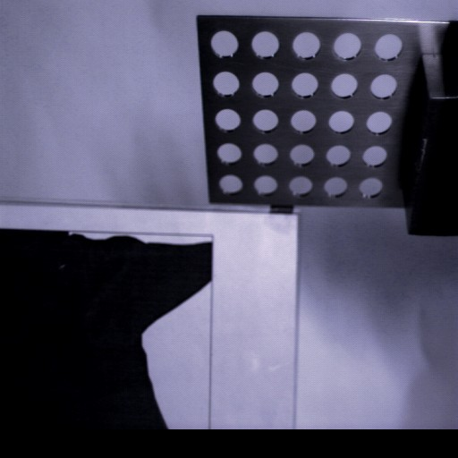
Tsai’s Camera Model (Step 4 example)
,
Calibration board

Slide 19
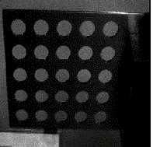
Tsai’s Camera Model (Step 4 example)
Cropped image
,
Calibration board

Slide 20
Two-stage approach
Stage 1: Radial Alignment Constraint
(1a) Solve for five parameters:
r₁₁/T_{y}, r₂₁/T_{y} , r₁/T_{y}, r₂₂/T_{y}, T_{x}/T_{y}
(1b) Find T_{y}
(1c) Solve for [R] T_{x}, T_{y}
Stage 2: Perspective Constraint
Given [R] T_{x}, T_{y} solve for f, k, T_{z}
Note: Only three of nine r_{ij} are independent.
[R]^{T}=[R]⁻¹

Slide 21
Two-stage approach (Stage 1a)
(1a) Solve for five parameters:
r₁₁/T_{y}, r₂₁/T_{y} , r₁/T_{y}, r₂₂/T_{y}, T_{x}/T_{y}
xy plane // uv plane,
Image plane
z
f
From Camera Model Step 1:
v
u
y
x
Substituting (2) into (1):

Slide 22
Two-stage approach (Stage 1a)
(1a) Solve for five parameters:
r₁₁/T_{y}, r₂₁/T_{y} , r₁/T_{y}, r₂₂/T_{y}, T_{x}/T_{y}
3D Camera
Frame (xyz)
Z
2D Calibration board, Z=0
2D Image
(uv)
(u_{d}, v_{d})
Y
X
3D world
Z=0
Z=0
6 unknowns: r₁₁, r₁₂ , r₂₁, r₂₂, T_{x}, T_{y}

Slide 23
Two-stage approach (Stage 1a)
(1a) Solve for five parameters:
r₁₁/T_{y}, r₂₁/T_{y} , r₁/T_{y}, r₂₂/T_{y}, T_{x}/T_{y}
6 unknowns: r₁₁, r₁₂ , r₂₁, r₂₂, T_{x}, T_{y}
Homogeneous equation:
For calibration, over-determined system

Slide 24
Two-stage approach (Stage 1)
1a) Solve for five parameters using least square (pseudo-inverse) :
r₁₁/T_{y}, r₂₁/T_{y} , r₁/T_{y}, r₂₂/T_{y}, T_{x}/T_{y}

Slide 25
Two-stage approach (Stage 1b, 1c)
Find T_{y} using the orthogonally of [R]
α^{T}=
β^{T}=
Step1
Step2
Step 2: square the result to eliminate r₁₃ and r_{23 .}

Slide 26
Two-stage approach (Stage 1)
To determine the sign of T_{y}, select one object point P(X₀, Y₀, 0):
If ξ_{x} must have the sign as u_{do}, and ξ_{y} must have the sign as v_{do} then T_{y} has the correct sign.
Otherwise, negate it.

Slide 27
Two-stage approach (Stage 1c)
1c) Solve for [R] T_{x}, T_{y}
The unknown signs s₁ and s₂ are determined from the orthogonal property of [R].
The two factors, a and b, must be equal and opposite.
Thus, choose s₁ = s₂ =+1, check
If yes, keep the signs; otherwise s₂ =−1.

Slide 28
Two-stage approach
(Stage 2)
Stage 2: Perspective Constraint
Given [R] T_{x}, T_{y} solve for f, k, T_{z}
Recall Camera Model Step 1:
From Camera Model Steps 2 and 3:
Eliminating u,

Slide 29
Notes on Tsai’s Camera Model
Recall Step 3: Radial lens distortion correction
v_{d}
Pin-hole, c
D_{y}
x
v
y
D_{x}
u
u_{d}
2D Image
(u, v)
u
(Modified)
(u_{d}, v_{d})
v
Parameter to be calibrated: k₁
(Tsai)
z

Slide 30
Notes on Tsai’s Radial lens distortion
If Tsai’s model were used,
Recall Steps 1 and 2
Tsai’s model for solving T_{z}, k₁ and f are non-linear!

Slide 31
Notes on Tsai’s Radial lens distortion
Recall Steps 1 and 2
Modified:

Slide 32
Two-stage approach
(Stage 2)
Stage 2: Perspective Constraint
Given [R] T_{x}, T_{y} solve for f, k, T_{z}

Slide 33
Example
The following Table gives five point correspondences input to the Calibration system.
The units for both the world coordinate system and the u-v image coordinate system are centimeters.
Assume that this is no lens distortion, compute (f, [R], T )
 | Object points |  |  | Image points
i | X_{i} | Y_{i} | Z_{i} | u_{i} | v_{i}
1 | 0.00 | 5.00 | 0.00 | -0.58 | 0.00
2 | 10.00 | 7.50 | 0.00 | 1.73 | 1.00
3 | 10.00 | 5.00 | 0.00 | 1.73 | 0.00
4 | 5.00 | 10.00 | 0.00 | 0.00 | 1.00
5 | 5.00 | 0.00 | 0.00 | 0.00 | -1.00

Slide 34
Example (cont.)
points | Object |  |  | Image
i | X_{i} | Y_{i} | Z_{i} | u_{i} | v_{i}
1 | 0.00 | 5.00 | 0.00 | -0.58 | 0.00
2 | 10.00 | 7.50 | 0.00 | 1.73 | 1.00
3 | 10.00 | 5.00 | 0.00 | 1.73 | 0.00
4 | 5.00 | 10.00 | 0.00 | 0.00 | 1.00
5 | 5.00 | 0.00 | 0.00 | 0.00 | -1.00
Stage 1

Slide 35
Example (cont.)
points | Object |  |  | Image
i | X_{i} | Y_{i} | Z_{i} | u_{i} | v_{i}
1 | 0.00 | 5.00 | 0.00 | -0.58 | 0.00
2 | 10.00 | 7.50 | 0.00 | 1.73 | 1.00
3 | 10.00 | 5.00 | 0.00 | 1.73 | 0.00
4 | 5.00 | 10.00 | 0.00 | 0.00 | 1.00
5 | 5.00 | 0.00 | 0.00 | 0.00 | -1.00
Stage 1:
Calculate T_{y}
Try T_{y} = +5
r₁₁ = -0.865; r₁₂ = r₂₁ = 0; r₂₂ = -1; T_{x} = 4.325
Check Point 2:
Wrong sign ⇒ T_{y} = −5.

Slide 36
Example
Stage 1 (cont.)
T_{y} =−5
Recalculate
r₁₁ = 0.865; r₁₂ = r21 = 0; r₂₂ = 1; T_{x} = -4.325
Try S₁=S₂=+1

Slide 37
Example (cont.)
points | Object |  |  | Image
i | X_{i} | Y_{i} | Z_{i} | u_{i} | v_{i}
1 | 0.00 | 5.00 | 0.00 | -0.58 | 0.00
2 | 10.00 | 7.50 | 0.00 | 1.73 | 1.00
3 | 10.00 | 5.00 | 0.00 | 1.73 | 0.00
4 | 5.00 | 10.00 | 0.00 | 0.00 | 1.00
5 | 5.00 | 0.00 | 0.00 | 0.00 | -1.00
Stage 2:
Solving for the unknown x’,
Hence, f =1.0123

Slide 38
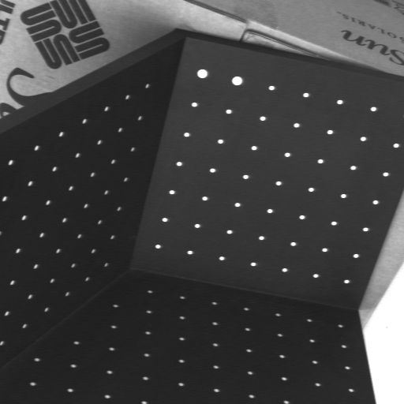
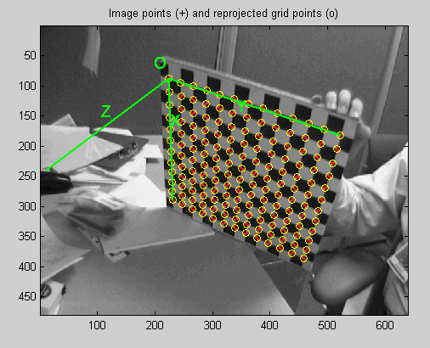
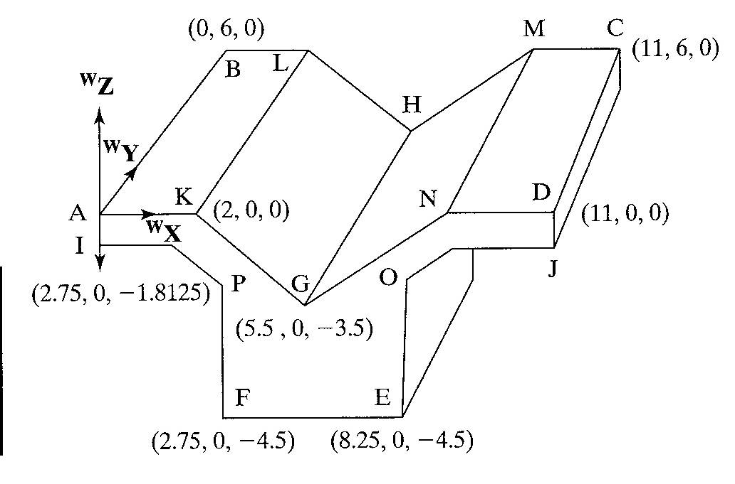
Example calibration boards

Slide 39
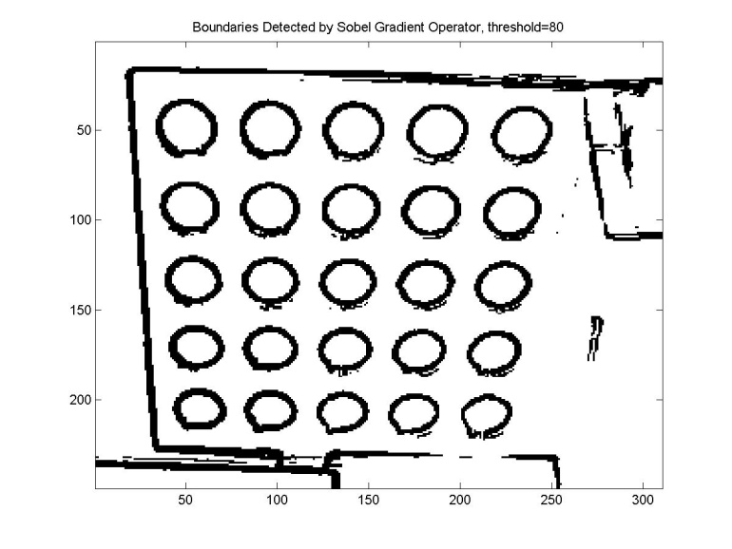
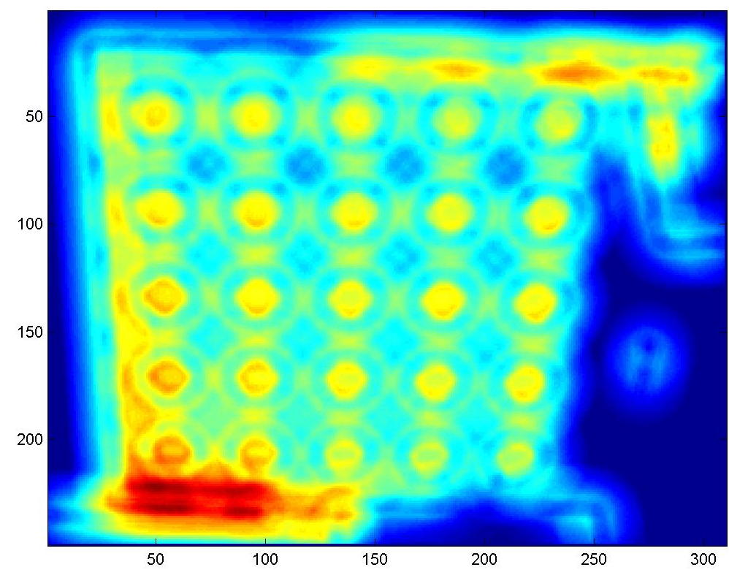
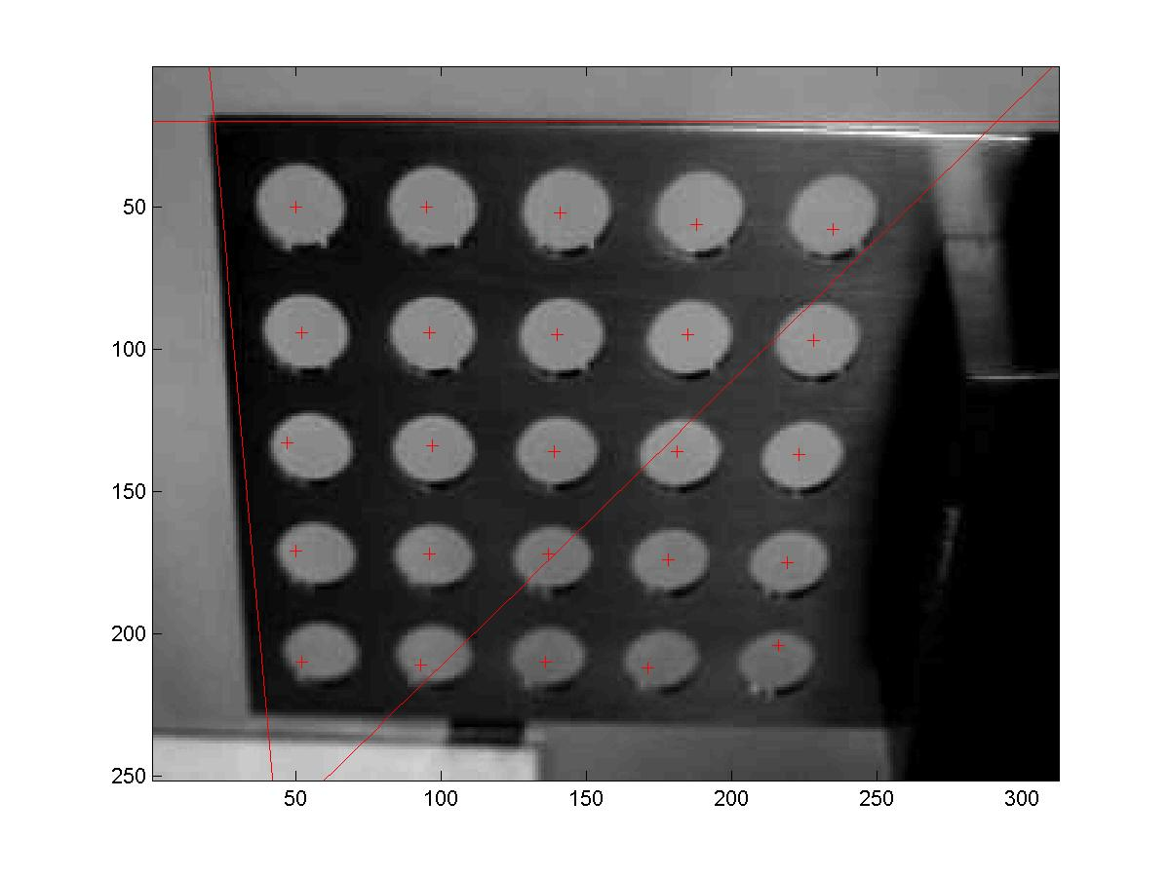
Example

Slide 40
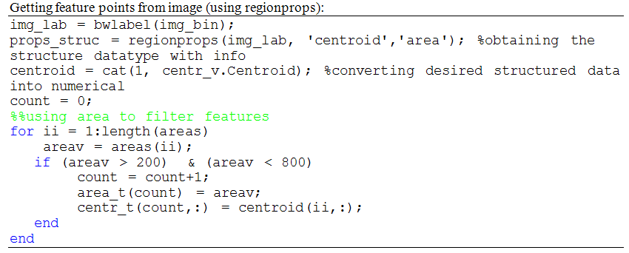
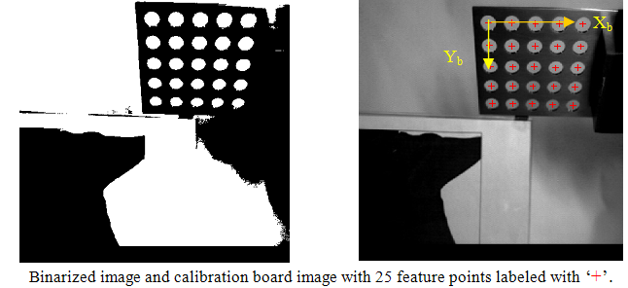
Example

Slide 41
Use Camera Model Step 4 to convert from pixels to physical units
Cropped image
,
Calibration board

Slide 42

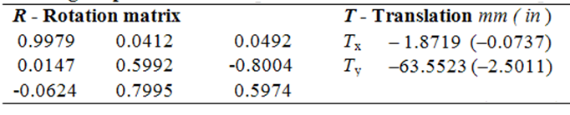
Example (cont., Results)
Camera Model Step 4:
Stage I:
Stage II:

Slide 43
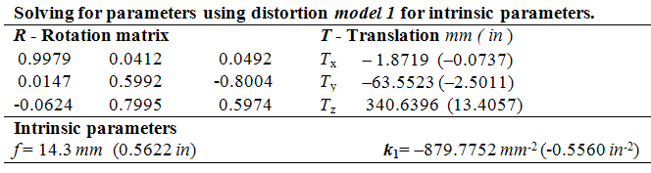
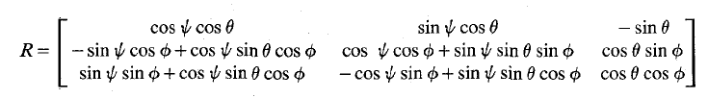
Example (cont., Results)
In terms of Euler angles yaw θ, pitch φ, and tilt ψ for rotation,
θ (x-axis rotation) | φ (y-axis rotation) | ψ (z-axis rotation)
-53° | -3° | 2°
The results satisfy
[R]^{T}=[R]⁻¹

Slide 44
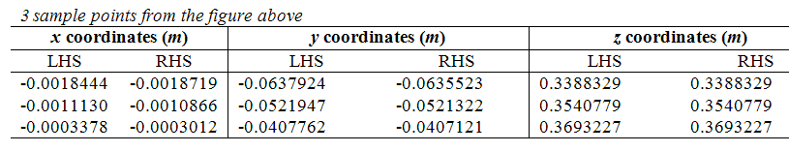
Example
(validating results)

Slide 45
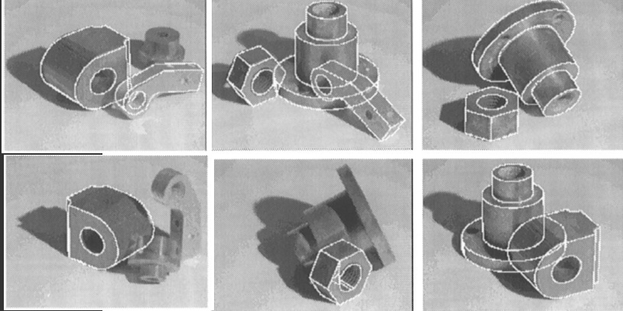
Pose estimation
Using point, line, circle-ellipse correspondences
Allow for 3D objects

Slide 46
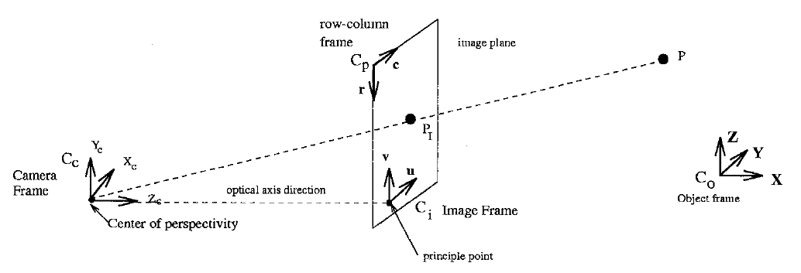
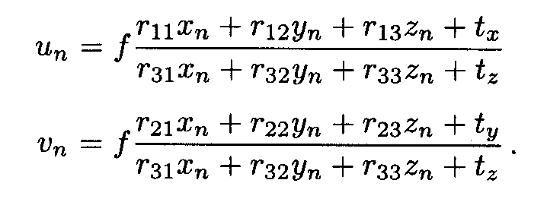
Point correspondences (Neglect lens distortion and f is known)

Slide 47
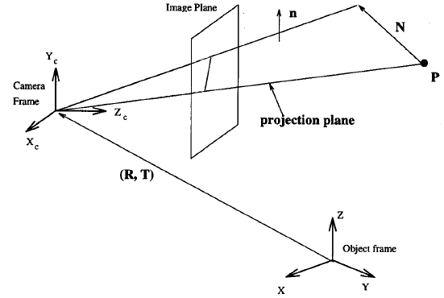
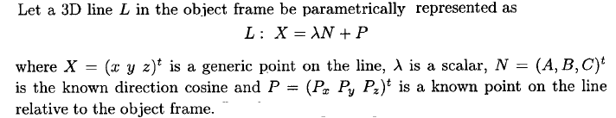
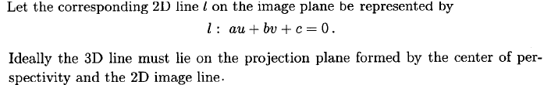
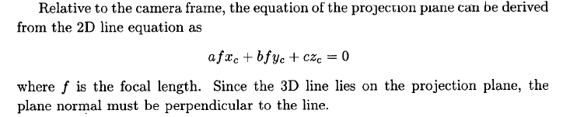
Line correspondences
Known with respect to
object frame:
Known from 2D image:
3D camera frame:

Slide 48
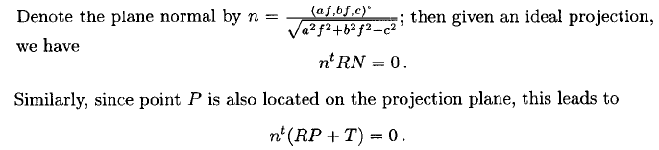
Line correspondences (cont.)
Known with respect to the object frame:
Co planarity equations:
Known from 2D image:
Line and its normal in 3D camera frame:
Unknown to be solved: [R], T

Slide 49
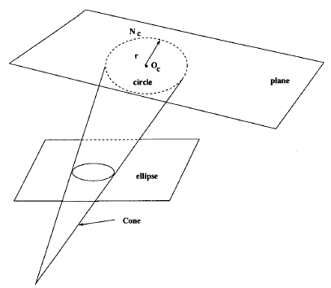
Circle-ellipse correspondences
Find object circle from imaged ellipse
Recall CM Step 2:
Known from 2D image:

Slide 50
Circle-ellipse correspondences
Find object circle from imaged ellipse
Object circle equation in 3D camera frame:
Image ellipse in 3D camera frame:

Slide 51
Circle-ellipse correspondences
Find object circle from imaged ellipse
Image ellipse in 3D camera frame:
Object circle equation in 3D camera frame:

Slide 52
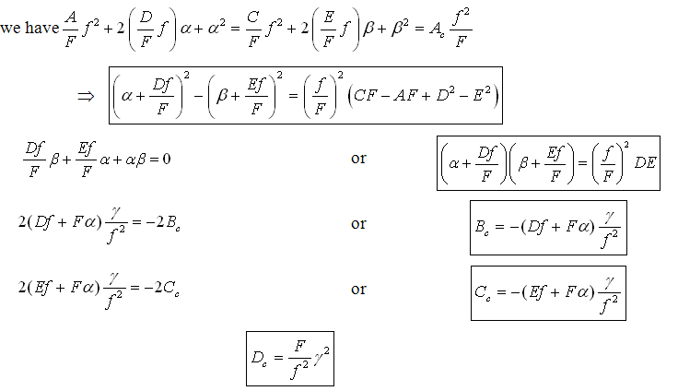
Circle-ellipse correspondences
Find object circle from imaged ellipse

Slide 53
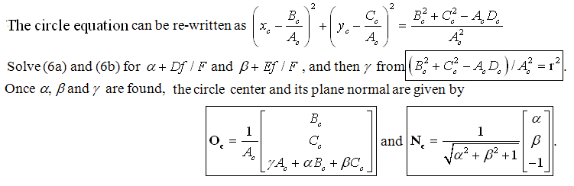
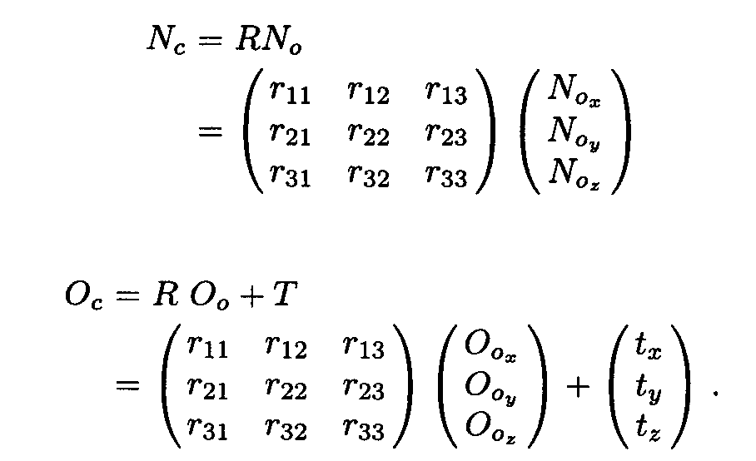
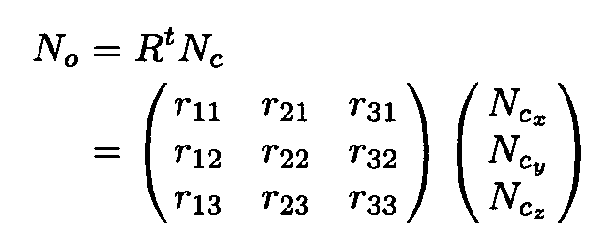
Circle-ellipse correspondences
[R]^{T}=[R]⁻¹

