Slide 1


StudyGenius – Your AI-Powered Study Assistant
Introducing StudyGenius, the ultimate AI-powered study companion designed to revolutionize the way you approach learning and academic success.
Notes:
1

Slide 2

Problem Statement
Students today face a myriad of challenges when it comes to effectively managing their studies. From information overload to time-management issues, the traditional study methods often fall short in addressing the modern learner's needs.
Notes:
2

Slide 3
Objectives
Streamline Learning
Personalized Guidance
Improved Outcomes
Leverage AI technology to simplify the study process, making it more efficient and effective.
Provide tailored recommendations and support to cater to each student's unique learning style and needs.
Empower students to achieve their academic goals and excel in their studies.
Notes:
3

Slide 4

Features
1
Summarizer
Automatically generate concise summaries of lengthy reading materials, helping students quickly grasp key concepts.
2
Flashcards
Create personalized digital flashcards that adapt to the user's learning progress, reinforcing retention of important information.
3
Quiz
Assess understanding through customizable quizzes and practice tests, providing real-time feedback and performance tracking.
4
Reminders
Receive timely reminders for upcoming deadlines, study sessions, and other important academic events.
Notes:
4

Slide 5





Technical Stack
HTML
CSS
JavaScript
Node.js
StudyGenius is built on a powerful technology stack that includes HTML, CSS, and JavaScript for the user interface, Node.js for the backend, and integration with the OpenAI API for advanced language processing capabilities. The entire platform is hosted on Replit, a collaborative coding environment.
Notes:
5

Slide 6
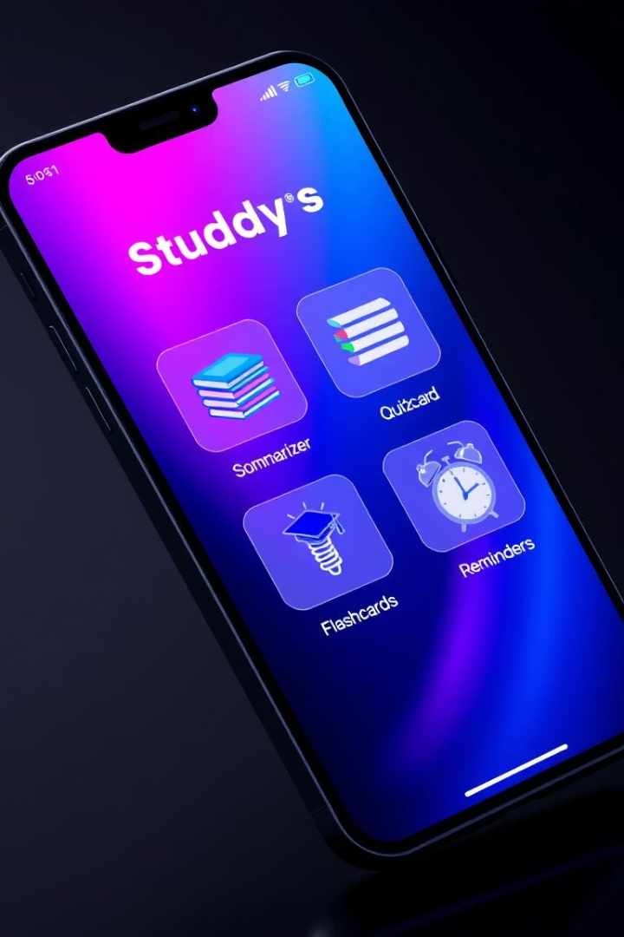
User Interface
The StudyGenius user interface is designed to be intuitive and user-friendly, with a clean and modern aesthetic. The main features, including the Summarizer, Flashcards, Quiz, and Reminders, are easily accessible through a seamless navigation menu.
Notes:
6

Slide 7

Workflow
Onboard
Practice
Sign up and set up your personalized study preferences.
Create flashcards and take quizzes to reinforce your understanding.
1
2
3
4
Summarize
Optimize
Upload documents and let the AI summarizer extract key points.
Receive personalized reminders and track your progress over time.
Notes:
7

Slide 8

Challenges
Data Privacy
AI Limitations
User Adoption
Ensuring the secure handling and storage of user data, including study materials and personal information.
Addressing the potential limitations and biases inherent in the AI-powered features, such as the summarizer.
Encouraging widespread adoption of the platform among students and educators, who may be resistant to change.
Notes:
8

Slide 9






Future Enhancements
Adaptive Learning
Develop advanced AI algorithms to create truly personalized learning experiences.
Collaborative Features
Introduce tools for students to study and work together, fostering a sense of community.
Predictive Analytics
Leverage data insights to provide proactive recommendations and identify at-risk students.
Notes:
9

Slide 10

Conclusion
StudyGenius is poised to revolutionize the way students approach learning and academic success. By harnessing the power of AI and cutting-edge technology, we aim to empower learners, enhance productivity, and unlock new heights of academic achievement.
Notes:
10

Slide 11
Thank You
We would like to extend our sincere appreciation to the entire team for their hard work and dedication in bringing StudyGenius to life. This project was a collaborative effort, and we are especially grateful for the following key contributions:
Arpit Raj (RA2311031010114)
Raushan Kumar (RA2311031010126)
Ishan Singh (RA2311031010130)
Together, this team worked tirelessly to bring this project to life, and we are deeply grateful for their hard work, dedication, and collaborative spirit.
https://github.com/arpitraj03/Arpit-Raj
Notes:
• Arpit Raj was the project lead, responsible for coordinating the team and ensuring timely delivery of all milestones.
• Raushan Kumar was the lead developer, who wrote the core functionality and implemented the technical architecture.
• Ishan Singh was the UI/UX designer, who created the visually appealing and intuitive interface for our application.
• Together, this team worked tirelessly to bring this project to life, and we are grateful for their hard work and dedication.
11

