Slide 1
MACHINE LEARNING
FLASK WEB APP
REGRESSION MODEL
House Price Prediction using Machine Learning
Predicting Residential Property Prices with Machine Learning & Flask Web Application.
Name: Arpit Rajpurohit
College: VIT Bhopal University
Department: Computer Science Engineering (AI/ML)
GitHub Repository: arpitraj10/House_price_prediction_web
PYTHON
FLASK
SCIKIT-LEARN
HTML
CSS

Slide 2

Introduction
The Problem & Our Solution
Buying a house is one of the most important financial decisions, but estimating its fair market value is challenging due to factors like location, area, number of bedrooms, and amenities.
Existing Challenges
Our Solution
Manual price estimation
Human bias in valuation
Time-consuming process
Inconsistent market pricing
Developed a Machine Learning-powered web application that predicts house prices instantly using historical housing data — eliminating bias and reducing guesswork.

Slide 3


Chapter 02
Dataset & Feature Engineering
The model is trained on a housing dataset containing important property attributes. Below is the journey of raw data becoming a clean, model-ready dataset.
Key Features
Feature Engineering
Location
Total Area (Sq. Ft.)
Number of Bedrooms (BHK)
Number of Bathrooms
Price (Target Variable)
Data cleaning & missing value handling
Outlier removal & feature selection
One-hot encoding & JSON mapping

Slide 4

Chapter 03
Machine Learning Pipeline
This is the complete machine learning lifecycle — from data ingestion to a live web application delivering real-time price predictions.
Feature Engineering
Data Cleaning
Dataset
Model Evaluation
Model Training
Train/Test Split
Price Prediction
Flask Web Application
Save Model
Each stage ensures the model is accurate, generalizable, and ready for production deployment.

Slide 5



Model Used & Performance
Algorithm
Linear Regression
Fast training & easy to interpret
Effective for continuous value prediction
Provides a strong baseline performance
85%
90%
82%
R² Score
Training
Testing
Model accuracy
Fit accuracy
Generalization
Evaluation metrics include R² Score, RMSE, and MAE, confirming the model's reliability in predicting property prices.

Slide 6
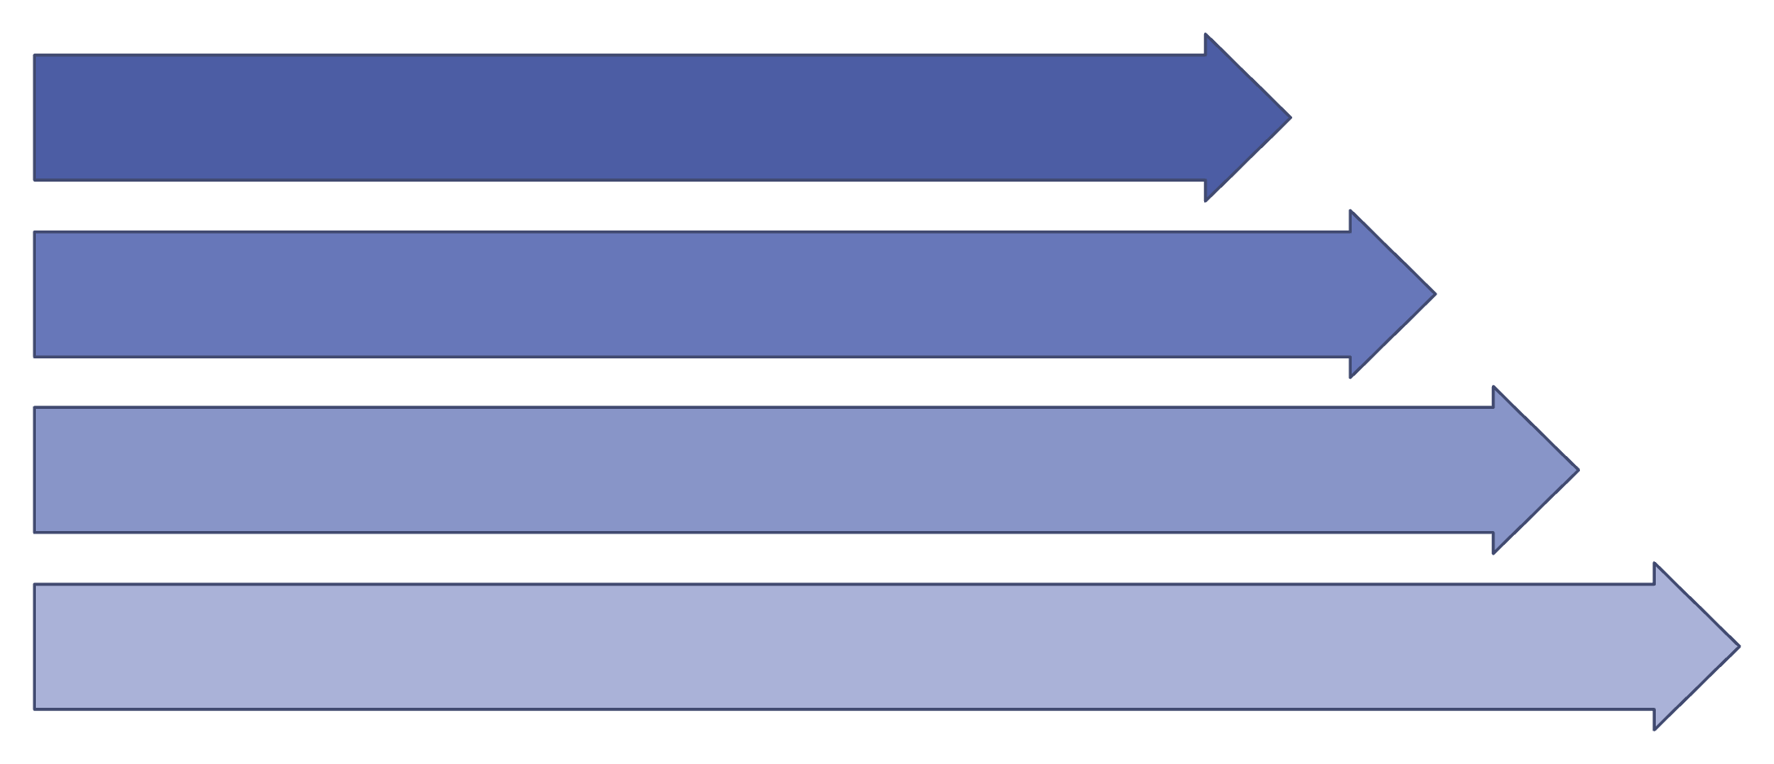
Chapter 04
Web Application & Deployment
The trained model is served via a Flask backend, accessible through a clean user interface for instant property valuation.
Technologies Used
User
Backend: Python, Flask, Scikit-learn
Frontend: HTML, CSS, JavaScript
Web Browser
Flask Backend
Data: Pandas, NumPy
Deployment: GitHub, Railway
ML Model

Slide 7
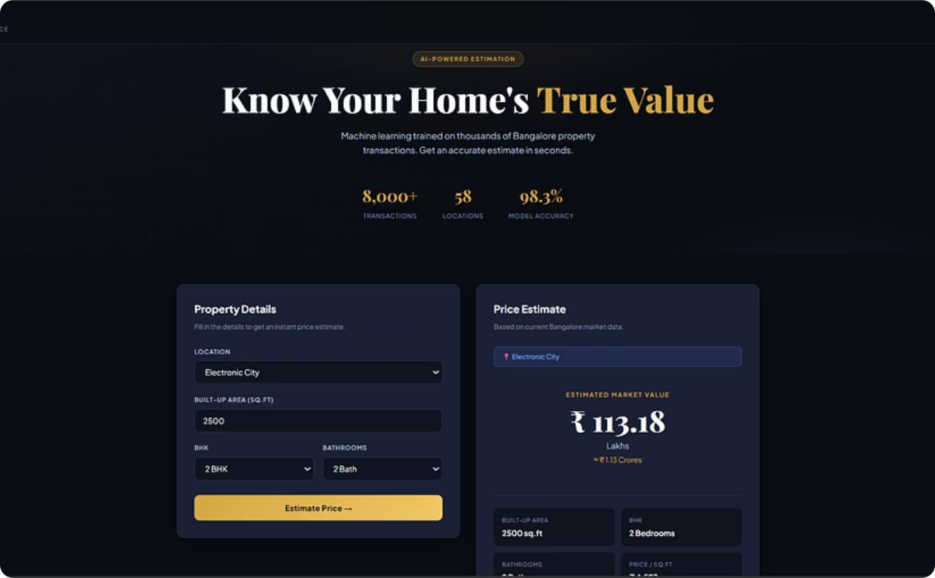
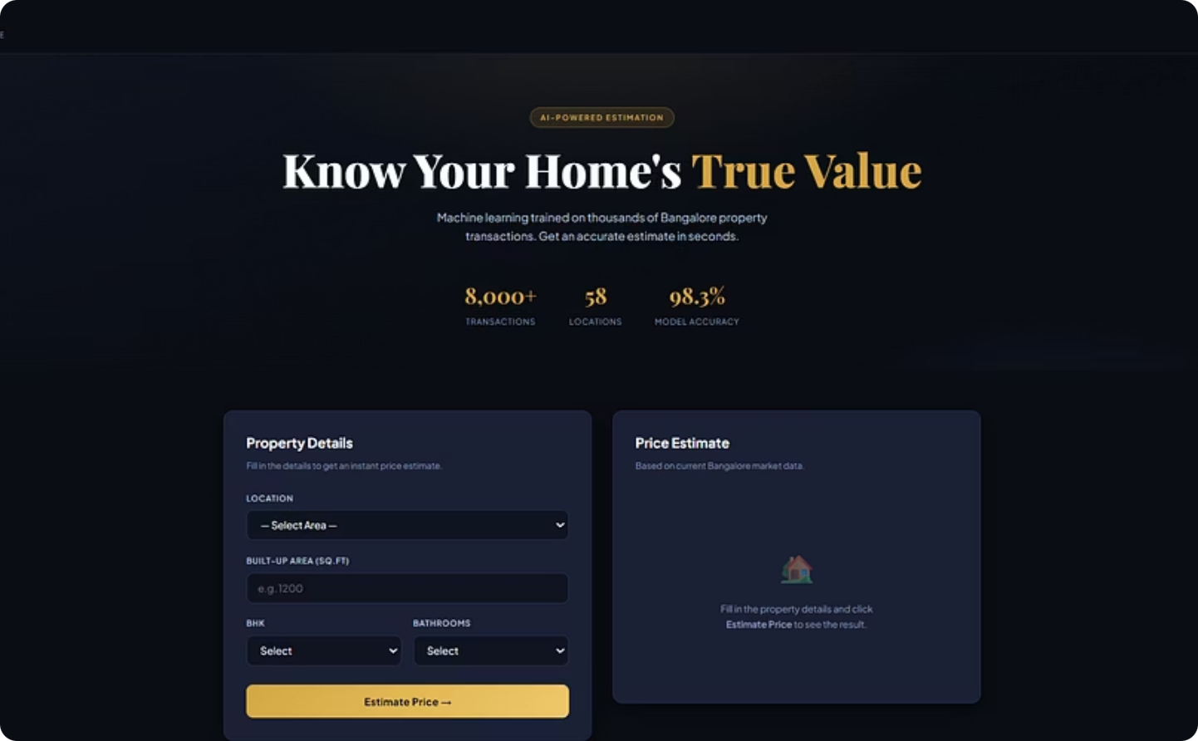
Project Demonstration
Application Screenshots
The web application provides a seamless user experience — from entering property details to receiving an instant, data-driven price prediction.
Input Form
Prediction Result
Users enter location, area, BHK, and bathroom count.
The model returns an estimated property value instantly.

Slide 8

Chapter 05
Challenges & Lessons Learned
1
1
Challenges Faced
Lessons Learned
Data preprocessing & cleaning
Handling missing values
Removing outliers
Model optimization & Flask integration
End-to-end ML workflow mastery
Importance of quality data
Regression model implementation
Web app deployment & GitHub management

Slide 9
Looking Ahead
Future Scope
Building on this foundation, the project can be enhanced with advanced algorithms and richer user experiences.
Advanced Models
1
Integrate XGBoost & Random Forest for higher accuracy.
2
Live Data Integration
Connect with real estate APIs & interactive map-based selection.
Cloud & CI/CD
3
Scalable cloud deployment with automated pipelines.
4
AI Recommendations
AI-powered property recommendation & price trend visualization.

Slide 10

Q & A
Thank You
Questions & Discussion
"Machine Learning transforms historical data into intelligent decisions, making property valuation faster, smarter, and more reliable."
GITHUB: ARPITRAJ10

