Slide 1

GRIDLOCK 2.0 · PROBLEM STATEMENT 1 · BENGALURU TRAFFIC POLICE
CURB
From 13,782 hotspots to one decision.
Curb Intelligence System
Root-cause intelligence for parking-induced congestion — built entirely from the provided enforcement dataset.
CURB bridges the gap between raw enforcement data and urban planning, giving cities the power to cure congestion at the root, rather than just treating the symptoms.
Live Demo: https://curb-parking-intelligence.vercel.app/
Repo Link: https://github.com/arpitraj18/curb-parking-intelligence
Notes:
1

Slide 2
THE PROBLEM
Enforcement data shows where — not what to do.
Officers get a flat list of violations. Planners get nothing prescriptive. The data records the symptom, not the diagnosis or the cure.
✓
Where fines happen
✗
Which spots choke traffic
✗
Why — and what fix
The dataset captures this well — every violation is geo-tagged.
No way to tell a minor street from a junction that strangles a corridor.
No root cause, no prescribed intervention. “Send a patrol” everywhere.
WHY NOW
Standard patrols don't scale. Congestion is compounding.
Cities cannot enforce their way out of a structural deficit. With vehicle density soaring, trying to send traffic cops to every minor parking violation is a misallocation of highly skilled resources. We need surgical intervention, not blanket patrols.
Notes:
3

Slide 3
THE INSIGHT
Every illegal park is a demand signal for kerb space.
Someone needed to stop there and couldn’t legally. Read the violations as unmet demand, and each hotspot tells you what the kerb is being asked to do — and how to fix it.
OUR POSITIONING
The enforcement layer already exists. We built the layer above it — root cause → differentiated fix.
THE SOLUTION
Five steps from raw citations to a deployment decision.
1
2
3
4
5
Rank
›
Classify
›
Prescribe
›
Narrow
›
Plan
Score every spot by obstruction impact.
Infer root cause from the vehicle mix.
Map each cause to a specific fix.
13,782 → the one to act on first.
Group the top spots by action needed.
Notes:
5

Slide 4
Main road / crossing | 3.0
Double parking | 2.5
Bus stop / school / hospital | 2.0
Wrong side / no-parking | 1.5
Footpath | 1.2
Scooter / 2-wheeler | 0.4 – 0.5
Auto | 0.8
Car | 1.0
Goods / van | 1.2 – 1.5
Bus / lorry / HGV | 3.0 – 3.5
PROOF OF CONCEPT
One provided dataset. No external data.
298K
100%
~150
248,376
VIOLATION RECORDS
GEO-TAGGED
DAY WINDOW
USABLE AFTER CLEANING
We drop rejected and duplicate records, then aggregate violations onto a ~55 m grid → 13,782 ranked hotspot cells. The relative spatial signal is trustworthy; we deliberately avoid the unreliable hour-of-day field.
THE SECRET SAUCE
cell impact = Σ ( severity × vehicle footprint ) → normalised 0–100
Obstruction-impact index
SEVERITY — WHERE IT HAPPENS
FOOTPRINT — ROAD SPACE (PCU)
A bus blocking a crossing outweighs a scooter on a footpath. Weights are transparent constants.
Notes:
7

Slide 5
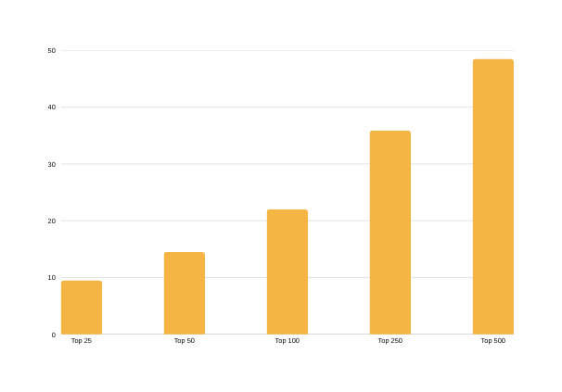
ROOT CAUSE → PRESCRIPTION
WHY PRIORITISATION PAYS
The vehicle mix tells us why
— and what to do.
Obstruction is concentrated
— act where it matters.
THE TAKEAWAY
ROOT CAUSE | SIGNAL IN THE DATA | PRESCRIBED FIX
Commuter overflow | Two-wheelers dominate | Park-and-ride + reroute
Delivery overflow | Goods-vehicle share high | Timed loading bay
Hire / transit demand | Autos & cabs cluster | Designated stand + drop-off
Safety risk | Crossing / school / footpath | Bollards + enforcement
Structural demand | High volume, all types | Paid / off-street provision
Enforcement priority | Recurring, no dominant type | Ranked patrol dispatch
48.5%
of the city’s total obstruction burden sits in just 500 spots.
The top 50 alone cover 14.5% — a focused patrol list, not a citywide sweep.
VISION
From 13,782 hotspots to one decision.
13,782
grid cells with a violation
500
ranked priority hotspots
— 48.5% of impact
top-impact spots
— 22% of impact
100
32
…that are also emerging
(getting worse)
…and also habitual
— same vehicles return
The one: Hosahalli Metro Station
— the single spot that is high-impact AND worsening AND repeat-heavy. That’s where you start.
1
Notes:
9

Slide 6
THE PRODUCT
An operational console, not a static report.
Hotspot map
Dispatch board
Hotspot profile
Every spot plotted by cause & impact, with filters and dispatch.
Ranked, sortable, filterable priority list.
One drawer: impact, cause, trend, recidivism, the fix.
Deployment plan
Trends & offenders
GenAI assistant
Top spots grouped by the action they need.
Emerging spots and repeat-offender intelligence.
Ask in plain language — answers from the data only.
THE GENAI LAYER
Ask the data in plain language.
Grounded only on the provided dataset
You
Phrases results — never invents or computes new facts
“Top 3 delivery hotspots.”
CURB
No external data, no web, no live retrieval
Here are the top 3 by obstruction impact, leading with AS Char Street, Mysore Road (delivery overflow). Each opens a full profile with its recommended fix.
LLM use approved in writing by the organisers
#59 AS Char Street, Mysore Road
#82 MBT Road, Devasandra Junction
#84 Dr Rajkumar Puniya Bhoomi Rd
Falls back to deterministic answers if offline
Notes:
12

Slide 7
TRUST & TRANSPARENCY
Honest by design. Built to be trusted.
Provided dataset only
An index, not traffic
Retrospective, not forecast
No external datasets. Severity & footprint weights are transparent, self-defined constants.
Impact is a 0–100 prioritisation index, never a measured percentage of congestion.
Trends describe the data window; the unreliable hour-of-day field is unused.
A prescription, not a label
Fully reproducible
Documented
The recommended fix is our rules-based inference from the vehicle mix, not a data field.
Re-run the pipeline on new data and the whole site regenerates from the output.
A methodology page states every assumption in plain language.
IMPACT FOR BTP
SCALE TO ANY CITY
Not a list of problems
— a deployment plan.
Reproducible by design.
Provided CSV
→
Python pipeline (pandas)
→
Ranked JSON outputs
→
Static site on Vercel
What the top 100 priority spots need, grouped by action:
30
Ranked patrol dispatch
The serverless GenAI assistant runs on the same deployment. Feed in a new month of data, re-run, and every page reflects it — no manual edits.
30
Park-and-ride + reroute
13,782 → 1
26
Designated auto / cab stand
9
Bollards + enforcement
CURB turns months of citations into one clear decision: where to act first, why, and how.
3
Timed loading bay
2
Paid / off-street study
Live Demo: https://curb-parking-intelligence.vercel.app/
Repo Link: https://github.com/arpitraj18/curb-parking-intelligence
“Where to act first, why, and how” — in one screen.
Notes:
14

