Slide 1


GOVERNMENT ENGINEERING COLLEGE
BHARATPUR (RAJ.) 321001
Industrial Training
VOICE ASSISTANT PPT
Presentation By:-
Amit Garg- 21EELCS006
Arpit Saxena- 21EELCS008
Deepak Chaudhary- 21EELCS013
GEC BHARATPUR

Slide 2

AGENDA OF PROJECT
INTRODUCTION
AIM OF
PROJECT
PREREQUISITE
WORKING
Code AND Module
Used
REFERENCES
CONCLUSION

Slide 3
INTRODUCTION
A.R.U- Audio Recognition Unit .
We Want To Built A Virtual Voice Assistant (A.R.U) .That Uses Speech Recognition, Natural Language Processing And Speech Synthesis To Take Actions To Help , Entertain Its Users.

Slide 4
AIM
To Provide The Arithmetic Calculations By Speech Input.
To Make A Google , Wikipedia Search About Any Topics.
To Open & Close The Different Applications Like Youtube
Games Etc.
To Make Any Pdf Like Audiobook , So By One Command
We Can Listen It.

Slide 5

PREREQUISITES
Python Language:-
We Are Using Python As A Priory Language As:-
Python Is Easy To Learn And Fun To Use. Its Syntax, Unlike Most Computer Languages, Reads Like English, So It Isn’t As Stressful To Learn As Other Programming Languages. It Was Named After Monty Python’s Flying Circus. So You Know Someone Had A Sense Of Humor Developing This Code And Thus Made It Simple To Use.

Slide 6
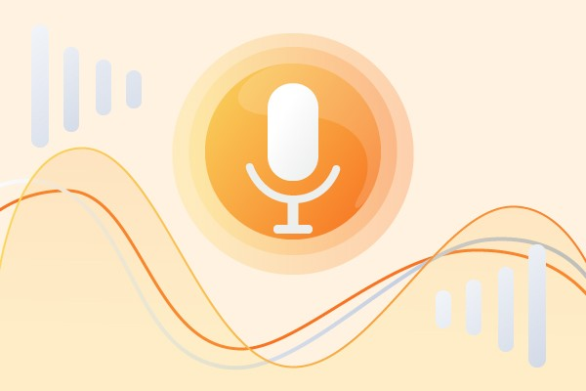
HOW IT WORKS
Speak The Name (OK ARU) To Activate It.
ARU Record The Voice And Match With The Available
Commands.
If The Command Is Available Then It Will Execute It.
If It Is Not Available It Show Message Like Give Favourable
Commands.
After The Execution It Ask To Search More Or To Leave.

Slide 7
Code-Modules
VS Code Editor used for code.
Python Modules such as Pyttsx3 & Speech Recognition
and many more modulus are used to convert text to
speech for A.R.U.
Latest version of pip is to be installed for Modules.

Slide 8
RESULT
Repeated tasks easily performed simply by voice commands.
Scheduled tasks & Remainders by Voice Assistant.
It reduces Physical work to perform activities.
It can entertain user only just by voice commands.
Make wireless communication between home devices.
All daily tasks , email , reading books by voice assistant.
It comforts the life of Physically Disable persons.

Slide 9
PREFERENCES
GOOGLE IMAGES
CODE WITH HARRY

