Slide 1


Tech ABC Corp - HR Database
[Arpit Sharma & 6-Jun-2021]

Slide 2
Step 1
Data Architecture Foundations

Slide 3
Step 1: Data Architecture Foundations
Hi,
Welcome to Tech ABC Corp. We are excited to have some new talent onboard. As you may already know, Tech ABC Corp has recently experienced a lot of growth. Our AI powered video game console WOPR has been hugely successful and as a result, our company has grown from 10 employees to 200 in only 6 months (and we are projecting a 20% growth a year for the next 5 years). We have also grown from our Dallas, Texas office, to 4 other locations nationwide: New York City, NY, San Francisco, CA, Minneapolis, MN, and Nashville, TN.
While this growth is great, it is really starting to put a strain on our record keeping in HR. We currently maintain all employee information on a shared spreadsheet. When HR consisted of only myself, managing everyone on an Excel spreadsheet was simple, but now that it is a shared document I am having serious reservations about data integrity and data security. If the wrong person got their hands on the HR file, they would see the salaries of every employee in the company, all the way up to the president.
After speaking with Jacob Lauber, the manager of IT, he suggested I put in a request to have my HR Excel file converted into a database. He suggested I reach out to you as I am told you have experience in designing and building databases. When you are building this, please keep in mind that I want any employee with a domain login to be have read only access the database. I just don't want them having access to salary information. That needs to be restricted to HR and management level employees only. Management and HR employees should also be the only ones with write access. By our current estimates, 90% of users will be read only.
I also want to make sure you know that am looking to turn my spreadsheet into a live database, one I can input and edit information into. I am not really concerned with reporting capabilities at the moment. Since we are working with employee data we are required by federal regulations to maintain this data for at least 7 years; additionally, since this is considered business critical data, we need to make sure it gets backed up properly.
As a final consideration. We would like to be able to connect with the payroll department's system in the future. They maintain employee attendance and paid time off information. It would be nice if the two systems could interface in the future
I am looking forward to working with you and seeing what kind of database you design for us.
Thanks,
Sarah Collins
Head of HR

Slide 4
Data Architect Business Requirement
Purpose of the new database:
What is the business partner requesting
Tech ABC Corp has recently experienced a lot of growth with its new AI powered video game console. As a result, company started operations in 4 new locations and its employee strength grew from 10 to over 200 employees. So, it is getting difficult for business partner (HR) to maintain employee information in shared spreadsheet. Besides this, HR partner has serious concerns about data integrity and data security. Therefore, HR partner wants to maintain this information in database.
Describe current data management solution:
What is the current method data storage/management
The current data management solution is manual as employee data is maintained in excel spreadsheet on shared location.
Describe current data available:
What data does the business currently have available
The HR dataset is an Excel workbook consisting of 206 records, with eleven columns. The data is in human-readable format and has not been normalized at all. It contains information such as job title, department, manager's name, hire date, start date, end date, work location, and salary.

Slide 5
Data Architect Business Requirement
Additional data requests:
Does the user have future data requests
Yes. The HR manager wants this new database to interface with payroll application in the future.
Who will own/manage data
What department will own / manage the data in the database
Management and HR employees will own and manage data.
Who will have access to database
List user types that will have access; also list any restrictions to access.
Following are the two user types who will have access to this new database
User Types | Access Level & Restrictions
Employees | - Read only access - No access to salary information
HR and management level Employees | - Write access - No restrictions

Slide 6
Data Architect Business Requirement
Estimated size of database
List the size of the database in terms of numbers of rows. Business users often understand row or column size instead of GBs or MBs
206 number of rows and 11 number of columns.
Estimated annual growth
List any expected growth to the data
20% growth a year for the next 5 years.
Is any of the data sensitive/restricted
List any data that may be sensitive or restricted from particular users
Yes, salary data is sensitive, and its access should be restricted to HR partner or management level employees. No other employees should be able to access salary information.

Slide 7
Data Architect Technical Requirement
Justification for the new database
Provide at least two justifications for building a database
Data integrity and data security issues will be addressed by building database.
It is becoming cumbersome to manage employee details in excel spreadsheet as employee numbers grew from 10-person team to 200+ person. Also, 20% growth is projected for next 5 years which will make it difficult to manager information in excel file.
Database objects
List the database objects (tables, views, special procedures) that will be created for the database.
Hint - you may want to circle back to this answer after completing the logical ERD in step 2.
Following tables – attributes needs to be created for HR database –
Employee - Employee Id, Employee name, Employee Email, Hire Date, Education ID
Employee History – Employee Id, Manager Id, Job ID , Salary ID, Department ID, Address ID, Start Date, End Date
Education – Education Id, Education
Job – Job ID, Job Title
Salary – Salary Id, Salary
Department – Department Id, Department Name
Address – Address Id, Address , City ID
City – City Id, City, State Id
State - State Id, State , Location Id
Location – Location Id, Location

Slide 8
Data Architect Technical Requirement
Data ingestion
Select a data ingestion method (ETL, Direct feed, API) based on the information provided.
ETL should be preferred data ingestion method to meet business requirements. Employee data is available in excel spreadsheet which can be loaded in staging table and after transformation we can load it in the destination tables.

Slide 9
Data Architect Technical Requirement
Data governance (Ownership and User access)
Ownership: who will own and maintain the data
HR and management level employees
User Access: who will and will not have access to the data
Scalability
Should replication or sharding be used to ensure scalability based on user needs
The database size would be quite small as it contains HR records for only 206 employees. Also, the database will grow at rate of 20% which will not increase database size significantly. We can also create an index on important columns to improve read performance.
Replication may be used, if the number of employees accessing the database would increase significantly in the future.
Shading is not required as this is not write heavy database.
User Types | Access Level & Restrictions
Employees | - Read only access - No access to salary information
HR and management level Employees | - Write access - No restrictions

Slide 10
Data Architect Technical Requirement
Flexibility
Describe measures taken to ensure future data integration if needed
Database engine used for this requirement is similar to other platforms within the organization . This which ensure seamless integration with other apps in the future.
Storage & retention
Storage (disk or in-memory): check IT best practices document
Disk based storage should suffice for this requirement as there are no requirements related to advanced analytics, machine learning applications.
Retention: how long does the data have to be kept for?
According to regulatory requirements, data must be kept for 7 years.
Backup
IT Best Practices document lists Backup schedule requirements
HR partner stated requirement in the Memo that employee data is considered business critical. So, according to IT best practices guidelines, we need choose critical back up option. i.e., Backup schedule is full backup 1x per week, incremental backup daily.

Slide 11
Step 2
Relational Database Design

Slide 12
Step 2: Relational Database Design
This step is where you will go through the process of designing a new database for Tech ABC Corp's HR department. Using the dataset provided, along with the requirements gathered in step one, you are going to develop a relational database set to the 3NF.
Using Lucidchart, you will create 3 entity relationship diagrams (ERDs) to show how you developed the final design for your data.
You will submit a screenshot for each of the 3 ERDs you create. You will find detailed instructions for developing each of the ERDs over the next several pages.

Slide 13
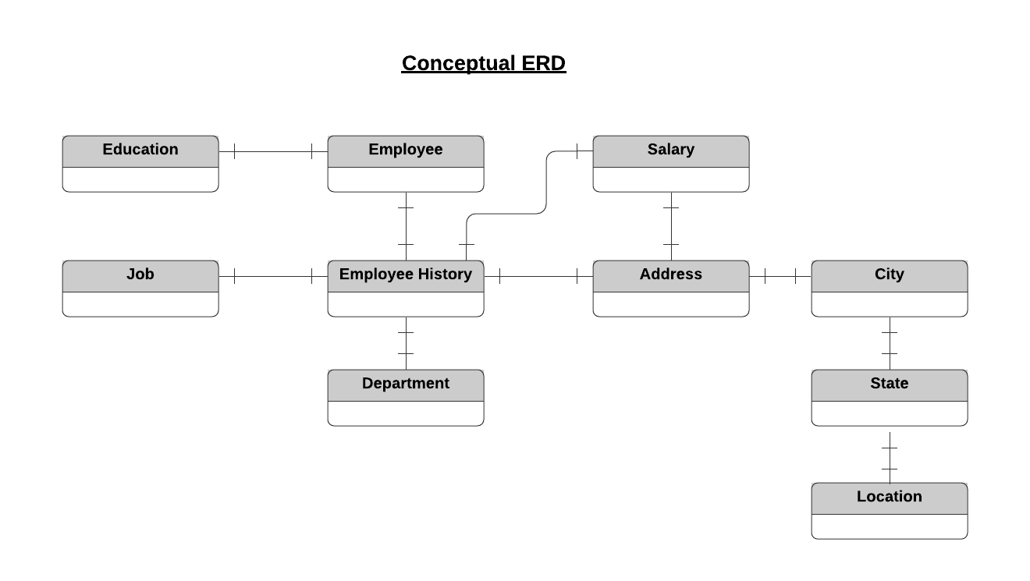
ERD
Conceptual
This is the most general level of data modeling. At the conceptual level, you should be thinking about creating entities that represent business objects for the database. Think broadly here. Attributes (or column names) are not required at this point, but relationship lines are required (although Crow's foot notation is not needed at this level). Create at least three entities for this model; thinking about the 3NF will aid you in deciding the type of entities to create.
Use Lucidchart’s built-in template for DBMS ER Diagram UML.

Slide 14
ERD
Logical
The logical model is the next level of refinement from the conceptual ERD. At this point, you should have normalized the data to the 3NF. Attributes should also be listed now in the ERD. You can still use human-friendly entity and attribute names in the logical model, and while relationship lines are required, Crow's foot notation is still not needed at this point.
Use Lucidchart’s built-in template for DBMS ER Diagram UML.
Rationale for primary key in Employee History table.
1. So, primary key for this table is combination of Employee ID, Job Title, Address ID, Manager ID, Department ID, Salary ID attributes.
2. Alternate key – We could have chosen a combination of Employee ID and Start Date also as a “Primary Key”, if there is a new start populated whenever there is a change in Department, Job title, Address, Manager and Salary.
S No | Assumptions | Case | Employee Hist Primary Key
1 | Employee department can change keeping all the other attribute same. For e.g., Product Development and IT department have same job title "Design Engineer" and "Network Engineer" . So, employee may change department without a change in manager, job title, Address ,salary attribute change | Department Change | Yes
2 | Employee job title may change keeping all the other attributes same. For Ex, Employee may draw the same salary and be in same department even after changing the job title. | Job Title Change | Yes
3 | Employee can move to different manager keeping all the other attributes same. For ex, Employee may get transferred from manager "Tyrone Hutchison" to "Allison Gentle" both of whom department is "Distribution". | Manager Change | Yes
4 | Employee may get transferred to other office (Change in address) without changing all the other attributes. | Address Change | Yes
5 | Employee received salary hike without change in designation and other attributes. This usually happens in most of the organization. | Salary Change | Yes

Slide 15
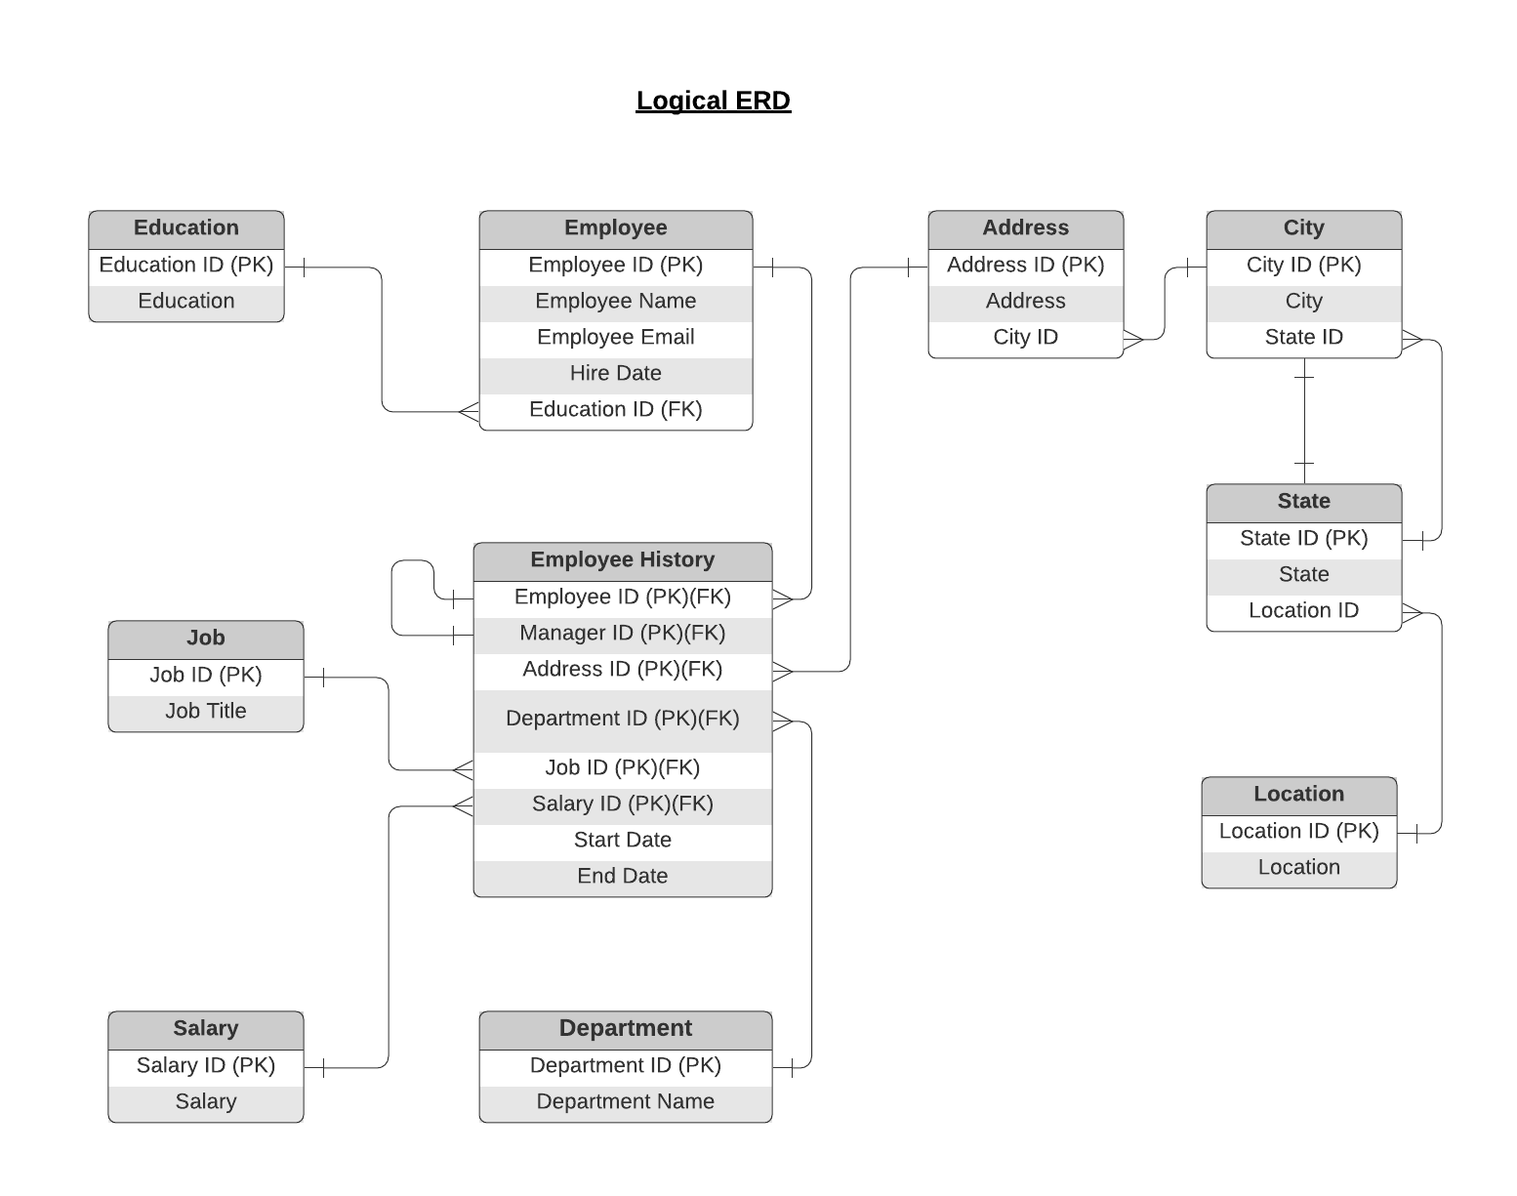
ERD

Slide 16
ERD
Physical
The physical model is what will be built in the database. Each entity should represent a database table, complete with column names and data types. Primary keys and foreign keys should also be represented here. Primary keys should be in bold type with the (PK) designation following the field name. Foreign keys should be in normal type face, but have the designation (FK) after the column name. Finally, in the physical model, Crow's foot notation is important.
Physical ERD is on next page

Slide 17
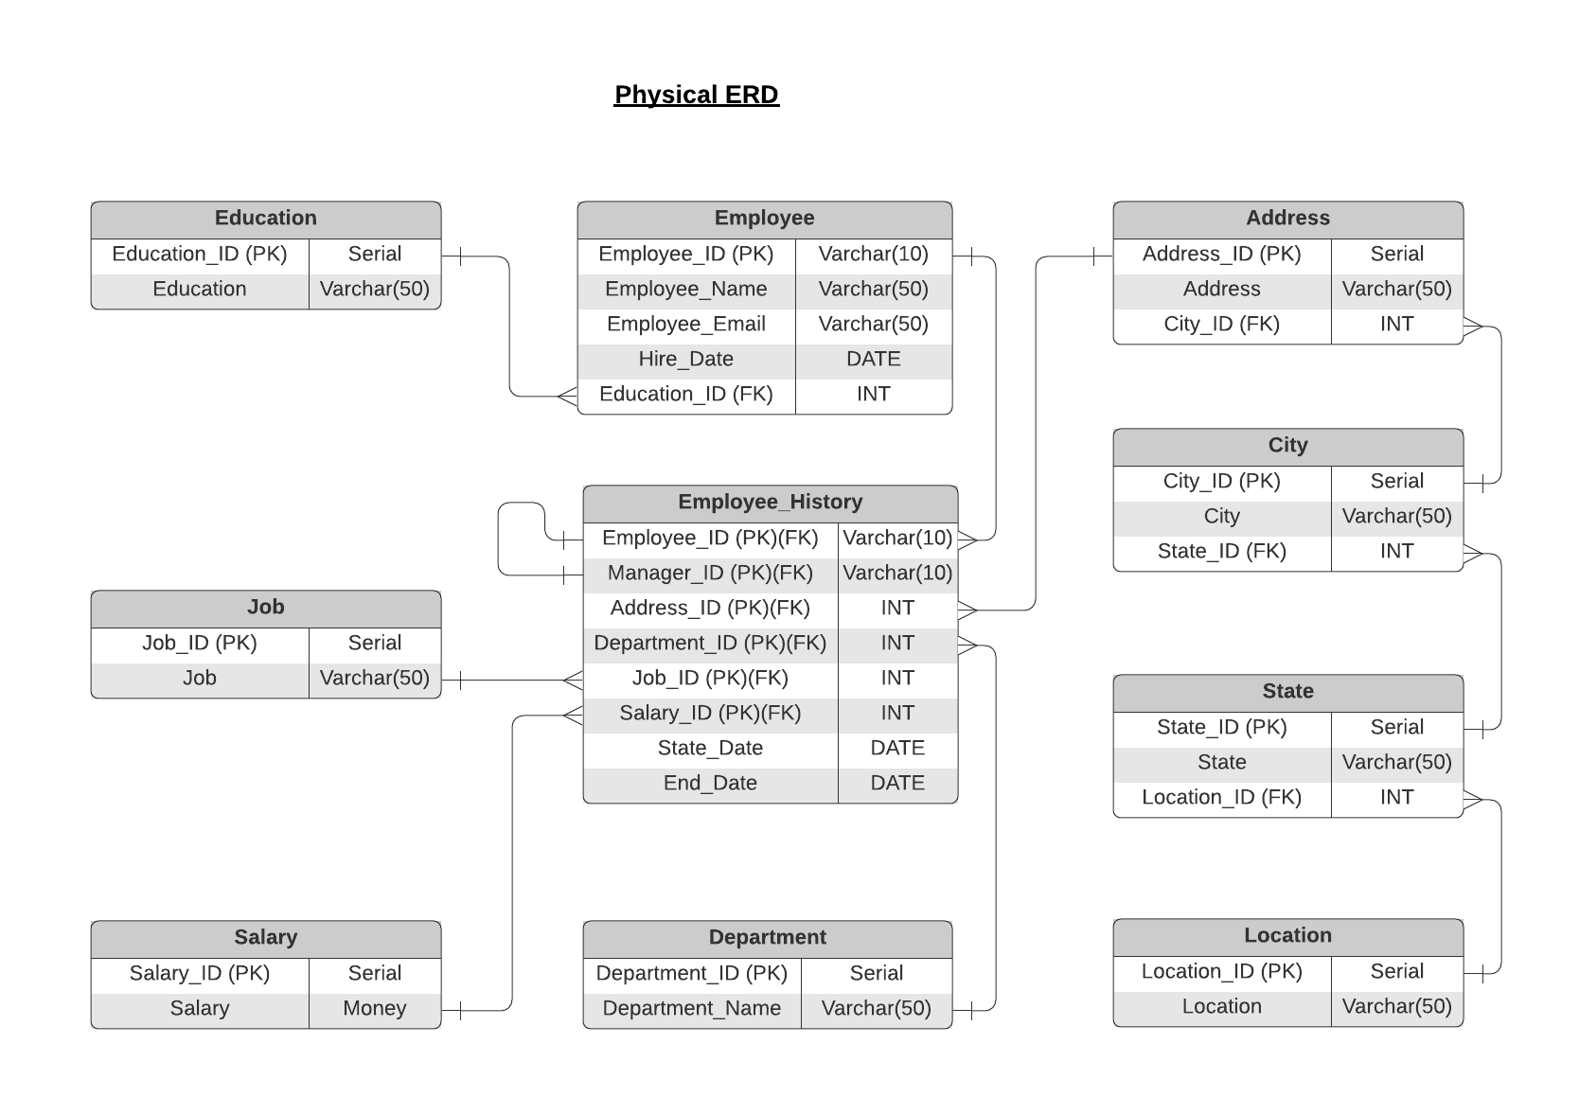
ERD

Slide 18
Step 3
Create A Physical Database

Slide 19
Step 3: Create A Physical Database
In this step, you will be turning your database model into a physical database.
You will:
Create the database using SQL DDL commands
Load the data into your database, utilizing flat file ETL
Answer a series of questions using CRUD SQL commands to demonstrate your database was created and populated correctly
Submission
For this step, you will need to submit SQL files containing all DDL SQL scripts used to create the database.
You will also have to submit screenshots showing CRUD commands, along with results for each of the questions found in the starter template.
Hints
Your DDL script will be graded by running the code you submit. Please ensure your SQL code runs properly!
Foreign keys cannot be created on tables that do not exist yet, so it may be easier to create all tables in the database, then to go back and run modify statements on the tables to create foreign key constraints.
After running CRUD commands like update, insert, or delete, run a SELECT* command on the affected table, so the reviewer can see the results of the command.

Slide 20
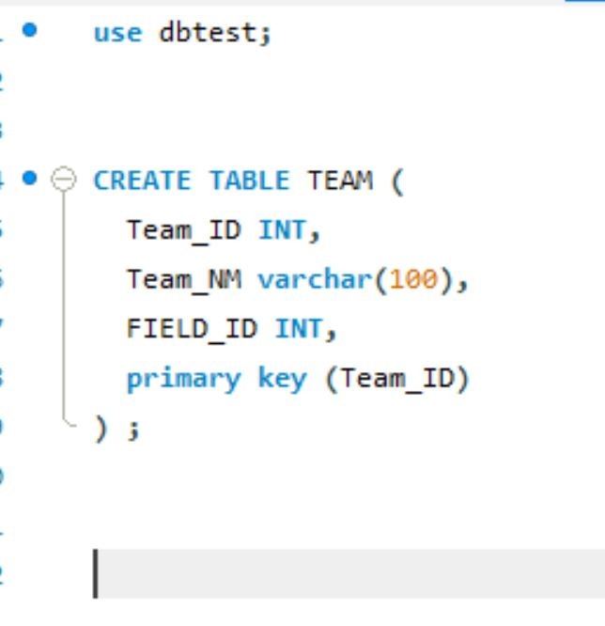
DDL
Create a DDL SQL script capable of building the database you designed in Step 2
Hints
The DDL script will be graded by running the code you submit. Please ensure your SQL code runs properly.
Foreign keys cannot be created on tables that do not exist yet, so it may be easier to create all tables in the database, then to go back and run modify statements on the tables to create foreign key constraints.
Remember to submit the related SQL file as well, not just a screenshot (replace the below screenshot).

Slide 21
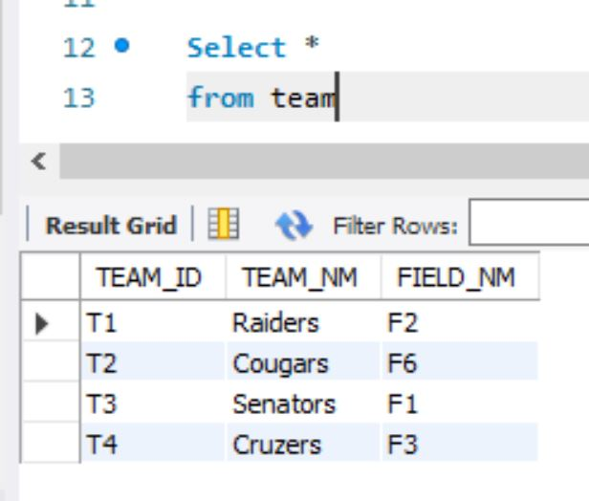
CRUD
Question 1: Return a list of employees with Job Titles and Department Names
** Replace example screenshot below with your response, and include the query in a SQL file

Slide 22
CRUD
Question 2: Insert Web Programmer as a new job title
** Replace example screenshot below with your response, and include the query in a SQL file

Slide 23
CRUD
Question 3: Correct the job title from web programmer to web developer
** Replace example screenshot below with your response, and include the query in a SQL file

Slide 24
CRUD
Question 4: Delete the job title Web Developer from the database
** Replace example screenshot below with your response, and include the query in a SQL file

Slide 25
CRUD
Question 5: How many employees are in each department?
** Replace example screenshot below with your response, and include the query in a SQL file

Slide 26
CRUD
Question 6: Write a query that returns current and past jobs (include employee name, job title, department, manager name, start and end date for position) for employee Toni Lembeck.
** Replace example screenshot below with your response, and include the query in a SQL file

Slide 27
CRUD
Question 7: Describe how you would apply table security to restrict access to employee salaries using an SQL server.
** answer in a short paragraph, how you would apply table security to restrict access to employee salaries

Slide 28
Step 4
Above and Beyond (optional)

Slide 29
Step 4: Above and Beyond
This last step is called Above and Beyond. In this step, I have proposed 3 challenges for you to complete, which are above and beyond the scope of the project. This is a chance to flex your coding muscles and show everyone how good you really are.
These challenge steps will bring your project even more in line with a real-world project, as these are the kind of “finishing touches” that will make your database more usable. Imagine building a car without air conditioning or turn signals. Sure, it will work, but who would want to drive it.
I encourage you to take on these challenges in this course and any future courses you take. I designed these challenges to be a challenge to your current abilities, but I ensured they are not an unattainable challenge. Remember, these challenges are completely optional - you can pass the project by doing none of them, or just some of them, but I encourage you to at least attempt them!

Slide 30
Standout Suggestion 1
Create a view that returns all employee attributes; results should resemble initial Excel file
** return a screenshot of the view create code, along with the results of a select all on the view

Slide 31
Standout Suggestion 2
Create a stored procedure with parameters that returns current and past jobs (include employee name, job title, department, manager name, start and end date for position) when given an employee name.
** submit screenshot of stored procedure creation code, along with a screenshot of the stored procedure executed using Toni Lembeck as the parameter value

Slide 32
Standout Suggestion 3
Implement user security on the restricted salary attribute.
Create a non-management user named NoMgr. Show the code of how your would grant access to the database, but revoke access to the salary data.
Submit screenshot of code

Slide 33
Appendix

Slide 34
Additional Info
You can include supporting or additional information that supports your previous slides, but isn’t necessary for every person to see that looks at your slides.

