Slide 1
PranaTwin-T2D
A clinician-facing research sandbox for short-horizon glycemic forecasts
Historical context.
An evolving virtual state.
A forecast that can be audited.
Happiest Health Digital Twin Challenge 2026
Team / institution: [FILL IN] | Research only
Notes:
Team identity is intentionally pending. Not for patient care, diagnosis, emergency use or medication decisions.
All default data and evaluation are synthetic. Source register: docs/sources.md. Generated from actual repository outputs.

Slide 2
The focused use case
Forecast glucose trajectories up to 120 minutes in a bounded software demonstrator
01
Research flags: glucose above 180 or below 70 mg/dL.
02
Three fictional outpatient contexts reflect comorbidity, waist/BMI and shift-work fields.
03
India-specific context does not imply ethnicity-based physiology or a representative cohort.
Notes:
Threshold source: Battelino et al., Diabetes Care 2019, DOI 10.2337/dci19-0028. Profiles are project-authored examples, not prevalence estimates.
All default data and evaluation are synthetic. Source register: docs/sources.md. Generated from actual repository outputs.

Slide 3
Two streams update one state
The historical glucose Observation initializes the state used by the replay
EHR baseline
FHIR R4 document
Causal twin state
Forecast + UI
5-minute telemetry
Glucose + meal log
REST / WebSocket
One FastAPI process serves the React UI. Consent gates patient routes and streams.
Notes:
Actual flow: engine/data.py, model.py and api.py. Architecture editable source: docs/architecture.mmd and scripts/build_figures.py.
All default data and evaluation are synthetic. Source register: docs/sources.md. Generated from actual repository outputs.

Slide 4
A transparent reduced-order model
Illustrative engineering dynamics with explicit units and bounds
01
Logged carbohydrate decays through a first-order proxy compartment.
02
Glucose relaxes toward the EHR-derived, causally updated baseline.
03
Each observation updates the state. No insulin or drug-response model is claimed.
Notes:
Equations and units: docs/model_methodology.md; coefficients: config/model.json. Gains are unvalidated illustrative assumptions. No Bergman/Hovorka claim.
All default data and evaluation are synthetic. Source register: docs/sources.md. Generated from actual repository outputs.

Slide 5
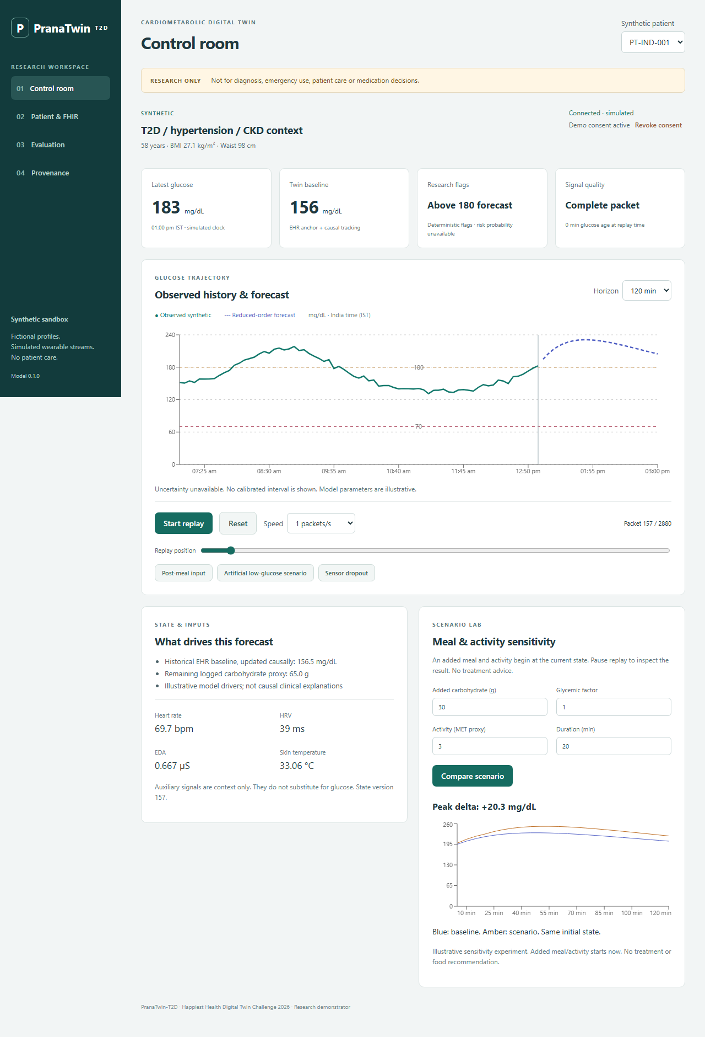
The working control room
Replay, inspect and compare from a consistent synthetic patient state
Start / pause / speed / seek
FHIR inspection
Bounded meal + activity scenarios
Visible source and uncertainty limits
Notes:
Screenshot captured by Playwright from the running app, reports/dashboard-desktop.png. Demo actions are implemented in frontend/src/App.tsx.
All default data and evaluation are synthetic. Source register: docs/sources.md. Generated from actual repository outputs.

Slide 6
Evaluation prevents future leakage
Within-patient chronological splits with a two-hour purge at each boundary
01
Training 60%, reserved validation 20%, final test 20%.
02
Fit ridge preprocessing and regression on training rows only.
03
Compare identical held-out targets at 15, 30, 60, 90 and 120 minutes.
Notes:
Exact indices and timestamps: reports/metrics.json manifest. Test origins every 30 minutes. Overlapping test windows remain correlated. No new-patient generalization claim.
All default data and evaluation are synthetic. Source register: docs/sources.md. Generated from actual repository outputs.

Slide 7
Regression is strongest on this simulator
RMSE in mg/dL; 276 held-out predictions per model and horizon
Synthetic results cannot establish clinical validity. Reduced-order also loses to persistence at 15 minutes.
Notes:
Computed source: reports/metrics.json; pair-level evidence: reports/predictions.csv. Dataset SHA256 7d8e375c62e3bb79118ac8ebdccb111ac950d00a972afa4d1843ca89c348d447
All default data and evaluation are synthetic. Source register: docs/sources.md. Generated from actual repository outputs.

Slide 8
Uncertainty and failure modes
The interface suppresses unsupported confidence bands and risk percentages
01
No calibrated intervals, probabilistic Brier score or verified Clarke grid.
02
Unannounced meals and the artificial low scenario expose forecast limitations.
03
Missing, stale and unsupported inputs trigger explicit quality states or errors.
Notes:
See docs/model_card.md. Deterministic any-crossing UI flags differ from endpoint labels used for evaluation metrics.
All default data and evaluation are synthetic. Source register: docs/sources.md. Generated from actual repository outputs.

Slide 9
Prototype governance
Revocation blocks protected endpoints and closes active live subscriptions
01
FHIR viewer reports local structural checks only. No full ABDM conformance claim.
02
Consent status and expiry are checked server-side. Demo restoration is intentionally accessible.
03
No identity system or compliance certification. Keep the sandbox on a trusted local computer.
Notes:
FHIR sources: https://hl7.org/fhir/R4/documents.html and https://nrces.in/ndhm/fhir/r4/StructureDefinition-DocumentBundle.html. Security boundary: docs/security_privacy.md.
All default data and evaluation are synthetic. Source register: docs/sources.md. Generated from actual repository outputs.

Slide 10
What remains before submission and clinical research
Working software is separate from evidence of clinical performance
01
Complete team details, publish the repository and record the required 20-minute minimum video.
02
Validate on authorized real CGM data with a prespecified subject holdout.
03
Integrate full FHIR validation, identified physiology and independent security review before clinical translation.
Notes:
Video status: PENDING. docs/audit.md records executed checks and external blockers. No clinical deployment claim.
All default data and evaluation are synthetic. Source register: docs/sources.md. Generated from actual repository outputs.

