Slide 1

P. P. SAVANI UNIVERSITY • SCHOOL OF ENGINEERING
GATESYNC
Smart Residential Society Security & Visitor Management System
An enterprise-grade, offline-first Progressive Web Application (PWA) replacing legacy paper visitor registers with sub-150ms bidirectional STOMP WebSocket gatekeeper alerts, 1-tap logistics clearance, and cryptographic guest access.
STUDENT DEVELOPER
ARPITSINH THAKOR
ENROLLMENT NUMBER
23SE02IE040
DEGREE & BRANCH
B.Tech in Information Technology & Engineering
School of Engineering
TECHNOLOGY FOCUS: Full Stack Development - Java
INSTITUTION
School of Engineering
P. P. Savani University, Surat, Gujarat, India
PROJECT CATEGORY
Final Year Project
ACADEMIC YEAR
Academic Year 2026–2027
Major Project Presentation (AY 2026–2027)

Slide 2
01. BACKGROUND & CHALLENGES
Problem Statement & Motivation
Why Traditional Physical Gatehouse Registers Fail in Modern Residential Societies
CRITICAL CHALLENGES IN PAPER LOGBOOKS
THE GATESYNC DIGITAL TRANSFORMATION
• Severe Gate Congestion: Manual pen-and-paper logging causes 3–5 min entry delays per vehicle during rush hours.
• Privacy Leaks: Resident flat numbers and visitor phone numbers sit exposed in open paper ledgers.
• No Real-Time Verification: Guards rely on intercoms or phone calls that go unanswered, leading to unverified entry.
• E-Commerce Logistics Surges: Frequent deliveries (Swiggy, Zomato, Amazon, Blinkit) overwhelm gatekeepers with repetitive typing.
• Sub-150ms Instant Push Alerting: Bidirectional STOMP WebSockets push arrival alerts straight to the resident mobile screen before visitor reaches barrier.
• 1-Tap Resident Remote Approvals: Residents verify visitor identity with arrival photo and tap Approve or Deny from anywhere in the world.
• Pre-Approved QR & 6-Digit Passes: Residents generate digital passes in advance for expected guests. Guards verify in 2 seconds via optical QR scanning.
• 1-Tap Logistics Partner Clearing: Dedicated 1-tap fast ingress for Swiggy, Zomato, Amazon, and Blinkit completely eliminates typing bottlenecks.
GateSync — Smart Society Security System | Arpitsinh Thakor (23SE02IE040)
SCHOOL OF ENGINEERING • SLIDE 2 / 12

Slide 3
02. ENGINEERING ARCHITECTURE
Full-Stack Architecture & Technology Stack
Robust Multi-Tier Cloud Architecture Built for Real-Time Responsiveness and Zero Data Loss
CLIENT PRESENTATION TIER (PWA)
ARCHITECTURAL BENCHMARKS
React 19 • Vite • Lucide Icons • STOMP over SockJS • Service Worker Precaching
Installable Progressive Web App (PWA) with responsive layouts, offline transaction queue, and audible chime notifications.
< 150 ms
STOMP WebSocket Alert Latency
BACKEND MICROSERVICE CORE (JAVA)
Java 21 LTS • Spring Boot 3.3.4 • Spring Security 6 • JJWT • RESTful APIs
100 %
Stateless multi-tenant controllers, WebSocket message broker (/topic and /user/queue), and atomic concurrency locks.
Tenant Isolation per Society
DUAL-DATABASE PERSISTENCE STRATEGY
Zero Trust
MongoDB Atlas Cloud (Distributed NoSQL) + Relational Enterprise Mapping
MongoDB Atlas stores high-throughput notifications, pre-approved passes, and audit trails; robust relational schemas for billing.
15-min Rotating JWT Access Tokens
Offline First
CLOUD DEPLOYMENT & CI/CD INFRASTRUCTURE
Render Cloud (Dockerized Spring Boot Container) + GitHub Pages (Production PWA)
Auto-syncing LocalStorage Queue
Fully automated continuous deployment with sub-second health monitors (/api/health) and automated failovers.
GateSync — Smart Society Security System | Arpitsinh Thakor (23SE02IE040)
SCHOOL OF ENGINEERING • SLIDE 3 / 12

Slide 4
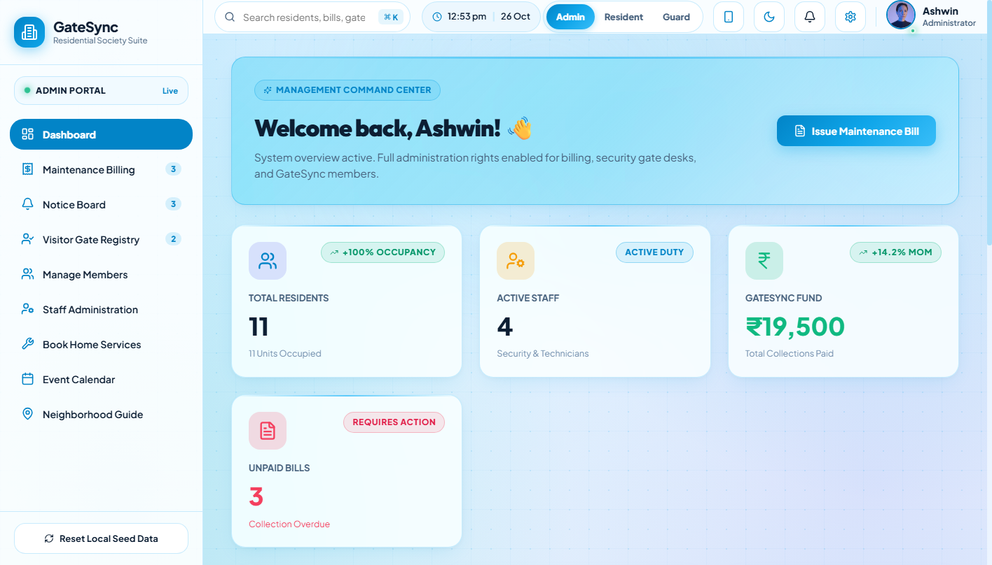
03. OPERATIONAL COMMAND
Executive Admin Dashboard & Analytics
Comprehensive Centralized Command Center for Society Administrators & Committee Members
CORE FUNCTIONALITY & WORKFLOW
• Real-Time Campus Metrics:
Visual KPI cards monitoring registered residential units, active residents, on-duty security staff, and monthly billing totals.
• Live Gatehouse Traffic Feed:
Streaming monitor of active gate entries, pending resident approvals, and recent checkouts with sub-second WebSocket synchronization.
• Rapid Operational Shortcuts:
1-tap access to visitor registries, staff management, resident directory, maintenance ledger, and campus broadcast dispatches.
• Multi-Tenant Scoping:
Strict role-based isolation guarantees that committee members only view statistics belonging to their society complex.
GateSync — Smart Society Security System | Arpitsinh Thakor (23SE02IE040)
SCHOOL OF ENGINEERING • SLIDE 4 / 12

Slide 5
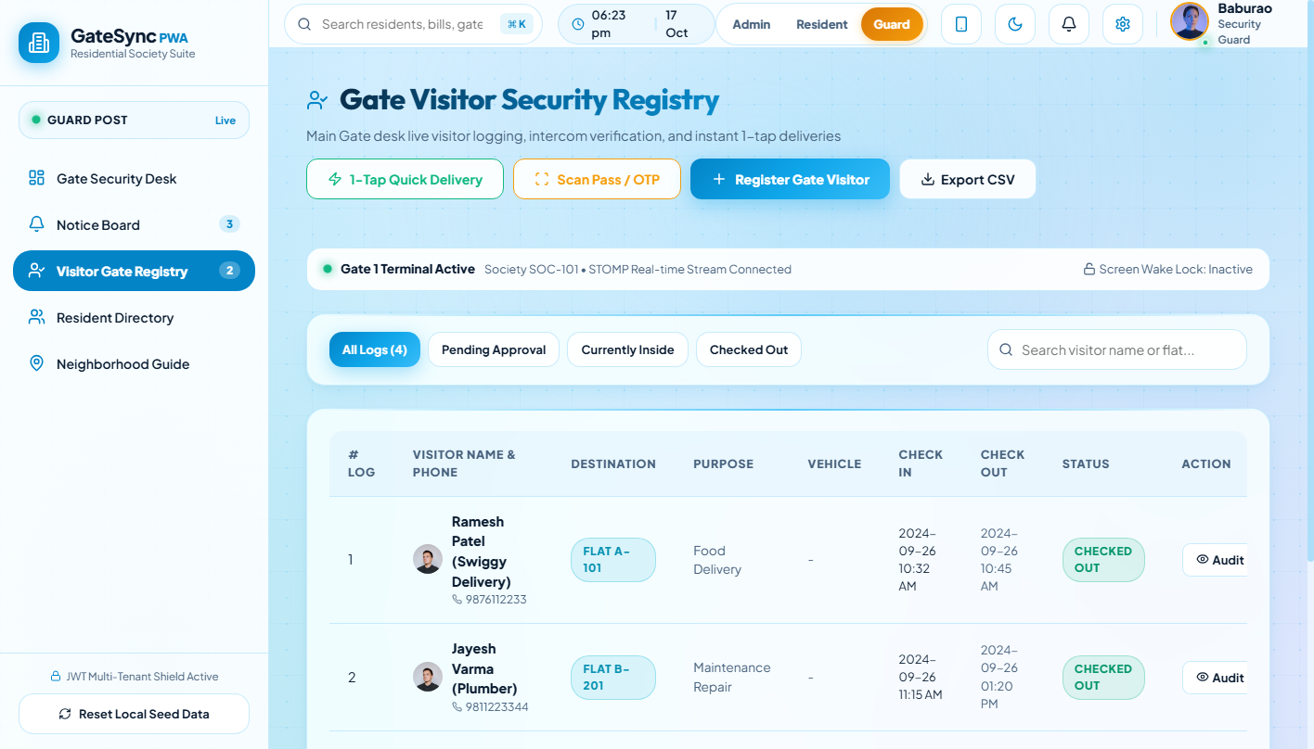
04. GATEHOUSE OPERATIONS
Guard Desk Terminal & Fast Visitor Ingress
Optimized High-Speed Interface Designed for Rapid Tablet and Gatehouse Terminal Input
CORE FUNCTIONALITY & WORKFLOW
• Swift Data Capture:
Guards register visitor full name, mobile number, target flat unit, vehicle plate, and visit category in under 15 seconds.
• Auto-Complete Resident Search:
Instant dynamic lookup by flat number (e.g., A-101) or resident name eliminates manual telephone book lookups.
• Instant Push Notification Dispatch:
Submitting entry automatically dispatches a real-time STOMP WebSocket notification to the resident smartphone.
• Live Entry Queue Feedback:
Guards view real-time decision updates (Pending, Approved, Denied) directly on screen without leaving their post.
GateSync — Smart Society Security System | Arpitsinh Thakor (23SE02IE040)
SCHOOL OF ENGINEERING • SLIDE 5 / 12

Slide 6
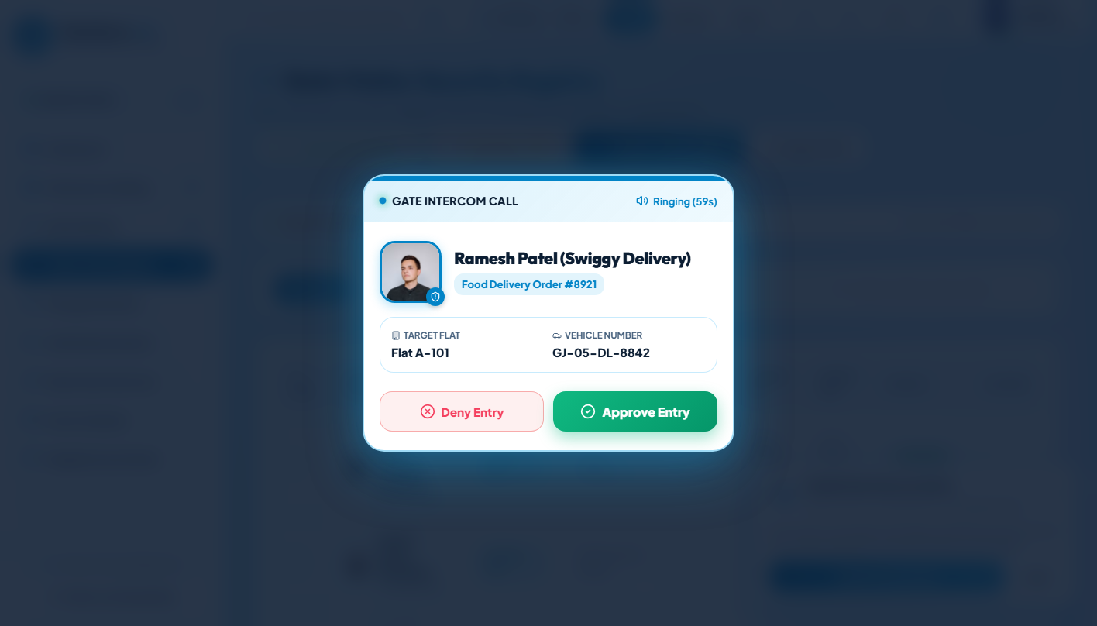
05. RESIDENT VERIFICATION
Resident Real-Time Alert & 1-Tap Remote Approval
Instant Push Notification Modal Connecting Gate Arrival Directly to Resident Smartphone
CORE FUNCTIONALITY & WORKFLOW
• Interactive Alert Modal:
Instantaneous pop-up modal appears on resident device with an audible arrival chime the moment guard logs the visitor.
• Identity & Arrival Details:
Presents visitor photo, full name, visit category, entry gate ID, and vehicle registration for complete transparency.
• 1-Tap Binary Decision:
Resident taps Approve Entry (Green) to open the barrier or Deny Entry (Red) with optional reason sent back to the guard.
• Atomic Concurrency Guard:
Server-side conflict protection (HTTP 409) prevents conflicting decisions if multiple family members open the alert.
GateSync — Smart Society Security System | Arpitsinh Thakor (23SE02IE040)
SCHOOL OF ENGINEERING • SLIDE 6 / 12

Slide 7
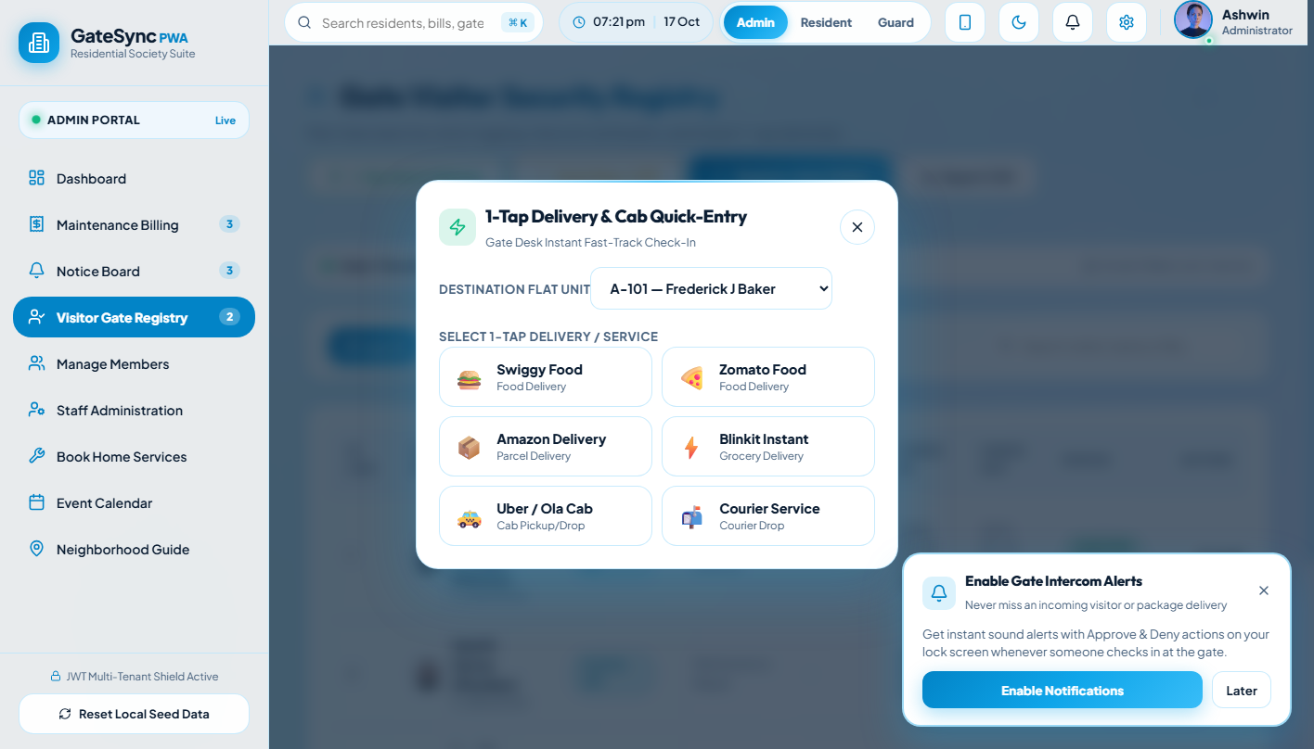
06. LOGISTICS INGRESS
1-Tap Fast Logistics & Delivery Clearance
Eliminating Typing Bottlenecks for High-Volume E-Commerce Delivery Personnel
CORE FUNCTIONALITY & WORKFLOW
• Dedicated Provider Presets:
Instant 1-tap buttons for Swiggy, Zomato, Amazon, Blinkit, and Flipkart eliminate tedious keyboard entry.
• Peak Delivery Ingress Speed:
Reduces courier entry processing from 2 minutes down to under 5 seconds per delivery executive.
• Doorstep vs Gate Delivery Rules:
Residents specify whether parcels are pre-approved to the door or must be left at the gate security desk.
• Tamper-Evident Courier Log:
Automatically logs delivery company name, parcel target flat, timestamp, and guard badge ID in the database.
GateSync — Smart Society Security System | Arpitsinh Thakor (23SE02IE040)
SCHOOL OF ENGINEERING • SLIDE 7 / 12

Slide 8
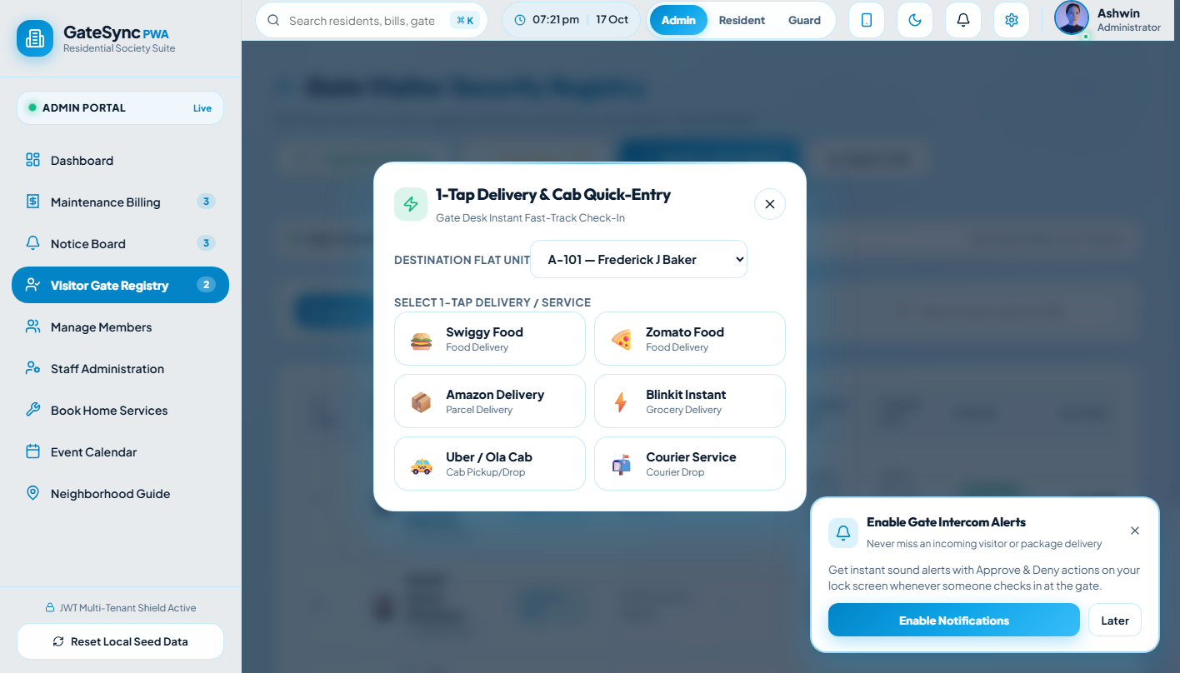
07. GUEST AUTOMATION
Pre-Approved Guest Passes & QR Code Scanner
Self-Serve Digital Invitations with Fast Optical Camera Verification at the Gate
CORE FUNCTIONALITY & WORKFLOW
• Resident Self-Service Creation:
Residents generate guest entry passes in advance with customized valid-from and valid-until date/time windows.
• Cryptographic 6-Digit OTP & QR:
Each generated pass embeds a unique cryptographic 6-digit numeric token and scannable high-contrast QR code.
• 1-Click WhatsApp Sharing:
Pre-formatted invitation message with pass link and QR code is sent directly to guests via WhatsApp.
• Optical Camera Scanner:
Gatekeeper terminal scans guest QR or enters the 6-digit OTP for instant 2-second automated gate clearance.
GateSync — Smart Society Security System | Arpitsinh Thakor (23SE02IE040)
SCHOOL OF ENGINEERING • SLIDE 8 / 12

Slide 9
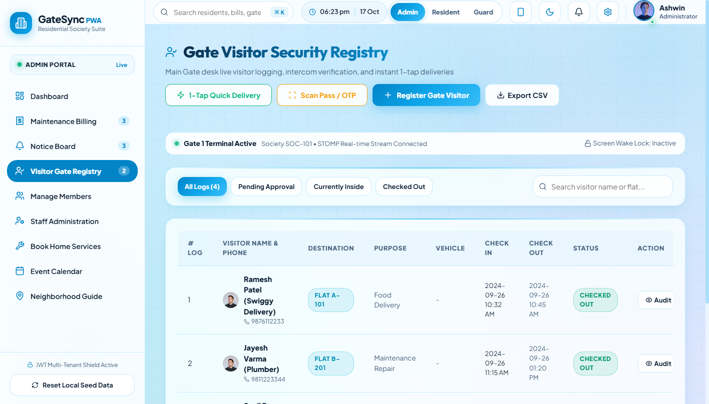
08. SECURITY GOVERNANCE
Digital Visitor Registry & Historical Security Logs
Complete Tamper-Proof Audit Trail of Campus Traffic, Parking & Checkout Timestamps
CORE FUNCTIONALITY & WORKFLOW
• Comprehensive Live Registry:
Filterable, searchable ledger tracking visitor name, contact number, vehicle plate, arrival gate, and host flat.
• Real-Time Status Badges:
Color-coded visual status tracking: INSIDE (currently on campus), CHECKED_OUT (departed), or REJECTED.
• 1-Tap Gate Checkout:
Guards log departure with a single tap, recording exact exit timestamps and calculating total stay duration.
• Auditing & Police Incident Export:
Historical logs are exportable for society committee reviews, incident investigations, or local authorities.
GateSync — Smart Society Security System | Arpitsinh Thakor (23SE02IE040)
SCHOOL OF ENGINEERING • SLIDE 9 / 12

Slide 10
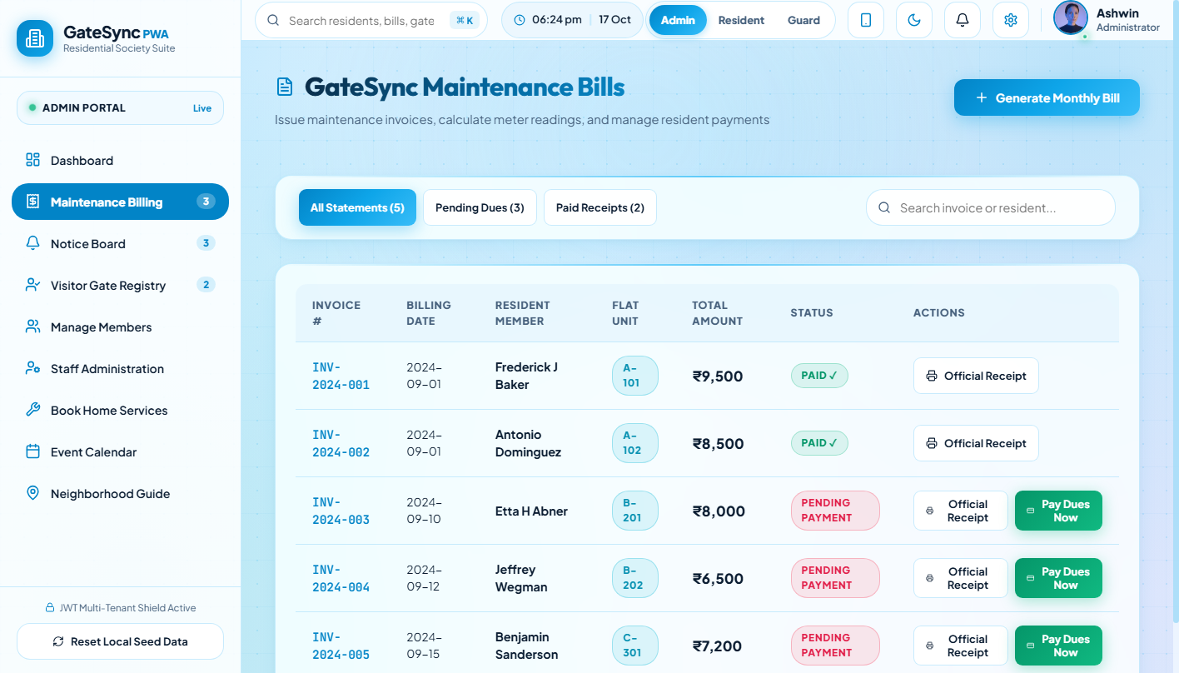
09. FINANCIAL GOVERNANCE
Society Maintenance Billing & Accounting Ledger
Automated Dues Calculation, Payment Status Tracking & Community Issue Helpdesk
CORE FUNCTIONALITY & WORKFLOW
• Digital Dues Management:
Maintains flat-wise monthly maintenance bills with itemized breakdowns for water, security, sinking funds, and parking.
• Real-Time Payment Tracking:
Instant visual classification of Paid, Pending, and Overdue flat accounts across all society blocks and wings.
• Printable Itemized PDF Invoices:
Residents and administrators can view and print professional digital PDF invoices with detailed transaction logs.
• Community Helpdesk Integration:
Integrated problem ticketing module allows residents to file repair tickets (plumbing, electrical) with real-time status.
GateSync — Smart Society Security System | Arpitsinh Thakor (23SE02IE040)
SCHOOL OF ENGINEERING • SLIDE 10 / 12

Slide 11
10. SECURITY & RESILIENCE
Zero-Trust Security & Offline PWA Architecture
Hardened Protection, Multi-Tenant Boundary Isolation, and Continuous Offline Operation
ZERO-TRUST JWT SECURITY
OFFLINE-FIRST PWA RESILIENCE
AUDITING & EMERGENCY SOS
• 15-Minute rotating JWT access tokens kept in-memory (XSS immune).
• Secure HttpOnly SameSite=Strict cookies for refresh tokens.
• BCrypt salted password hashing with forced first-login password update.
• Strict Role-Based Access Control (RBAC): ADMIN, RESIDENT, and GUARD.
• Service Worker precaches assets for 100% offline application startup.
• Offline Transaction Queue stores visitor entries in LocalStorage.
• Automatic synchronization immediately when network reconnects.
• Segregated dual-database design: In-memory mapping + MongoDB Atlas.
• Immutable audit logging capturing actor ID, IP address, and payload.
• 2-Second deduplication key window prevents duplicate alert spam.
• 100% multi-tenant data isolation ensures zero data leaks across societies.
• Emergency SOS trigger sounds immediate guard desk alarm and siren.
GateSync — Smart Society Security System | Arpitsinh Thakor (23SE02IE040)
SCHOOL OF ENGINEERING • SLIDE 11 / 12

Slide 12
THANK YOU
GateSync — Smart Society Security Platform | Evaluation & Discussion
LIVE DELIVERABLES & PRODUCTION CLOUD ENDPOINTS
• Live Progressive Web App (PWA): https://arpitthakor28.github.io/sms1/
• Live Cloud Backend API (Render): https://sms1-c9sj.onrender.com
• Cloud Nap Stopper / Health Check: https://sms1-c9sj.onrender.com/api/health
• GitHub Source Code Repository: https://github.com/arpitthakor28/sms1
PROJECT DEVELOPED BY
ARPITSINH THAKOR
Enrollment Number: 23SE02IE040
B.Tech in Information Technology & Engineering
Technology Focus: Full Stack Development - Java
DEPARTMENT & INSTITUTION
School of Engineering
P. P. Savani University, Surat, Gujarat
Final Year Project • Academic Year 2026–2027
GATESYNC • Smart Residential Security Platform | All Rights Reserved © 2026–2027

