Slide 1

P. P. SAVANI UNIVERSITY • SCHOOL OF ENGINEERING
GATESYNC
Next-Generation Smart Residential Security & Real-Time Visitor Management Platform
Replacing legacy physical register books with a real-time, zero-trust digital gatehouse bridge featuring sub-150ms STOMP WebSocket alerts, 1-tap deliveries, and offline-first PWA resilience.
CANDIDATE NAME:
ARPITSINH THAKOR
ENROLLMENT NUMBER:
23SE02IE040
ACADEMIC PROGRAM:
B.Tech Computer Engineering
GUIDE & INSTITUTION:
Department of Computer Engineering, PPSU

Slide 2
01. BACKGROUND & CHALLENGES
Problem Statement & Motivation
Why Traditional Gated Security Systems Fail in Modern Communities
CRITICAL CHALLENGES IN PAPER LOGBOOKS
THE GATESYNC DIGITAL ADVANTAGE
• Severe Gate Congestion: Manual pen-and-paper logging causes 3–5 min entry delays per vehicle during rush hours.
• Privacy Leaks: Resident flat numbers and visitor phone numbers sit exposed in open paper ledgers.
• No Real-Time Verification: Guards rely on intercoms or phone calls that go unanswered, leading to unverified entry.
• E-Commerce Logistics Surges: Frequent deliveries (Swiggy, Zomato, Amazon, Blinkit) overwhelm gatekeepers with repetitive typing.
• Instant Bidirectional Alerts: Sub-150ms STOMP WebSocket push notifications directly to resident mobile screens.
• 1-Tap Remote Decisions: Residents verify visitor identity with photo and tap Approve/Deny from anywhere in the world.
• 1-Tap Fast Deliveries: Pre-configured courier ingress buttons eliminate guard keyboard input.
• Zero-Trust Security: Multi-tenant isolation, rotating JWT tokens, optical QR pass scanners, and full offline PWA queueing.
GATESYNC • Smart Residential Security Platform | Arpitsinh Thakor (23SE02IE040)
PPSU • 2026

Slide 3
02. ENGINEERING & DESIGN
System Architecture & Tech Stack
Multi-Tier Cloud Architecture Built for Sub-150ms Real-Time Responsiveness
FRONTEND PWA CLIENT
React 19 • Vite • Lucide • STOMP over SockJS • Service Worker
CORE ARCHITECTURAL HIGHLIGHTS
Installable PWA with offline queueing, responsive layouts, and instant audio chimes.
< 150 ms
BACKEND MICROSERVICE CORE
Bidirectional STOMP push latency
Java 21 LTS • Spring Boot 3.3.4 • Spring Security 6 • JJWT
Stateless REST controllers, WebSocket message broker, and atomic concurrency controls.
100 %
Multi-tenant isolation per society
CLOUD PERSISTENCE STRATEGY
MongoDB Atlas Cloud • Relational In-Memory H2 DB
Zero Trust
Multi-tenant document collections (notifications, passes, audit logs) + relational schema.
Stateless JWT with rotating HttpOnly cookies
DEPLOYMENT & CLOUD HOSTING
Offline-First
Render Cloud (Dockerized Container) • GitHub Pages (Static PWA)
Auto-syncing LocalStorage transaction queue
Automated GitHub Actions CI/CD pipeline delivering high-availability cloud uptime.
GATESYNC • Smart Residential Security Platform | Arpitsinh Thakor (23SE02IE040)
PPSU • 2026

Slide 4
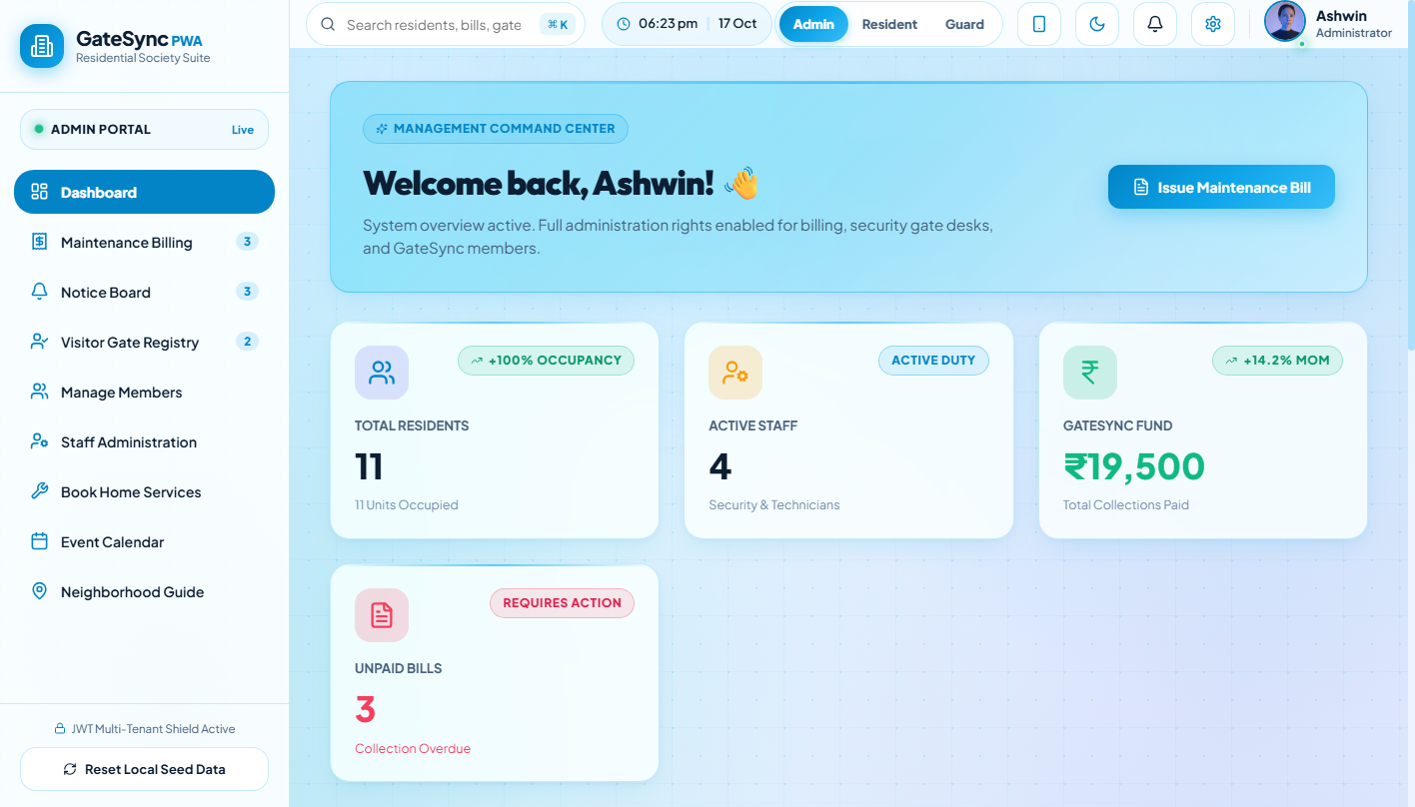
03. REAL-TIME OPERATIONS
Executive Admin Dashboard & Analytics
Unified Command Center for Society Management, Gate Activity & Financials
KEY FUNCTIONALITY & WORKFLOW
• High-Level Metrics: Displays real-time KPIs including 128 registered flats, 342 active residents, 8 guards on duty, and monthly billing totals.
• Live Gate Feed: Visual monitoring of active gate requests, pending resident approvals, and recent checkouts with sub-second synchronization.
• Interactive Quick Actions: Direct navigation to visitor registrations, staff management, resident directory, and emergency broadcasts.
• Multi-Tenant Scope: Restricts analytics and resident information strictly within the authorized society boundary.
GATESYNC • Smart Residential Security Platform | Arpitsinh Thakor (23SE02IE040)
PPSU • 2026

Slide 5
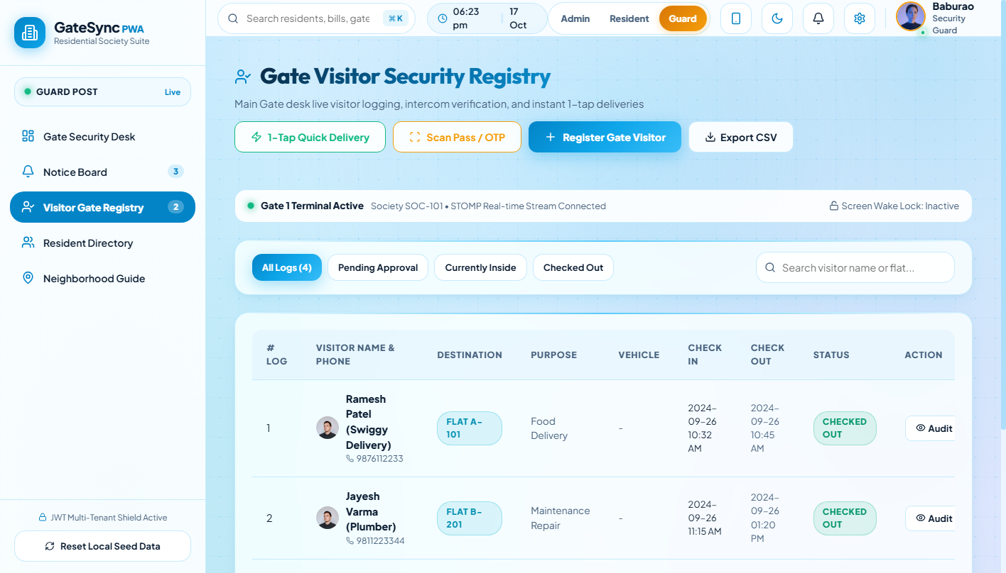
04. GATEHOUSE INGRESS
Guard Desk Terminal & Visitor Entry
High-Speed Gatekeeper Workflow Replacing Bulky Paper Visitor Logs
KEY FUNCTIONALITY & WORKFLOW
• Rapid Data Entry: Guards capture visitor full name, mobile number, visiting flat, purpose, and vehicle registration number in seconds.
• Instant Resident Search: Auto-completing search for flat units and resident names eliminates phone directory lookups.
• Instant Notification Dispatch: Submitting the entry request triggers immediate WebSocket push to the target resident device.
• Queue Status Tracking: Guards observe the real-time decision status (Pending, Approved, Rejected) without leaving their station.
GATESYNC • Smart Residential Security Platform | Arpitsinh Thakor (23SE02IE040)
PPSU • 2026

Slide 6
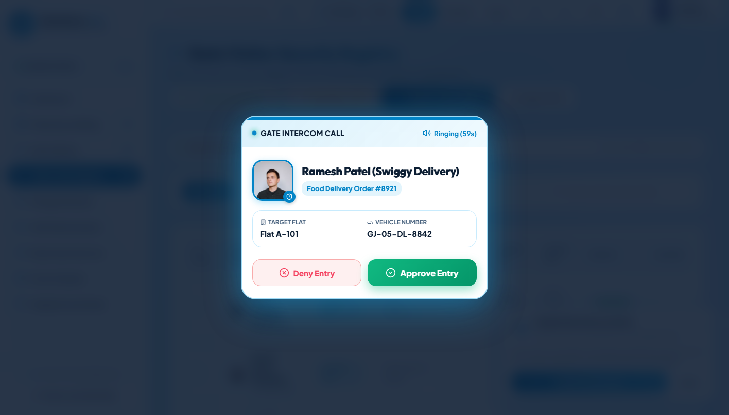
05. RESIDENT VERIFICATION
Resident Real-Time Alert & 1-Tap Approval
Sub-150ms Direct In-App Notification and Remote Gate Decisioning
KEY FUNCTIONALITY & WORKFLOW
• Instant Alert Modal: Real-time WebSocket pop-up modal appears on the resident device the moment a visitor arrives at the gate.
• Complete Verification Details: Presents visitor name, arrival gate, purpose of visit, and vehicle details with an audible arrival chime.
• 1-Tap Binary Decision: Residents tap Approve Entry (Green) or Deny Entry (Red) with an optional denial note for the guard.
• Double-Decision Guard: Server-side atomic lock prevents race conditions or conflicting decisions from co-residents.
GATESYNC • Smart Residential Security Platform | Arpitsinh Thakor (23SE02IE040)
PPSU • 2026

Slide 7
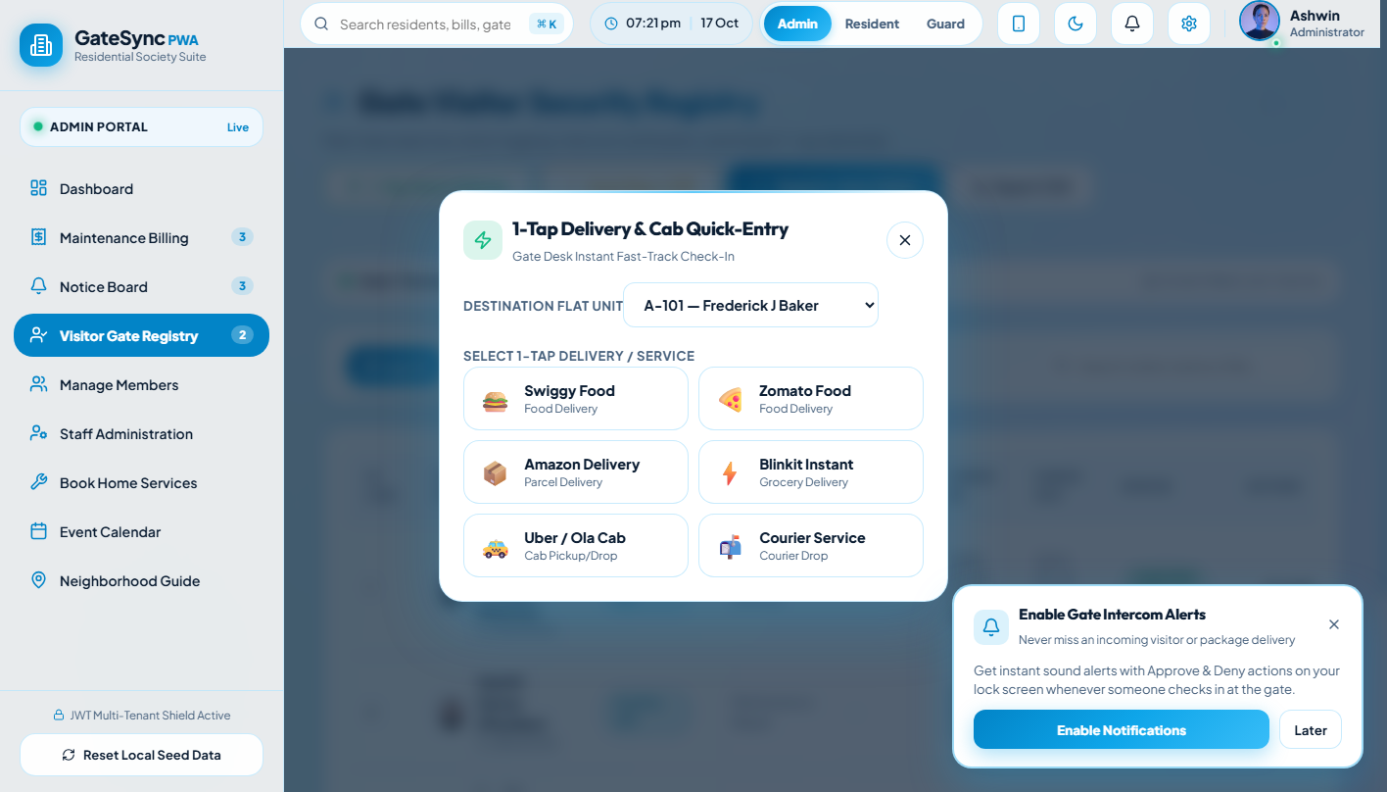
06. LOGISTICS INGRESS
1-Tap Fast Logistics & Courier Clearance
Optimized Gate Workflow for High-Volume E-Commerce Delivery Partners
KEY FUNCTIONALITY & WORKFLOW
• 1-Tap Logistics Presets: Dedicated branded buttons for Swiggy, Zomato, Amazon, Blinkit, and Flipkart eliminate typing delays.
• Peak-Hour Throughput: Reduces courier entry clearance time from 2 minutes to under 5 seconds per delivery person.
• Doorstep vs Gate Delivery: Residents can pre-authorize drop-at-gate or instruct guard to allow the courier directly to their unit.
• Automated Courier Audit: Logs delivery company name, parcel target, timestamp, and gatekeeper ID in the MongoDB audit ledger.
GATESYNC • Smart Residential Security Platform | Arpitsinh Thakor (23SE02IE040)
PPSU • 2026

Slide 8
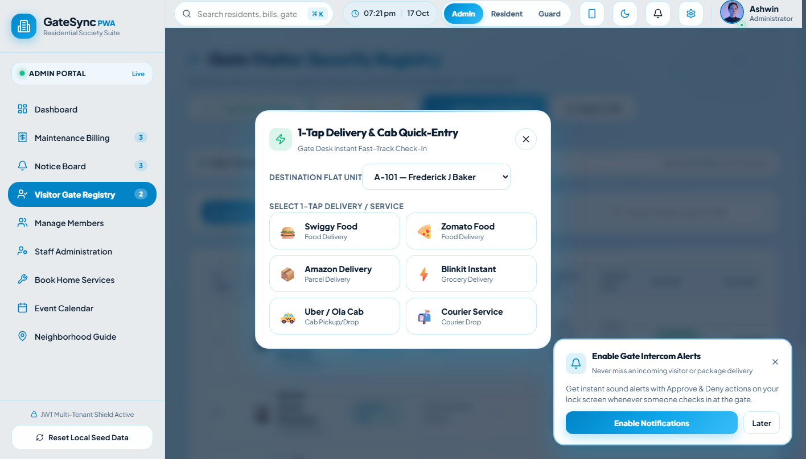
07. GUEST ACCESS AUTOMATION
Pre-Approved Guest Passes & QR Scanner
Frictionless Self-Serve Invitations with Cryptographic Verification
KEY FUNCTIONALITY & WORKFLOW
• Resident Self-Service: Residents generate digital passes in advance for family, event guests, or expected service workers.
• 6-Digit OTP & QR Code: Each pass includes a time-bounded cryptographic numeric code and high-contrast scannable QR.
• WhatsApp 1-Click Sharing: Generates a ready-to-share message and invite link directly sent to guests via WhatsApp.
• Optical Camera Scanner: Gate guards verify passes in 2 seconds via optical QR scanning or numeric keypad entry.
GATESYNC • Smart Residential Security Platform | Arpitsinh Thakor (23SE02IE040)
PPSU • 2026

Slide 9
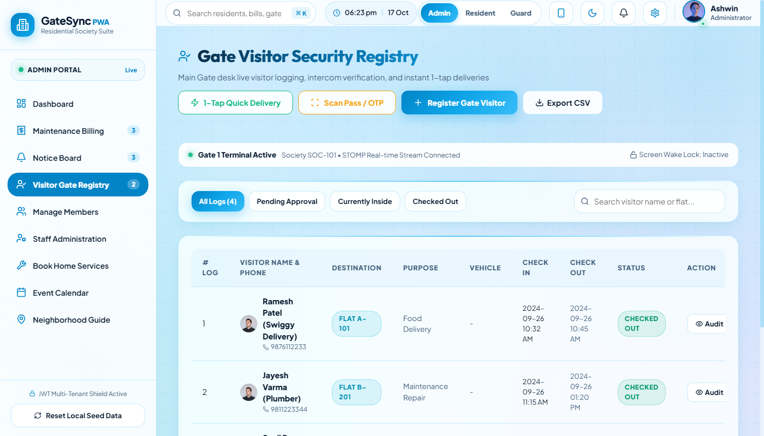
08. SECURITY GOVERNANCE
Digital Visitor Registry & Audit Trail
Tamper-Proof Historical Log of Every Gate Crossing and Checkout
KEY FUNCTIONALITY & WORKFLOW
• Comprehensive Gate Registry: Live searchable table tracking visitor names, contact details, vehicle tags, arrival gate, and host flats.
• Status Lifecycle Badges: Clear visual status indicators: INSIDE (active in campus), CHECKED_OUT (departed), or REJECTED.
• 1-Tap Checkout Workflow: Guards log departure with a single tap, recording exact exit timestamps and duration of stay.
• Filterable Audit History: Search historical records by date range, vehicle number, or flat for complete security auditing.
GATESYNC • Smart Residential Security Platform | Arpitsinh Thakor (23SE02IE040)
PPSU • 2026

Slide 10
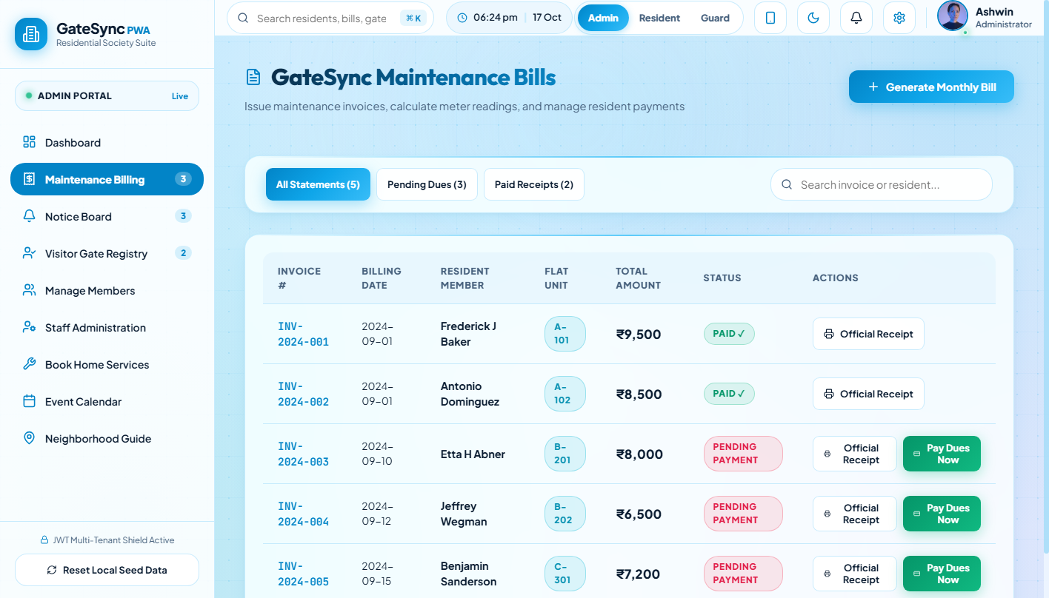
09. FINANCIAL GOVERNANCE
Society Maintenance Billing & Accounting
Automated Invoicing, Payment Tracking & Community Helpdesk
KEY FUNCTIONALITY & WORKFLOW
• Digital Invoice Management: Maintains flat-wise monthly maintenance dues, utility charges, sinking funds, and penalty breakdowns.
• Payment Status Tracking: Instant visual classification of Paid, Pending, and Overdue dues across all wings and blocks.
• Printable PDF Receipts: Residents and committee members can view and print professional itemized invoices.
• Community Problem Tracker: Residents file facility maintenance tickets (plumbing, electrical, elevator) with live status updates.
GATESYNC • Smart Residential Security Platform | Arpitsinh Thakor (23SE02IE040)
PPSU • 2026

Slide 11
10. SECURITY & RELIABILITY
Zero-Trust Security & Offline Resilience
Hardened Data Protection, Multi-Tenant Boundaries & Offline Business Continuity
🛡️ ZERO-TRUST JWT SECURITY
⚡ OFFLINE-FIRST PWA RESILIENCE
🔒 CLOUD AUDIT & DATA INTEGRITY
• 15-Minute rotating JWT access tokens in memory (XSS immune).
• Secure HttpOnly, SameSite=Strict cookies for refresh tokens.
• BCrypt salted password hashing with forced first-login reset.
• Strict Role-Based Access Control (RBAC): ADMIN, RESIDENT, GUARD.
• Service Worker precaches app assets for 100% offline startup.
• Offline Transaction Queue stores visitor requests in LocalStorage.
• Automatic synchronization immediately when network reconnects.
• Dual database fallback: In-memory H2 mapping + MongoDB Atlas.
• Immutable audit logging capturing actor ID, IP address, and payload.
• 2-second deduplication key window prevents duplicate alert spam.
• Strict multi-tenant partitioning ensures zero data leaks across societies.
• Emergency SOS triggers instant campus sirens and SMS dispatches.
GATESYNC • Smart Residential Security Platform | Arpitsinh Thakor (23SE02IE040)
PPSU • 2026

Slide 12
THANK YOU
Q&A / Project Evaluation & Discussion
LIVE DEPLOYMENTS & REPOSITORIES
• Live Web Application (PWA): https://arpitthakor28.github.io/sms1/
• Live Cloud Backend API: https://sms1-c9sj.onrender.com (Nap Stopper: /api/health)
• GitHub Code Repository: https://github.com/arpitthakor28/sms1
DEVELOPED BY:
ARPITSINH THAKOR | Enrollment: 23SE02IE040
School of Engineering (SOE) • P. P. Savani University • Academic Year 2025–2026

