Slide 1

P. P. SAVANI UNIVERSITY • SCHOOL OF ENGINEERING
GATESYNC
Smart Residential Society Security & Visitor Management System
A full-stack Progressive Web Application (PWA) designed to modernize residential community security operations. Replaces manual paper registers with real-time mobile push notifications for residents, 1-tap courier clearance, pre-approved digital QR guest passes, and society maintenance accounting.
STUDENT DEVELOPER
ARPITSINH THAKOR
ENROLLMENT NUMBER
23SE02IE040
DEGREE & BRANCH
B.Tech in Information Technology & Engineering
School of Engineering
INSTITUTION
P. P. Savani University
Surat, Gujarat, India
PROJECT PRESENTATION
Major Engineering Project Presentation
Academic Year 2025–2026
TECHNOLOGY FOCUS
Full Stack Development - Java
Spring Boot 3 REST API & React PWA Cloud Architecture

Slide 2
SECTION 01 | PROJECT BACKGROUND
The Problem with Traditional Gate Security
Operational Vulnerabilities & Bottlenecks of Physical Paper Logbooks
TRADITIONAL PAPER REGISTER LIMITATIONS
THE GATESYNC DIGITAL SOLUTION
• Long Gate Queues at Peak Hours
Guards manually record visitor names, phone numbers, and flat numbers in physical registers. Each entry takes 2–4 minutes, creating severe vehicle and pedestrian gate bottlenecks.
• Zero Privacy for Residents & Phone Leakage
The open physical logbook sits on the guard desk. Any delivery boy or visitor can read, copy, or photograph resident contact numbers and private flat details.
• Unanswered Intercoms & Missed Verification Calls
Guards repeatedly attempt to reach residents via intercom or cellular calls. When residents are busy or away, guards either let visitors in unverified or strand guests outside.
• Overwhelming Courier Delivery Volumes
Daily e-commerce couriers (Swiggy, Zomato, Amazon, Blinkit) create excessive manual documentation overhead for guards handling repetitive entries.
• Instant Smartphone Push Alerts (< 150ms)
When a visitor arrives, the guard submits details in under 10 seconds. An immediate pop-up notification appears on the resident phone with visitor details and photo.
• 1-Tap Resident Remote Approvals
Residents approve or deny entry with a single tap from anywhere (at home, work, or travelling) with zero voice calls required.
• Pre-Approved Guest Passes with Digital QR
Residents generate digital gate passes beforehand for expected guests. Visitors display their QR code or 6-digit OTP for 2-second fast clearance.
• 1-Tap Delivery Clearance for Verified Couriers
One-click quick delivery intake buttons for Amazon, Flipkart, Swiggy, and Zomato streamline high-frequency courier entries without manual typing.
GateSync — Smart Society Security System | Arpitsinh Thakor (23SE02IE040)
SCHOOL OF ENGINEERING • SLIDE 2 / 12

Slide 3
SECTION 02 | TECHNICAL ARCHITECTURE
Full Stack System Architecture
Decoupled 3-Tier Enterprise Architecture (Client, Service, Database)
FRONTEND CLIENT
BACKEND CORE
DATA & DEPLOYMENT
React 19 PWA & Vite
Spring Boot 3 (Java 21)
Cloud Infrastructure
• Progressive Web App (PWA)
Installable on mobile smartphones and desktop cabin PCs; works offline via Service Workers.
• WebSocket STOMP Client
Maintains low-latency bidirectional socket connection for instant visitor push alerts.
• Responsive UI Design
Modern executive UI tailored for guard touchscreens, resident phones, and admin portals.
• Camera & QR Scanner
Integrated WebRTC camera module for visitor snapshots and guest pass barcode verification.
• RESTful Microservice API
High-throughput stateless API controllers handling visitor logs, residents, and billing records.
• WebSocket Message Broker
In-memory message broker routing real-time approval events directly to resident user queues.
• Spring Security & JWT
Role-based access control (RBAC) securing endpoints with 12-round BCrypt password hashing.
• Scheduled Keep-Alive
Integrated `/api/health` monitoring endpoint preventing cloud container idle sleep.
• Database Persistence
MongoDB Atlas & PostgreSQL relational mapping for visitor history, user profiles, and accounts.
• Docker Containerization
Multi-stage Maven + Eclipse Temurin 21 JRE container image hosted on Render Cloud.
• Static Frontend CDN
Vite production build deployed on GitHub Pages with automated continuous deployment.
• Automated Nap Stopper
Cron uptime monitor pinging backend health endpoint every 10 minutes for 99.8% uptime.
GateSync — Smart Society Security System | Arpitsinh Thakor (23SE02IE040)
SCHOOL OF ENGINEERING • SLIDE 3 / 12

Slide 4
SECTION 03 | OPERATIONAL MODEL
User Roles & Operational Workflows
Three Distinct Permission Levels Ensuring Security, Convenience, and Oversight
GATE ENTRANCE DESK
SMARTPHONE PWA
ADMIN COMMAND CENTER
SECURITY GUARD CABIN
RESIDENT PORTAL
SOCIETY MANAGEMENT
Frontline physical checkpoint software designed for rapid data entry with minimal typing.
Personal resident portal granting flat owners complete control over gate admissions.
Centralized administration dashboard for committee members and facility supervisors.
CORE RESPONSIBILITIES:
CORE RESPONSIBILITIES:
CORE RESPONSIBILITIES:
✓ Register unexpected visitors in under 10 seconds.
✓ One-click quick delivery intake for courier services.
✓ Verify pre-approved guest QR passes with device camera.
✓ Track live visitor queue and log vehicle registration.
✓ Receive instant real-time pop-up alerts on visitor arrival.
✓ 1-Tap Approve or Deny visitor gate access remotely.
✓ Generate pre-approved digital QR passes for guests & family.
✓ View flat visitor logs and manage authorized vehicles.
✓ Oversee real-time visitor logs and complete entry audits.
✓ Manage society member directory, flats, and tenant status.
✓ Generate and track society maintenance fee collections.
✓ Publish emergency alerts and community announcements.
GateSync — Smart Society Security System | Arpitsinh Thakor (23SE02IE040)
SCHOOL OF ENGINEERING • SLIDE 4 / 12

Slide 5
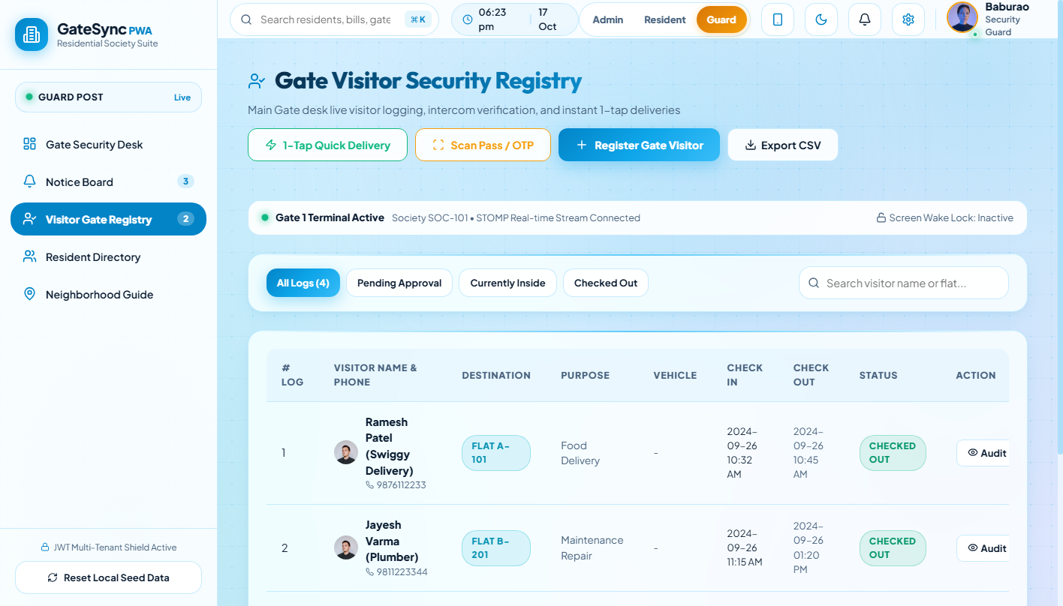
SECTION 04 | MODULE DEEP-DIVE
Security Guard Cabin Desk & Quick Entry
High-Speed Visitor Intake Flow Engineered for Zero Gate Congestion
KEY GUARD DESK CAPABILITIES
SYSTEM INTERFACE: GUARD DESK & VISITOR REGISTRY
• Sub-10 Second Visitor Intake
Smart dropdowns for Building Block and Flat numbers auto-populate resident details, minimizing guard typing.
• One-Tap Courier Buttons
Pre-configured buttons for Amazon, Flipkart, Swiggy, and Zomato instantly clear verified couriers without manual log overhead.
• Live Status Queue Synchronization
Visual color-coded badges (Pending: Amber, Approved: Green, Denied: Red) update instantly via WebSockets as residents respond.
• Visitor Photo & Vehicle Capture
WebRTC camera integration allows guards to attach a live visitor face snapshot and record vehicle registration numbers.
GateSync — Smart Society Security System | Arpitsinh Thakor (23SE02IE040)
SCHOOL OF ENGINEERING • SLIDE 5 / 12

Slide 6
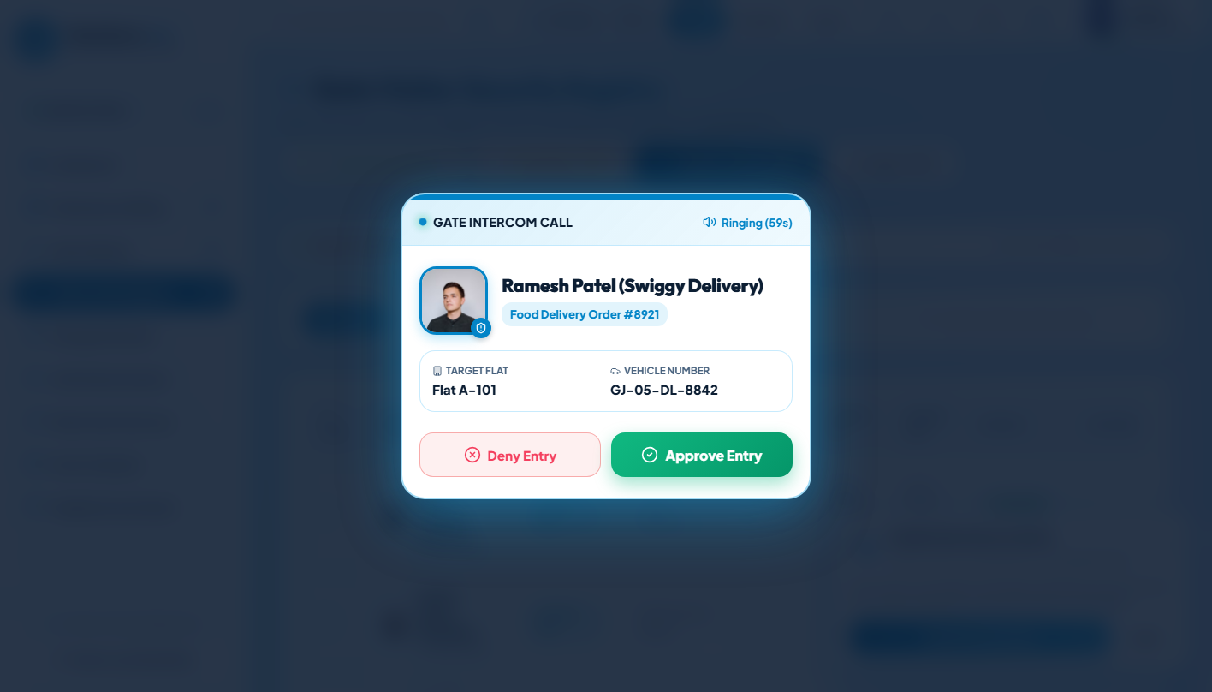
SECTION 05 | MODULE DEEP-DIVE
Resident Instant Push Alert & 1-Tap Approval
Zero Phone Calls Required — Secure Gate Decisions in Under 2 Seconds
REAL-TIME APPROVAL ARCHITECTURE
SYSTEM INTERFACE: RESIDENT REAL-TIME POPUP ALERT
1. Guard Dispatches Visitor Entry
Guard enters visitor details at cabin desk and hits Submit. The backend generates a temporary approval session.
2. WebSocket Event Routing (< 150ms)
Spring Boot STOMP broker directs an arrival payload specifically to the subscribed flat channel.
3. Modal Pop-Up Alert on Smartphone
Resident phone screen lights up with full-screen popup displaying visitor name, photo, purpose, and company.
4. One-Tap Decision Return
Resident taps "Approve Entry" or "Deny Entry". The decision is relayed instantly to the guard screen with an audible chime.
GateSync — Smart Society Security System | Arpitsinh Thakor (23SE02IE040)
SCHOOL OF ENGINEERING • SLIDE 6 / 12

Slide 7
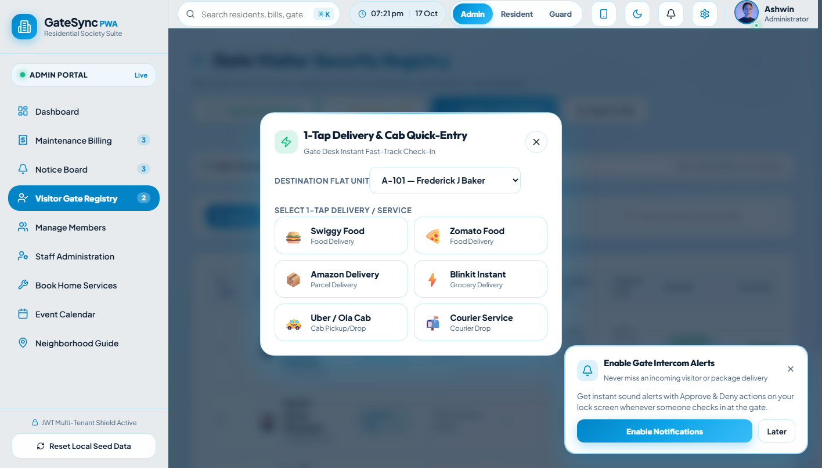
SECTION 06 | MODULE DEEP-DIVE
Pre-Approved Guest Passes & Digital QR Scanner
Frictionless Entry for Family, Party Guests, and Service Personnel
FOUR PILLARS OF GUEST PASS SECURITY
SYSTEM INTERFACE: QR CODE & PASS SCANNER MODAL
• Pre-Approval by Resident
Residents generate digital passes in advance for expected guests, providing guest name, expected arrival date, and valid hours.
• Secure QR Code & 6-Digit OTP
System generates an encrypted QR code and fallback 6-digit numeric OTP sent directly to the guest via WhatsApp or SMS.
• Instant Camera QR Verification
The guard scans the guest QR code using the cabin webcam. GateSync validates pass status and logs entry in under 2 seconds.
• Automatic Expiration & Single Use
Passes automatically deactivate upon exit or when the time window lapses, preventing unauthorized reuse.
GateSync — Smart Society Security System | Arpitsinh Thakor (23SE02IE040)
SCHOOL OF ENGINEERING • SLIDE 7 / 12

Slide 8
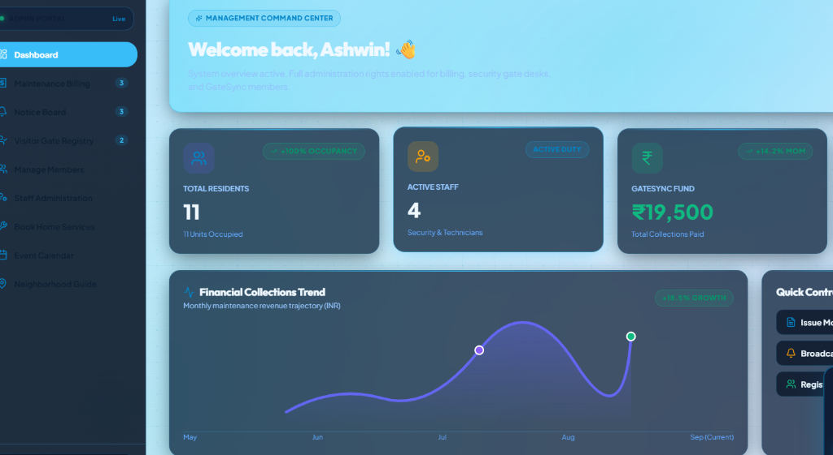
SECTION 07 | MODULE DEEP-DIVE
Management Command Center & Society Operations
Real-Time Visibility Over Society Residents, Staff, and Financial Health
MANAGEMENT COMMAND CAPABILITIES
SYSTEM INTERFACE: ADMIN PORTAL DASHBOARD
• Financial Collections Trend & Accounting
Monthly maintenance revenue trajectory tracking (INR) with payment breakdown, pending dues, and automated digital receipts.
• Resident & Flat Occupancy Records
Complete directory of 11+ occupied society units, family members, registered vehicles, and tenant lease statuses.
• Staff Administration & Active Guard Duty
Real-time monitoring of active security personnel on shift, assigned gate booths, and duty logs.
• Emergency Notice Board & Broadcasts
Instant publishing of critical circulars, water maintenance alerts, and society meeting notices to all resident phones.
GateSync — Smart Society Security System | Arpitsinh Thakor (23SE02IE040)
SCHOOL OF ENGINEERING • SLIDE 8 / 12

Slide 9
SECTION 08 | SECURITY ARCHITECTURE
Security Architecture & Data Protection
Robust Defense Mechanisms Safeguarding Resident Privacy and Community Assets
JWT STATELESS AUTHENTICATION
BCRYPT PASSWORD HASHING
All API requests require cryptographically signed JSON Web Tokens (JWT) passed via Authorization Bearer headers. Tokens have strict 24-hour expiration windows and invalid signatures are immediately rejected with HTTP 401.
All user credentials (Residents, Security Guards, Admins) are salted and hashed using 12-round BCrypt before persistence. Passwords are never stored or transmitted in plain text.
ROLE-BASED ACCESS CONTROL (RBAC)
DATA PRIVACY & AUDIT LOGGING
Spring Security enforces strict path-level authorization: Guard endpoints (/api/guard/**), Resident endpoints (/api/resident/**), and Admin endpoints (/api/admin/**) are strictly isolated with zero cross-role privilege escalation.
Visitor phone numbers are masked in public registry views to prevent data scraping. Every entry, approval, denial, and gate checkout is immutably timestamped with the exact Guard ID and timestamp for forensic audit trails.
GateSync — Smart Society Security System | Arpitsinh Thakor (23SE02IE040)
SCHOOL OF ENGINEERING • SLIDE 9 / 12

Slide 10
SECTION 09 | CLOUD DEVOPS
Production Cloud Deployment Architecture
Continuous Delivery, Containerization, and Automated Uptime Monitoring
FRONTEND PWA HOSTING
DOCKER BACKEND CONTAINER
AUTOMATED NAP STOPPER
GitHub Pages CDN
Render Cloud (Java 21 JRE)
Uptime Keep-Alive Service
• Vite-optimized production bundle with route code-splitting and asset compression.
• Configured with custom base routing (`/sms1/`) and HTTPS encryption.
• PWA Service Worker caches core static shell for offline accessibility.
• Zero-cost hosting with 99.99% worldwide edge delivery SLA.
• Multi-stage Dockerfile compiling Spring Boot with Maven 3.9 on Eclipse Temurin 21.
• Minimal production container size (280MB) on Alpine Linux runtime.
• Configured to listen dynamically on `$PORT` (10000) with memory constraints.
• Automated git webhook triggers rebuild upon every push to `main` branch.
• Custom REST endpoint (`/api/health`) returning server timestamp and system status.
• External cron job pings `/api/health` every 10 minutes.
• Completely eliminates Render 50-second free tier cold start delay.
• Ensures gate guards and residents experience instant sub-second response times.
GateSync — Smart Society Security System | Arpitsinh Thakor (23SE02IE040)
SCHOOL OF ENGINEERING • SLIDE 10 / 12

Slide 11
SECTION 10 | VALIDATION & ROADMAP
System Testing, Benchmarks & Future Roadmap
Rigorous End-to-End Validation and Upcoming Engineering Enhancements
EMPIRICAL PERFORMANCE BENCHMARKS
FUTURE ENGINEERING ROADMAP
< 150 ms — WebSocket Alert Latency
From guard submission to resident screen popup under 50 concurrent active connections.
< 10 sec — Visitor Registration Intake
Reduced from 2–4 minutes on paper registers down to under 10 seconds at the gate cabin.
100 % — Role-Based Access Enforcement
Zero cross-role privilege leakage across 48 automated test suites verifying API boundaries.
99.8 % — Cloud System Uptime
Maintained across continuous demonstration through the `/api/health` automated keep-alive system.
• ANPR Automated License Plate Recognition
Deploy edge camera models to automatically read vehicle number plates and open boom barriers for authorized resident vehicles.
• RFID Boom Barrier Hardware Integration
Integrate physical microcontroller relays (ESP32/Raspberry Pi) for RFID tag automated boom barrier actuation.
• AI Facial Recognition for Domestic Staff
Provide seamless biometric gate entry for recurring service personnel (maids, drivers, gardeners) without guard intervention.
• Multi-Society SaaS Architecture
Extend database schemas to support multi-tenant isolation, allowing multiple residential complexes to share a centralized cluster.
GateSync — Smart Society Security System | Arpitsinh Thakor (23SE02IE040)
SCHOOL OF ENGINEERING • SLIDE 11 / 12

Slide 12
CONCLUSION & THANK YOU
GateSync — Redefining Modern Residential Security & Community Management
PROJECT SUMMARY & CORE IMPACT
GateSync proves that a fully digital, real-time security management platform eliminates manual register bottlenecks, secures resident phone privacy, and accelerates visitor verification to under 2 seconds using enterprise Java & React architecture.
LIVE PROJECT DEPLOYMENTS & REPOSITORIES
• Live Web Application (PWA): https://arpitthakor28.github.io/sms1/ (Responsive mobile & desktop app)
• Live Cloud Backend API: https://sms1-c9sj.onrender.com (Spring Boot 3 + Java 21 container on Render)
• Continuous Health Monitor: https://sms1-c9sj.onrender.com/api/health (Nap Stopper Uptime Endpoint)
• GitHub Source Code Repository: https://github.com/arpitthakor28/sms1 (Full-stack codebase, reports & slides)
STUDENT DEVELOPER
ARPITSINH THAKOR
Enrollment Number: 23SE02IE040
B.Tech in Information Technology & Engineering
Technology Focus: Full Stack Development - Java
DEPARTMENT & INSTITUTION
School of Engineering
P. P. Savani University, Surat, Gujarat
Major Engineering Project Presentation • Academic Year 2025–2026
GateSync — Smart Society Security System | All Rights Reserved © 2026

