Slide 1

C++ : Foundation and Advanced with DSA by fifth force presented by Arpit Tyagi

Slide 2
ABOUT THE OGRANISATION
Fifth Force is an initiative to strengthen an individual’s skillset to make one sustain and meet the ever-changing competitive world and industry demand and in turn, enable individuals to achieve their career goal. In one word, They are trying to bridge the gap between an individual’s dream and reality. This humble educational institute was founded by someone with extensive experience in shaping students for varied Entrances
Mission & Vision
To develop young minds into confident and self-assured professionals that contribute to nation and society.
To help students realize the potential they have and make them aware of the career opportunities ahead of them.
To create an environment where students have the most ideal opportunities to learn, understand and nurture their talents.
To imbibe students with the necessary skills for succeeding in their career pursuits.

Slide 3
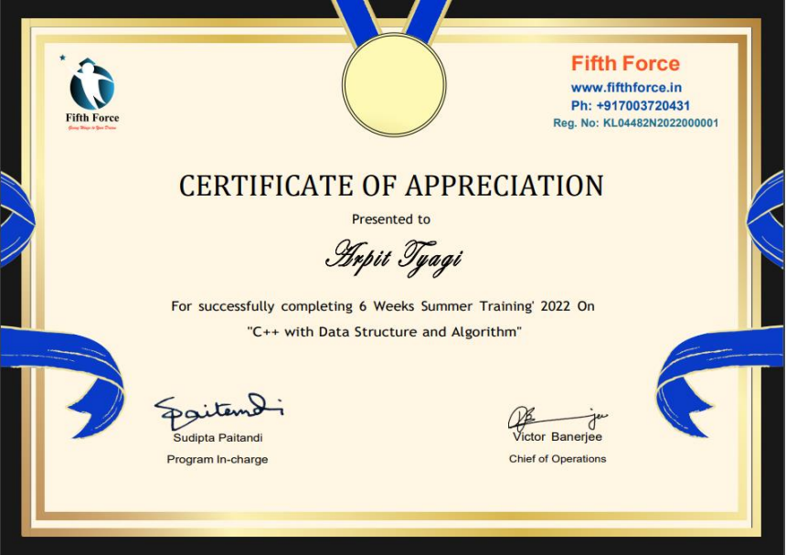
02

Slide 4
Introduction to the course
01
Foundation to C++ and basics DSA is a self-paced six-week course to learn C++ and basics Data Structures and Algorithms from the ground level, in which we have the flexibility to learn either through video lectures (live classes) or through recordings after the class ,and were given pdfs of the daily lectures with which we could study.
C++ is a general-purpose, object-oriented programming language. It was created by Bjarne at Bell Labs circa 1980. C++ is very similar to C (invented by Dennis Ritchie in the early 1970s). C++ is so compatible with C that it will probably compile over 99% of C programs without changing a line of source code. Though C++ is a lot of well-structured and safer language than C as it OOPs based. C++ is a great language to learn because Right now, C++ ranks as the 4th most popular language in the world according to the TIOBE index and the IEEE spectrum. C++ is one of the standard languages within back-end development. It’s an extremely fast and efficient language. Many tools and frameworks rely on the speed and efficiency of C++. It’s in high demand now, and it will remain in high demand in 2022 because of its reliability, performance, and efficiency

Slide 5
The name of C++ signifies the evolutionary nature of the changes from C. “++” is the C increment operator.
C++ is one of the predominant languages for the development of all kind of technical and commercial software.
C++ introduces Object-Oriented Programming, not present in C. Like other things, C++ supports the four primary features of OOP: encapsulation, polymorphism, abstraction, and inheritance.
C++ got the OOP features from Simula67 Programming language.
A function is a minimum requirement for a C++ program to run.(at least main() function)
Uses of C++ (With Real-World Applications)
Almost all the programs and systems that you use or a part of their codebase is written either in c or in c++ Be it Windows, a web browser, your favourite game, or a video editing software, the uses of C++ can be found in almost all applications today. Here are some interesting areas where C++ is popularly used.

Slide 6
C++ is used by programmers to develop computer software.
It is used to create general system software
It is used to build drivers for various computer devices
Software for servers and software for specific applications.
Used in creation of video games
Many primary user interfaces and system files of Windows and Macintosh are written using C++
Difference between C and C++
C++ was developed as an extension of C, and both languages have almost the same syntax.
The main difference between C and C++ is that C++ support classes and objects, while C does not

Slide 7
Course Content
C++ and OOPS
C++ classes and Objects
C++ inheritance and overloading
C++ polymorphism and Abstraction
C++ files and streams
C++ exception Handling and Namespaces
Introduction to Data Structures
Recursion , Arrays, String And Matrices
Linked list , stacks, Queues and trees
Sorting , hashing ,Graphs And Time-space complexity
Project

Slide 8
INTRODUCTION OF THE MINI PROJECT UNNDERTAKEN
Resort booking program [using c+ +] for Resort management system, this program is for booking rooms and any other additional facilities such food, swimming pool ,hourse riding etc. to book beforehand through online mode
The Resort Booking System is the program that allows the users to book their room online before going to resort.
We have any facilities such as in booking we can choose the date and time of booking which further it shows the details of the rooms which we have in our resort and the type of room you want you can choose according the price you want, For additional services such as swimming, arcade, horse riding and many other facilities and special discount's if we take cancelation policy before hand and not only that we also have policies such as Display all records in which we can also confirm by seeing our records of our bookings

Slide 9
OBJECTIVE: The main objective of this online Resort Booking System program is to book there room’s easily such that one can save their time, fuel and energy in waiting for them while standing in line for their booking and can do them in just in minutes. The program consists of home page for which consist every single detail about the resort and the process of booking the rooms, food, and additional swimming, arcade, horse riding.
Working:
The Project works by taking the Customers booking details, and many other details, such as date of check in and date of check out, the types of room they want, in case they want to cancel the room they have cancelation facilities.
The costumer can easily register and book the room by just giving some basic details such as check-in and check-out time of the booking, the type of room they want to book.
And if they want any add Onn's to that they can add by additional services
This program is user friendly as this program is designed such that every one can use this progarm
:

Slide 10
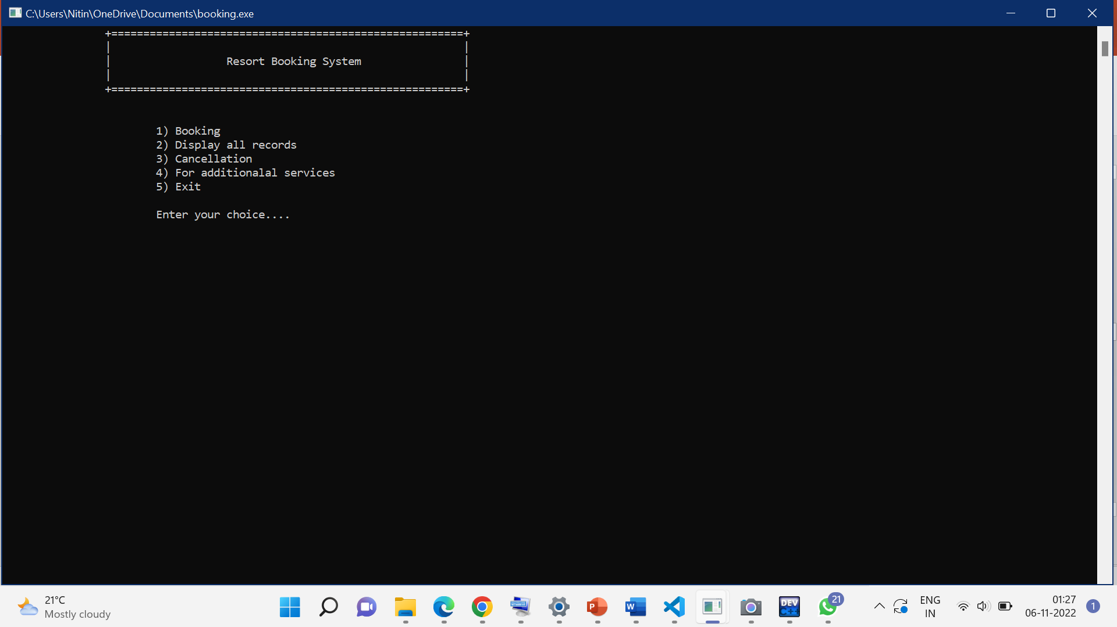
HOMEPAGE OF THE PROGRAM

Slide 11
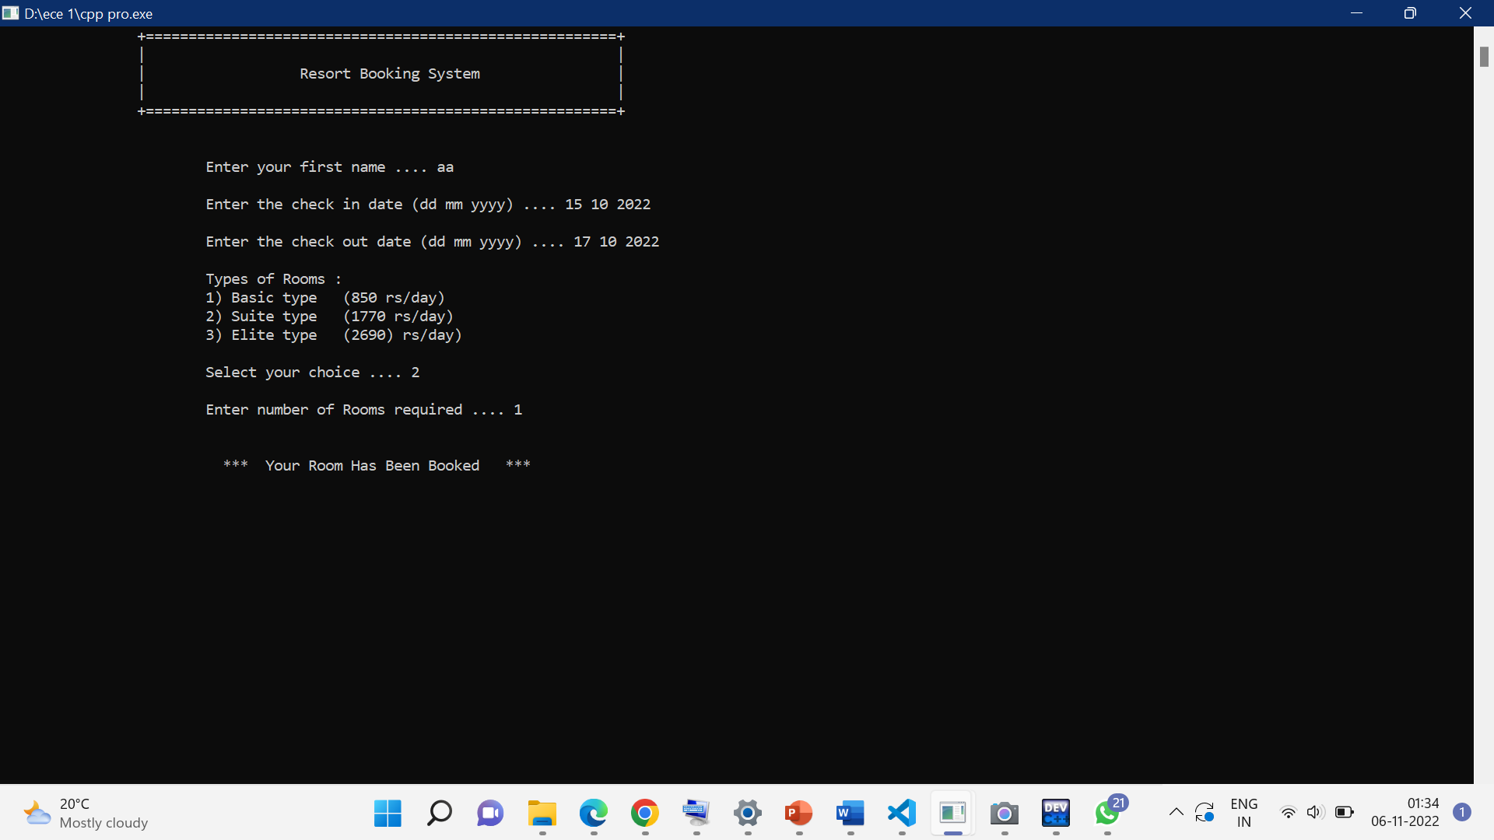
WHEN CHOOSE OPTION AS 1[FOR BOOKING ] THIS PAGE OPENS
IN THE BOKING SYSTEM F
1 WE HAVE TO TYPE OUR NAME
2 WE HAVE TO GIVE THE CHECKIN AND CHECK OUT DATE MONTH AND YEAR
3 WE HAVE TO CHOOSE THE TYPE OF ROOM WE WANT
ROOM IS SUCCESFULLY BOOKED

Slide 12
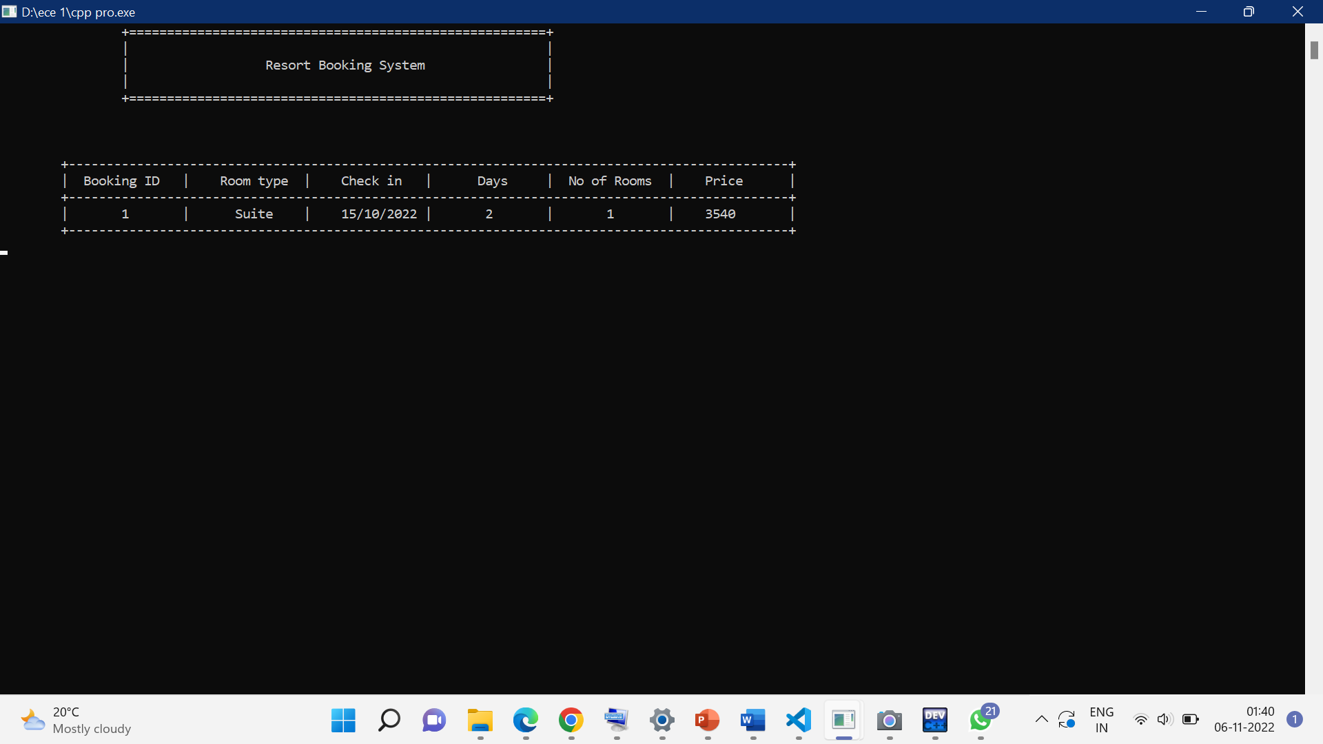
AFTER SUCCSESFUL BOOKING THEN THIS PAGE APPEARS THE DETAILS OF THE ROOM WHICH WE HAVE BOOKED ,BY PRESSING ENTER THIS EXITS

Slide 13
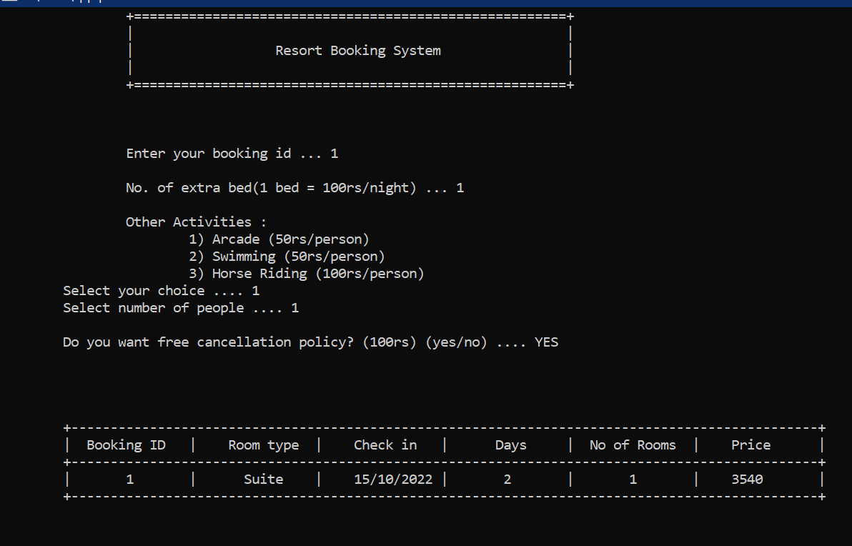
WHEN WE CHOOSE FOR ADDITIONAL SERVICES THIS PAGE OPENS
1 WE HAVE TO TYPE THE BOOKING ID
2 TYPE THE NUMBER OF BEDS YOU WANT EXTRA
3 CHOOSE FROM THE GIVEN OPTIONS IF YOU WANT ANY OTHER
4 WE GET THE DETAILS OF THE ROOM INCLUDUNG THE ADDITIONAL SERVICES

Slide 14
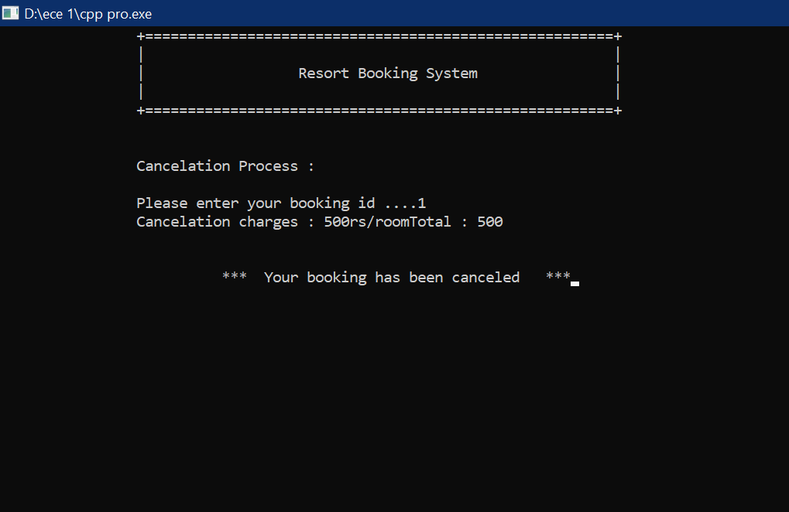
IF WE CHOOSE FOR CANCELATION PROCESS THEN THIS PAGE OPENS
1. WE SHOULD GIVE THE BOOKING ID
2.WE CAN SEE THE CANCELATION CHAEGES

Slide 15
THANK YOU

