Slide 1

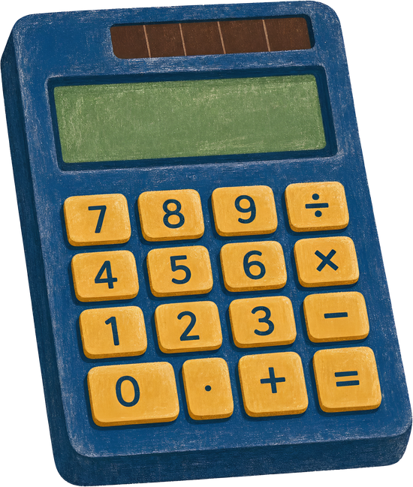
CalcSuite Pro Calculator
A multi-purpose desktop application for calculations,conversions and everyday utility tasks.
NEXTHIKES IT SOLUTIONS
Presented by: Arpit Vats
01

Slide 2
01 | PROJECT OBJECTIVES
What the project aims to achieve
The objectives below are reflected in the application's implemented modules and workflows.
Consolidate tools
Make tasks accessible
Bring several frequently used calculators and converters into one desktop application.
Offer a graphical, tab-based interface rather than requiring users to run separate scripts.
Support flexible inputs
Present understandable results
Accept multiple units, date formats through separate fields, and mathematical expressions.
Show formatted outputs, categories, conversion tables, history and visual indicators.
Improve reliability
Stay responsive
Validate inputs and provide clear feedback for invalid expressions, values and dates.
Keep the interface usable while live currency data is being fetched.
CALCSUITE PRO | PROJECT PRESENTATION
02

Slide 3
02 | PROJECT OVERVIEW
One application. Five practical tools.
CalcSuite Pro brings common calculation and conversion tasks into a single desktop interface.
5 modules
Python
CalcSuite Pro is a Python desktop application built with Tkinter. Its tab-based interface groups five utilities in one place, allowing users to move between mathematical, health-related, date and conversion tasks without opening separate tools.
Distinct tools in one app.
Core programming language.
Tkinter
Tabbed UI
Desktop graphical interface.
Simple module navigation.
The project focuses on usability, practical functionality and clear result presentation.
CALCSUITE PRO | PROJECT PRESENTATION
03

Slide 4
03 | APPLICATION STRUCTURE
Five modules at a glance
Each tab is designed around a specific everyday use case.
01
Scientific calculator
02
BMI calculator
03
Currency converter
Arithmetic, trigonometry, logarithms, statistics and memory.
Body Mass Index from metric or imperial measurements.
Multi-currency conversion with offline and live-rate modes.
04
Unit converter
05
Age calculator
Conversions across physical and digital measurement categories.
Exact age and elapsed time between two dates.
CALCSUITE PRO | PROJECT PRESENTATION
04

Slide 5
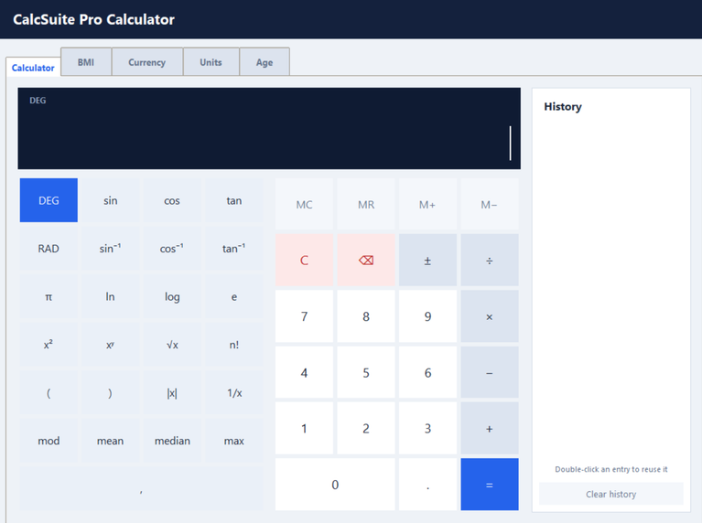
04 | CORE FUNCTIONALITY
Scientific calculator
Designed for basic arithmetic as well as more advanced mathematical expressions.
Arithmetic
Scientific functions
Convenience tools
Addition, subtraction, multiplication, division, modulo and powers.
Trigonometry, inverse trigonometry, logarithms, roots, factorials and constants π and e.
DEG/RAD modes, memory controls, previous answer (ans), expression history and recall.
Implementation highlight
Expressions are parsed with Python's Abstract Syntax Tree (AST). A whitelist of approved operators and functions is used instead of unrestricted eval(), helping limit what user-entered expressions can execute.
CALCSUITE PRO | PROJECT PRESENTATION
05

Slide 6
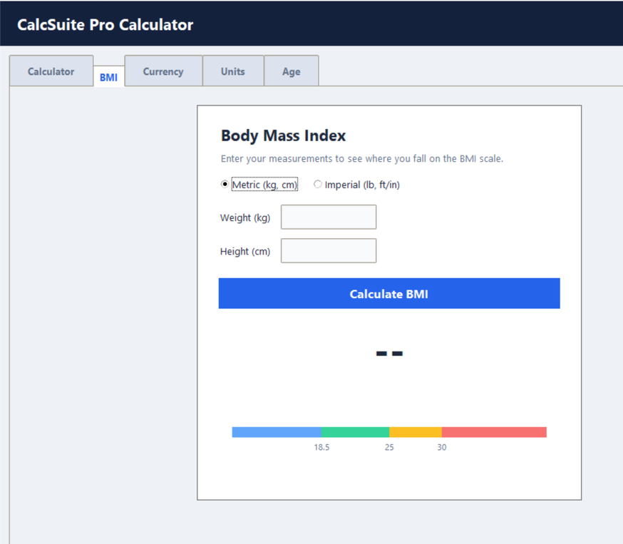
05 | CORE FUNCTIONALITY
BMI calculator
A guided input flow converts height and weight into a BMI result and category.
Flexible measurements
Instant calculation
Visual feedback
Metric: kilograms and centimetres. Imperial: pounds, feet and inches.
BMI is calculated as weight in kilograms divided by height in metres squared.
Displays BMI category, a coloured scale and an estimated healthy-weight range for the entered height.
BMI = weight (kg) ÷ [height (m)]²
The BMI result is an informational indicator, not a medical diagnosis.
CALCSUITE PRO | PROJECT PRESENTATION
06

Slide 7
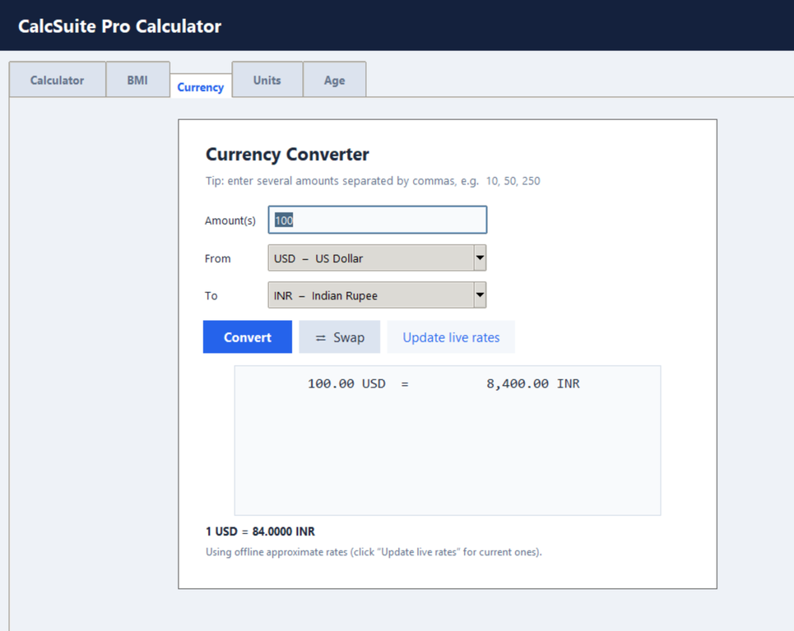
06 | CORE FUNCTIONALITY
Currency converter
Converts one or several amounts between supported currencies.
Multi-amount input
Currency selection
Rate update
Accepts multiple amounts separated by commas, semicolons or spaces, and can display a combined total.
Provides currency codes and names, with a swap control to reverse the conversion direction.
Uses stored approximate fallback rates offline and can request updated rates from an external exchange-rate API.
Technical note
The network request runs in a background thread. A queue and Tkinter's scheduled polling keep the interface responsive while the rate request completes.
CALCSUITE PRO | PROJECT PRESENTATION
07

Slide 8
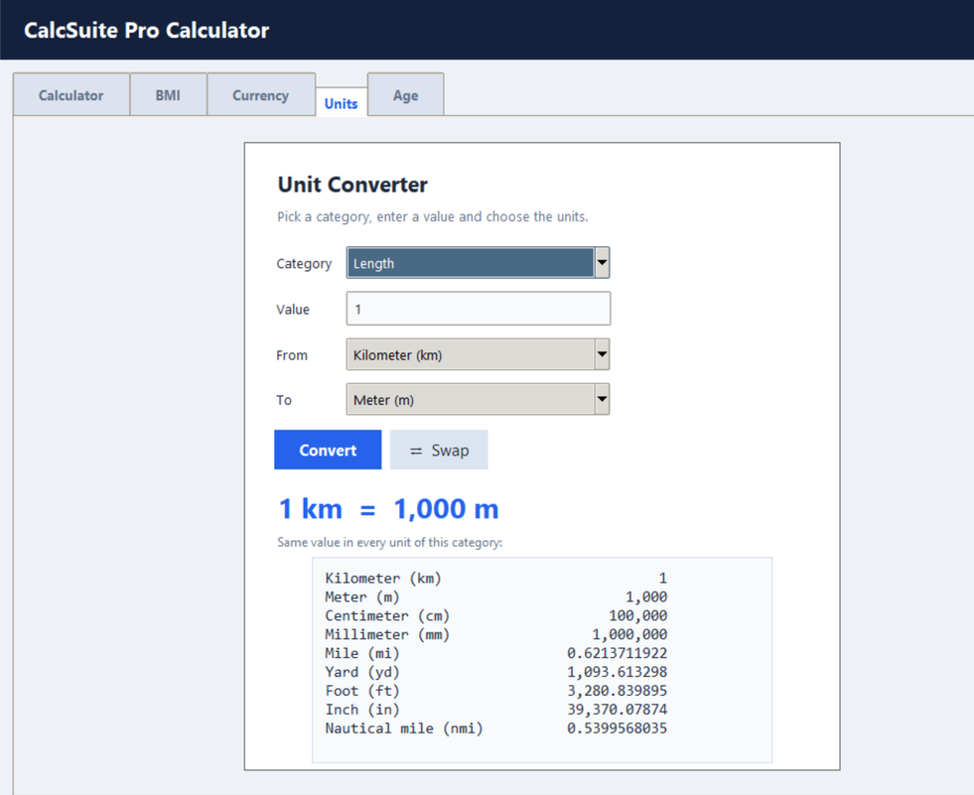
07 | CORE FUNCTIONALITY
Unit converter
A category-based conversion tool with a common input pattern.
Length
Mass
Area
Volume
Speed
Time
Data
Energy
Pressure
Temperature
How it works
For most categories, each unit is represented by a factor relative to a base unit. The input is converted to the base unit and then from the base unit to the selected target unit. Temperature uses dedicated Celsius-based formulas because it is not a simple scale-factor conversion.
CALCSUITE PRO | PROJECT PRESENTATION
08

Slide 9
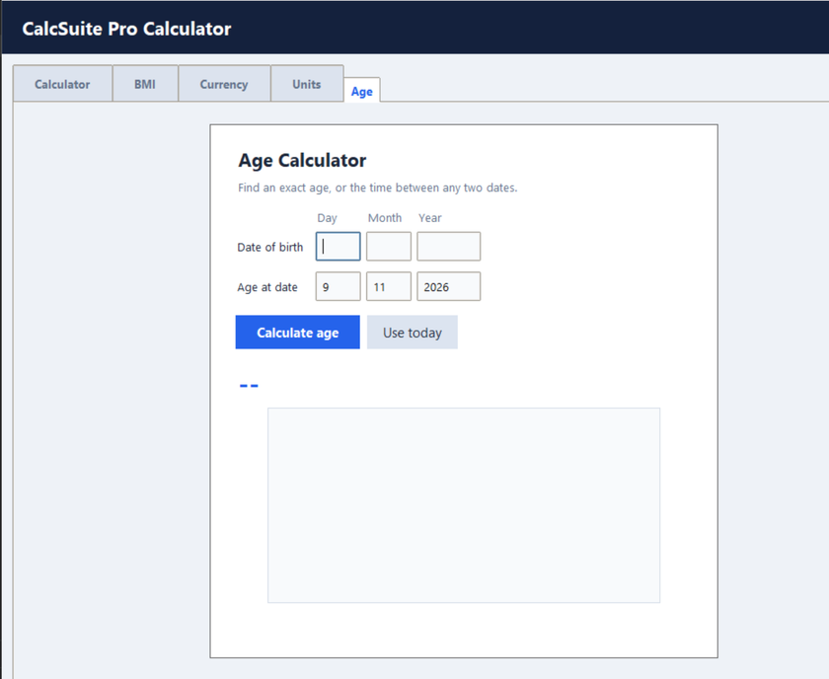
08 | CORE FUNCTIONALITY
Age calculator
Calculates age precisely between a date of birth and a selected reference date.
Date-based input
Detailed output
Date awareness
Users enter day, month and year for both the birth date and the comparison date.
Shows years, months and days, plus total months, weeks, days, hours and minutes.
Includes a Use Today shortcut, next-birthday countdown and birthday message.
Special date handling
The add-months helper adjusts the day when the target month has fewer days—for example, moving from 31 January into February. This helps handle month-end and leap-year cases consistently.
CALCSUITE PRO | PROJECT PRESENTATION
09

Slide 10
09 | TECHNICAL IMPLEMENTATION
Technology and application flow
The code combines Python's standard libraries with Tkinter for the desktop interface.
USER INPUT
→
MODULE LOGIC
→
CALCULATION
→
RESULTS
Buttons, fields,
selectors and dates
Five independent
feature tabs
Math, formulas,
conversions, dates
Formatted output,
messages and history
Key libraries and components
• tkinter and ttk — windows, widgets, tabs and layouts
• ast, operator, math and statistics — safe expression processing and calculations
• datetime and calendar — date arithmetic and age calculations
• urllib.request, threading and queue — live currency-rate retrieval without blocking the UI
CALCSUITE PRO | PROJECT PRESENTATION
10

Slide 11
10 | DEVELOPMENT CHALLENGES
Difficulties faced during development
The following challenges are evident from the logic required by the implemented features.
Expression safety
Input validation
Supporting flexible mathematical input while restricting execution to approved operations and functions.
Handling incomplete expressions, invalid numbers, division by zero and impossible dates.
Conversion accuracy
Live API handling
Managing different base units, floating-point values and temperature's non-linear formulas.
Dealing with network delays or failures while keeping the desktop interface responsive.
Date edge cases
Interface complexity
Calculating elapsed age across varying month lengths, leap years and birthday boundaries.
Arranging multiple controls and result areas while maintaining a consistent, usable layout.
CALCSUITE PRO | PROJECT PRESENTATION
11

Slide 12
11 | RELIABILITY AND CONSIDERATIONS
How the application handles errors
Practical safeguards are built into the calculation and conversion workflows.
Validation
Error feedback
Fallback behaviour
Checks numeric inputs, positive BMI measurements, valid dates and valid currency amounts.
Displays messages for invalid expressions, division by zero, unsupported input and API failures.
Retains approximate stored currency rates if live rate retrieval is unavailable.
Important limitations to communicate
Offline currency values are approximate and may become outdated. Live conversion depends on network access and the external API. BMI should be interpreted as a general screening measure, not a clinical assessment.
CALCSUITE PRO | PROJECT PRESENTATION
12

Slide 13

12 |
CONCLUSION
A practical toolkit,
built as one application.
CalcSuite Pro combines scientific calculations, BMI, currency conversion, unit conversion and age calculation in a single Python desktop interface. The project demonstrates GUI development, modular programming, input validation, mathematical logic, date handling and basic API integration.
CALCSUITE PRO | PROJECT PRESENTATION
13

