Slide 1

DAYANANDA SAGAR UNIVERSITY
SCHOOL OF ENGINEERING
Department of Computer Science and Engineering
Major Project Stage-II
IDENTIFICATION OF IMAGES USING CBIR WITH KERAS
Under the Supervision of
Prof. Amrithavalli. M
Presented By:
Arpit Kumar (ENG19CS0042)
Ashutosh Mishra (ENG19CS0050)
B Vijay Kumar Kakra (ENG19CS0059)
Dheeraj Kumar (ENG19CS0085)

Slide 2
Overview
Abstract
Problem Statement
Introduction
Social/Environment Impact
State of the Art work
Design
Deliverables
References

Slide 3
Abstract
Today’s world is digital with the appearance of many devices that are used in image acquisition. Nowadays, it becomes easy to store huge amounts of images by using image processing techniques. Since the collection of images and databases is fast and is increasing day by day, there is a need for new image retrieval techniques that should be eﬃcient and fast.
Content-based image retrieval (CBIR) is a widely used technique for retrieval images from huge and unlabeled image databases. However, users are not satisfied with the traditional information retrieval techniques. Moreover, the emergence of web development and transmission networks and also the amount of images which are available to users continue to grow.
Therefore, a permanent and considerable digital image production in many areas takes place. Hence, the rapid access to these huge collections of images and retrieving similar images of a given image(or Object) from this large collection of images presents major challenges and requires efficient techniques.

Slide 4
Problem Definition
Identification of Images and Objects is a problem of identifying and detecting real time images and Objects.
It is easy to find and detect objects with high accuracy in various Domains(Automated Vehicles, medical imaging, object identification in satellite images, traffic control systems, brake light detection, machine vision, and more.)
EXAMPLE :-
Problem: “Detecting and Classifying Images & objects of real time data.”
Solution: Advanced CNN, CBIR

Slide 5
Introduction
Image classification is a classical problem of image processing, computer vision and machine learning fields.
It is one of the hot research directions in computer vision field, and it is also the basic image classification system in other image application fields, which is usually divided into three important parts: image preprocessing, image feature extraction and classifier
Recently, image classification is growing and becoming a trend among technology developers especially with the growth of data in different parts of industry such as e-commerce, automotive, healthcare, and gaming. The most obvious example of this technology is applied to Facebook.
The classification problem is to categorize all the pixels of a digital image into one of the defined classes.
Image classification is the most critical use case in digital image analysis.
Image classification is an application of both supervised classification and unsupervised classification

Slide 6
Social/Environmental Impact
Privacy concerns: ML algorithms can be trained on large datasets of images, which may contain personal information about individuals. If these images are not properly anonymized, there is a risk of privacy breaches and data misuse.
Bias: ML algorithms are only as good as the data they are trained on. If the training data contains biases, the resulting algorithm may also be biased. This can result in unfair outcomes and discrimination against certain groups.
Environmental impact: The training of ML algorithms requires large amounts of computing power, which can have environmental impacts due to the energy consumption of data centers. Additionally, the production of hardware required for these computations can also have environmental impacts

Slide 7
Inaccuracy: ML algorithms for image classification can sometimes produce inaccurate results, which can have negative consequences. For example, misclassification of medical images could lead to misdiagnosis and incorrect treatment.
Lack of transparency: ML algorithms can be difficult to interpret, which can make it challenging to understand how decisions are being made. This lack of transparency can make it difficult to identify and address biases in the algorithm.

Slide 8
State of the Art-work
Author’s Name/ Paper Title | Conference/Journal Name and year | Technology/ Design | Results shared by author | What you infer
[1] Image Classification Using Deep Learning | 2017 International Journal of Engineering Research & Technology (IJERT) | convolution neural network(CNN), Artificial Neural Network (ANN), Deep Learning and CUDA technology | uses CNN for extracting and selecting the features for any given image and classify the images into appropriate classes with high accuracy | Convolution Neural Networks are a good choice for Image Classification. Further this system can be extended for applications such as biometric recognition
[2] Image Classification using Deep learning | 2018 International Journal of Engineering & Technology (IJET) | AlexNet architecture with CNN, Deep Learning, Image Classification, ImageNet, Machine Learning | we observed that the images are classified correctly even for the portion of the test images | The convolutional neural network is used in AlexNet architecture for classification purpose gives more accurate result.

Slide 9
State of the Art-work
Author’s Name/ Paper Title | Conference/Journal Name and year | Technology/ Design | Results shared by author | What you infer
[3] Research on image classification model based on deep convolutional neural network | EURASIP Journal on Image and Video Processing (2019) | Based on the analysis of the error backpropagation algorithm and to obtain maximum interval minimum classification error Convolution neural network, Image classification, M3 CE-CEc are used. | In order to avoid explicit feature extraction, the CNN uses feature detection layer to learn from training data implicitly, and because of the weight sharing mechanism, neurons on the same feature mapping surface have the same weight. | The use of ZCA whitening to process the image data, makes all pixels have the same mean value and variance, eliminates the white noise problem in the image, and eliminates the correlation between pixels and pixels.
[4] A study on Image Classification based on Deep Learning and Tensorflow | INTERNATIONAL CONFERENCE ON INNOVATIVE COMPUTING AND COMMUNICATION (ICICC 2019) | Two main techniques, Image classification and DNN | flowers showed up to 90% accuracy in terms of implementation of the system of image classification by using DNN. | input data mainly focuses in flowers category, epochs in DNN was able to control accuracy and also prevent any problems such as overfitting

Slide 10
State of the Art-work
Author’s Name/ Paper Title | Conference/Journal Name and year | Technology/ Design | Results shared by author | What you infer
[5] Tensorflow Based Image Classification using Advanced Convolutional Neural Network | International Journal of Recent Technology and Engineering (IJRTE) (2020) | Advanced CNN with Tensorflow Framework | Advanced CNN are very faster in comparison to other, it take very less time for classification with over 95% accuracy rate. | DNN was not accurate and in CNN validation loss is high which causes overfitting, so Advanced CNN was used.
[6] Image Classification Using Convolutional Neural Network | International Journal of Emerging Trends in Engineering Research (2020) | Computer Vision, Supervised Classifier, Unsupervised Classifier, Image Classification | CIFAR-10 dataset. This dataset contains 60000 training images of size 32*32 in 10 classes, Out of which 50000 are training images and the remaining 10000 are testing images | For image classification a system that itself can extract features efficiently and classify them is used. Convlayers to extract features and max pooling to decrease the size of image, increases accuracy.

Slide 11
State of the Art-work
Author’s Name/ Paper Title | Conference/Journal Name and year | Technology/ Design | Results shared by author | What you infer
[7] Image Classification Using CNN | INTERNATIONAL CONFERENCE ON INNOVATIVE COMPUTING AND COMMUNICATION (ICICC 2021) | CNN, Curvelet transform, Quality Assessment, Image Classification, CBIR | used cifar-10 dataset classes and then applied CNN technique on 3 classes and obtained 94 percent validation accuracy | CNN techniques are been used to perform different operations and based on the computational power
[8] Image Classification Using Machine Learning and Deep Learning Model | International Journal of Emerging Trends in Engineering Research (2020) | Image, Dog ,Cat, Classification, Relu, SoftMax, Pooling, Machine Learning. Two main Technology DNN, ANN | Result model with lowest loss in validation is used (0.55) with accuracy 0.78 in validation images, achieved the best classification accuracy of 88.31 % | with the optimal parameter settings of the proposed architecture, Training the CNN with various epochs and with restricted layers demonstrated the constrained space for further change in test accuracy.

Slide 12
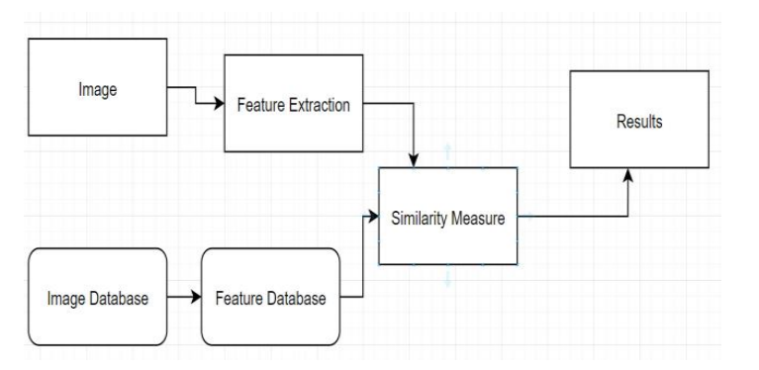
Design
Image Extraction Process

Slide 13
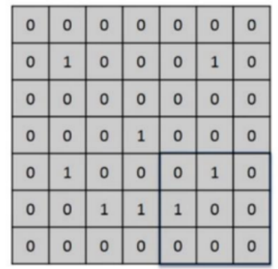
What the Computer See’s

Slide 14
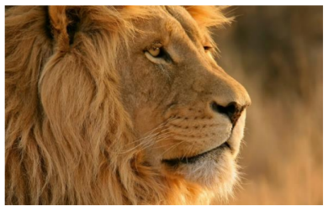
What we see

Slide 15
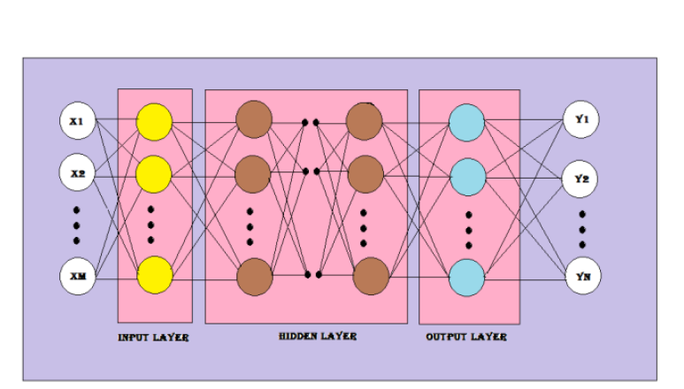

Slide 16
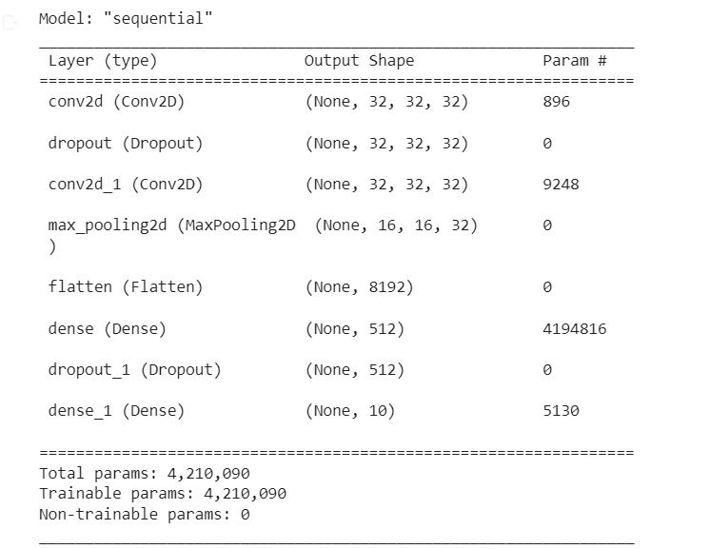
Implementation & Testing.

Slide 17
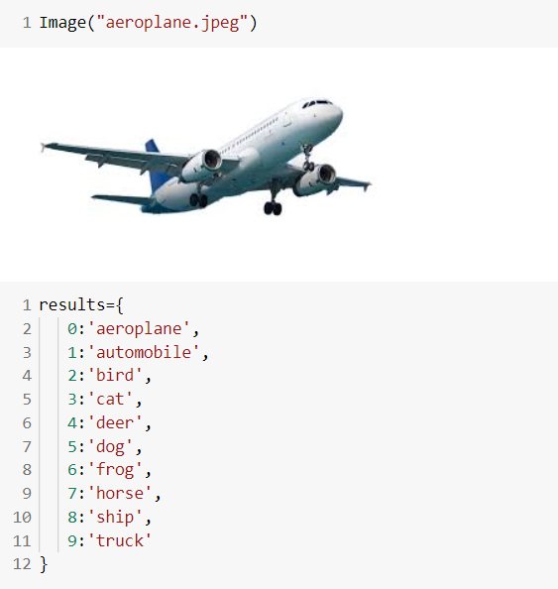


Slide 18
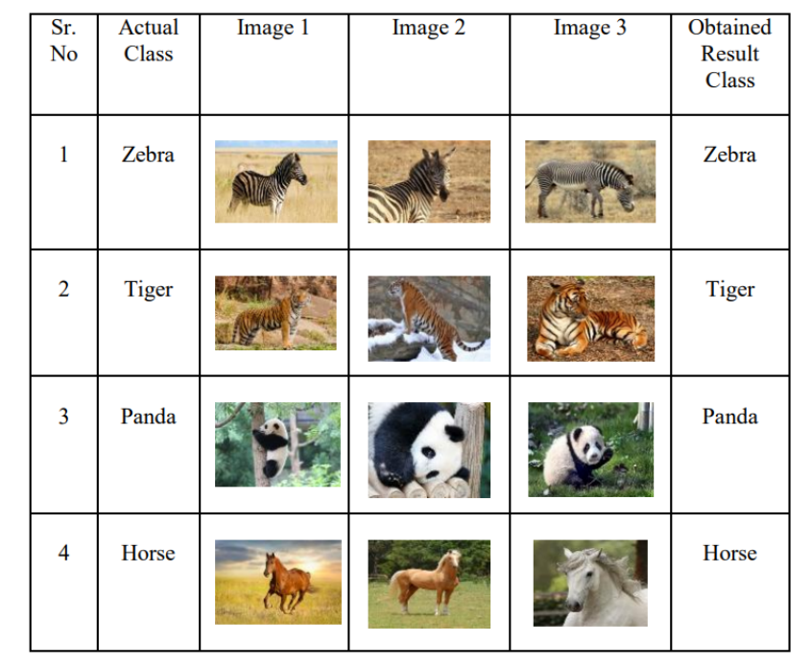

Slide 19
Results.
There are several tests conducted from this trained model. To prove trained model works, prediction done in a computer which is used in training using new test images Result model with lowest loss in validation is used (0.93) with accuracy 0.85 in validation images.
We also compared our system with two existing CBIR systems, and our system out performed both of them in terms of accuracy and efficiency.

Slide 20
Conclusion.
In conclusion, in this project, we proposed a CBIR system that uses CNNs to extract features from images and Machine Learning Techniques to retrieve similar images. Our experiments showed that the proposed CBIR system performs well on a large dataset of images and outperforms existing CBIR systems in terms of accuracy and efficiency. The proposed system can be extended to other datasets and can be used in various applications such as image retrieval, image search engines, and multimedia databases.

Slide 21
Deliverables
A complete application with the GUI in python will be able to identify and classify objects be it a living or non-living thing which will be useful in future for prediction of objects coming in front of Automatic vehicles, Geostationary satellites etc.

Slide 22
References
[1] Bharadi, D. V. A., Mukadam, A. I., Panchbhai, M. N., & Rode, N. N. (2017). Image classification using deep learning. International Journal of Engineering Research and Technology, 6.
[2] Krishna, M. M., Neelima, M., Harshali, M., & Rao, M. V. G. (2018). Image classification using deep learning. International Journal of Engineering & Technology, 7(2.7), 614-617.
[3] Xin, M., & Wang, Y. (2019). Research on image classification model based on deep convolution neural network. EURASIP Journal on Image and Video Processing, 2019(1), 1-11.
[4] Kumar, P., & Dugal, U. (2020). Tensorflow Based Image Classification using Advanced Convolutional Neural Network. International Journal of Recent Technology and Engineering (IJRTE), 8, 994-998.
[5] Sharma, A., & Phonsa, G. (2021, April). Image Classification Using CNN. In Proceedings of the International Conference on Innovative Computing & Communication (ICICC).
[6] Lakshmi, K. P., Solanki, M., Dara, J. S., & Kompalli, A. B. (2020). Video genre classification using convolutional recurrent neural networks. International Journal of Advanced Computer Science and Applications, 11(3).
[7] Abu, M. A., Indra, N. H., Rahman, A. H. A., Sapiee, N. A., & Ahmad, I. (2019). A study on Image Classification based on Deep Learning and Tensorflow. International Journal of Engineering Research and Technology, 12(4), 563-569.
[8] Ramprasath, M., Anand, M. V., & Hariharan, S. (2018). Image classification using convolutional neural networks. International Journal of Pure and Applied Mathematics, 119(17), 1307-1319.
[9] Sinchana, K. R., & Kunte, S. R. (2022). Image Classification Using Machine Learning And Deep Learning Model (No. 8118). EasyChair.

Slide 23
Thank You

