Slide 1


Build a Personalized Online Course Recommender System with Machine Learning
Anthony R. Poggioli
19 September 2024

Slide 2

Outline
Introduction and Background
Exploratory Data Analysis
Content-based Recommender System using Unsupervised Learning
Collaborative-filtering based Recommender System using Supervised learning
Conclusion
Appendix

Slide 3
Introduction
AI Training Room is a startup offering massive open online courses (MOOCs) in AI, data science, machine learning, cloud development, et cetera. This firm would like to enhance growth, engagement, and learner satisfaction by developing a course recommendation system.
The goal of this project is to develop a memory-based and a model-based recommendation system. These systems will be deployed on separate user segments, and engagement and satisfaction will be measured for the purposes of A/B testing.
The model-based system will be trained on course ratings and evaluated based on its ability to accurately reproduce test ratings.

Slide 4

Exploratory Data Analysis

Slide 5
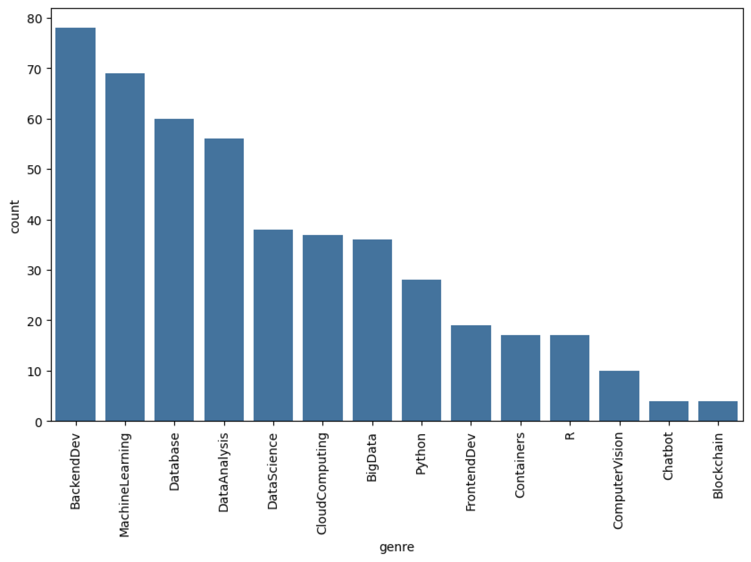
Course counts per genre
This plot shows a bar chart of the number of courses associated with each genre, providing us an indication of the distribution and relative popularity of different course genres.

Slide 6
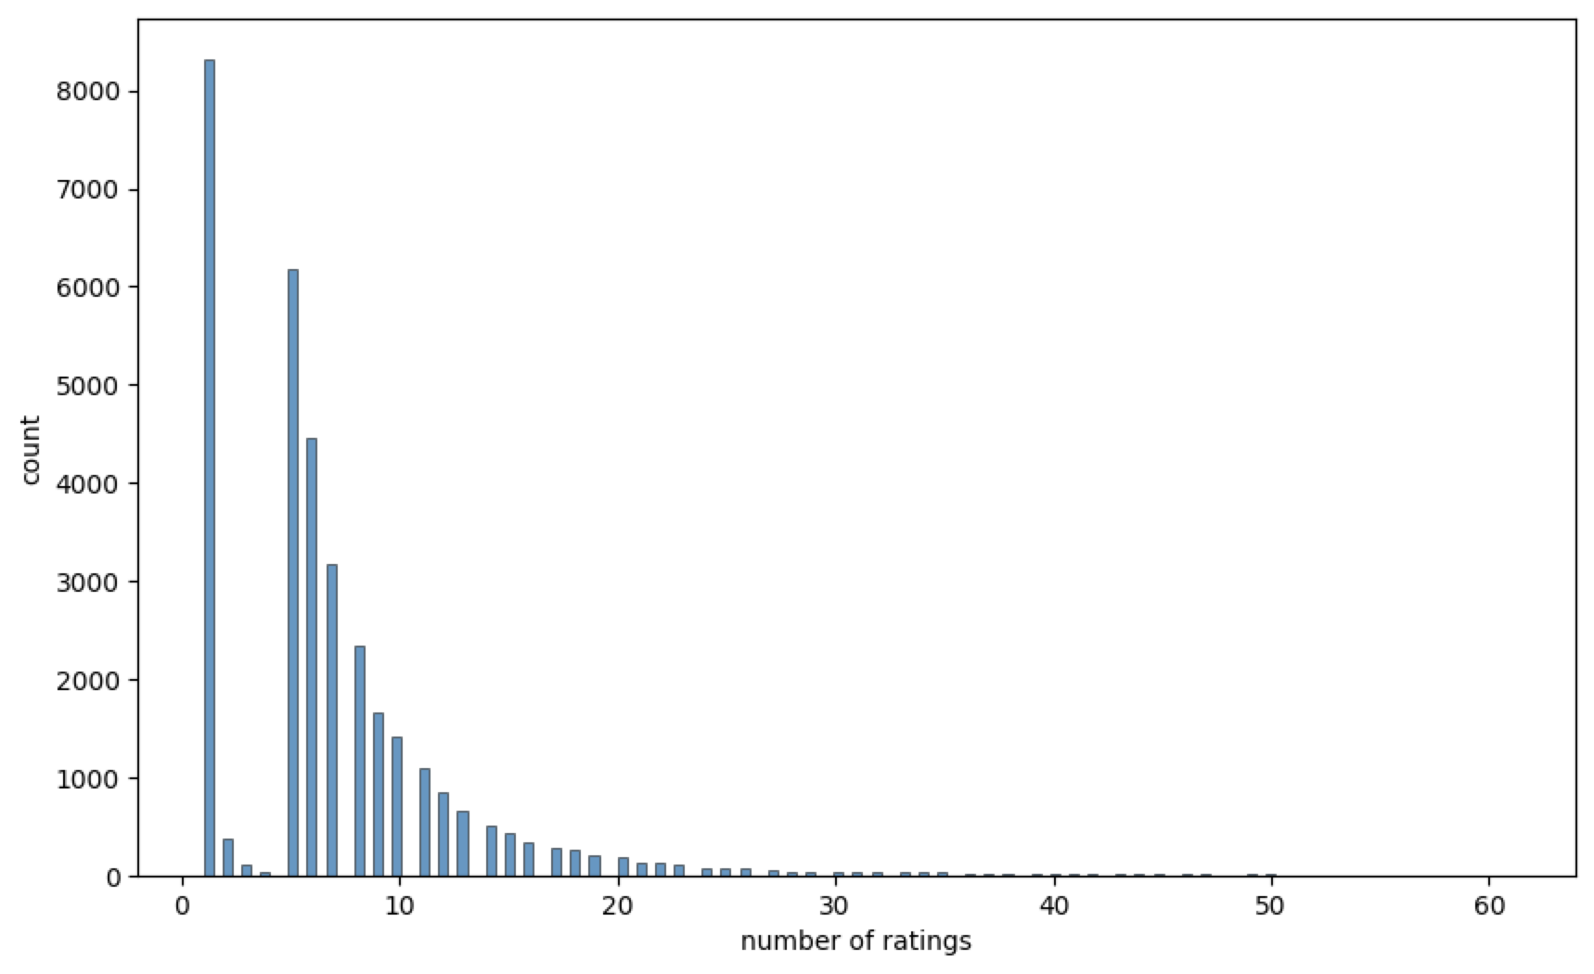
Course enrollment distribution
This plot shows a histogram of the number of ratings provided by users, which is equal to their number of enrollments. We see two peaks – the first is associated with a large number of users with one enrollment. There is a second peak at five enrollments with an exponential decay as enrollments increase – likely associated with full-time students.

Slide 7
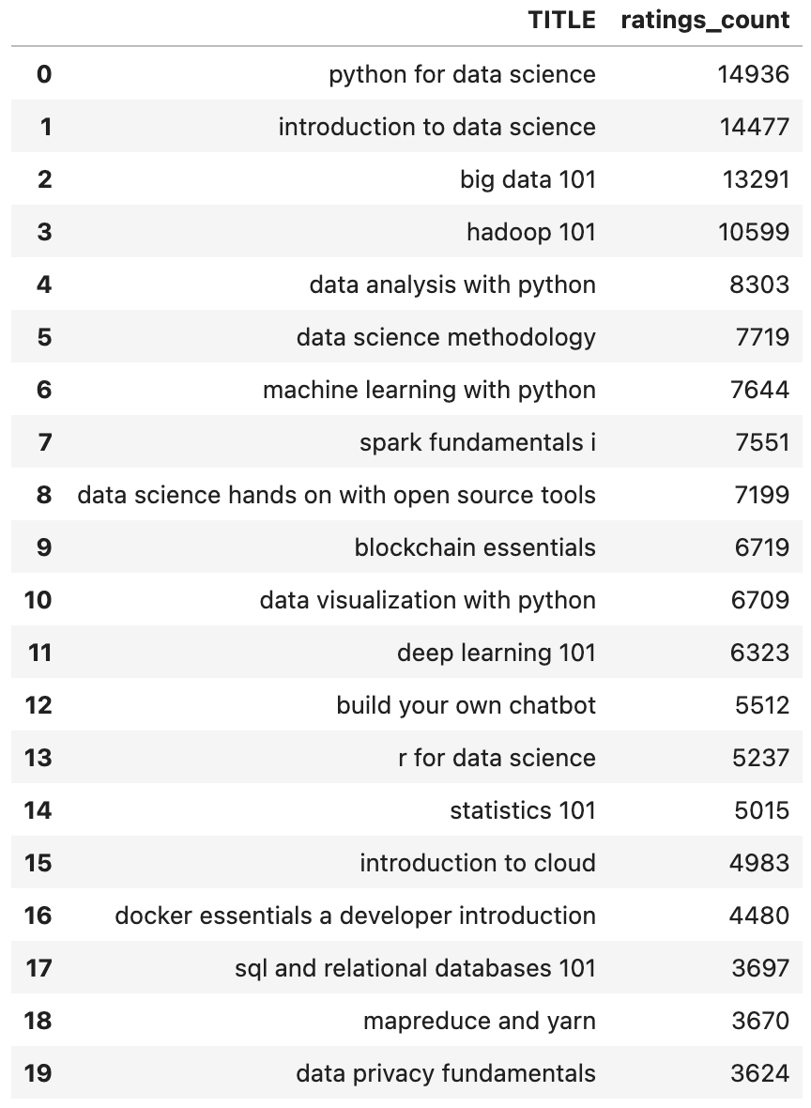
20 most popular courses
This list shows the 20 most popular courses by enrollment, including both the course title and the total number of times the course was rated (equal to the number of course enrollments).

Slide 8
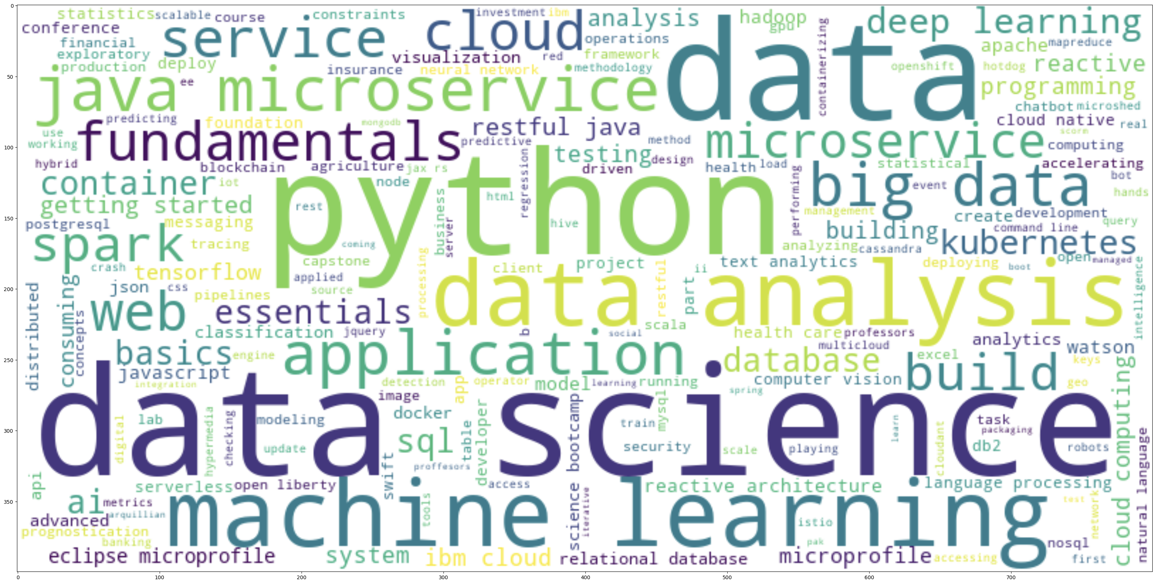
Word cloud of course titles
This is a word cloud generated based on the course titles in the system. The word sizes are determined by the frequency with which they appear in course titles.

Slide 9
Content-based Recommender System using Unsupervised Learning
Cluster2
Cluster1

Slide 10
User profile and course genres recommender system
This is a simple, deterministic algorithm in which predicted ratings are calculated as the inner product of user profile and course genre vectors. Course recommendations are then returned based on these calculated ratings and according to a minimum threshold, adjusted such that ers are recommend 5-6 courses on averaged

Slide 11
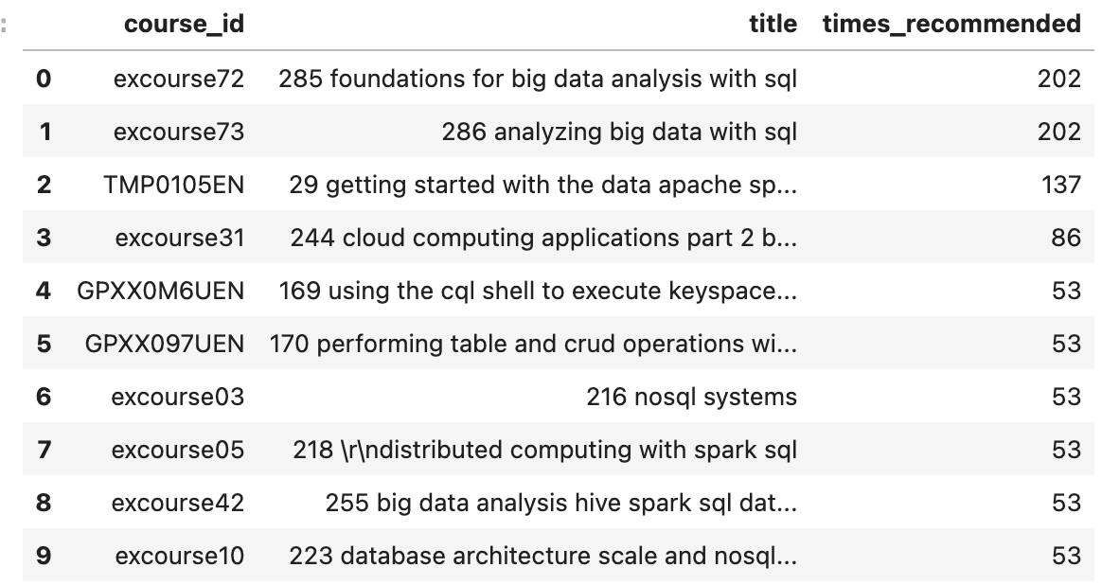
Evaluation results of user profile-based recommender system
The only hyperparameter of this model is the score threshold for recommending courses; this was adjusted to result in 5-6 course recommendations/user on average, resulting in a value of 95.
The score threshold was adjusted to result in approximately 5.5 course recommendations/user on average.
10 most commonly recommended courses:

Slide 12
Course similarity recommender system
Course similarity is determined based on a bag-of-words analysis of the course titles and descriptions. A TF-IDF vector is calculated for each course, and this is then embedded using a pre-trained word embedder, Word2Vec. Course similarities are then calculated based on cosine similarity in this latent feature space, and this is used to construct a course similarity matrix.
Recommendations are returned based on the similarity of unseen courses to the courses a user has previously enrolled in. There is a minimum threshold for course similarity that is again adjusted such that the algorithm returns 5-6 course recommendations.

Slide 13
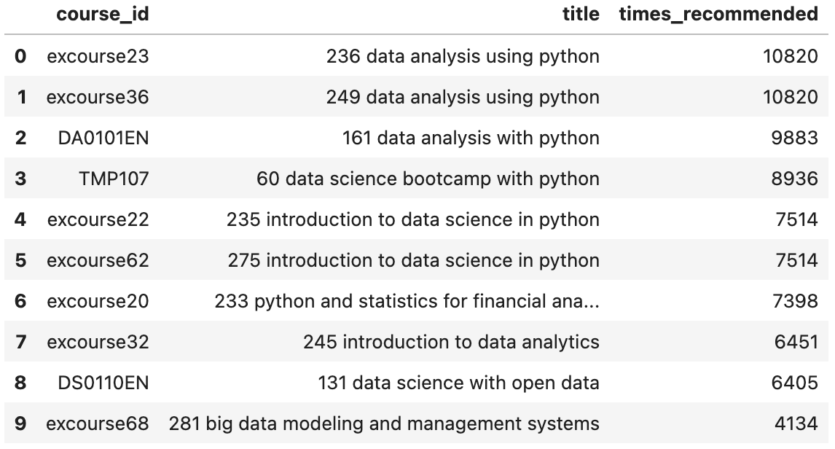
Evaluation results of course similarity based recommender system
The only hyperparameter of the model was the minimum similarity to recommend a course. This was adjusted to 0.47.
Adjusting the minimum similarity score to 0.47 resulted in 6.2 course recommendations/user on average.
10 most commonly recommended courses:

Slide 14
Clustering-based recommender system
PCA analysis is first used to reduce the dimensionality of a user profile matrix. K-means clustering is then performed on this reduced-dimension dataset.
Courses common across clusters are identified and ordered based on the total number of enrollments. An enrollment threshold is then specified to ensure that 5-6 courses are recommended to users on average.

Slide 15
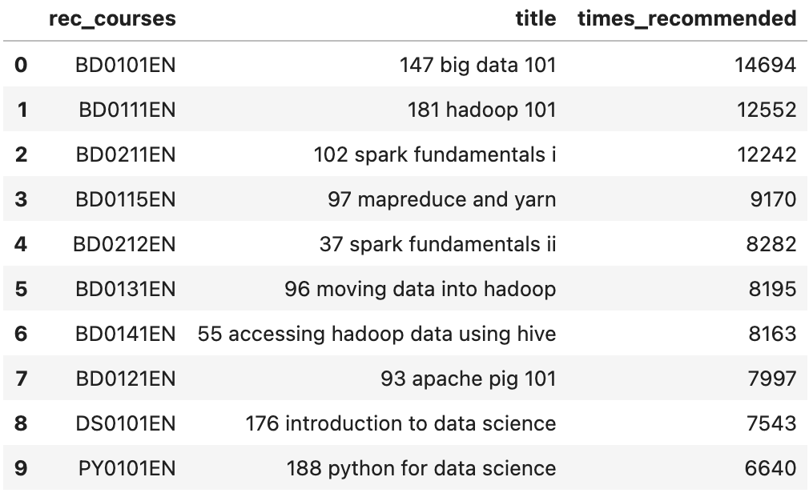
Evaluation results of clustering-based recommender system
The original data frame contained 14 features. Clustering was performed using k-means with k = 20 clusters on the first 9 principal components (explaining roughly 92.7% of the total variance in the data). Course recommendations were thresholded based on enrollment, with a minimum enrollment of 400 required for a course to be recommended.
10 most commonly recommended courses:
The hyperparameters detailed above resulted in an average of 5.9 course recommendations/user.

Slide 16
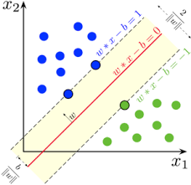
Collaborative-filtering Recommender System using Supervised Learning

Slide 17
Model-based/collaborative filtering recommendation systems
Three model-based recommendation systems are trained on course ratings with the purpose of predicting how users will rate unseen courses.
The first two are collaborative filtering systems based on the user-item interaction matrix: an item-based k-nearest-neighbors algorithm and a non-negative matrix factorization algorithm.
The third model is a neural network trained on embedded representations of user profile and course description vectors.

Slide 18
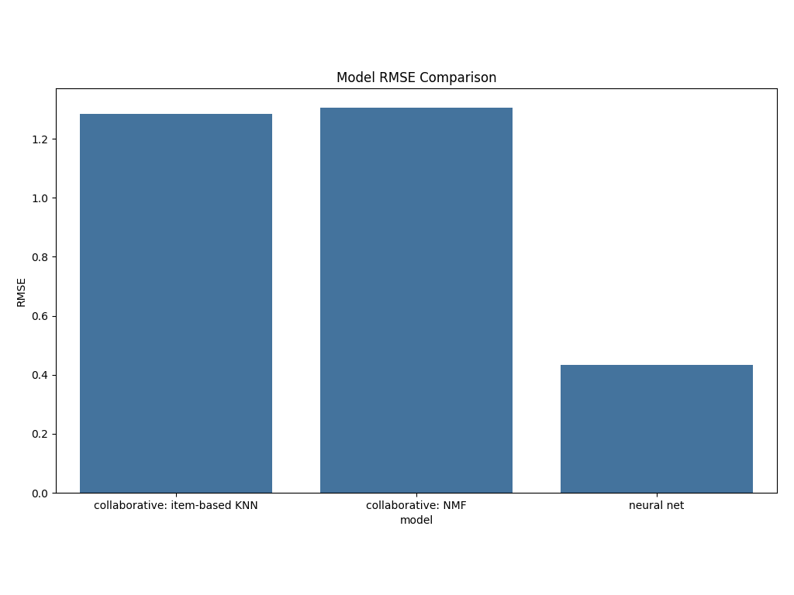
Compare the performance of collaborative-filtering models
This bar chart indicates the performance of three tune models: an item-based k-nearest-neighbors (KNN) collaborative filtering model, a non-negative matrix factorization (NMF) collaborative filtering model, and a neural network model based on user and item embeddings.
Performance is indicated by root-mean-squared error in course ratings predictions.
As we can see, the neural network model strongly outperforms the KNN and NMF models

Slide 19
Conclusions
User-profile-, course-similarity-, and clustering-based recommendation systems will need to be validated/calibrated based on user engagement and satisfaction metrics.
The neural network model for predicting course ratings outperforms both (optimized) collaborative filter models. If a model-based approach is taken, it should be neural-network-based.
The neural network model presented here is a proof of concept. The model should likely undergo additional fine-tuning to improve test performance.

Slide 20
Appendix
GitHub repository containing all Jupyter Notebooks associated with this capstone project can be found at https://github.com/arpogg24/arpogg24.github.io/tree/main/machine-learning/IBM-Machine-Learning/capstone

