Slide 1
ChainForge
A Platform for Rapid Blockchain Creation
CSE542 : Introduction to Blockchain
Group - IBC04
Team members
Arth Patel AU2340023
Akshat Patel AU2340053
Jay Shah AU2340069
Jainik Patel AU2340042
Notes:
“Good morning/afternoon. We are presenting our project ChainForge, which is a platform for creating customizable blockchain systems. In this presentation, we will explain our problem, design approach, and planned implementation.”

Slide 2
Problem Statement
Blockchain systems provide immutability, transparency, and cryptographic integrity.
However, developing a blockchain solution requires deep expertise in distributed and decentralised systems, networking, cryptography, and security.
As a result:
Blockchain adoption remains limited.
Many real-world use cases avoid blockchain due to complexity.
Developers must build infrastructure from scratch.
Hence, there is a need for a system that simplifies blockchain creation while preserving its core guarantees.

Slide 3

Motivation
Technological progress happens when developers build on existing foundations instead of starting from scratch.
The knowledge gap discourages the use of blockchain in practical systems.
Our motivation is to lower the entry barrier and enable developers to use blockchain as an infrastructure component.
By simplifying blockchain creation, we aim to encourage innovation and real-world adoption.
Notes:
Most developers understand web systems and databases, but not blockchain internals. This makes blockchain adoption difficult. Our motivation is to provide a reusable foundation so that developers can focus on solving real problems instead of learning low-level blockchain concepts.

Slide 4
Example Use Case: Certificate Verification System
Stakeholders
University → Issues certificates
Student → Receives certificate
Company / Employer → Verifies certificate
Smart Contracts:
Issuer Authorization Contract
Maintains list of approved universities
Allows only them to append certificates
Certificate Registry Contract
Stores certificate hashes
Tracks status (active / revoked)
Verification Contract
Provides verifyCertificate() function
Returns validity + proof
Blockchain Structure:
{
Index
Timestamp
Event Data
Previous Hash
Current Hash
Issuer ID
}
Notes:
To explain our platform, we use a certificate verification example. Universities issue certificates, students receive them, and companies verify them. Today, verification is manual and trust-based. A blockchain can store immutable issuance records, allowing instant verification.
In this use case, smart contracts can be used to ensure that only authorized universities issue certificates and that all records follow a fixed format. The blockchain stores certificate hashes, while companies can verify records through smart contracts. However, legal validation remains outside the blockchain.

Slide 5
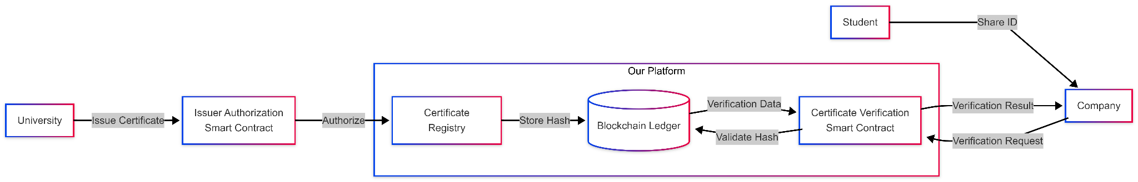
Example Use Case: Certificate Verification System
Developer’s Logical flow
User’s Logical flow
Notes:
ChainForge guides the developer through a structured workflow. The user selects architecture, defines roles and permissions, and configures optional smart contracts. Based on this input, the platform generates a ready-to-deploy blockchain package that runs on the user’s infrastructure.

Slide 6
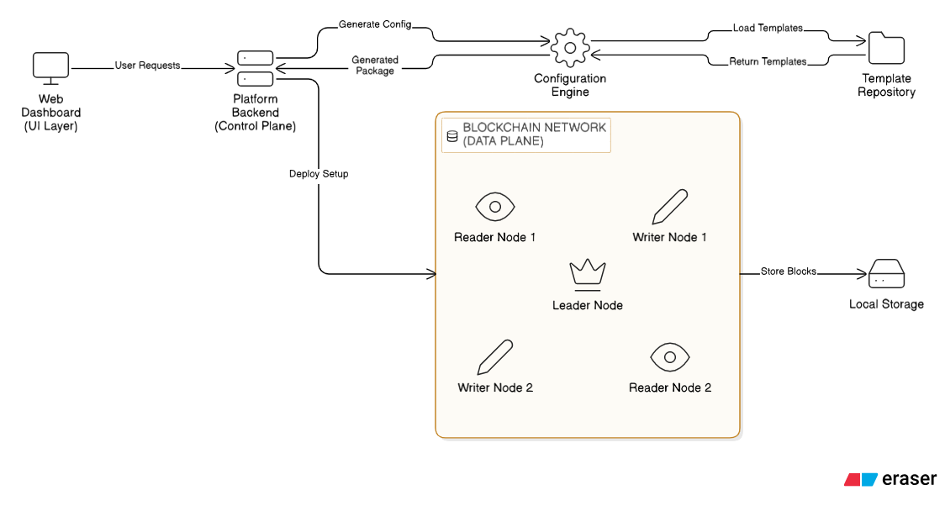
General System Architecture
Architecture
Notes:
This project is divided into two parts: the control plane and the data plane.
The control plane consists of the web dashboard, the platform backend, and the configuration engine.
The configuration engine fetches templates from the template repository and generates a configuration package based on user-defined settings. A template is a blueprint that defines how many nodes exist, their roles, and system behavior.
The generated setup is deployed into the data plane. The data plane consists of multiple nodes with different responsibilities.
In this case the template defines that there are 2 reader nodes & 2 writer nodes along with one leader node so the Writer nodes submit new records, the leader node is responsible for ordering and committing those records, and reader nodes independently verify and store the finalized blocks.
Each node maintains its own append-only storage. This ensures that records cannot be modified once written, and consistency is maintained across nodes.
Q: Is the blockchain here centralised?
Ans: The ordering mechanism is centralized through the leader, but storage and verification are distributed across independent nodes.
1️⃣ “Why do you need a leader node?”
Safe answer:
“The leader ensures a consistent order of records when multiple writers exist. Without ordering, conflicting entries could occur.”
That’s enough. Don’t mention consensus algorithms unless asked.
2️⃣ “What happens if the leader fails?”
Safe answer:
“In the current design, the leader is a single point of ordering. Future versions can implement leader election for fault tolerance.”
You show awareness but don’t overclaim.
3️⃣ “If writers exist, why not let them write directly?”
Answer:
“Allowing multiple writers to commit independently can cause conflicting histories. The leader enforces a single consistent sequence.”
Simple. Logical.
4️⃣ “How do reader nodes verify blocks?”
Answer:
“Reader nodes independently check record integrity by validating the linkage between records and ensuring ordering consistency before storing them.”
No math explanation needed unless asked.
5️⃣ “Why separate control plane and data plane?”
Answer:
“Separating orchestration from record execution improves modularity and scalability. The control plane manages configuration, while the data plane handles execution and storage.”
That sounds architect-level.
6️⃣ “Why use templates?”
Answer:
“Templates allow us to define different system structures without modifying backend logic. This enables rapid and flexible deployment.”
That ties directly to your architecture.
7️⃣ “Is this fully decentralized?”
Answer:
“No, this design prioritizes controlled ordering with distributed verification rather than full decentralization.”
Very mature answer.
8️⃣ “What prevents a malicious leader from cheating?”
Safe answer:
“Because reader nodes independently verify record integrity, inconsistencies would be detectable. However, leader trust assumptions depend on deployment mode.”
This is a smart, honest answer.
9️⃣ “Isn’t this just a distributed database?”
This one is tricky.
Say:
“It is a distributed system, but it enforces append-only storage and ordered record linkage, which prevents silent modification of historical data.”
That differentiates you without buzzwords.
🔟 “Why not remove the control plane and hard-code everything?”
Answer:
“The control plane allows dynamic configuration and scalable deployment without changing application logic.”
That reinforces design thinking.
🎯 Most Important One
If someone asks:
“What makes this a blockchain?”
Say:
“The system maintains an ordered, append-only history where each record references the previous one, making tampering detectable.”
Stop there.
That is the safest definition.
🧠 Final Advice
If you ever feel unsure:
Always bring answers back to:
Ordering
Append-only storage
Independent verification
Separation of concerns
Those four pillars defend your entire architecture.
If you want, I can now:
Simulate a mini viva with you
Give rapid-fire questions
Or help you craft perfect confident tone answers
Just say the word 🔥
our architecture is divided into two parts. The control plane handles blockchain creation and configuration, while the data plane handles actual blockchain execution. ChainForge generates deployment packages but does not store blockchain data
1. An API server (FastAPI)
2. A ledger engine
3. A block data model
4. A hash-linking mechanism
5. A rule engine (contracts)
6. A database that never overwrites data
This architecture is divided into two main parts: a control plane and a data plane.
The control plane consists of the web dashboard, the platform backend, and the configuration engine. The dashboard is only responsible for user interaction. All logic and orchestration happen in the platform backend.
The configuration engine generates system-specific configurations from predefined templates. These templated basically describe the blockchain to be created, for example a centralized blockchain with 1 writer node and multiple reader nodes.
These templates describe how many nodes exist, their roles, and system rules. This allows the system to be configured without changing backend code.
Once a configuration is generated, the platform backend deploys it into the data plane. Nodes join the system using a secure registration process, where they authenticate using a secret key and receive their configuration dynamically.
The data plane consists of multiple nodes. One node acts as the leader and appends new records, while reader nodes independently verify and store the same history. Each node maintains its own append-only storage.
This separation ensures that control and configuration are isolated from record storage and verification, making the system scalable and tamper-evident.

Slide 7









Technologies and Tools
Frameworks &
Libraries
Development Programming language
Database
Version Control & Scalability
Smart contracts
Hashing
SHA-256
Notes:
Q why didnt u use etheruim
Ethereum is designed for public, permissionless networks where participants are unknown and untrusted. Our system targets permissioned environments, such as institutions or enterprise use cases, where participants are identified and governed by defined policies.
Using Ethereum would introduce unnecessary complexity, including gas mechanisms, public consensus, and virtual machine execution. Our goal is to design a configurable, application-oriented ledger framework rather than deploy on a public cryptocurrency network

Slide 8
MVP (Minimal Viable Product)
Network Architecture
Public (Permissionless) Blockchains
Permissioned (Private / Consortium) Blockchains
Centralized Architecture (Single Leader)
Distributed / Decentralized Architecture (Multiple Writers)
Consensus
Proof of work (Pow)
Proof of Stake (Pos)
RAFT
PBFT
Smart Contract Support
Dynamic smart Contract code blocks
Notes:
Our platform supports both public and permissioned blockchains. Public blockchains are fully decentralized, while permissioned blockchains can operate in centralized or distributed modes. All architectures share core blockchain properties such as immutability, validation, and auditability.

Slide 9
MVP (Minimal Viable Product)
Synchronization
Block Propagation Mechanism
Out-of-Order Block Buffering
Missing Block Recovery (Syncing)
Node Rejoining Support
Access & Participation
Role-Based Read/Write Permissions
Node Admission Control (Permissioned Mode)
Open Participation (Public Mode)

Slide 10
Conclusion And Expected Outcomes
Conclusion
ChainForge simplifies blockchain creation.
It abstracts low-level complexity.
It supports multiple architectures.
It enables real-world applications.
Expected Outcome
By the end of the project:
A working blockchain creation framework
Support for all the above mentioned functionalities.
Create a demo blockchain to demonstrate use of the platform.

Slide 11
Thank you

