Slide 1

Genome Arithmetic with bedtools
Aaron Quinlan
quinlanlab.org
University of Virginia
https://github.com/arq5x/bedtools
Notes:
Wed. Jun 26.
Rm 204
5:00-5:13

Slide 2
What is a genome “interval”?
Genes: exons, introns, UTRs, promoters
Conservation
Genetic variation
Transposons
Origins of replication
TF binding sites
CpG islands
Segmental duplications
Sequence alignments
Chromatin annotations
Gene expression data
…
Your own observations: put them in context

Slide 3
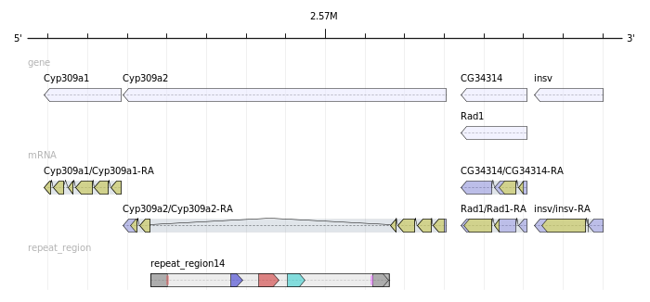
Genome “intervals”

Slide 4

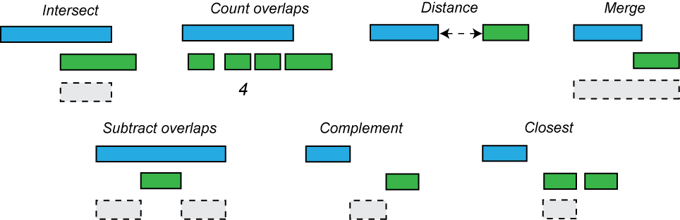
bedtools: a Swiss army knife for “genome arithmetic”
Many complex analyses can be reduced to genome arithmetic
Notes:
For those not familiar, bedtools is a suite of utilities for analyzing and comparing genomics datasets. It is comprised on multiple subtools for intersection, merging, etc. The idea is that each tool is itself simple and fast. Complex analyses can be conducted through
Clever combinations of multiple tools. In many cases, complex analyses can be reduced to a recipe of genome arithmetic tasks. You are the chef, bedtools has the ingredients to get you 90% of the way. Plots, a simple script at the end.

Slide 5
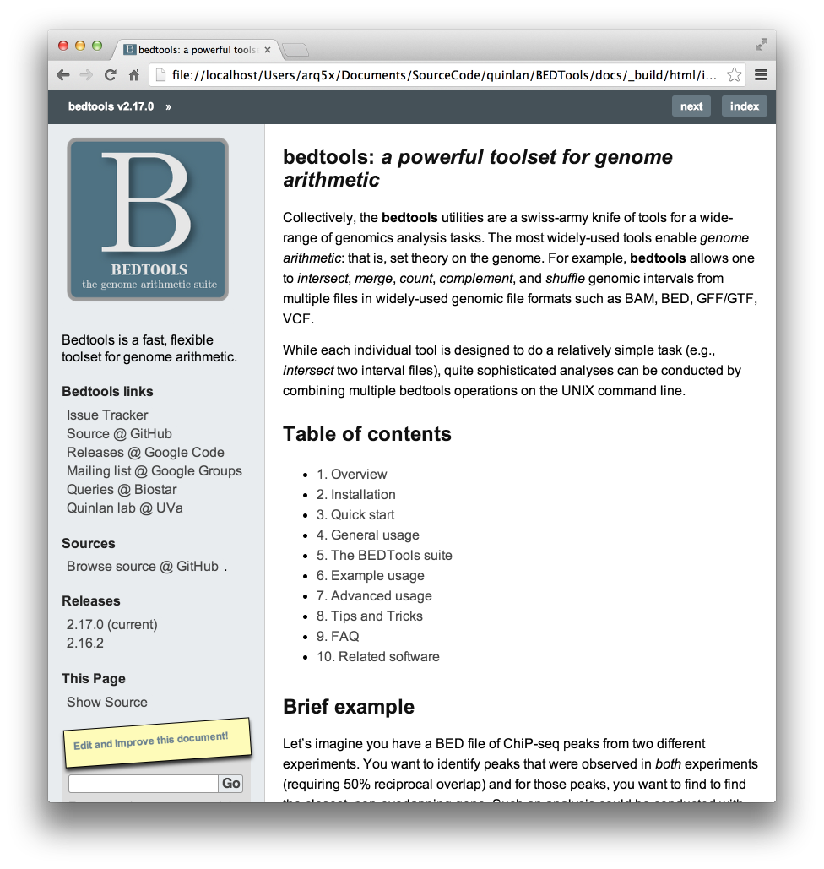
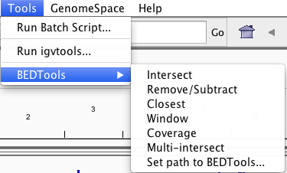
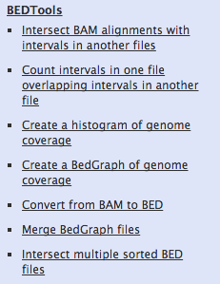
Improve ease of use, and reproducibility
Integrated into IGV
Docs: users can edit and comment.
bedtools.rtfd.org
In Galaxy Toolshed
> 100 Unit tests
Active mailing list
Notes:
One of our goals over the last year has been to further improve the ease of use, correctness and reproducibility of of bedtools.
To this end, bedtools is now:
1. Built into the IGV browser thanks to a great collaboration with the IGV team.
2. Available in the Galaxy toolshed.
We have also released an extensive documentation site, added 100s of tests to ensure correctness, and maintain an active mailing list for support.

Slide 6
Answerable questions
Closest gene to a ChIP-seq peak.
Is my latest discovery novel?
Is there strand bias in my data?
How many genes does this mutation affect?
Where did I fail to collect sequence coverage?
Is my favorite feature significantly correlated with some other feature?

Slide 7
An annoying wealth of formats
Standard attributes
BED
BEDGRAPH
WIG
GFF
VCF
SAM/BAM
…
chrom
start position
end position
name / label
score / value
strand
other
No standards: Some formats use 1-based coordinates, while others use 0-based

Slide 8
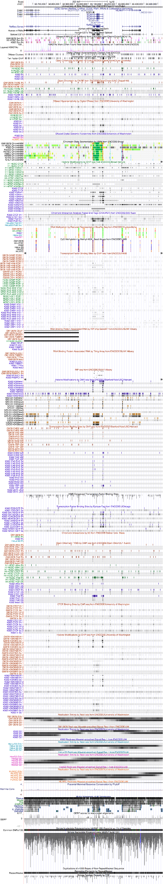
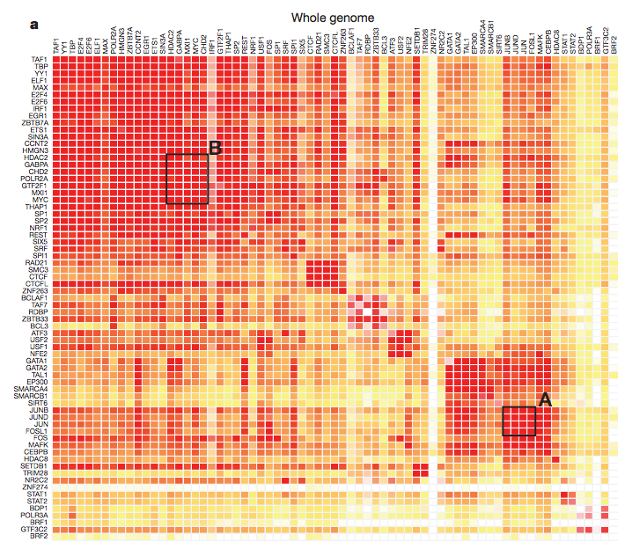
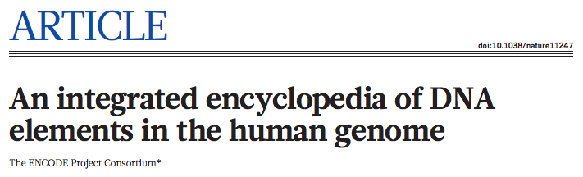
Reduce this...
... to this
Notes:
In other words, we need a toolbelt of computational and statistical methods for reducing complex, highly dimensional datasets to metrics that facilitate visualization and comparison.

Slide 9
Improve ease of use, and reproducibility
Integrated into IGV
Docs: users can edit and comment.
bedtools.rtfd.org
In Galaxy Toolshed
> 100 Unit tests
Active mailing list
Notes:
One of our goals over the last year has been to further improve the ease of use, correctness and reproducibility of of bedtools.
To this end, bedtools is now:
1. Built into the IGV browser thanks to a great collaboration with the IGV team.
2. Available in the Galaxy toolshed.
We have also released an extensive documentation site, added 100s of tests to ensure correctness, and maintain an active mailing list for support.

Slide 10






One Many formats that rule us all.
BED+
G[T|F]F
VCF
BAM
BIGWIG
(future)
API and code infrastructure have been completely re-engineered
Neil Kindlon
Notes:
As we all know, the mantra in genomics is “why use an existing format when you can create a new one”.
To address this, Neil Kindlon, a programmer in my lab, has been completely rewriting the core API in bedtools to all our algorithms to work with all common genomics formats.
Our goal is that if you give us a chromosome and start and end coordinates, bedtools will play ball.

Slide 11
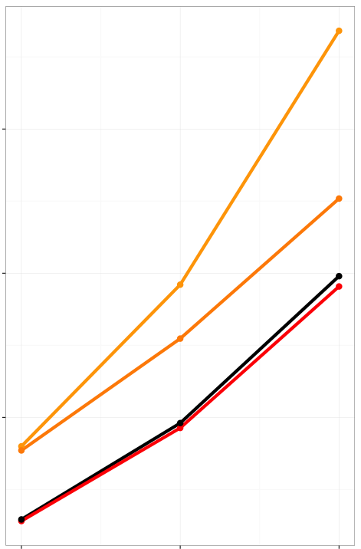
Sweep is now as fast as bedops*
bedtools v2.16
80 minutes
1000
60X
bedtools v2.17
5.5 minutes
100
bedops v2.3
95 seconds
Wall time (seconds)
bedtools v2.18
80 seconds
10
1
1M record
BAM
10M record
BAM
100M record
BAM
bedtools intersect -a gencode.exons.bed -b exome.bam -sorted -c
bedmap --echo --count gencode.exons.bed exome.bam
* Note: bedops requires BAM conversion to BED. Not counted
Notes:
As a result, our “sweep” algorithm for sorted data is as fast, or slightly faster than that of bedops. And we natively support more than just BED format to boot.

Slide 12
Performance: The “sweep” algorithm
5’
3’
E1
E2
E3
Exons
Sequence alignments
A1
A3
A4
A5
A8
A9
A10
A11
A2
A6
A12
A7
{}
Requires that datasets to be sorted by chromosome and start coordinate.
Advantage: single pass; ~0 memory usage (scalable!)

Slide 13
The “sweep” algorithm
5’
3’
E1
E2
E3
Exons
Sequence alignments
A1
A3
A4
A5
A8
A9
A10
A11
A2
A6
A12
A7
{E1}
Start of E1.
E1 is active.

Slide 14
The “sweep” algorithm
5’
3’
E1
E2
E3
Exons
Sequence alignments
A1
A3
A4
A5
A8
A9
A10
A11
A2
A6
A12
A7
{E1=(A1)}
A1 overlaps E1

Slide 15
The “sweep” algorithm
5’
3’
E1
E2
E3
Exons
Sequence alignments
A1
A3
A4
A5
A8
A9
A10
A11
A2
A6
A12
A7
{E1=(A1,A2)}
A2 also overlaps E1

Slide 16
The “sweep” algorithm
5’
3’
E1
E2
E3
Exons
Sequence alignments
A1
A3
A4
A5
A8
A9
A10
A11
A2
A6
A12
A7
{}
End of E1.
E1 is now inactive.
Report
E1=(A1,A2,A3)
as output

Slide 17
The “sweep” algorithm
5’
3’
E1
E2
E3
Exons
Sequence alignments
A1
A3
A4
A5
A8
A9
A10
A11
A2
A6
A12
A7
E1=(A1,A2,A3)
E2=(A5,A6,A7)
E3=(A10,A11,A12)

Slide 18
http://quinlanlab.org/tutorials/cshl2015/bedtools.html

