Slide 1
Citizen Feedback on Maintenance of Road (Complaint Box)

Slide 2
Abstract
This is an android application that will enable citizens to provide feedback or complaints for the maintenance of roads and other necessities.
This will enable authorities to act on these complaints effortlessly.
Complaints and feedback from citizens are a powerful quality management tool for Local Municipalities.
Listening to citizen feedback can therefore be a continuous improvement strategy and in order to get the best out of it, an effort to identify its components needs to be done.

Slide 3
Problem Statement
In India, the fact is, we don’t have any direct communication between the government and public in an efficient way for solving the problems like broken roads, street light bulb fused etc.
There is no such way for getting a problem solved as one has to go through the hassles of registering the complaint to respective departments which in turn forward to the concern officers and then the problem may or may not get solved and also takes a lot of time.

Slide 4
Methodology
Citizens have to register yourself on application with their Phone/Email.
Then citizens can raise complaints and submit feedbacks.
After the complaint has been raised, Admin will review the complaints and take action respectively.
Citizens can check Status of their complaints.

Slide 5
Software Required
Android Studio
Android Studio provides the fastest tools for building apps on every type of Android device.
Android Studio is the official integrated development environment for Google's Android operating system, built on JetBrains' IntelliJ IDEA software and designed specifically for Android development.
Firebase
Firebase Authentication: Firebase security applies Google's internal expertise to easily build app sign-ins. Develop simple, free multi-platform sign-in with Firebase Authentication.
Firebase Realtime Database: Store & sync data between your users in Realtime with the Firebase Realtime Database. Optimize for offline use and build strong user-based security for your app.

Slide 6
Hardware Required
Microsoft Windows 7/8/10 (32-bit or 64-bit)
3 GB RAM minimum, 8 GB RAM recommended (plus 1 GB for the Android Emulator)
2 GB of available disk space minimum, 4 GB recommended (500 MB for IDE plus 1.5 GB for Android SDK and emulator system image)

Slide 7
Language Required
Java
Java is the technology of choice for building applications using managed code that can execute on mobile devices. Android applications can be developed by using the Java programming language and the Android SDK.
XML
eXtensible Markup Language, or XML: A markup language created as a standard way to encode data in internet-based applications. Android applications use XML to create layout files. Unlike HTML, XML is case-sensitive, requires each tag be closed, and preserves whitespace.

Slide 8
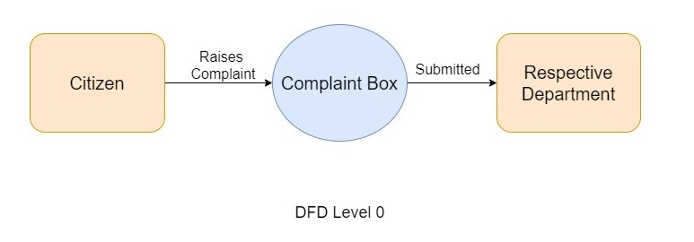
DFD-> Level 0

Slide 9
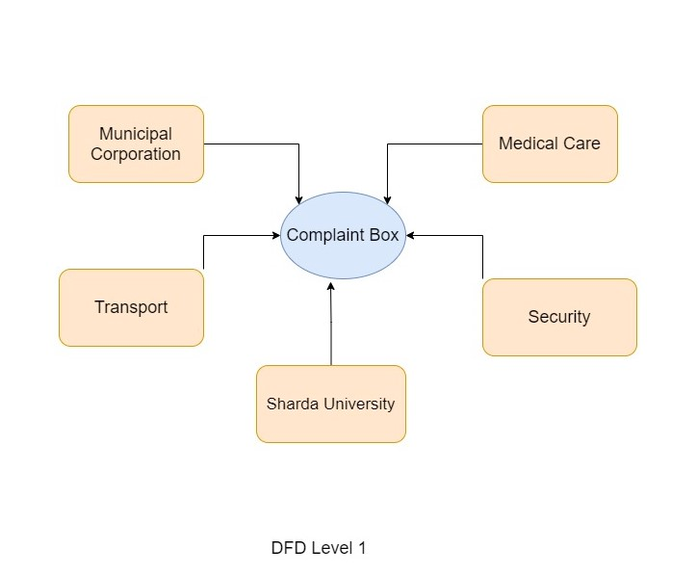
DFD-> Level 1

Slide 10
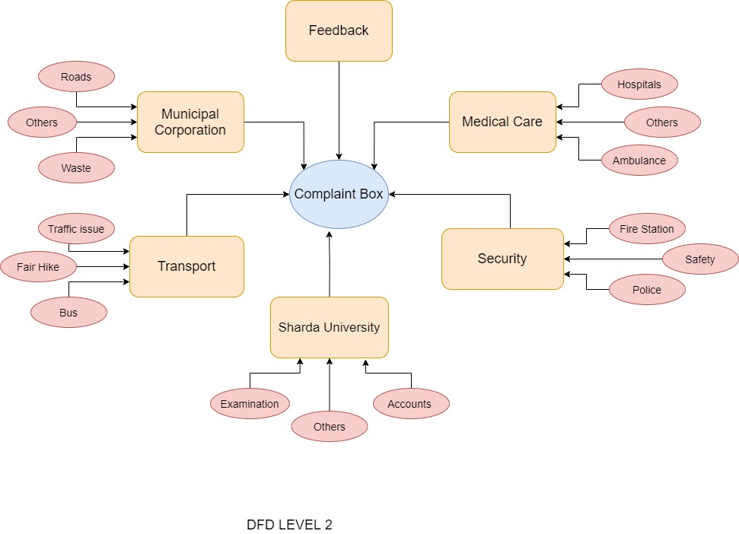
DFD-> Level 2

