Slide 1



University POLITEHNICA bucharest FACULTy of energy engineering department of hydraulic, hydraulic machinery and environmental engineering 313 Independentei spl., 060042 Bucharest, romania
EPANET 2.2
Liana Ioana VUTA
Bucharest 14 March 2022

Slide 2
Athens UPB 012 - Water quality monitoring and control in distribution networks
EPANET is one of the most used and robust software for hydraulic analysis of WDN.
EPANET was developed by U.S. Environmental Protection Agency- US EPA.
The worldwide use of EPANET is largely due to its advantages over other similar commercial software:
It is a free software – the users can download, copy, use and distribute;
Is made available to users in compiled form;
It has a friendly and easy to use graphical user interface;
Is open source – so it can be modified by experienced users;
requires modest hardware resources - the executable file is 1.51 MB, and after installation it occupies a disk space of only 2.15 MB; while running, EPANET 2 consumes very little RAM.

Slide 3
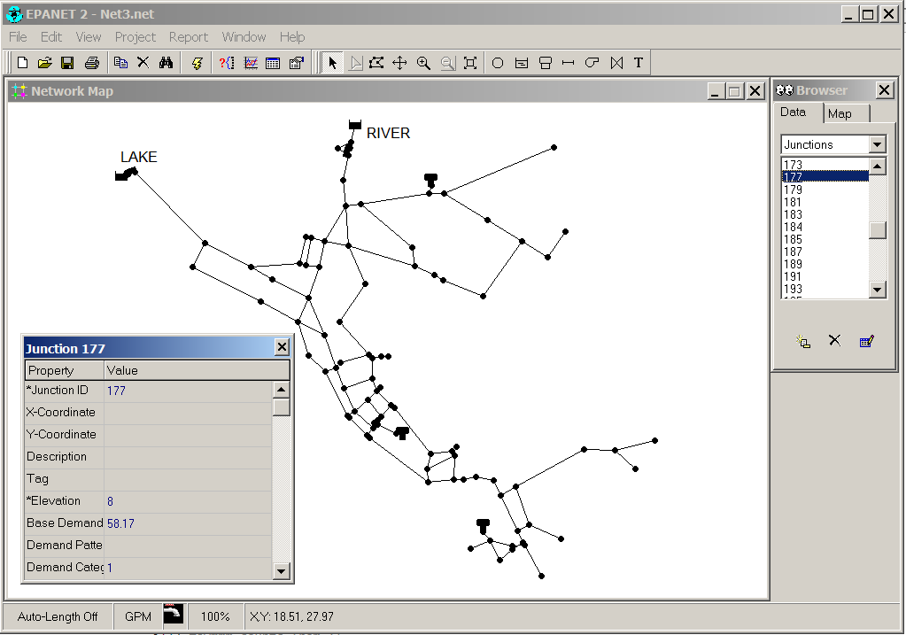
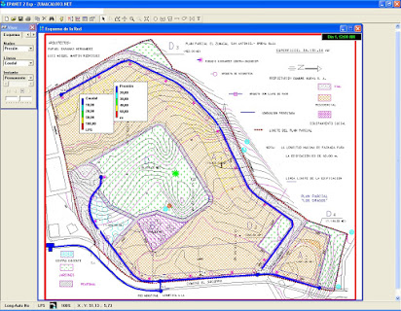
Athens UPB 012 - Water quality monitoring and control in distribution networks
EPANET Capabilities
EPANET performs extended period simulation of hydraulic (the flow of water in each pipe, the pressure at each node, the height of water in each tank) and water quality behavior (concentration of a chemical species, water age, source tracing) within pressurized pipe networks.
EPANET is set by default for analyzing cold water through the network, but allows the choice of another liquid (or hot water) by setting the physical properties of the liquid (kinematic density and viscosity).
EPANET permits the modelling of any kind of pressurized pipe networks (branched, looped, or mixt) and of any size (small or urban size).

Slide 4

Athens UPB 012 - Water quality monitoring and control in distribution networks

Slide 5
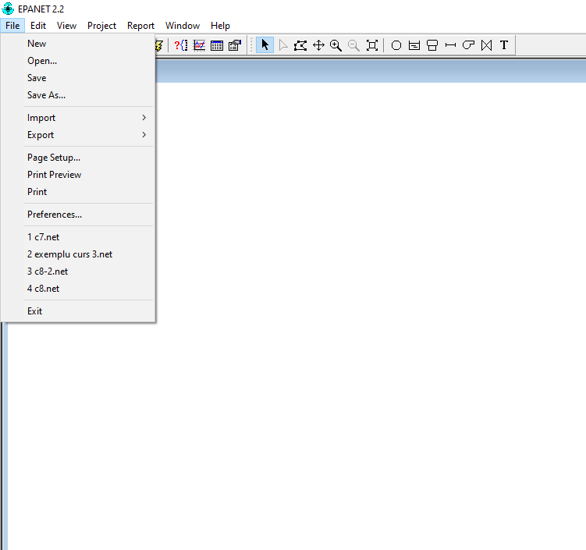
Athens UPB 012 - Water quality monitoring and control in distribution networks
Creates a new project
Opens an existing project
Import network data or map
Saves the current project
Export network data or map
Saves the current project under different name or at a different location
Sets page layout/preferences for printing
Sets the general preferences
Previews before printing
Prints the current view
Exit EPANET

Slide 6
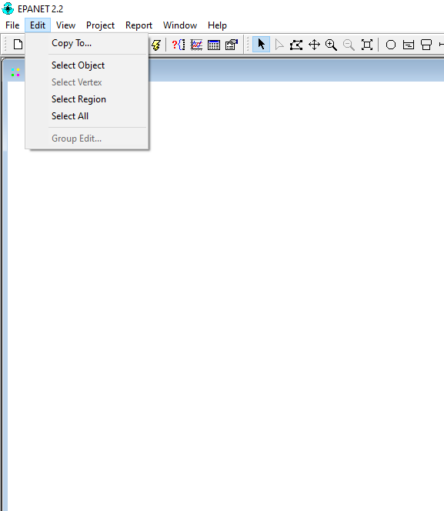
Athens UPB 012 - Water quality monitoring and control in distribution networks
Copies the active view (table, report)to clipboard or to a file
Allows selection of an object on the map
Allows selection of link vertices on the map
Makes the outlined region the entire viewable map area
Allows selection of an outlined region on the map
Edits a property for the objects within the outlined region of the map

Slide 7

Athens UPB 012 - Water quality monitoring and control in distribution networks
Dimensions of the map
Allows a backdrop map to be viewed
Redraw the map at full extent
Pans across the map
Zoom in on the map
Locates a specific item on the map
Searches for items on the map
Zoom out on the map
Toggles the overview Map on/off
Controls the display of map legends
Sets map appearance options
Toggles the toolbars on/off

Slide 8
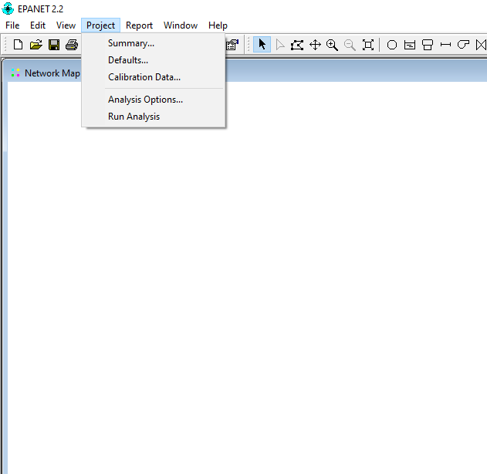
Athens UPB 012 - Water quality monitoring and control in distribution networks
Provides a summary description of the project
Edits the properties of the project
Registers files containing calibration data with the project
Edit analysis options
Runs a simulation

Slide 9

Athens UPB 012 - Water quality monitoring and control in distribution networks
Reports changes in the status of links
Reports the energy consumption
Reports average reaction rates
Reports differences between simulated and measured values
Edits a property for the objects within the outlined region of the map
Creates a full report of the computed results
Creates a table with quantities for selected nodes/links
Controls the display style of a report

Slide 10
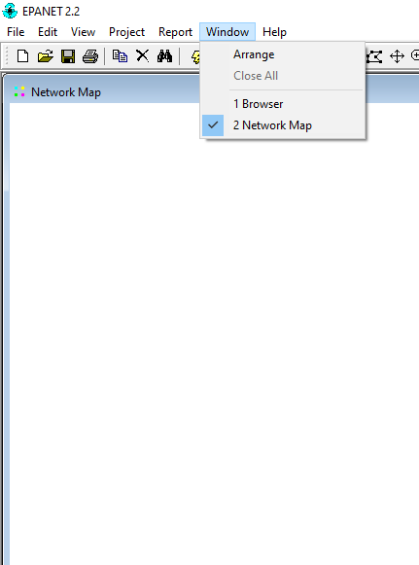
Athens UPB 012 - Water quality monitoring and control in distribution networks
Rearrange all windows to fit into the main window
Close all open windows (not the Map and Browser)
List all opened windows

Slide 11
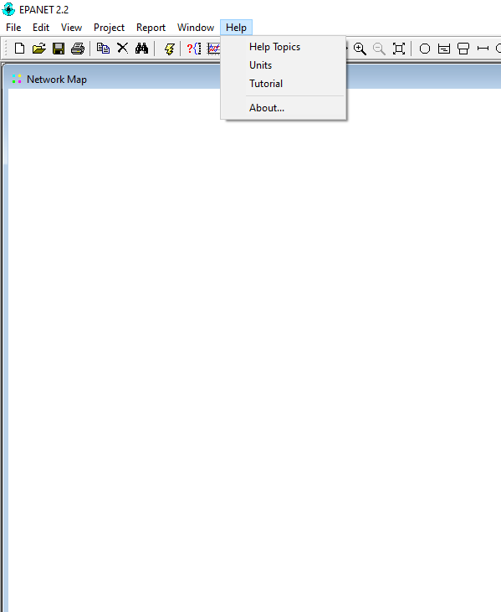
Athens UPB 012 - Water quality monitoring and control in distribution networks
Display the Help Topics/dialog box
Tutorial
List the units of measurement for all parameters
Information regarding the Epanet version

Slide 12
Athens UPB 012 - Water quality monitoring and control in distribution networks
In EPANET, two categories of WDN components are considered:
1. Physical (concrete) components , which appear explicitly on the network map and which in turn are divided into two categories:
Nodes : Junctions, Reservois and Tanks;
Links between two nodes: Pipes, Pumps – with constant or variable speed, Valves;
2. Non-Physical components , which, although not explicitly included in the network map, are related to the operation of some of the "concrete" components existing in the network, namely:
Curves of some system components (tanks, pumps or valves);
Time Patterns related to different network parameters;
Controls that can implement the operation algorithm of nodes and links through control structures.

Slide 13
Athens UPB 012 - Water quality monitoring and control in distribution networks
Through its graphical user interface, EPANET provides an integrated environment for:
preprocessing - via a network editor, which allows to draw the map of the hydraulic network, to edit the properties of the network components (input / modify data), to enter different operating curves or time patterns, and set the options of analysis and control;
running simulations - by activating the Run or Run Analysis buttons;
post-processing - viewing and saving results: network maps, displaying values, variation charts, tables.

Slide 14
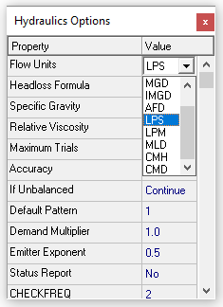
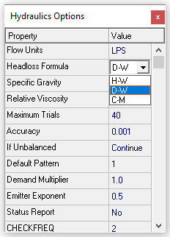
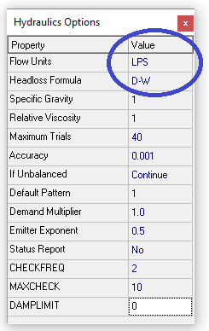
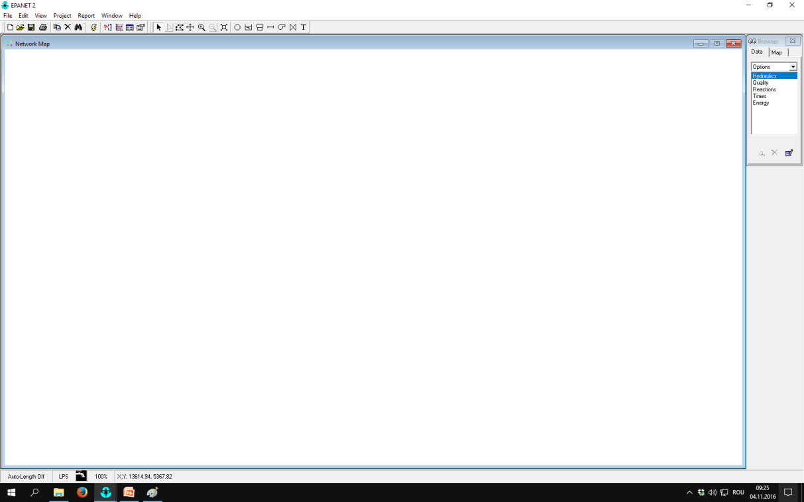

Athens UPB 012 - Water quality monitoring and control in distribution networks
Setting Analysis Options
Flow units (LPS = liters/second); Headloss formula Darcy-Weisbach (D-W)
After making the basic settings in Hydraulics Options, the file is saved again. Results:

Slide 15
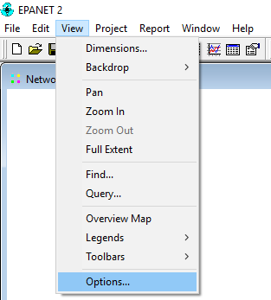
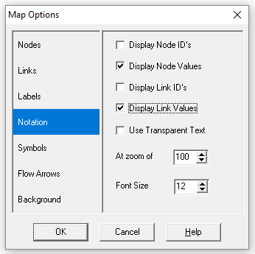
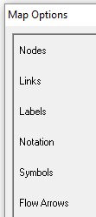
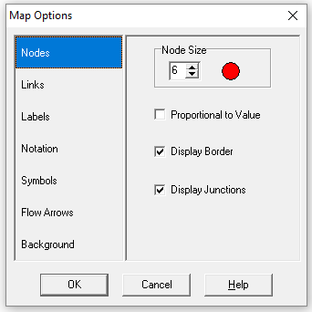
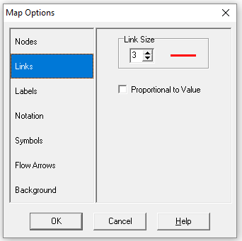
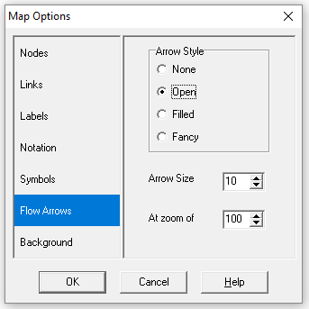
Athens UPB 012 - Water quality monitoring and control in distribution networks
The following view settings are made in View / Options / Map Options (these settings are optional, the program can run without them).

Slide 16
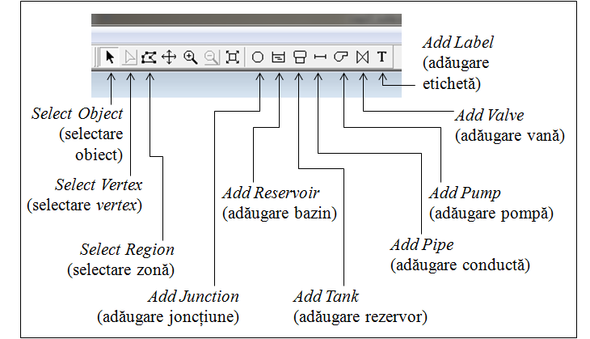
Athens UPB 012 - Water quality monitoring and control in distribution networks
The Toolbar
Note that there are two types of tanks in EPANET:
one is called a Reservoir and is an infinite external source of water to the network, for example a basin (or lakes, or river, or aquifer);
another is called Tank and is a reservoir with a storage volume which can vary with time during a simulation.For the application in this course, a Reservoir must be selected.

Slide 17
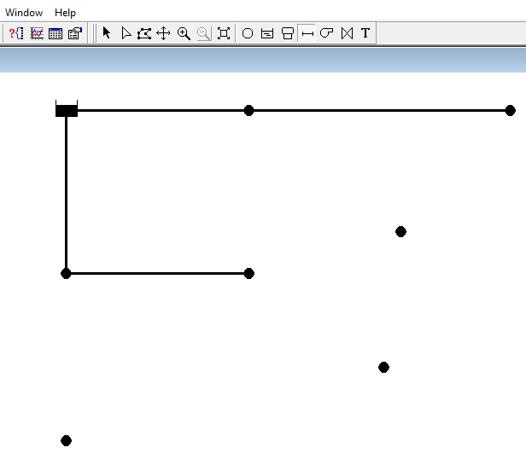
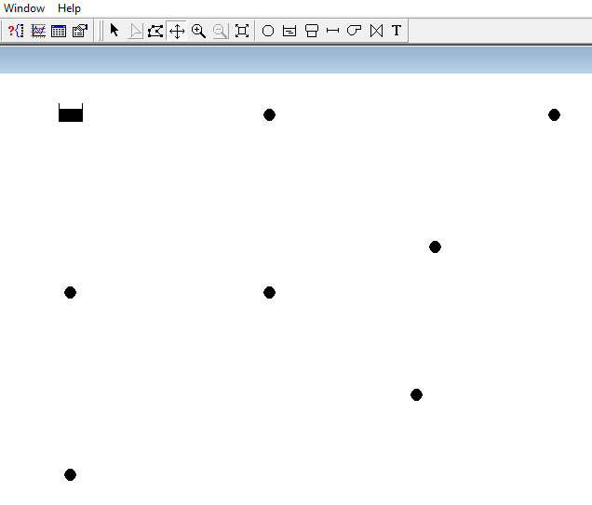
Athens UPB 012 - Water quality monitoring and control in distribution networks
The network can be draw, using the graphical symbols in the Toolbar: At first add the reservoir R (Add Reservoir) and the 7 consumption nodes (Add Jonctions) on the map, then add the pipes (Add Pipes), connecting the pipe by clicking between the reservoir and an adjacent node, respectively, between two consecutive nodes.

Slide 18
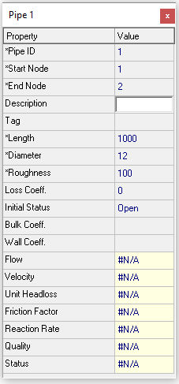
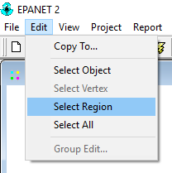
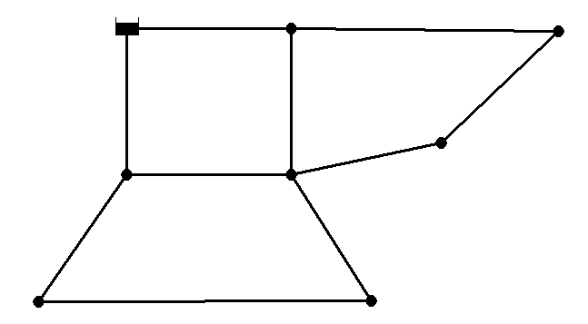
Athens UPB 012 - Water quality monitoring and control in distribution networks
After drawing the network, set the properties of the network components:
For the 10 pipes, the length (Length) in meters, the diameter (Diameter) in mm and the roughness (Roughness) in mm.
The Roughness have the same value for all pipes so it can be set with Group Editor, via Edit / Select Region, then Edit / Group Edit. To select the region, surround the network with a polygon, by clicking the mouse, and finally press Enter to close the polygon.

Slide 19
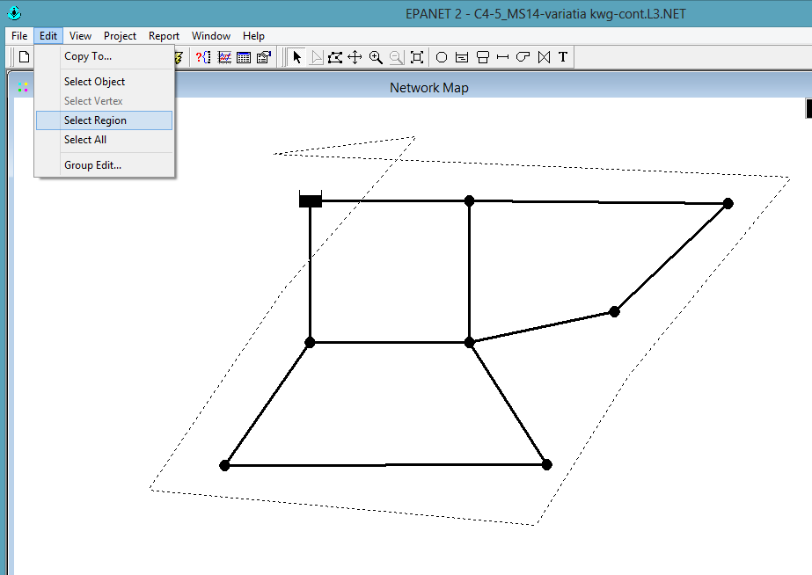
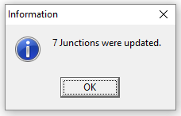
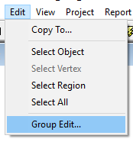
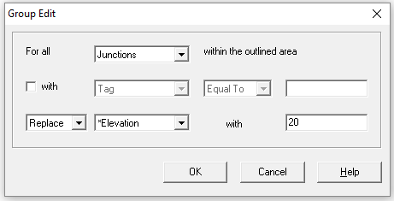
Athens UPB 012 - Water quality monitoring and control in distribution networks
Setting up the Elevation in nodes/jonctions, with Group Edit:
Be careful when selecting the region, the polygon should only include the nodes, not the reservoir.

Slide 20
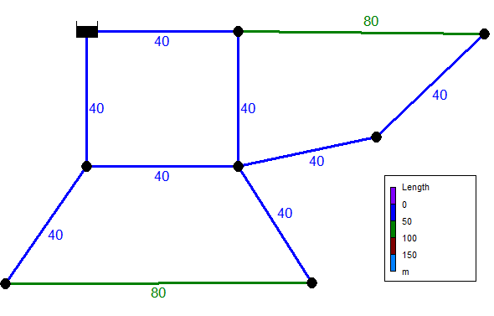
Athens UPB 012 - Water quality monitoring and control in distribution networks
Lenght of the pipes (in meters):

Slide 21
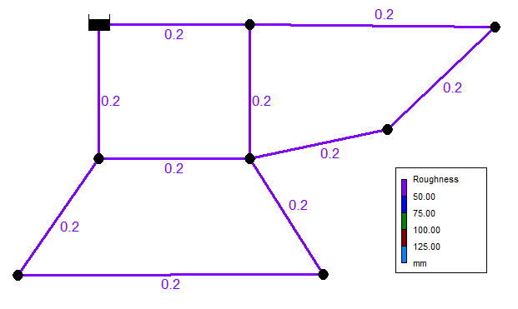
Athens UPB 012 - Water quality monitoring and control in distribution networks
Values of the pipe’s roughness (in mm)

Slide 22
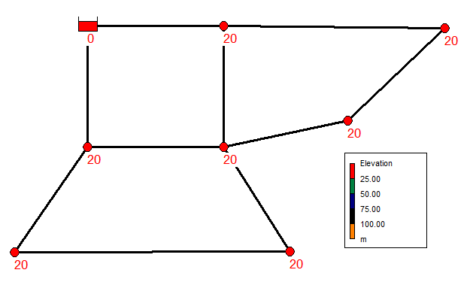
Athens UPB 012 - Water quality monitoring and control in distribution networks
Values of the nodes' Elevation (in meters):

Slide 23
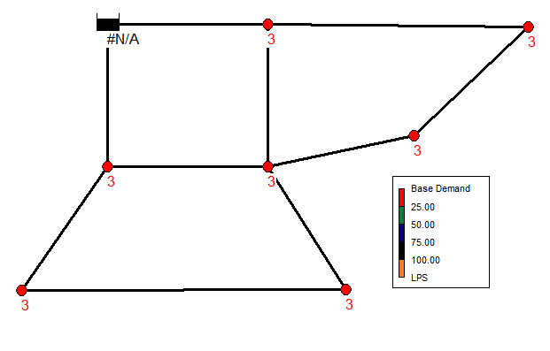
Athens UPB 012 - Water quality monitoring and control in distribution networks
As in the case of Elevation, the values of the consumed flow (Base Demand) in nodes are selected/inserted, in l / s, as in the figure:

Slide 24
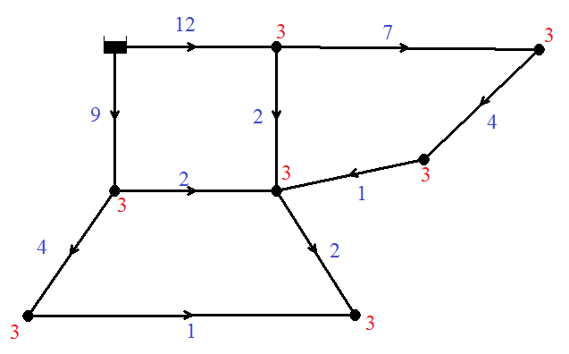
Athens UPB 012 - Water quality monitoring and control in distribution networks
Values of the pipes’ diameters (in mm)
To determine the diameters of the pipes, the following steps are performed:
1. Choose a distribution of the flow on the pipes respecting the continuity equation in nodes (the total outflow of the reservoir is given by the sum of the base demand of the consumers: Q_{t} = 21 l / s).

Slide 25
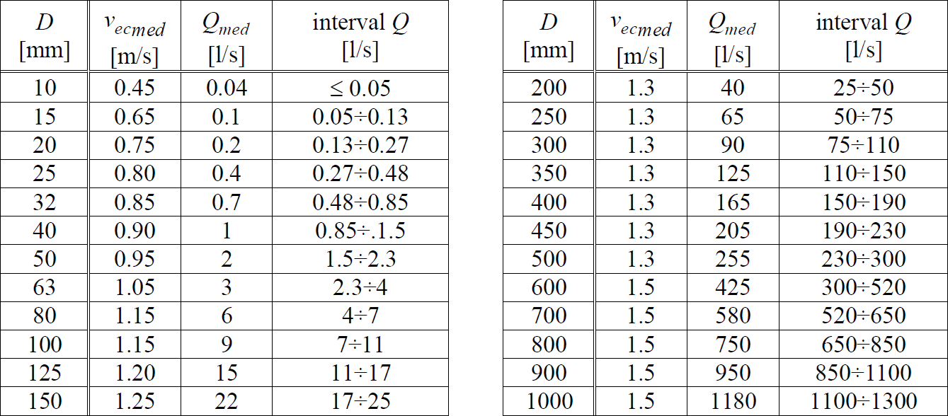
Athens UPB 012 - Water quality monitoring and control in distribution networks
2. The criterion of economic velocities is applied and the diameters are identified from the table below:

Slide 26
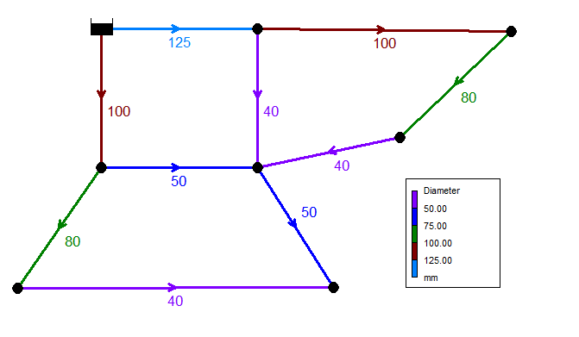
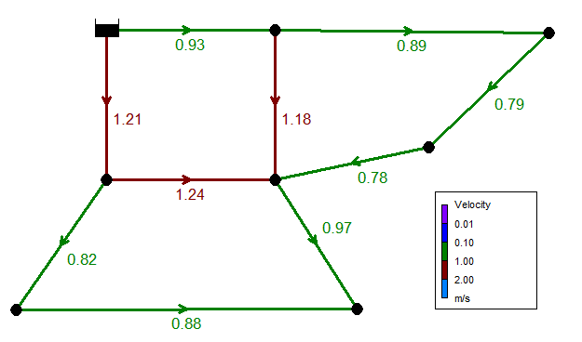
Athens UPB 012 - Water quality monitoring and control in distribution networks
3. Diameter values are obtained and a run of the network is performed to identify the velocities on the pipes that must be in the range of 0.5-1.5 m / s.
4. If the velocities are exceeding the required range, the diameter values are changed until the velocities conditions are met.

Slide 27
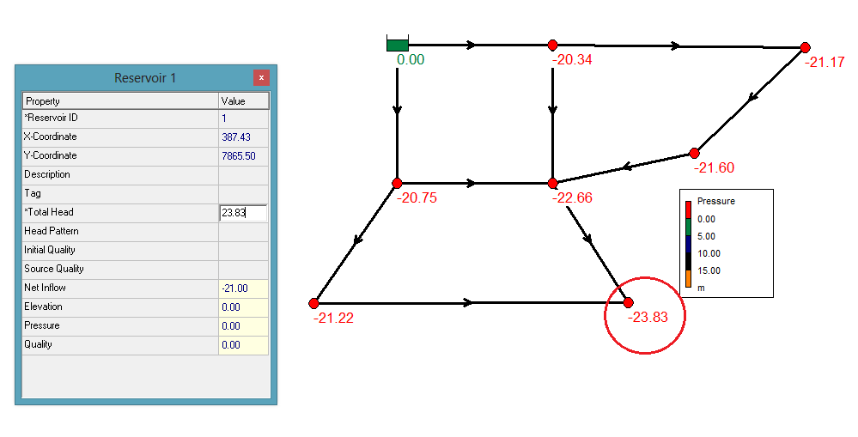
Athens UPB 012 - Water quality monitoring and control in distribution networks
The value of Total Head at the reservoir (in meters)
Node pressure is displayed to analyze depression values (negative values of the relative pressure). The identification of the value of the maximum depression (here: -23.83 m.c.a) is inserted to the Total Head of the reservoir.

Slide 28
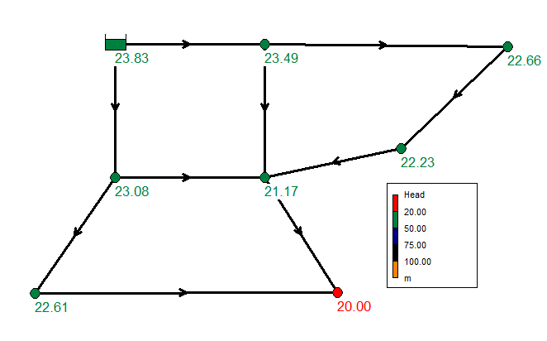
Athens UPB 012 - Water quality monitoring and control in distribution networks
Finally, we can display the values of final piezometric heads (Head) in the network nodes.

Slide 29
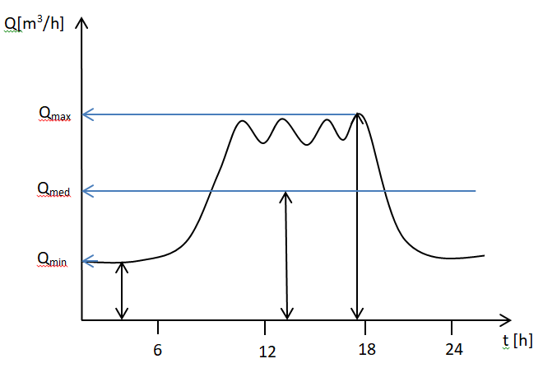
Athens UPB 012 - Water quality monitoring and control in distribution networks
Demand pattern
The insurance and calculation of water consumption is done depending on the type of use and its duration. This way are defined hourly flows (minimum, maximum and average), daily flows (minimum, maximum and average) and monthly flows (minimum, maximum and average).
The daily flow variation curve – Demand pattern - means the hourly variation of the required water flow to the consumer.
Thus, the Time Pattern makes demands at the nodes vary in a periodic way over the course of a day.

Slide 30


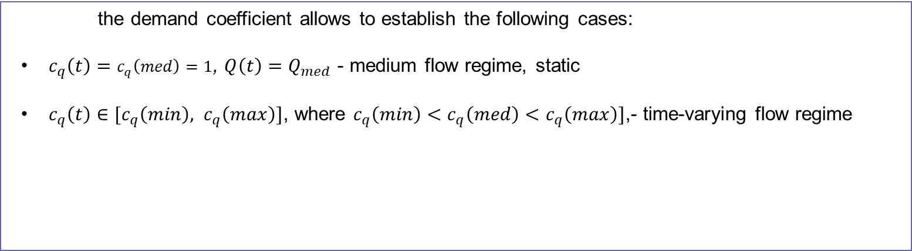

Athens UPB 012 - Water quality monitoring and control in distribution networks
The demand coefficient, c_{q} (t)
The demand coefficient, c_{q}(t), represents the ratio between demand of each node at time t and the daily average demand.
$$c_{q}\left(t\right)=\frac{Q(t)}{Q_{med}}$$
the demand coefficient allows to establish the following cases:
$c_{q}\left(t\right)=c_{q}\left(med\right)=1$, $Q\left(t\right)=Q_{med}$ - medium flow regime, static
$c_{q}\left(t\right)∈[c_{q}\left(min\right), c_{q}\left(max\right)]$, where $c_{q}\left(min\right)<c_{q}\left(med\right)<c_{q}\left(max\right)]$,- time-varying flow regime
$$c_{q}\left(min\right)=\frac{Q_{min}}{Q_{med}}$$
$$c_{q}\left(max\right)=\frac{Q_{max}}{Q_{med}}$$

Slide 31
Athens UPB 012 - Water quality monitoring and control in distribution networks
Demand Pattern in EPANET
The notion of Demand Pattern refers to the hourly demand at consumption nodes.
Demand Pattern in EPANET has a unique ID (identification number) attached to it. A certain Demand Pattern (with an ID attached) actually contains only the values of the coefficients of hourly demand coefficients c_{q}(t) for each time step t; with the values c_{q}(t) is multiplied any value Q_{c} (Base Demand), inserted in the Property Editor of any junction, if for that junction the ID of this Demand Pattern has been completed.
The values of the demand coefficients c_{q}(t) are entered through an editor, namely the Pattern Editor (in the Browser / Data / Patterns / Pattern Editor menu), and the corresponding ID will be identical to the Demand Pattern ID inserted in the junction Property Editor.

Slide 32
Athens UPB 012 - Water quality monitoring and control in distribution networks
Inserting the Time Pattern in EPANET
Known data:
Q₁=Q₂= 20 l/s, Q₃=40 l/s
H₁=20 m, H₂=H₃=40m
k=0.2 mm
L₁=…=L₆=1000 m
Demand coefficients values (demand pattern):
What is the value of Total head at the Reservoi?
R
C1
t ∈[00:00÷06:00), c_{q}(t) = 0.7
t ∈[06:00÷12:00), c_{q}(t) = 1
t ∈[12:00÷18:00), c_{q}(t) = 1.3
t ∈[18:00÷24:00), c_{q}(t) = 0.7
C2
C3

Slide 33
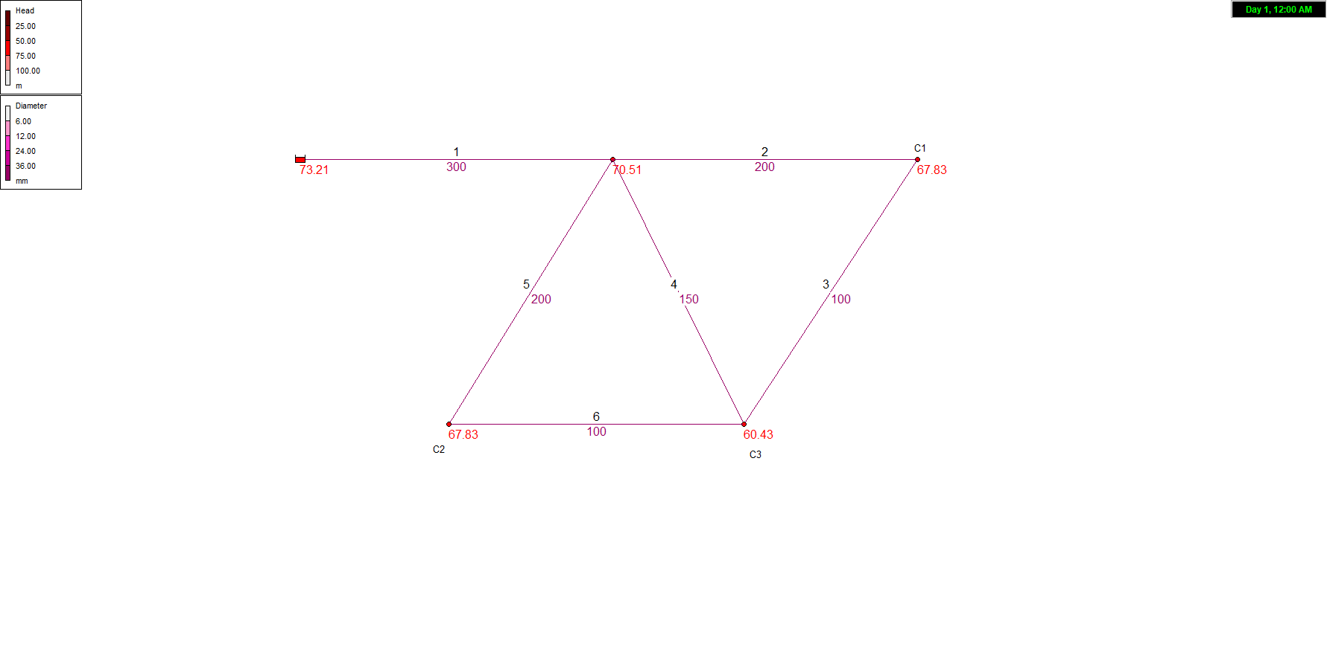
Athens UPB 012 - Water quality monitoring and control in distribution networks
Values of the pipes diameters

Slide 34
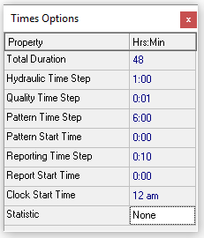
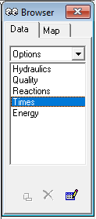
Athens UPB 012 - Water quality monitoring and control in distribution networks
For setting up a time variation of the parameters, the following time steps will be chosen, in Hours:Minutes (Hrs:Min):
For the hydraulic analysis (Hydraulic Time Step) = 1:00 (one hour);
For the water quality analysis (chlorine) (Quality Time Step) = 0:01 (one minute);
For demands variation (Pattern Time Step) = 6:00;
For reporting the results (Reporting Time Step) = 0:10;
Duration of the simulation (Total Duration) = 48 (hours).
Data/ Options/ Times, in the editor Times Options:
click for editing

Slide 35
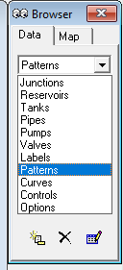
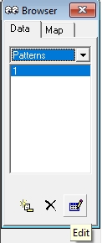
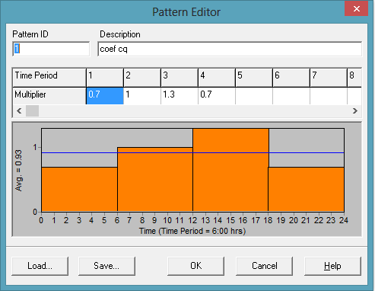
Athens UPB 012 - Water quality monitoring and control in distribution networks
Inserting the demand coefficient values, in Data/ Patterns/ Pattern Editor:
t ∈[00:00÷06:00), c_{q}(t) = 0.7
t ∈[06:00÷12:00), c_{q}(t) = 1
t ∈[12:00÷18:00), c_{q}(t) = 1.3
t ∈[18:00÷24:00), c_{q}(t) = 0.7
Pattern ID = 1
click for editing

Slide 36
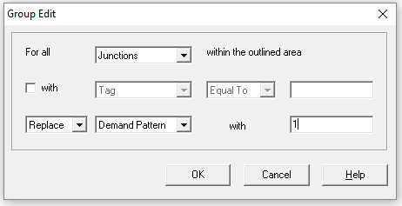
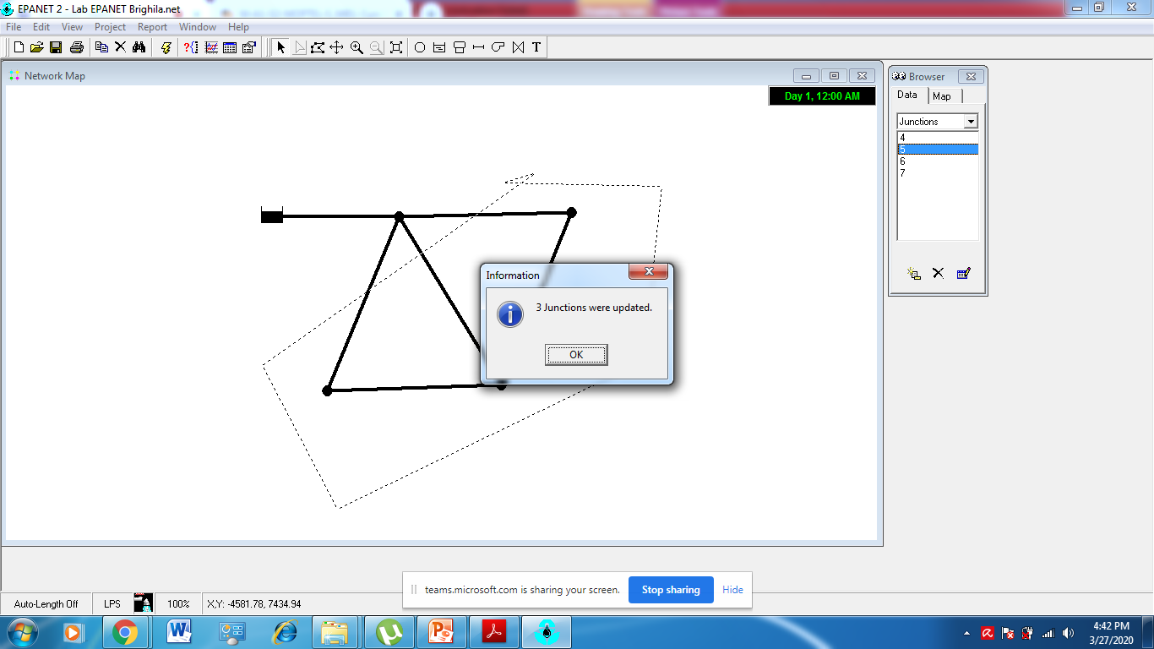
Athens UPB 012 - Water quality monitoring and control in distribution networks
Setting up the ID of Demad Pattern in WDN’s junctions, using Group Edit:

Slide 37
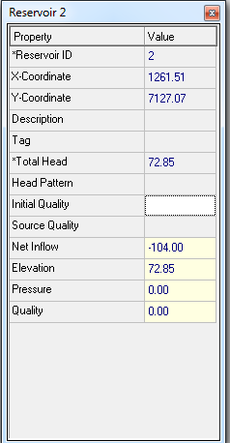
Athens UPB 012 - Water quality monitoring and control in distribution networks
The hydraulic analysis will have errors, because of the demand coefficient c_{q}(t) = 1.3, which imply a demand 30% greater than the medium regime.
In this case is necessary to identify the pressure deficit in the network (the most disadvantaged consumer) and to increase the Total Head at the reservoir. After this, a new run of the network will be ok - Run was succesful.

Slide 38
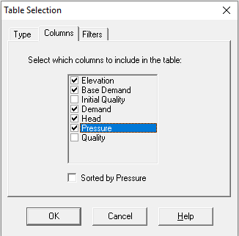
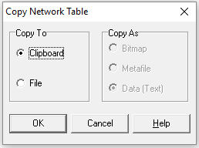


Athens UPB 012 - Water quality monitoring and control in distribution networks
Data can be saved as Table (Toolbar/ Table/ editorul Table Selection/ select all/ Edit/ Copy to Clipboard then paste in Excel).

Slide 39


Athens UPB 012 - Water quality monitoring and control in distribution networks
Graphical representation of time variation of the parameters can be drawn for the selected pipes or for the selected nodes (Toolbar / Graph). Graphics can be saved via Print Screen. Here is an example for the flow variation on the pipe j = 10.
Using the Add button up to 5 pipes can be added and 5 curves result, with the corresponding legend.
Right-clicking on the graph opens the Graph Options editor in which can be choose Vertical Axis between the desired min / max limits (uncheck Auto Scale), change the color / type of the curve (in the Series field) etc.

