Slide 1



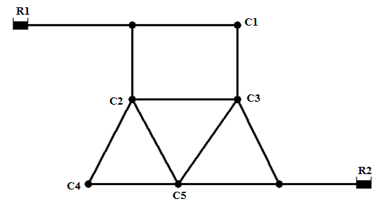
University POLITEHNICA bucharest FACULTy of energy engineering department of hydraulic, hydraulic machinery and environmental engineering 313 Independentei spl., 060042 Bucharest, romania
Epanet – Example 1
Liana Ioana VUTA
Bucharest 15 March 2022

Slide 2
Athens UPB 012 - Water quality monitoring and control in distribution networks
First step:
Project → Analysis Options → Options → Hydrulics → LPS as flow units and D-W as headloss formula
Second step:
View → Option → Notation → Check Display Node ID’s & Values
→ Check Display Link ID’s & Values
→ Flow Arrows → Check Display Node ID’s & Values

Slide 3
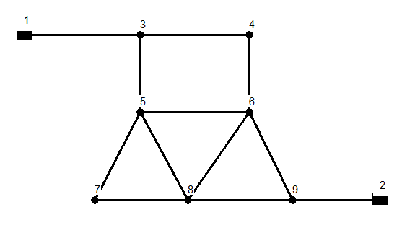
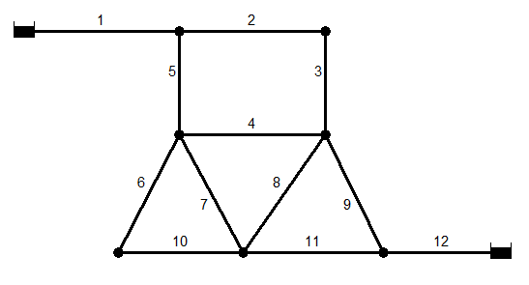
Athens UPB 012 - Water quality monitoring and control in distribution networks
We draw the network using the graphical symbol from the Toolbar: First we add the two reservoirs R1 and R2 (Add Reservoir) and the 7 junction (Add Junctions), then we add the 12 pipes (Add Pipes), linking the pipe with a click on the reservoir and the adjacent node, or clicking on two consecutive nodes.

Slide 4
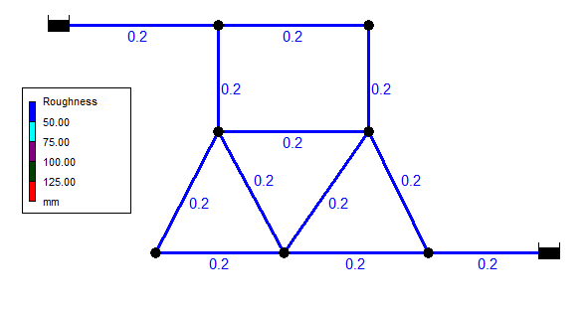
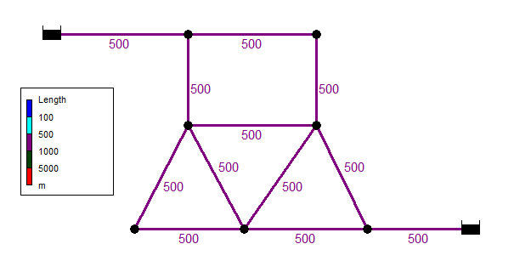
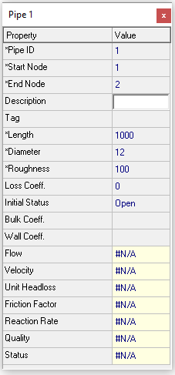

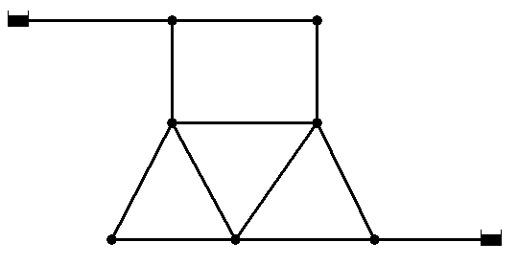
Athens UPB 012 - Water quality monitoring and control in distribution networks
Set for all the pipe of the network the Length [m] and the Roughness [mm]

Slide 5
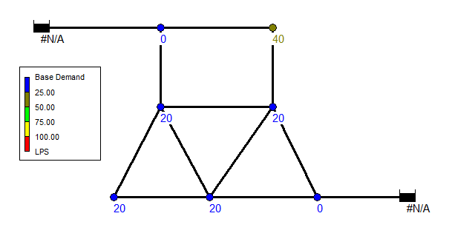
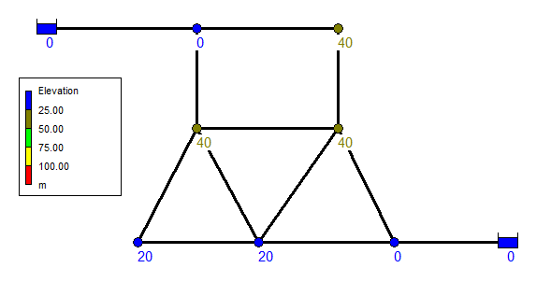
Athens UPB 012 - Water quality monitoring and control in distribution networks
Set for all the nodes of the network the Base demand [l/s] and the Elevation [m]

Slide 6
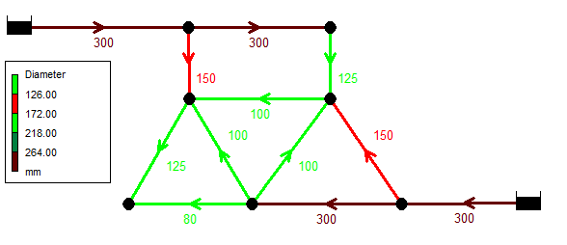
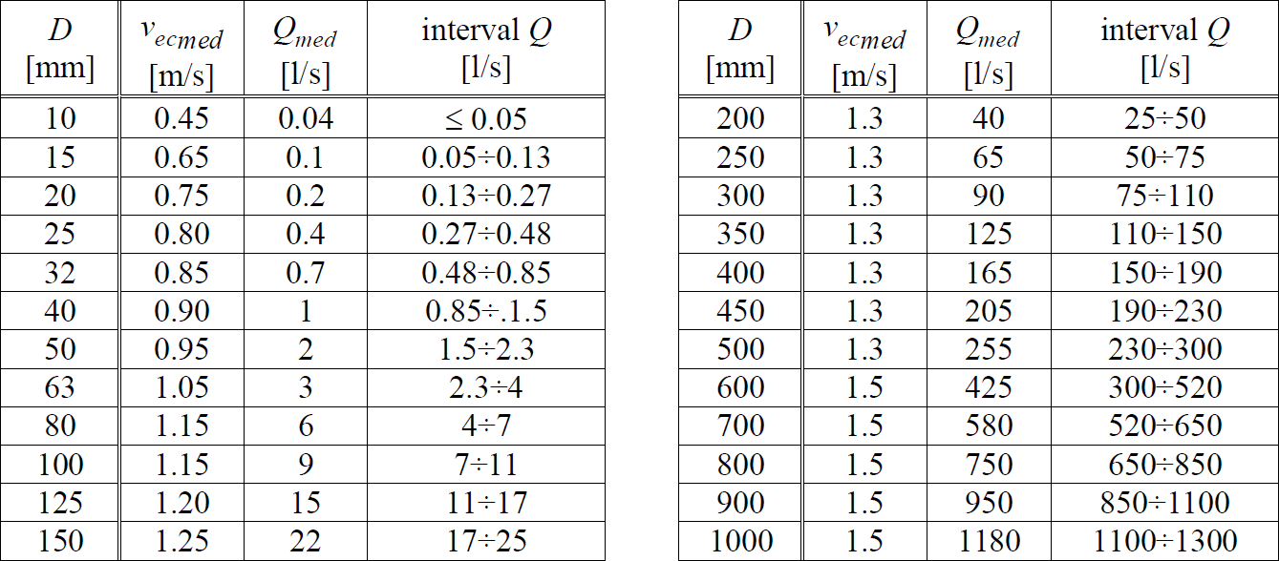
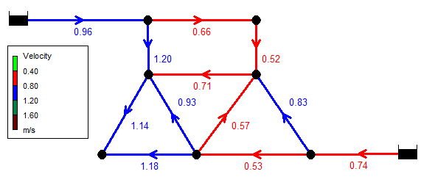
Athens UPB 012 - Water quality monitoring and control in distribution networks
At this point we must consider the flow rate on each pipe of the network and, based on the economic velocity criteria, to choose a diameter for each pipe. After choosing the diameters the Run Analysis is executed and velocities values can be displayed on the network.

Slide 7
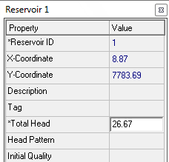
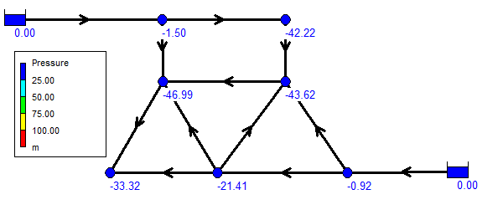
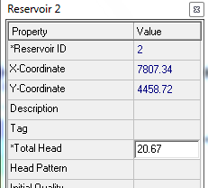
Athens UPB 012 - Water quality monitoring and control in distribution networks
We display also the pressure in the nodes, to identify the most disadvantaged consumer, and its pressure values is divided between the two reservoir, representing the Total Head.

Slide 8
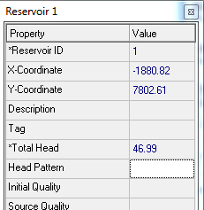
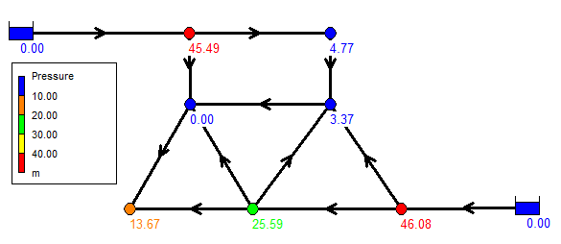
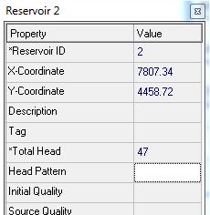
Athens UPB 012 - Water quality monitoring and control in distribution networks
We perform a new hydraulic analysis and, in this case it can be noticed that there are still negative pressure in the network, so we update the values of the Total Head of the reservoirs until all the pressures in the systems are positive. The final value of the total head for the 2 reservoirs is of 94 m, equally divided between them.

Slide 9
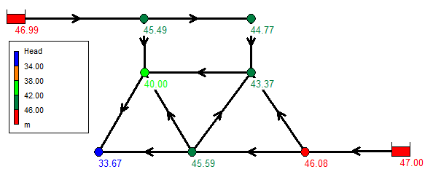
Athens UPB 012 - Water quality monitoring and control in distribution networks
The Head values (elevation + pressure) in the network nodes

Slide 10
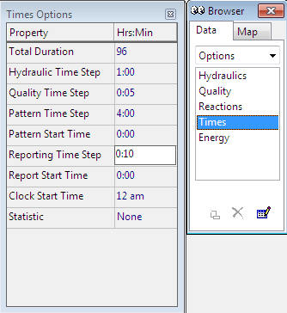
Athens UPB 012 - Water quality monitoring and control in distribution networks
For defining the diurnal variation in nodes, we must set up the following time steps first:
in Times Options(Data/ Options/ Times), in (Hrs:Min)
Hydraulic Time Step = 1:00 (one hour);
Pattern Time Step = 4:00 (four hours);
Reporting Time Step = 0:10 (10 minutes);
Total Duration = 96 (hours).

Slide 11
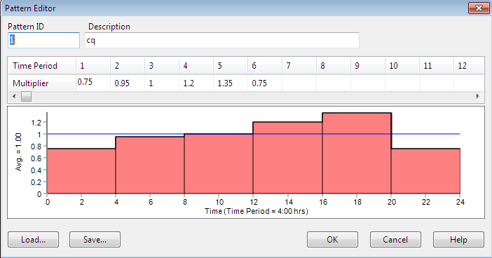
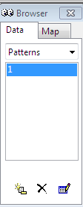
Athens UPB 012 - Water quality monitoring and control in distribution networks
Introducing the demand coefficients values in Data/ Patterns/ Pattern Editor:
t ∈[00:00÷04:00), cq(t) = 0.75
t ∈[04:00÷08:00), c_{q}(t) = 0.95
t ∈[08:00÷12:00), c_{q}(t) = 1
t ∈[12:00÷16:00), c_{q}(t) = 1.2
t ∈[16:00÷20:00), c_{q}(t) = 1.35
t ∈[20:00÷24:00), c_{q}(t) = 0.75

Slide 12
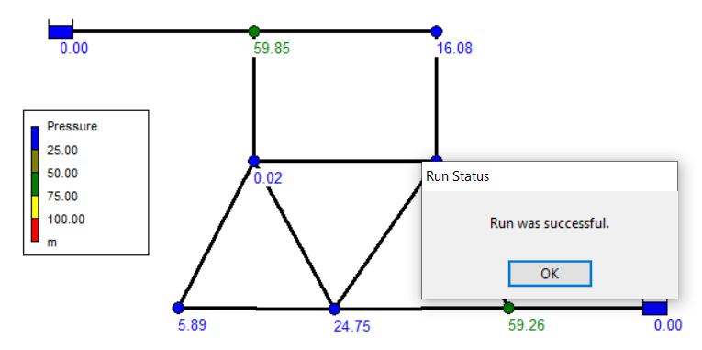
Athens UPB 012 - Water quality monitoring and control in distribution networks
Apply the Demad Pattern in all consumption nodes;
Identify the pressure deficit;
Update the Total Head, until the run status is successful.

Slide 13
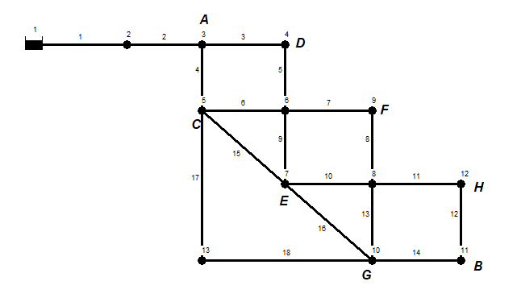
Athens UPB 012 - Water quality monitoring and control in distribution networks
Practice 1
Considering the WDN from the picture, with 18 pipes, noted with j = 1÷18, for which are known:
Pipes length L_{j} : 300+2*N [m]
Absolute roughness : k=0.3 [mm]
The elevation in the nodes:
2, 3, 4, 11 = 0, ​
5, 6 = 10+N [m] ​
7÷ 10, 12, 13 = 20+N [m]
The flow at the consumption nodes (8 consumers, from A to H)​
A = B = 50+N [l/s], industrial​
C = D = E = F = G = H = 20+N [l/s]
The demand pattern:
Total duration : 96 ore
Determine:
The most disadvantaged consumer
Total head at the reservoir for the average flow regime
Total head at the reservoir for the maximum flow regime
t ∈[08:00÷12:00), cq(t) = 1 ​
t ∈[12:00÷16:00), cq(t) = 1​
t ∈ [ 16:00÷20:00), cq(t) = 0.6
t ∈[00:00÷04:00), c_{q}(t) = 0.65
t ∈[04:00÷08:00), c_{q}(t) = 0.95
t ∈[08:00÷12:00), c_{q}(t) = 1 (regimul mediu)
t ∈[12:00÷16:00), c_{q}(t) = 1.2
t ∈[16:00÷20:00), c_{q}(t) = 1.35
t ∈[20:00÷24:00), c_{q}(t) = 0.95

Slide 14
Athens UPB 012 - Water quality monitoring and control in distribution networks

