Slide 1
IX: A Protected Dataplane Operating System for High Throughput and Low Latency
CSE231 Presentation
Lakshmi Krishnaswamy

Slide 2
Problem statement and motivation
“Improving operating systems for applications with aggressive networking requirements running on multi-core servers.”
Hardware OS mismatch
Datacenter Applications

Slide 3
Key Contributions
Propose “IX”, dataplane operating system, that is said to achieve high throughout, low latency, resource efficiency - all without any compromise on security.
Three way isolation between control plane, networking stack and application
Use hardware virtualization, to have each application run on its own address space coupled with networking logic

Slide 4
Design Principles
Separation and protection of control and data plane
Run to completion with adaptive batching
Native, zero-copy API with explicit flow control
Flow consistent, synchronization-free hashing

Slide 5
Design Principles
Separation and protection of control and data plane
Run to completion with adaptive batching
Each dataplane executes all network processing stages for a batch of packets in the dataplane kernel, followed by the associated application processing in user mode.
Improves data and instruction locality and helps wear off API overheads
Native, zero-copy API with explicit flow control
Design guided by commutativity rule*
Includes event-based API as well
Flow consistent, synchronization-free hashing
Each dataplane controls its own set of NIC queues, running a single application and networking stack, so no need for synchronization or coherence traffic.

Slide 6
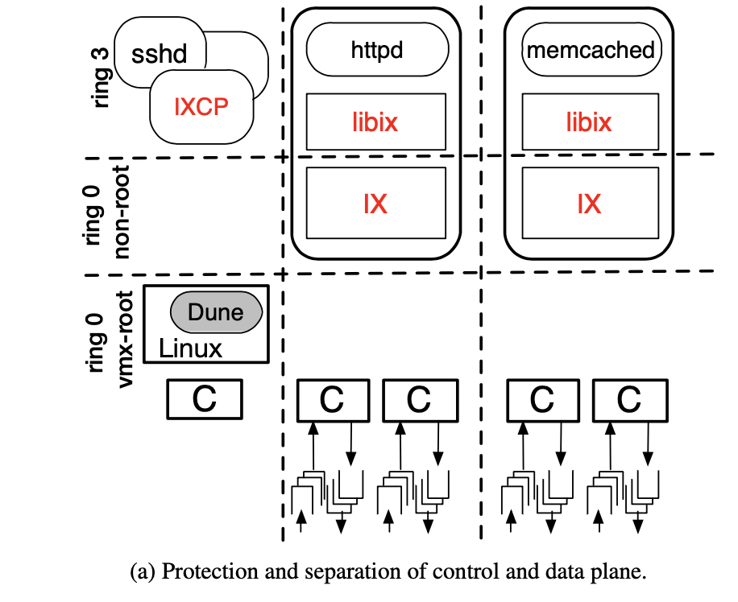
System Design
Each dataplane supports a single, multithreaded application.
A NIC hardware queue assigned to every dataplane.
Each dataplane supports elastic threads and background threads.
Elastic threads interact with IX dataplane
Background threads can timeshare an allocated hardware thread.
The control plane allocates resources to each dataplane in a coarse-grained manner.
Reference: from the paper

Slide 7
Performance Evaluation
Compared against Linux and mTCP (TCP implemented in the user space )
Networking microbenchmarks for measuring latency, throughput, scalability
Memcached application -> used to measure IX’s performance benefits
All message packets mostly just 64B size messages*
IX outperforms in most of the scenarios

Slide 8
Discussion takeaways
IX minimizes kernel overheads, lacks intermediate buffers thus aiding in developing efficient, application specific implementations of I/O abstractions .
Adaptive bounded batching usage, helps attaining both low latency and high throughput at the same time, regardless of the load size.
Eliminates synchronization on multi-core servers.
Doesn’t have support for IOMMU yet.
Doesn’t make use of NIC’s SR-IOV yet.

Slide 9
Conclusion
“A protected dataplane OS for datacenter applications with an event-driven model and demanding connection scalability requirements” ^{[1]}
Virtualization enables efficient access to hardware resources
Overall a great paper, interesting work, really amazing design choices - but is this too tailored just for data center applications? How easily adaptable is it for other applications?
[1] - paper presentation slides

Slide 10
Questions and Discussion
How much of an effect would the policies in the control plane have an impact on the performance of dataplane?
Curious to know about the explorations between IX and networking protocols evaluated and if there have been works in this front recently as well.
How does IX compare with Arrakis ?

