Slide 1
“Lightweight Remote Procedure Call”
Nayan Bhatia

Slide 2
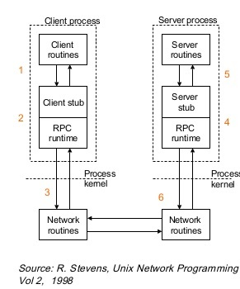
What is Remote Procedure Call?
RPC calls: Cross-machine or Cross-Domain(micro-kernel)
Server provides interface for procedures/function to the client.
Client makes local procedure calls.
The local procedure hides the details of the network communication.
https://web.cs.wpi.edu/~cs4514/b98/week8-rpc/week8-rpc.html

Slide 3
Communication in different kernels
Monolithic kernel:
Easy communication between kernel threads due to shared address space.
Micro kernel:
Each module in its own “protection domain”, since can only access its own address space.
For communication between these protected domain, RPC is used(Cross domain RPC).
https://documen.site/download/pptx-5acd5f67b613b_pdf

Slide 4
Confusion
Why call it “Remote” Procedure Call for the same machine?
Same RPC interface for local and remote clients
The RPC architecture optimizes under the hood calls to local servers, so that local clients are not penalized by some remote IPC technique that would be sub-optimal for local communication (light RPC).
https://stackoverflow.com/questions/33272898/what-is-the-point-of-lrpc-why-would-anyone-want-to-make-remote-procedure-calls?noredirect=1&lq=1

Slide 5
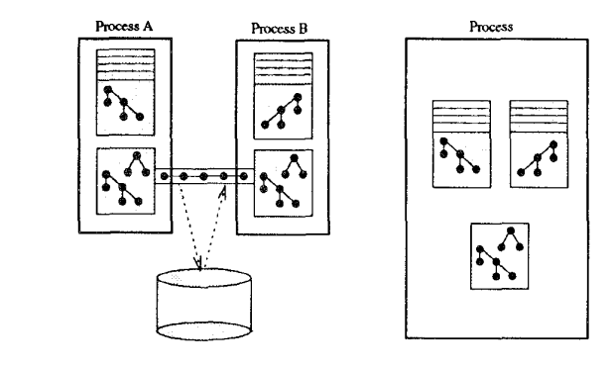
Problems with RPC in cross-domain
RPC systems incur an unnecessarily high cost on the same machine
Coalesce weakly related subsystems into the same protection domain, trading safety for performance

Slide 6
Light RPC
Simple Control Transfer- Request on server’s domain
Simple Data Transfer- Eliminate redundant data copy
Simple Stub-Simple and fast stub in assembly language
LRPC on MP

Slide 7
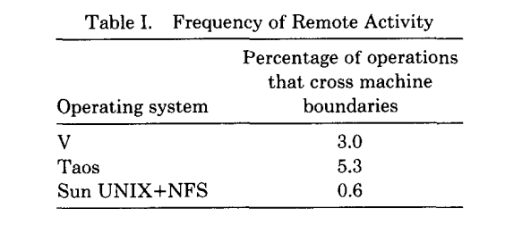
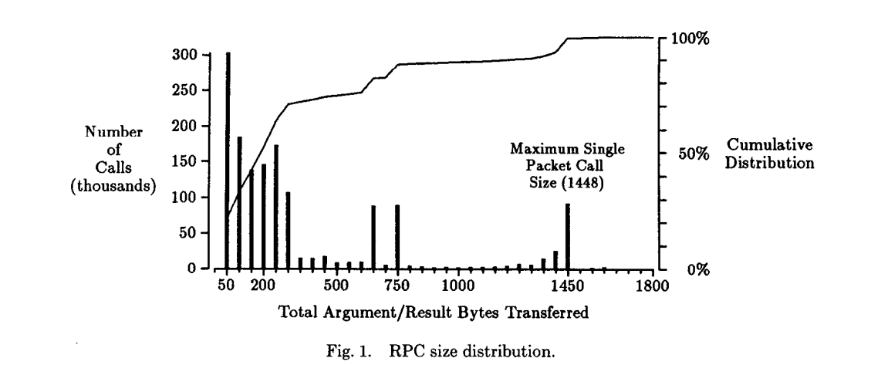
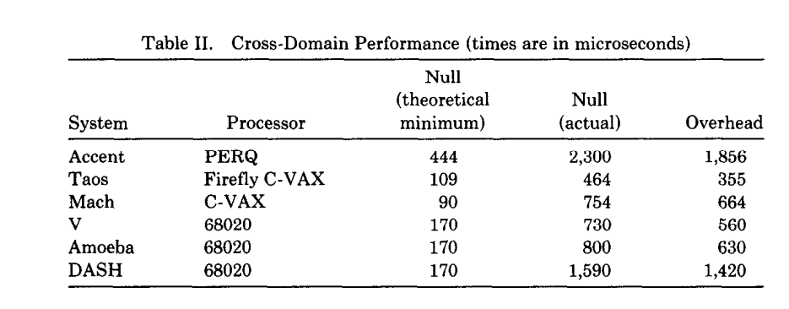
USE AND PERFORMANCE OF RPC SYSTEMS
Frequency of Cross-Machine Activity
Parameter Size and Complexity
The Performance of Cross-Domain RPC

Slide 8
Design and Implementation of LRPC
Execution Model
Binding
Calling
Stub Generation
LRPC on Multiprocessor (MP)
Argument Copying

Slide 9
LightRPC Discussion
In the world of Unix, are LRPC still relevant today?
How are portals different from LightRPC?

