Slide 1
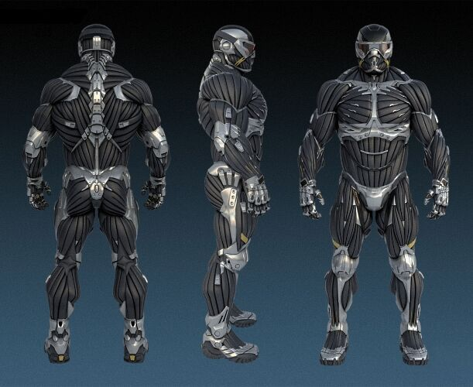
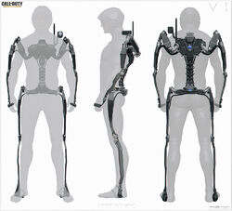
ExoKernel: An operating system architecture for application-level resource management

Slide 2
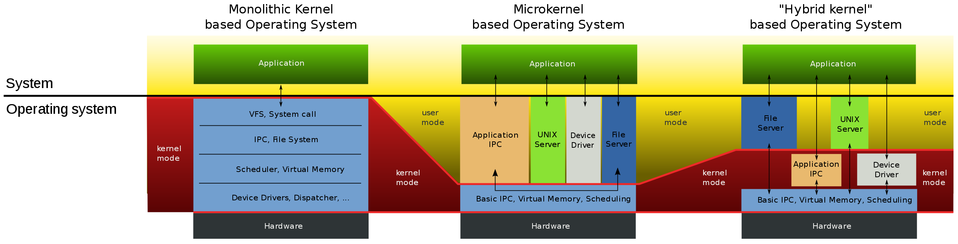
Complaints about Traditional OS’s
OS is doing too many things.
Fixed OS abstractions are evil (limiting).

Slide 3
Decouple Protection from Management
Give application/user maximum control.
Defining abstractions, scheduling processes, …
Securely expose hardware, avoid resource management.
Potential benefits…
Domain Specific Architecture.
Efficient, light-weight, and simple kernel design.

Slide 4
ExoKernel: A minimal kernel that multiplexes available resources to untrusted software and allows the software to create its own abstractions.

Slide 5

Library “OS” (Applications)
The rest of the “OS”.
Unprecedented control of physical resources and abstractions.
Request specific pages.
Access physical addresses.
Create your own VM and IPC structure.
Can also maintain its own resource policy.
But ExoKernel can as well…

Slide 6
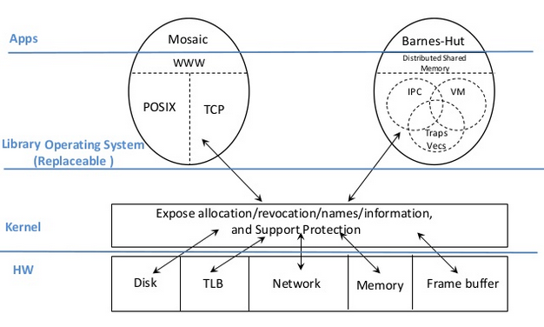

Slide 7

What is ExoKernel Doing?
Tracking resource ownership.
Protecting resource usage.
Revoking resource access.
How Does ExoKernel Do it?
Secure Binding.
Visible Resource Revocation.
Abort.

Slide 8

Secure Binding
Simple ExoKernel primitives for resource protection checks.
Protect resources/applications without understanding them.
Decouples authorization from usage.
Three techniques:
Hardware Mechanisms (capabilities).
Software Caching.
Downloading Code (mini-program).

Slide 9

Visible Resource Revocation
Usually OS does invisible resource revocation.
Exokernel informs application.
Kernel informs, applications prepare for and handle deallocation.
But…
Invisible is better when revocation is frequent.

Slide 10

Abort
Forced visible revocation (ExoKernel’s “Policy”).
When initial revocation request does not go well.
Request → Command.
Breaks All secure bindings to the application.
Besides a couple vital memory pages.
Repossession Vector.
Besides a couple vital resources.

Slide 11
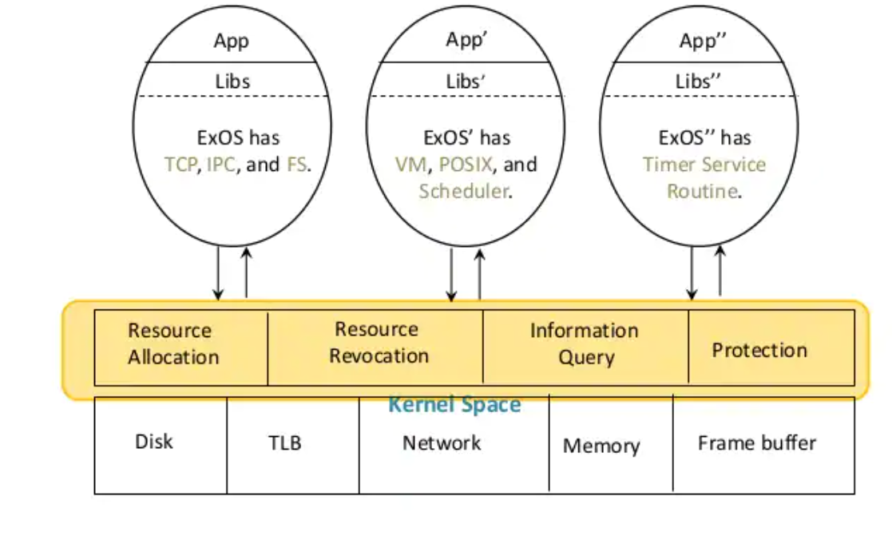
Aegis + ExOS vs. Ultrix 4.2 / Unix

Slide 12
Experiment Takeaways
Ultrix is better in some ways, and ExoKernel is as well.
Removes overhead.
Direct physical memory access.
Efficient cache-miss handling.
Usable for networks:
Download code into kernel and secure bind to network.

Slide 13
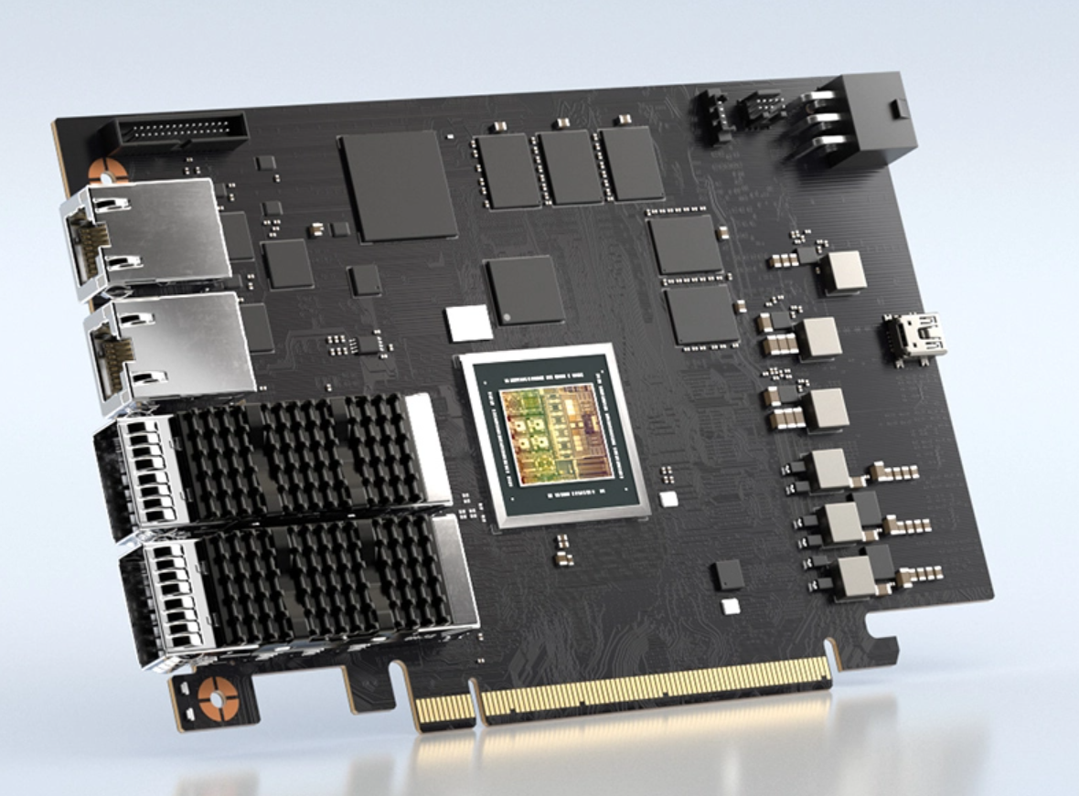
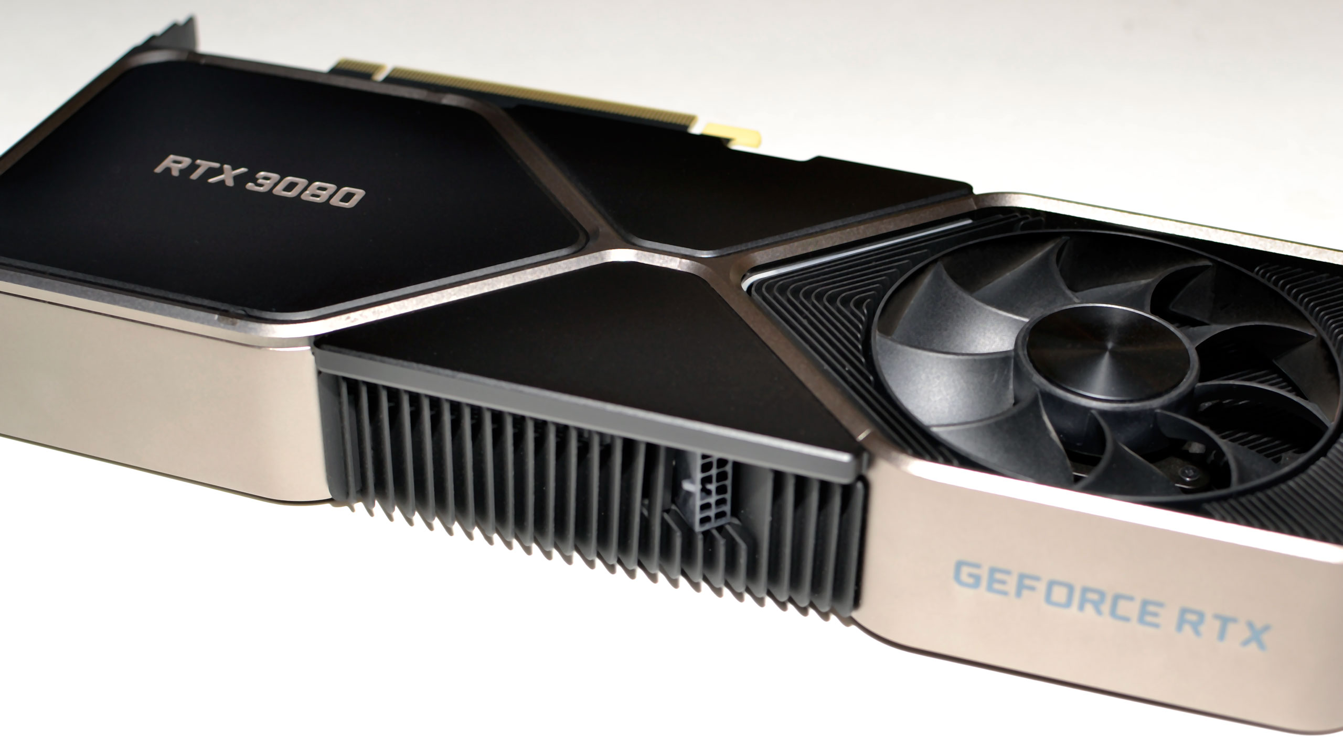
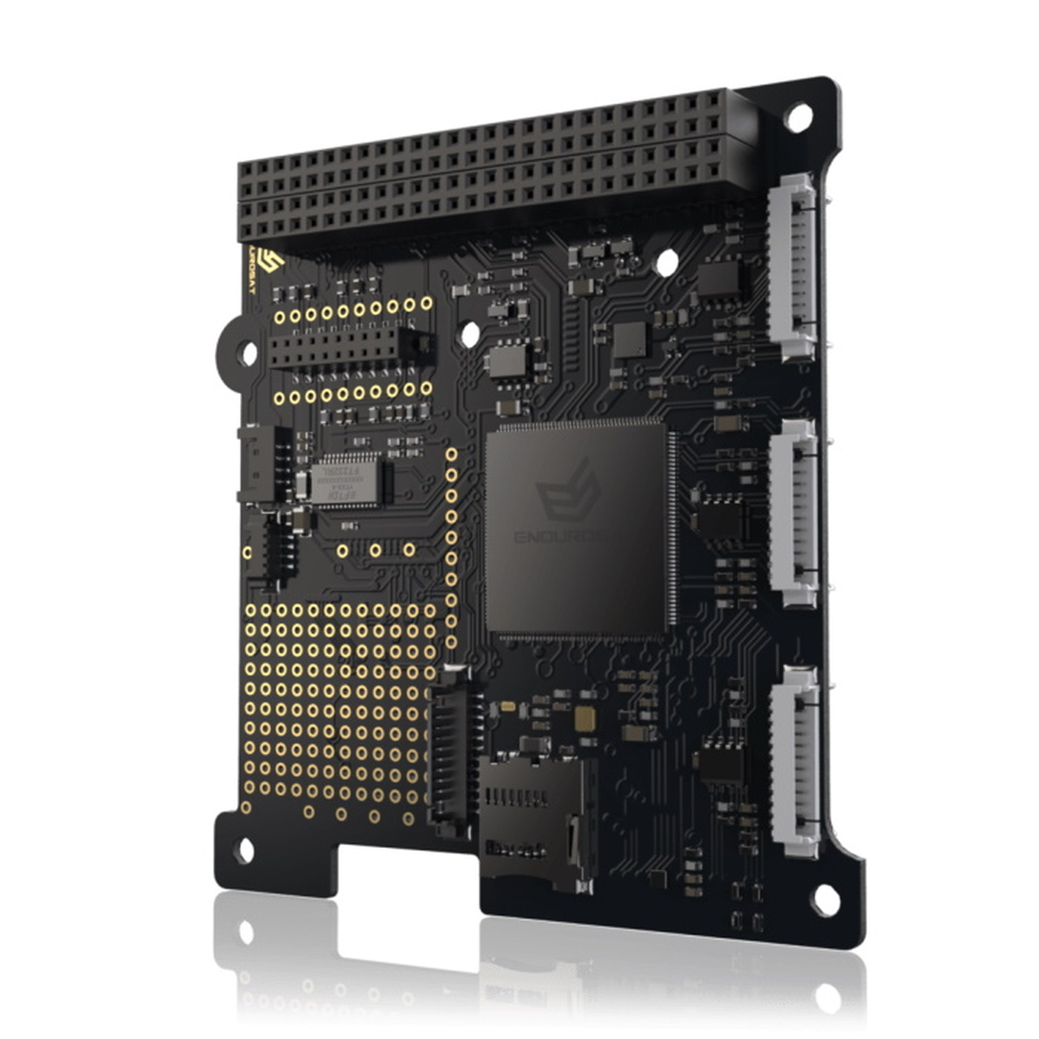
Discussion/Comments
Authors were onto something.
Computer Architecture leaning more into DSA.
GPU, DPU, TPU, etc.
Why not used more today?
Still not researched and tested enough, reduces consistency, …
Low level hardware abstractions are not easy to create (kernel doesn’t care).

