Slide 1




Typescript

Slide 2
TypeScript
Typescript adds basically types to javascript which enables program to identify the errors ahead of runtime during compilation.
TypeScript supports OOPS concepts like classes, interfaces, inheritance, etc.
Angular framework itself is built on typescript

Slide 3
Working with TypeScript:
Write
code in ts file app.ts
Compile
ts file to js tsc app.ts
Run
app.js file node app.js
Note: As TypeScript is only for development purpose, and not used in runtime, It should be installed as dev dependency.
If you don’t find tsc command
Do following in your working directory:
npm install typescript --save-dev
Then use below path for tsc
node_modules/typescript/bin/tsc app.ts

Slide 4
TypeScript Compiling to JS
Typescript | Javascript (Generated by ts 1.8.10 )
var message:string = "Hello World" console.log(message) | var message = "Hello World"; console.log(message);
class Greeting { greet():void { console.log("Hello World!!!") } } var obj = new Greeting(); obj.greet(); | var Greeting = (function () { function Greeting() { } Greeting.prototype.greet = function () { console.log("Hello World!!!"); }; return Greeting; }()); var obj = new Greeting(); obj.greet()

Slide 5
Types

Slide 6
Data type | Keyword | Description
Number | number | Double precision 64-bit floating point values. It can be used to represent both, integers and fractions.
String | string | Represents a sequence of Unicode characters
Boolean | boolean | Represents logical values, true and false
Void | void | Used on function return types to represent non-returning functions
Null | null | Represents an intentional absence of an object value.
Undefined | undefined | Denotes value given to all uninitialized variables
Statements valid in js but error in ts
var num:number = "hello" // compile error string can’t be assigned to number
var num = 2; // data type inferred as number though we didn’t mention console.log("value "+num); num = "12"; //compiler error as variable is number above, we can’t assign string console.log(num);

Slide 7
Decision Making
Statement | Example
If | if (num > 0) { console.log("number is positive") }
If.. Else | if (num % 2==0) { console.log("Even"); } else { console.log("Odd"); }
Nested If | if(num > 0) { console.log(num+" is positive") } else if(num < 0) { console.log(num+" is negative") } else { console.log(num+" is neither positive nor negative") }
Switch | switch(grade) { case "A": { console.log("Excellent"); break; } default: { console.log("Invalid choice"); break; } }

Slide 8
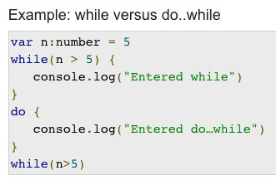
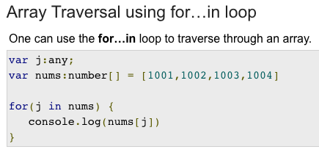
Loops

Slide 9
Operators
The major operators in TypeScript
Arithmetic operators // +, -, *, /, %, **, ++, --
Logical operators // &&, ||, !
Relational operators // ===, ==, !==, !=, <=, <, >=, >
Bitwise operators
Assignment operators //=, +=, -=, *=, /=
Ternary operator. // var result = 1 > 0 ? "positive” : ”negative”;
String operator // var msg:string = "hello"+"world";
Type Operator. // var num = 12; console.log(typeof num);

Slide 10
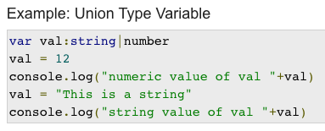
Tuples
var name = [value1,value2,value3,…value n]
let x: [string, number]; // Declare a tuple type
x = ["hello", 10]; // OK
x = [10, "hello"]; // Error
Union

Slide 11
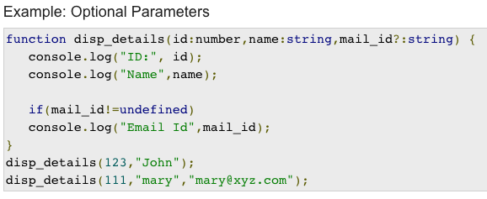
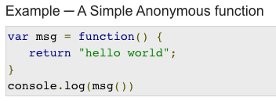
Functions
function name (param1[:type], param2[:type], param3[:type])

Slide 12
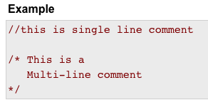
Lamda Functions
Typescript | Javascript
var foo = (x:number) =>10 + x console.log(foo(20)) //outputs 30 | var foo = function (x) { return 10 + x; }; console.log(foo(20)); //outputs 30
Comments in TypeScript

Slide 13
Interfaces
an interface defines the syntax that any entity must adhere to
Interfaces define properties, methods, and events, which are the members of the interface.
Interfaces contain only the declaration of the members
It is the responsibility of the deriving class to define the members
//Example: Interface and Objects
interface IPerson {
firstName:string,
lastName:string,
sayHi: ()=>string
}
var customer:IPerson = {
firstName:"Tom",
lastName:"Hanks",
sayHi: ():string =>{return "Hi there"}
}
console.log("Customer Object ")
console.log(customer.firstName)
console.log(customer.lastName)
console.log(customer.sayHi())
var employee:IPerson = {
firstName:"Jim",
lastName:"Blakes",
sayHi: ():string =>{return "Hello!!!"}
}
console.log("Employee Object ")
console.log(employee.firstName);
console.log(employee.lastName);
//Interface Inheritance
interface Person {
age:number
}
interface Singer extends Person {
song:string
}
var s = <Singer>{};
s.age = 27
s.song = "Bla Bla"
console.log("Age: "+s.age)
console.log("Song: "+s.song)

Slide 14
Classes
//Class Inheritance
class Shape {
area:number
constructor(a:number) {
this.area = a
}
}
class Circle extends Shape {
disp():void {
console.log("area:"+this.area)
}
}
var obj = new Circle(223);
obj.disp()
//Method Overriding
class Printer {
doPrint():void {
console.log("Parent print…")
}
}
class StringPrinter extends Printer {
doPrint():void {
//super.doPrint()
console.log(”Child print…")
}
}
var obj = new StringPrinter()
obj.doPrint()
//Class with Interface
interface Loan {
roi:number
}
class MyLoan implements Loan {
roi:number
fee
constructor(roi:number, fee) {
this.roi = interest
this.fee = fee
}
}
var a = new MyLoan(10,1)
console.log(”ROI:"+a.roi+" Fee:"+a.fee)
A class in terms of OOP is a blueprint for creating objects
A class encapsulates data for the object.
A class definition can include Fields, Constructors and Functions

Slide 15
Access Specifiers
Access | Description
public | has universal accessibility, members in a class are public by default.
private | accessible only within the class, compiler throws error on external access
protected | accessible within same class as that of the former and by the child classes
//Example for private
class Hello {
s1:string = "hello"
private s2:string = "world"
}
var obj = new Hello()
console.log(obj.s1) //accessible
console.log(obj.s2) //Error: as s2 is private
Static Members
instanceof operator
class Hi {
static name:string; //declare static
static disp():void {
console.log("Hi, "+ Hi.name)
}
}
Hi.name = ”Raj" // initialize static variable
Hi.disp(). //invoked using class name
// Example for instanceof operator
class Person{ }
var obj = new Person()
var isPerson = obj instanceof Person;
console.log("is Person? " + isPerson);

Slide 16
var, let and const
var can be accessed outside of a block in which it is declared (but inside function block only)
let can only be accessed inside the block in which it is declared
const is same as let in scope, the difference is that it doesn’t allow reassigning value.
Only once we can assign its value
function fun()
{
if(true)
{
let l2=20;
var v2=20;
console.log(l2); //Output 20
console.log(v2); //Output 20
}
console.log(l2); //Compiler Error l2 not found
console.log(v2); //Output 20
}
fun();
const PI = 3.14; PI = 12; // Error: Assignment to const variable.

Slide 17
Arrays
//declaring arrays
let a1: string[];
let a2: string[] = [];
let a3: string[] = new Array();
let a4: string[] = Array();
let s1: number[] = [10, 20, 30, 40];
let s2: Array<number> = [5, 4, 2, 3];
// adding new elements
s1.push( 50 );
s1.push(‘xyz’); //Error: we can’t add string to number array
//iterate through array
for (var s of s1) {
console.log(s); //Outputs 10 20 30 40
}
//clone array
let cs2 = [...s2];
s2.push(1);
console.log(s2);
console.log(cs2);
//add new values to array while cloning
let cs3 = [...s2, 7, 8];
console.log(s2);
console.log(cs3);
//merge arrays
let ms = [...s1, ...s2];
console.log(ms); //[ 10, 20, 30, 40, 50, 60 ]

Slide 18
Map
A Map allows us store key-value pairs
Map is introduced in latest versions so use lib above 2015, Use below:
tsc --lib dom,es2018 app.ts
//declaration
let m1 = new Map();
//declare with initial values
let m2 = new Map([
[”k1", ”v1"],
[”k2", ”v2"]
]);
//Iterate over map keys
for (let key of m2.keys()) {
console.log(key); //k1, k2
}
//Iterate over map values
for (let value of m2.values()) {
console.log(value); //v1, v2
}
//Iterate over map entries
for (let entry of m2.entries()) {
console.log(entry[0], entry[1]); //k1 v1 k2 v2
}
//Methods to access map elements
let m4 = new Map();
//Add entries in Map
m4.set("Raj", 35);
m4.set("John", 40);
//Get entries
m4.get("John"); //40
//Check entry is present or not
m4.has(”Raj"); //true
//Size of Map with
m4.size; //2
//Delete an entry
m4.delete(”Raj"); // true
//Clear all entries
m4.clear();

Slide 19
Set
It allows you store distinct values into a List
//declaration
let s1 = new Set();
//Add values
s1.add(1).add(2).add(3).add(4);
//Chaining of add() method is allowed
//Iterate over set entries
for (let i of s1) {
console.log(i); //1 2 3 4
}
// Iterate set entries with forEach
s1.forEach(function(value) {
console.log(value); //1 2 3 4
});
let diceEntries = new Set();
//Add Values
diceEntries.add(1);
diceEntries.add(2);
diceEntries.add(3).add(4);
//Check value is present or not
diceEntries.has(1); //true
diceEntries.has(10); //false
//Size of Set
diceEntries.size; //6
//Delete a value from set
diceEntries.delete(6); // true
//Clear whole Set
diceEntries.clear(); //Clear all entries

Slide 20
Generics
Generics allows to create a component that can work over a variety of types rather than a single one.
function throwBack<T>(arg: T): T { //Function return the parameter as it is
return arg;
}
let outputStr = identity<string>("myString"); //OK
let outputNum = identity<number>( 100 ); //OK
let days: string[] = [”1-Sun",”2-Mon",”3-Tue", ”4-Wed", ”5-Thu", ”6-Fri", ”7-Sat"]
let days2: number[] = [ 1, 2, 3, 4, 5, 6, 7 ];
function getMax<T>(days: T[]): T{
return days.sort().pop();
}
console.log(getMax(days));
console.log(getMax(days2));

Slide 21
Type Assertions
Modules
Modules are executed within their own scope, not in the global scope;
Members declared in a module are not visible outside
Modules are declarative; the relationships between modules are specified in terms of imports and exports at the file level
Modules import one another using a module loader.
//Convert one type to other to use its members
//Also called as TypeCasting
//Option#1 use ‘as string’
let s1: any = "this is a string";
let s1Len: number = (s1 as string).length;
//Option#2 use <string>
let s2: any = "this is a string";
let s2: number = (<string>s2).length;
//Export Example
export class StringValidator {
isValid(s: string): boolean {
return s != null
};
}
//Import Example
import {StringValidator } from "./StringValidator ";
let myValidator = new StringValidator();
myValidator.isvalid(“xyz”);
Type Alias
type Hour = number;
let time1: number = 10;
let time2: Hour = 10;
console.log(typeof time1)
console.log(typeof time2)

Slide 22
Decorators
In general sense, decorators are annotations. They are used with '@' symbol. It allows us to decorate classes and functions, similar to annotations in java and decorators in python.
Note: It is important to learn that every decorator is javascript function. To create decorator, create function like this:
function Get ( target ) { //Decorator impl
target.prototype.name = 'Raj'
}
@Get //Decorator
class Person {
name;
getName(){
return this.name;
}
}
let admin = new Person();
console.log(admin.getName()); // Raj
Note: Decorators are an experimental feature;
To enable experimental support for decorators, enable the compiler option either on the command line or in your tsconfig.json:
tsc --target ES5 --experimentalDecorators app.ts s

Slide 23
Summary:
TypeScript is the ES6 version of JavaScript + a few other TypeScript only features which Angular needs in order to work.
TypeScript is superset of JavaScript. It scales JavaScript with datatype support.
Existing JavaScript programs are also valid TypeScript programs.
TypeScript is only for development. To run in browser, it must be converted to either ES6 or ES5 version of JavaScript.

Slide 24
Types
Object Types | Example
Array | var names:string[]=[“ts, ”js”, ”java”]
Tuple | let row=[1, “ts”, true]
Interface | interface ICalc { square (n: number): number; } let Calculator: ICalc = { square (n: number) { return n * n; } }
Class | class Person { name: string; constructor(name: string) { this.name = name; } show(): void { console.log(“Hello “+name); } }
Enum | enum Colour { Red, Green, Yellow } let c1: Colour = Colour.Red; //OK let c2: Colour = ”Blue”; // Error
Function | let fun: Function = () => console.log("Hello"); fun=“xyz” // Error: string can’t be assigned to type Function
Type | type Colour = ”Red" | ”Green" | ”Blue"; let c: Colour; c = ”Red"; //OK console.log(d) c=”Orange"; //Error: not assignable to type Colour
Primitives | Example
number | let num: number = 123; num = 123.456; num = '123'; // Error
string | let str: string = 'hello';
boolean | let bool: boolean = true;
void | function warnUser(): void { alert("message"); }
null | let name=null;
undefined | let x;
any | let val: any = 'hello'; val = 123; // OK val = true; // OK

