Slide 1




ANGULAR PROJECT STRUCTURE

Slide 2

Folders in app
e2e/ − end to end test folder. Mainly e2e is used for integration testing and helps ensure the application works fine.
node_modules/ − The npm package installed is node_modules. You can open the folder and see the packages available.
src/ − This folder is where we will work on the project using Angular. Inside src/ you will have app/ folder created during the project setup and holds all the required files required for the project.
Note: The src/ folder is the main folder, which internally has a different file structure.

Slide 3
Files in app folder
angular.json − It basically holds the project name, version of cli, etc.
.editorconfig − This is the config file for the editor.
.gitignore − A .gitignore file should be committed into the repository, in order to share the ignore rules with any other users that clone the repository.
package.json − The package.json file tells which libraries will be installed into node_modules when you run npm install.
Note: In case you need to add more libraries, you can add those over here and run the npm install command.
tsconfig.json − This basically contains the compiler options required during compilation.
tslint.json − This is the config file with rules to be considered while compiling.

Slide 4
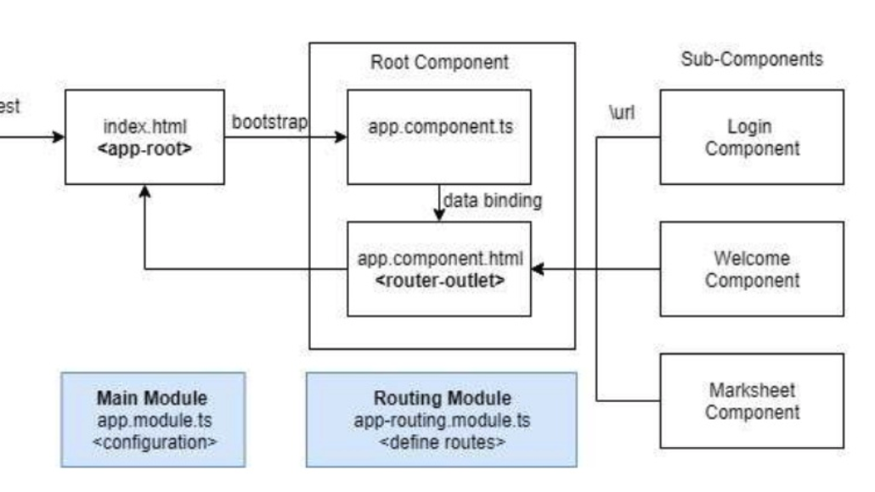
Project Flow

Slide 5
Key components
File app.module.ts contains configuration of the application.
File app-routing.module.ts contains url mapping of components. Components are accessed by their mapped urls.
File app.component.ts contains definition of Root- Component
File index.html is first page of application. It bootstraps root component.
For new UI screens new components are created called sub components
File main.ts from where we start our project.

Slide 6
main.ts
main.ts is the file from where we start our project. It starts with importing basic module which we need. Right now if you see angular/core, angular/platform-browser-dynamic, app.module and environment is imported by default during angular-cli installation and project setup.
The platformBrowserDynamic().bootstrapModule(AppModule) has the parent module reference AppModule. Hence, when it executes in the browser, the file is called index.html. Index.html internally refers to main.ts which calls the parent module, i.e., AppModule when the last line of the code executes −
When AppModule is called, it calls app.module.ts which further calls the AppComponent based on the bootstrap −
In app.component.ts, there is a selector: app-root which is used in the index.html file. This will display the contents present in app.component.html.

Slide 7
app.module.ts
It will have the imports (dependent classes, etc) required for the module.
BrowserModule provides services that are essential to launch and run a browser app. BrowserModule also re-exports CommonModule from @angular/common , which means that components in the AppModule module also have access to the Angular directives every app needs, such as NgIf and NgFor .
We can see app-routing.module is also added. This is because we had selected routing at the start of the installation. The module is added by @angular/cli.
@NgModule is imported from @angular/core and it has object with following properties −
Declarations − In declarations, the reference to the components is stored. The App component is the default component that is created whenever a new project is initiated. We will learn about creating new components in a different section.
Imports − This will have the modules imported as shown above.
Providers − This will have reference to services created. service will be discussed later.
Bootstrap − This has reference to the default component created, i.e., AppComponent.

Slide 8
app-routing.module.ts
This file will deal with the routing required for your project. It is connected with the main module, i.e., app.module.ts. We must configure routes of application in this file.
app.component.ts
The class for the component is defined over here. You can do the processing of the html structure in the .ts file. The processing will include activities such as connecting to the database, interacting with other components, routing, services, etc. This is configured as root component
index.html
This is the file which is displayed in the browser. The body has <app-root></app-root>. This is the selector which is used in app.component.ts file and will display the details from app.component.html file.

Slide 9
Other files
polyfill.ts
This is mainly used for backward compatibility.
styles.css
This is the style file required for the project.
test.ts
Here, the unit test cases for testing the project will be handled.
tsconfig.app.json
This is used during compilation, it has the config details that need to be used to run the application.
tsconfig.spec.json
This helps maintain the details for testing config.
typings.d.ts
It is used to manage the Typescript definition.

Slide 10
Components
Major part of the development with Angular is done in the components. Components are basically classes that interact with the .html file of the component, which gets displayed on the browser. We have seen the file structure for default component earlier.
The application logic to support various functions like data binding, event binding, etc.
The file structure for the app component and it consists of the following files −
app.component.css
app.component.html
app.component.spec.ts
app.component.ts

Slide 11
Adding New Component
Now, angular-cli has a command to create our own component. However, the app component which is created by default will always remain the parent and the next components created will form the child components.
Let us now run the command to create the component with the below line of code −
ng generate component cmp2
Or
ng g c cmp2
Once the command successfully executed you will see new folder structure created for cmp2.
And also app.module.ts updated with the new component automatically
New component had a class which implements OnInit in which there is a constructor and a method called ngOnInit(). ngOnInit is called by default when the class is executed.

Slide 12
By default cmp2 wont display anythis in the browser as its selector element was not present in the html anywhere.
So, to make cmp2 render to ui take the selector from app.cmp2.ts and update the app.component.html as it is the parent component.
Update the cmp2 component to have a member variable and use that in html template.
Update some style in newly generated css file as below and verify it in browser.
p {
color: blue;
font-size: 25px;
}

Slide 13
component metadata
Metadata associates a template with the component, either directly with inline code, or by reference. Together, the component and its template describe a view.
Following are the most used properties defined in metadata:
selector: A CSS selector helps Angular to create and insert an instance of the component wherever it finds the corresponding tag in template HTML.
templateUrl: The module-relative address of the component’s HTML template.
template: The inline HTML template defined in `//html stuff goes here`.
styleUrls: One or more URLs for files containing CSS style-sheets specific only to this component.
styles: One or more inline CSS style-sheets specific only to this component.
import { Component } from '@angular/core';
@Component({
selector: 'app-root',
templateUrl: './app.component.html',
styleUrls: ['./app.component.css']
})
export class AppComponent {
title = 'app1';
}

Slide 14
templates and views
A template is an HTML snippet that tells Angular how to render the component in angular application.
The template is immediately associated with a component defines that component’s view.
Types of Templates
1. Inline Template
@Component({
selector: 'app-root',
template: ‘<div>inline template works</div>',
styles: [‘div { font-weight: bold; }’]
})
2. Template File
@Component({
selector: 'app-root',
templateUrl: './app.component.html',
styleUrls: ['./app.component.css']
})

Slide 15
Modules
Module in Angular refers to a place where you can group the components, directives, pipes, and services, which are related, in such a way that can be combined with other modules to create an application.
To define module, we use the NgModule, during new project creation using angular cli a default module is created with name app.module.ts
The NgModule needs to be imported from core to use NgModule decorator over our class AppModule.
We need to import all the other modules that are required in the declaring module.
We need to import all the components in the current module.
We can create new module using below ng cli command
ng generate module mod2
Or
ng g m mod2

Slide 16
It starts with @NgModule and contains an object which has declarations, imports, providers and bootstrap.
declarations:
It is an array of components. any new component will be imported first, reference will be included here.
imports:
It is an array of modules required. It can also be used by the components in the Declaration array.
exports:
It is an array of components that need to be shared with other modules.
Providers:
This will include the services created.
Bootstrap:
This includes the main app component for starting the execution.
declarations: [
AppComponent, NewCmpComponent
]
imports: [
BrowserModule, FormsModule
]

Slide 17
Routing
Routing basically means navigating between pages, Here the pages means components
During project setup, we have included the routing module and same is in app.module.ts
app-routing.module is generated during setup and it has a const routes defined which is of type Routes. It is an array which holds all the routes we need in our project.
const routes: Routes = [ {path:"home", component:HomeComponent}, {path:"contactus", component:ContactusComponent} ];
To display the routing details to the user, we need to add <router-outlet> directive where we want the view to be displayed. The same is added in app.component.html
Add some paths in app.component.html
<h1>Angular Routing Demo</h1> <nav>
<a routerLink = "/home">Home</a>
<a routerLink = "/contactus">Contact Us </a> </nav>
<router-outlet></router-outlet>
As you click on the link, you will also see the page url in the address bar changing. It appends the path details at the end of the page

Slide 18
Multi Modules and Lazy Loading
If app size is growing and we want load some modules only when they are clicked in the browser then we can use lazy loading
Configure route of module in the routes array of router module as below to lazy load
{
path: 'admin',
loadChildren: () => import('../admin/admin.module').then(m => m.AdminModule)
}
AuthGuard for a page or protect a page from public access or role-based access.
Configure route of page in the routes array of router module as below
And create a service to return a Boolean value if user is authorized
{
path: 'admin',
canActivate: [AuthGuardService],
data: { roles: ['Admin'] },
component: LoginComponent
// loadChildren: () => import('../admin/admin.module').then(m => m.AdminModule)
}

Slide 19
Authentication
Create a service class which had authenticate method and validates the username and password
Create a login component with username and password fields, bind login click event to invoke the above service
The service will validate the user and stores the reponse session token in the sessionStorage.
Subsequent http requests should include the session token in the request inorder to get the data from backend service
If there is any AuthGuard service configured for any page then the app will validate the user against the token stored in the sessionStorage.
AuthGuard service can check if user is authenticated or authorized to use the page.

