Slide 1




ANGULAR

Slide 2
Angular History
Version | Released Date
Angular JS | October 2010
Angular 2.0 | Sept 2016
Angular 4.0 | March 2017
Angular 5.0 | November 2017
Angular 6.0 | May 2018
Angular 7.0 | October 2018
Angular 8.0 | April 2019
Angular 9.0 | October 2019
Angular is owned by Google
List of Angular versions released so far −
Google plans to release the major Angular version every 6 months. The version released so far are backward compatible and can be updated to the newer one very easily.

Slide 3
What is ANGULAR
Angular is a JavaScript Framework
Angular is used to build client-side applications using HTML
Angular bootstraps JavaScript with HTML tags.
Angular is used to make rich UI application.
Angular enhances UI experience for User.
Angular code is written in TypeScript language
TypeScript is compiled into JavaScript
JavaScript is used in HTML pages

Slide 4
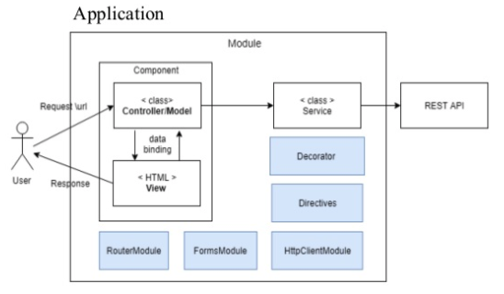
Angular Application
An application contain Modules
Module contains components
Component uses Services
Services contains data and reusable business methods
Basic building block of Angular is Component
It is said that Angular follows Component/Service architecture.
Internally it follows MVC Architecture
One Module’s components and services can be used by another module
Notes:
Use Bank App reference withdrawal (Account, Amount), deposit, transfer, investments, profile (update password, pone, email)

Slide 5
Angular - Environment Setup
In this chapter, we will discuss the Environment Setup required for Angular.
To install Angular, we require the following −
NodeJs/Npm
Angular CLI
IDE for writing Code (Visual Studio Code)
Notes:
From NodeJS we use few utilities like npm just to manage our project dependencies, we no need to learn node just install and use it.
Angular uses TS from MS and VS Code also from MS so it includes cool features to deal with TS like debugging etc

Slide 6
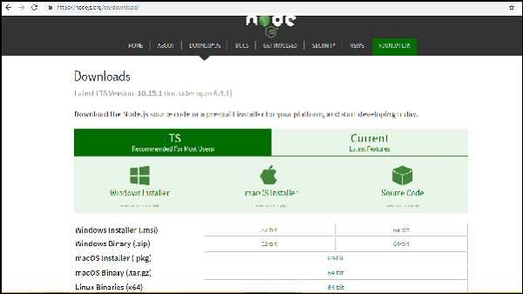
Nodejs/Npm
Check node version using command prompt
node –v
v12.18.3
If it does not print anything, install nodejs on your system. To install nodejs, go to the homepage, https://nodejs.org/en/download/ of nodejs and install the package based on your OS.
npm -v
6.14.6

Slide 7
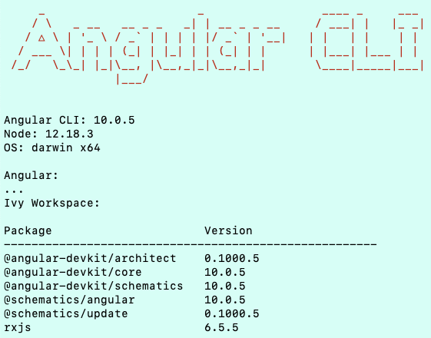
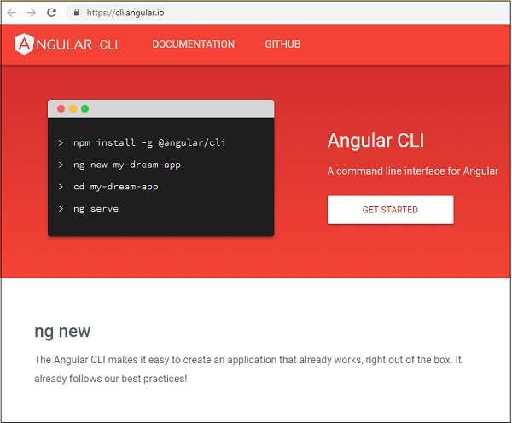
Angular CLI
It will take a while to install and once done you can check the version using below command −
It will display version details of angular - cli as well version of other packages as shown below −
npm install –g @angular/cli
** Use sudo npm install –g @angular/cli if you face access issues
ng version
Angular installations are very simple with the help of angular CLI.
Visit the homepage https://cli.angular.io/ of angular to get the reference of the command. And basic commands to start

Slide 8
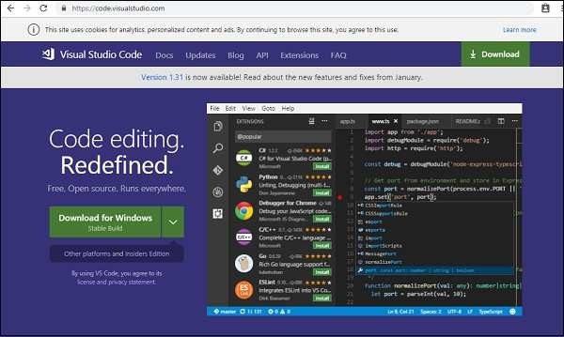
Visual Studio Code
If you don’t have VS Code installed, download and install it from
the VS Code website https://code.visualstudio.com/download

Slide 9
Angular – Project Setup
In this chapter, we shall discuss about the Project Setup in Angular.
To get started with the project setup, make sure you have installed all valid versions:
1. node –v
2. npm –v
3. ng version
To create a project, we use the following command −
ng new projectname
You can use the projectname of your choice.
Let us now run the above command in the command line.
Refer to Angular CLI website for more commands: https://cli.angular.io

Slide 10

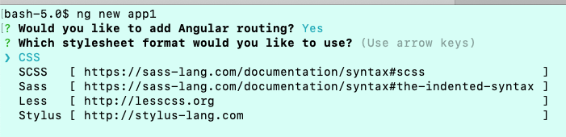
Create Project
First cd to the desired location where you want create application
Here, we use the projectname as app1. Once you run the command it will ask you about routing as shown below −
Type y to add routing to your project setup.
The next question is about the stylesheet −
The options available are CSS, Sass, Less and Stylus. In the above screenshot, the arrow is on CSS. To change, you can use arrow keys to select the one required for your project setup. At present, we shall discuss CSS for our project-setup.

Slide 11
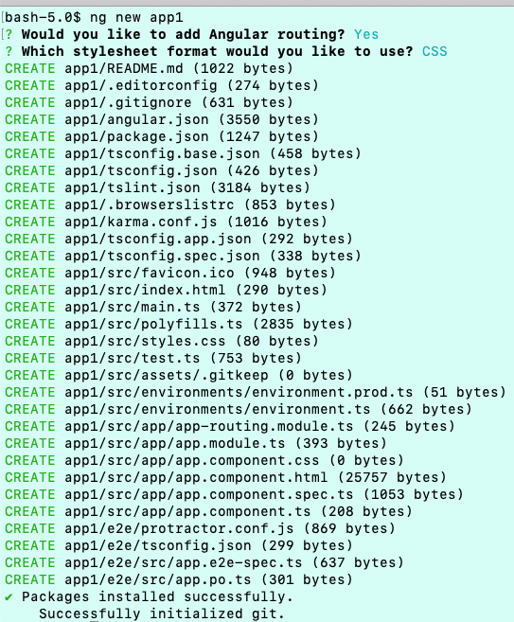
The project app1 is created successfully. It installs all the required packages necessary for our project to run in Angular. Let us now switch to the project created, which is in the directory app1.
Change the directory in the command line using the given line of code −
cd app1

Slide 12
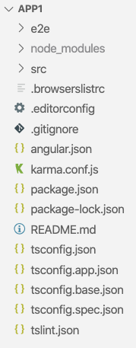
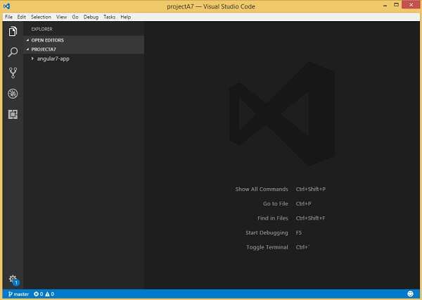
VS Code Editor
We will consider the app1 project. Let us open the app1 and see how the folder structure looks like.
Following is the Editor −
We have not started any project in it. Let us now take the project we have created using angular-cli.

Slide 13
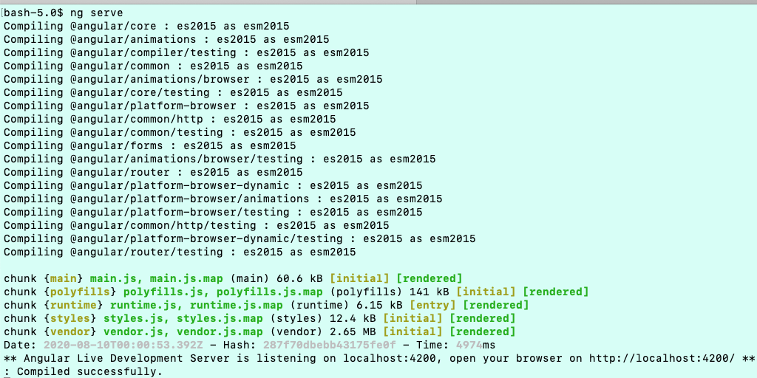
Start Application
Now that we have the file structure for our project, let us compile our project with following command −
The ng serve command builds the application and starts the web server.
ng serve

Slide 14
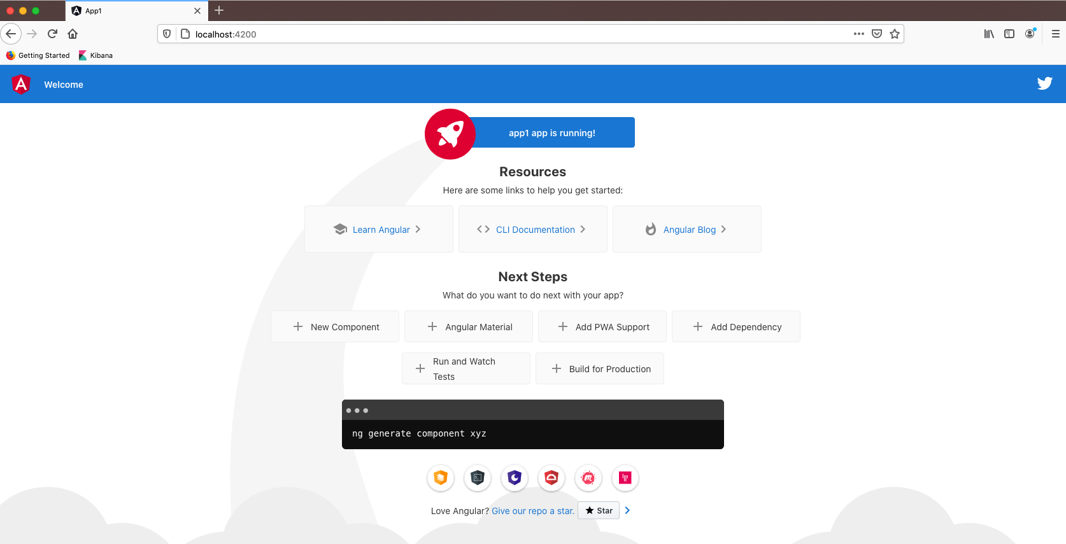
Browse Application
The web server starts on port 4200. Type the url, "http://localhost:4200/" in the browser and see the output. Once the project is compiled, you will receive the following output −

Slide 15
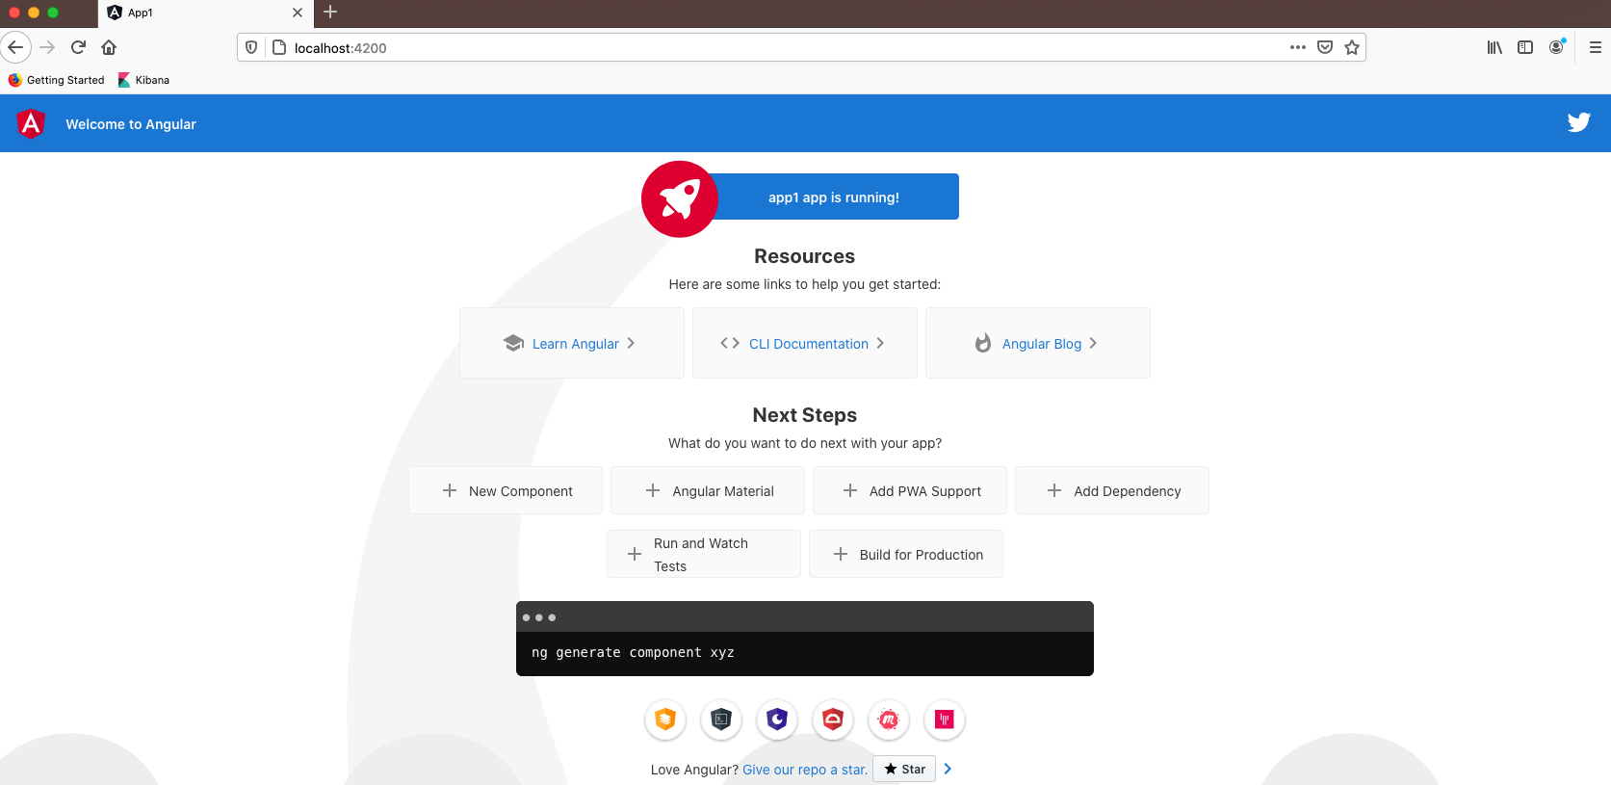
Modify Application
Let us now make some changes to display the following content −
“Welcome to Angular”
We have made changes in the files − app.component.html and app.component.ts. We will discuss more about this in our subsequent chapters.
Let us complete the project setup. If you see we have used port 4200, which is the default port that angular–cli makes use of while compiling. You can change the port if you wish using the following command −
ng serve --host 0.0.0.0 –port 4205

