Slide 1

Spring - 2024 CSE438
BanglaNewsClassifier: A Machine Learning Approach for News Classification in Bengali Newspapers.
Submission Date: 24/04/2024
Group: A21
20301154-Tanzir Hossain
20301164-Ar-Rafi Islam

Slide 2
Introduction(Objectives)
Critically analyzing Bangla media on various issues including international sports, technology, country, economy, and entertainment.
Performing in-depth content analysis to identify diversity, emotional differences, biases, and linguistic features.
Investigating objectivity and potential bias in news coverage across groups and locations.
Providing a comprehensive, data-driven understanding of the Bangla media landscape.

Slide 3
Design and Architecture:
Ensemble of machine learning models from scikit-learn library:
Decision Trees: For content classification and sensitivity analysis.
Naive Bayes classifiers: For text classification and sentiment analysis.
Random Forests: To improve robustness and accuracy of content classification.
Hierarchical training approach for balanced categories and sensitivities.
Cross-validation methods to check model performance and prevent overfitting.

Slide 4
Data Collection:
Data collected through web scraping using Selenium.
Random interval method used during scraping to prevent bot detection.
Dataset contains news stories from six categories: International, Sports, Technology, Country, Economy, and Entertainment.
Dataset overview: 98,884 rows, saved in a CSV file with class and media description columns.

Slide 5
Data Preprocessing:
Minimal processing required due to high-quality newspaper articles.
Preprocessing steps:
Removal of Bangla stop words using bangla-stemmer library.
Removal of punctuation marks for text cleanliness.

Slide 6
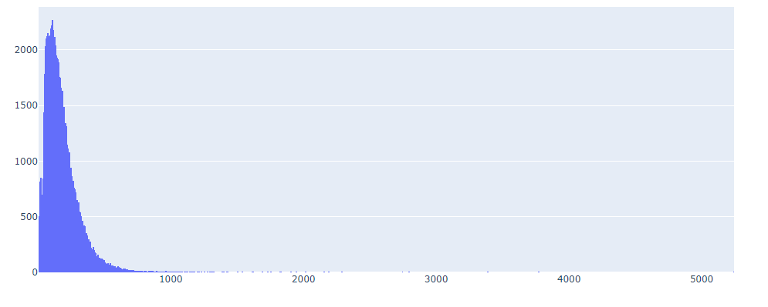
EDA (Exploratory Data Analysis):
Category Distribution: We Analyze the distribution of news articles across the six categories to understand the dataset's balance or skewness.
Text Length Analysis: Investigating the length of news descriptions by calculating summary statistics and visualize the distribution using histograms or box plots.
Text Length Histogram of news articles in the dataset

Slide 7
Text Preprocessing and Vectorization:
Tokenization: News descriptions divided into individual words or tokens.
Stemming or Lemmatization: Reduction of word inflections.
Vectorization: Conversion of preprocessed text data into numerical vectors using methods like TF-IDF.

Slide 8
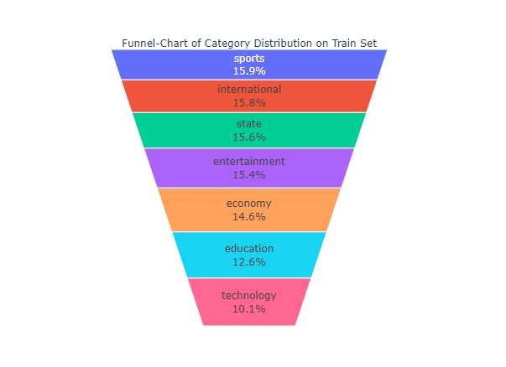
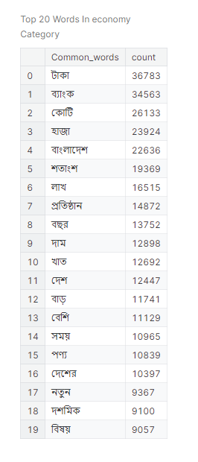
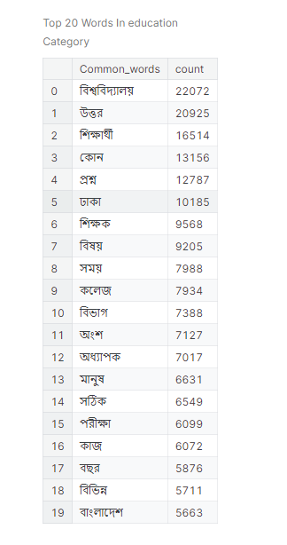
Exploratory Visualization
Category distribution visualization: Dataset is close to balance.
Analysis of subcategories for most frequently used words in the dataset.

Slide 9
Thank you!

