Slide 1

Case Study: Cyclistic Bike Share
By Cipriano arralde

Slide 2
Scenario
Cyclistic Bike Share is a fictional company based on the city of Chicago, Illinois. The company owns more than 5,800 bikes, 700 docking stations and has two types of users, member and casual.
Business questions
How do each user type use the bikes differently?
Why would casual riders buy memberships?
How can we use digital media to encourage casuals to become members?
My task
Determine how member and casual users differ in the service use

Slide 3
Data Source
The data source was provided by the case study guide.
(https://divvy-tripdata.s3.amazonaws.com/index.html)
Represents all rides taken in the year 2021
Provided by Motivate International Inc., which operates in Chicago’s Divvy Bicycle Share powered by Lyft
Cited and available under the Data License Agreement

Slide 4
Hypothesis
The main difference in the service use relies on the quantity and duration of the trips taken by each user type. Whereas:
Member users tend to take more trips with a shorter duration
Casual users tend to take fewer trips with a longer duration
Member users are locals who use the bikes to run errands, occasional transport, etc
Casual users might be tourists who ride the bikes to roam the city and sight see
Notes:
After reviewing all 12 months of data separately, I found the same trend. Member users took lots of shorter trips, and casual users did the exact opposite.
Members tend to be local citizens who choose to use the service for ocasional transport, running errands, etc.
Casuals might be tourists who chose the service to explore the city and sight see.

Slide 5
Data Manipulation
Used R to perform wrangling, cleaning and analysis. What I did:
Created trip_duration column
Created date column, then extracted weekday, hour, day, month and year
Removed duplicate, blanks and values where trip_duration <= 0
Renamed and reorganized columns

Slide 6
Quick Stats
Member Users
3.060.457 (55%) rides
13 min average trip_duration
Wednesday busiest day
July busiest month
Casual Users
2.256.236 (45%) rides
32 min average trip_duration
Saturday busiest day
September busiest month

Slide 7
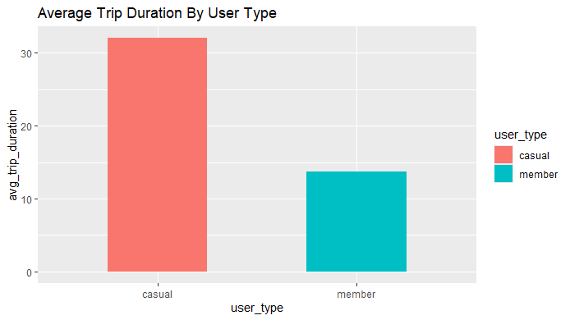
Average Trip Duration By User Type
user_type versus the average trip_duration (minutes) for each
Clear indication of service use tendencias
Reinforces my initial hypothesis

Slide 8
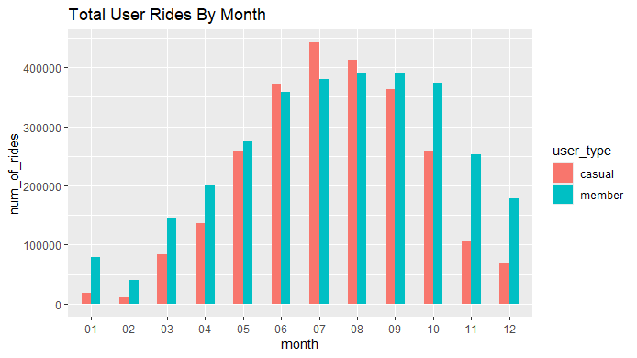
Total User Rides By Month
Ride number versus user_type by month
Shows seasonal trend, use of service peaked during summer and the beginning of autumn

Slide 9
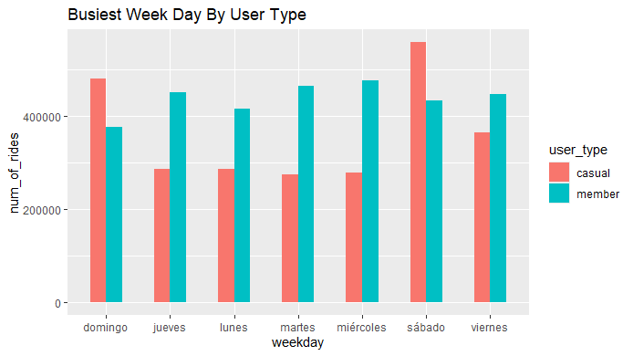
Busiest Day By User Type
Weekday versus user_type
Shows another indication of user tendencias
Members use of service keeps steady during the week, while casuals peak during weekends

Slide 10
Recommendations
Based on my hypothesis and given the previous analysis, my recommendations are:
To offer discounts in plans before the start of summer
To give benefits to clients who decide to become member users
To create weekly passes, to encourage casual users not to depend on daily passes
To offer weekend passes as well, in order to captivate casual users and encourage them to take more rides

Slide 11
Case Study: Cyclistic Bike Share
By Cipriano arralde
Thank you for listening!!

