Slide 1

Curso de creación de libros digitales
Escrito por : Alfredo Alvarez

Slide 2
Agenda
¿Que es Google Play?
Proceso de inscripcion
Herramientas para este Mercado
Demonstración

Slide 3
Google play
Es la tienda electronica para sistemas androids
Es un portal cerrado solo para las aplicaciones que lo corren
Requiere una cuenta con google
Sistema de pago super simple
Android tiene la mayor cantidad de pantallas del mundo

Slide 4
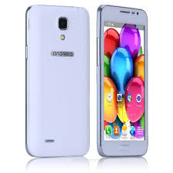
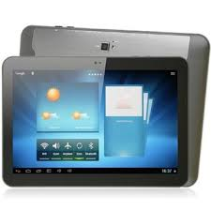
El problema
Las resoluciones

Slide 5
Dos formatos
PDF
Minimum resolution:
Content pages: 400 pixels per inch binary; 200 ppi grayscale or color
Images and book covers: 300 ppi color If a page of your book measures 8 inches by 10 inches, your minimum resolution for optimal display is 2400 pixels by 3000 pixels (8 * 300 by 10 * 300).
EPUB

Slide 6
¿Como crear la cuenta?
https://play.google.com/books/publish

Slide 7
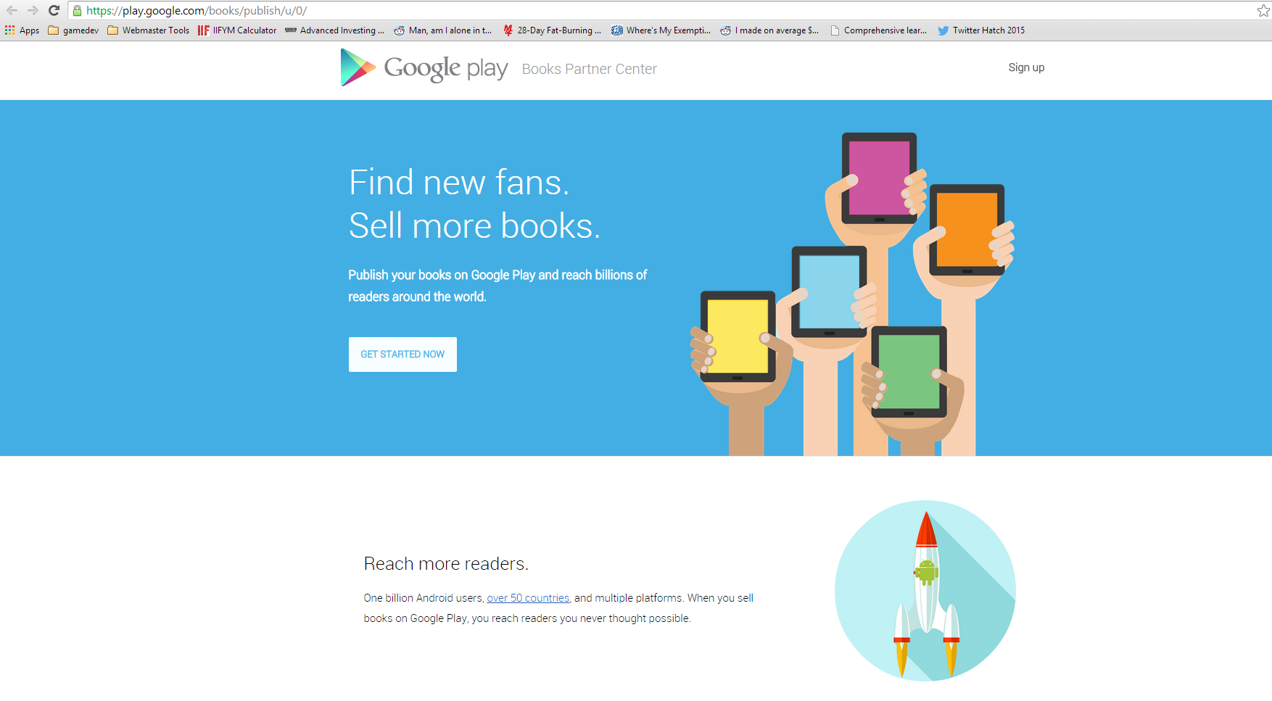
Demonstracion Ibook

Slide 8
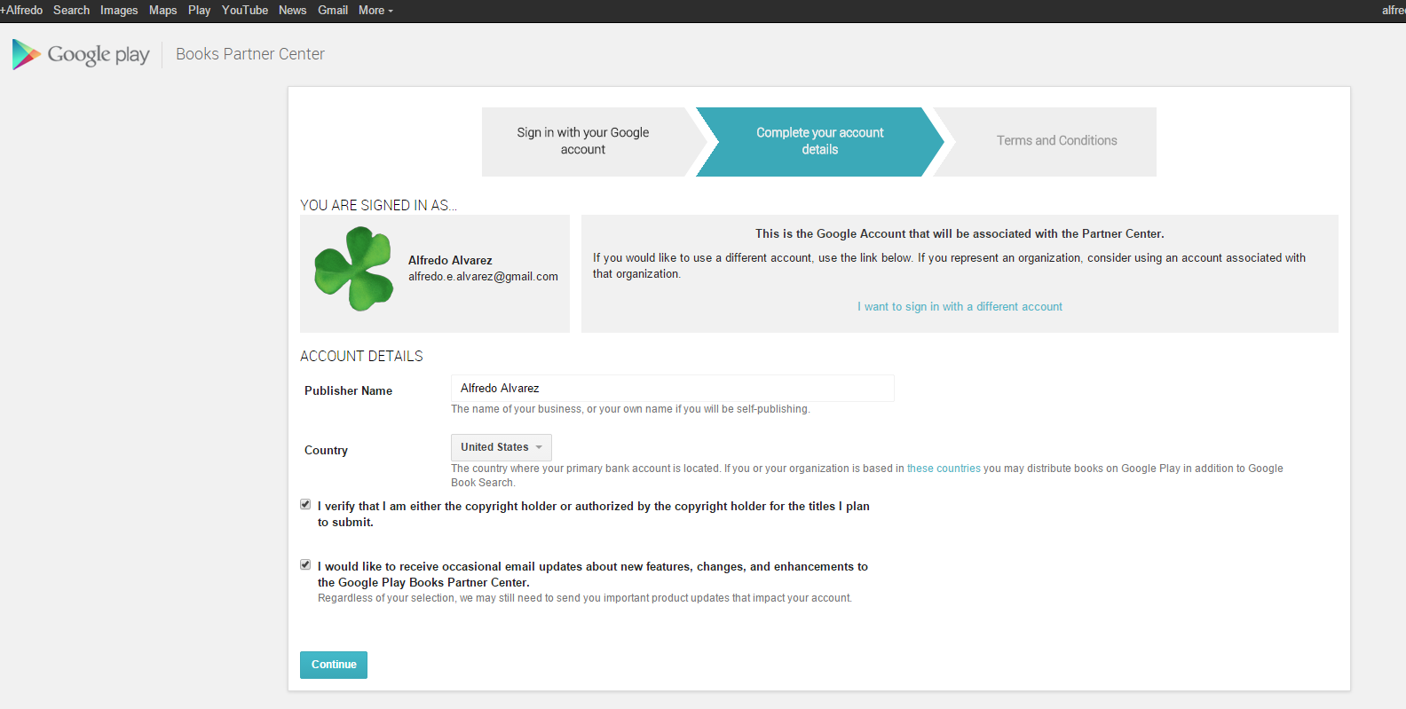

Slide 9
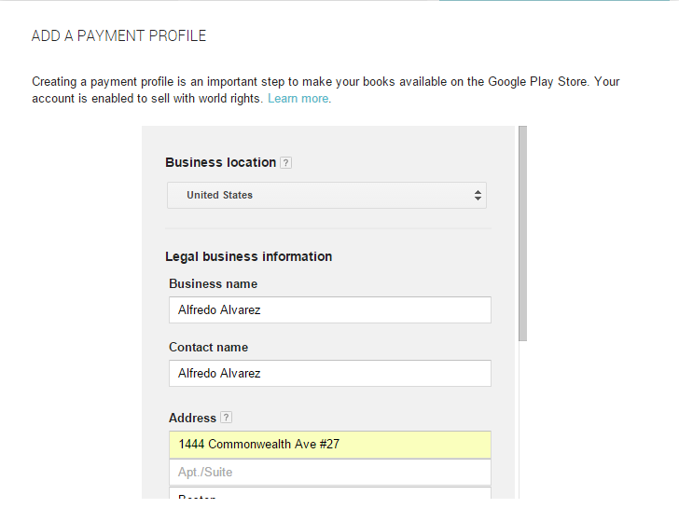

Slide 10
Partner Center

Slide 11
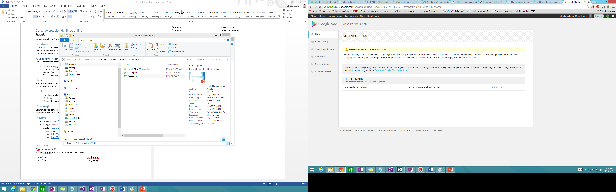

Slide 12
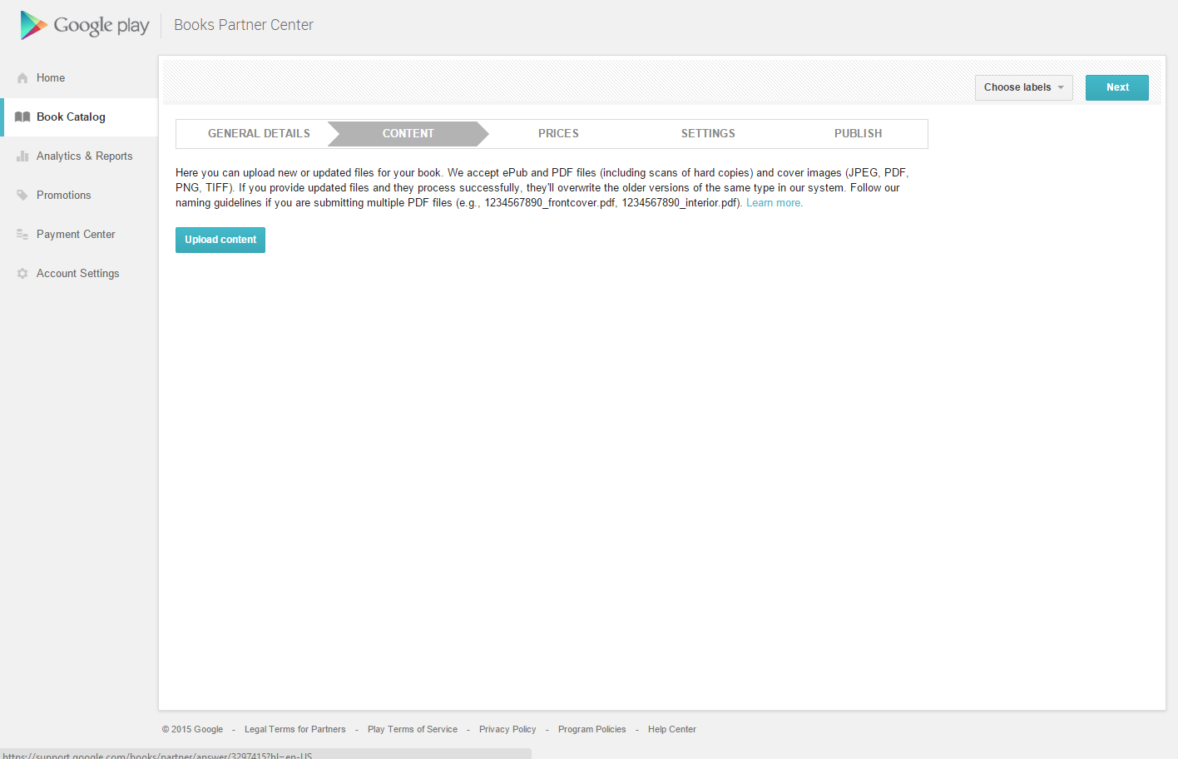

Slide 13
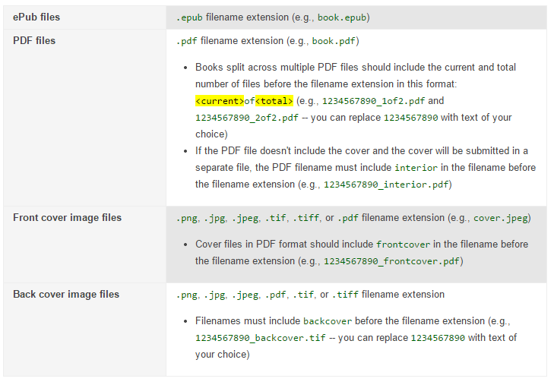
File Name Guidelines

Slide 14
Quality Reviewers
Grant a book
To grant a book to a quality reviewer, follow these steps:
In your Partner Center account, go to the Book Catalog.
Click the title of the book.
Click the Content tab.
Under the section labeled Quality Reviewers, click the Add button.
Enter the email address associated with the quality reviewer's Google Account.
Click OK. The reviewer's email address should now be listed.
Repeat steps 4-6 to add any additional reviewers.
When you're done, click the Save button near the top of the page.

Slide 15
Demo de Publicacion de libro

