Slide 1


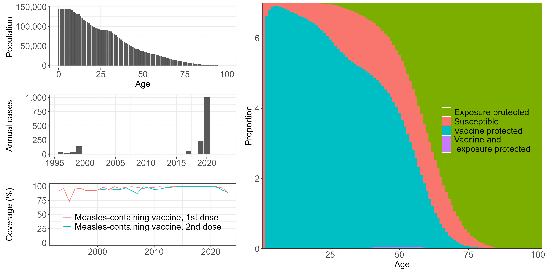

Slide 2

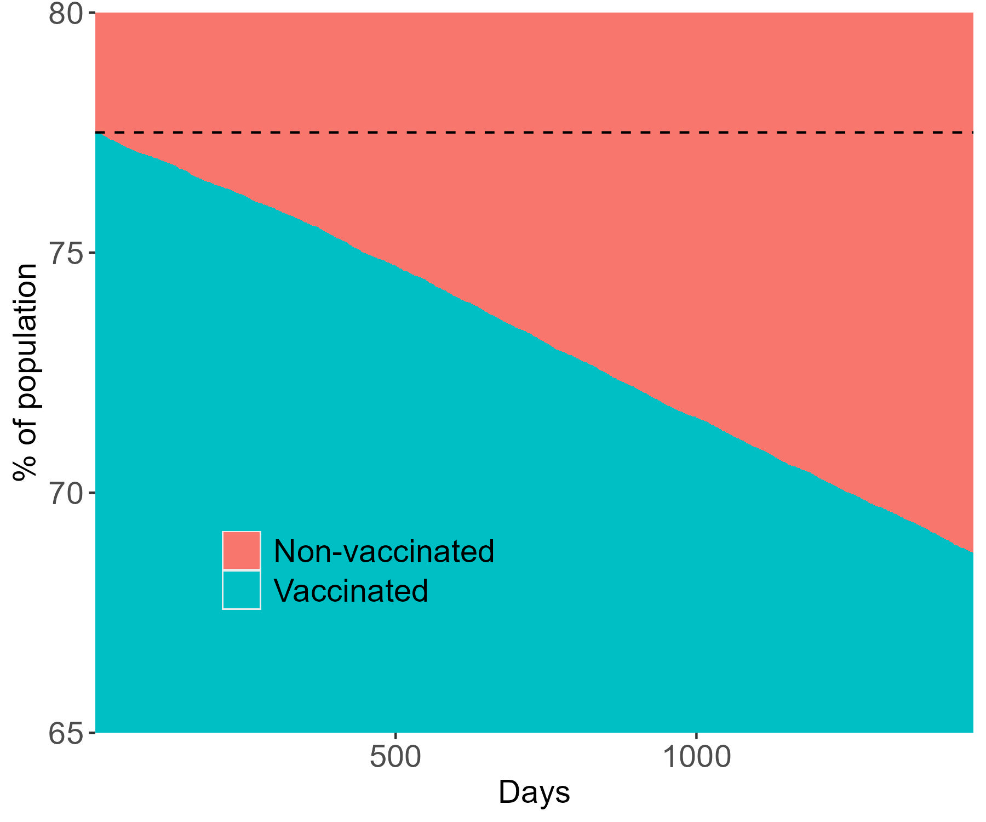
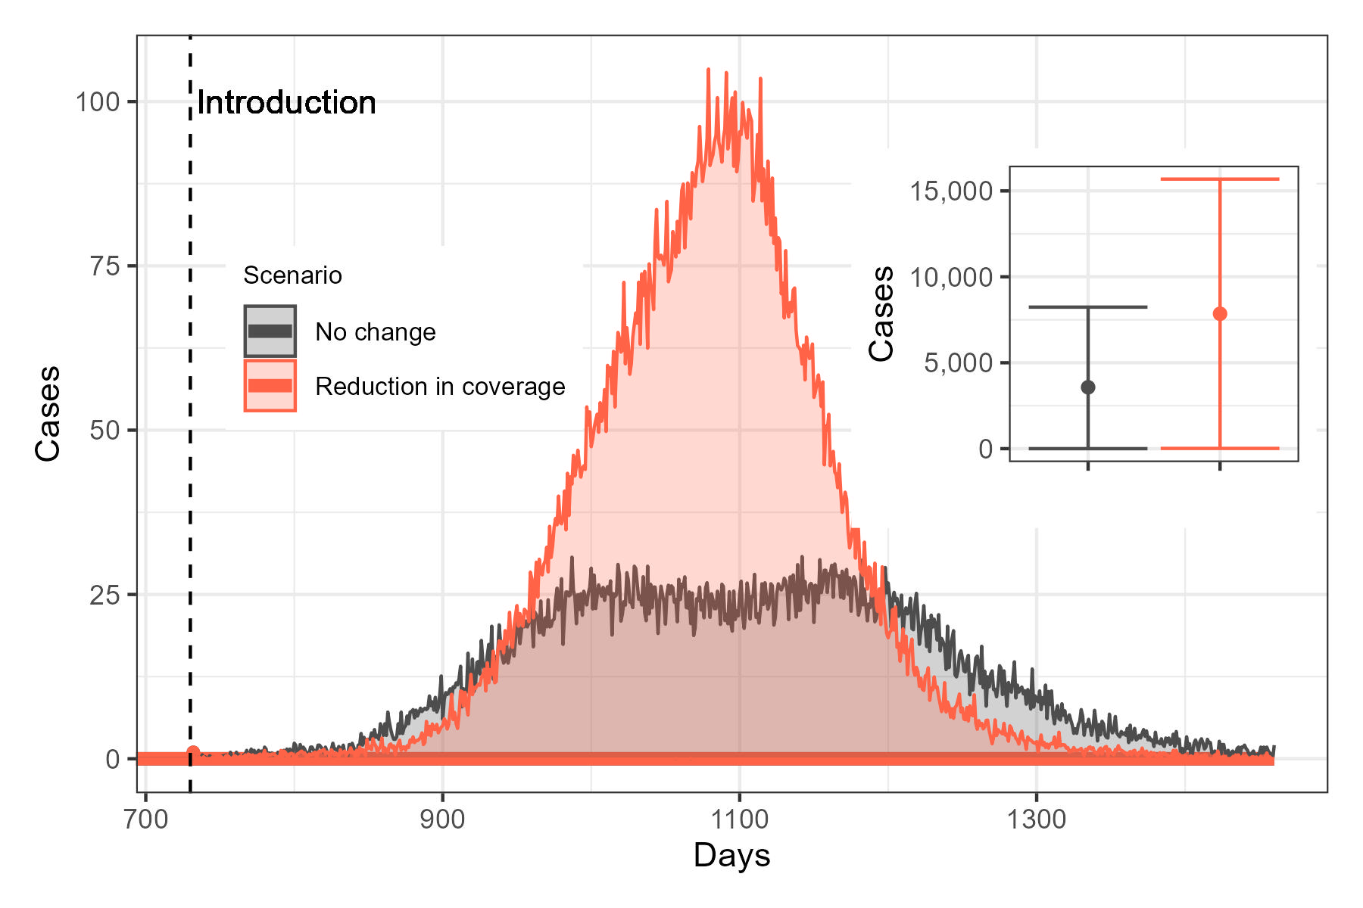
7.8% reduction in the population protected by vaccination
50% increase in outbreak occurrence
219.8% increase in cases

