Slide 1
Predicting Hospital Readmission Risk
A Comparative Study of Classical and Ensemble Models
Adele Chinda, Oumar Diallo, Yusuf Mumin
Georgia State University
Data Mining Project
November 2024

Slide 2
Problem Statement
Hospital readmissions are costly and often preventable
30-day readmission rates are a key quality metric for healthcare
Challenge: Predict which patients are at high risk of readmission
Goal: Enable early intervention and reduce readmission rates
Dataset: 100,000+ hospital admissions from diabetes patients (1999-2008)

Slide 3
Research Objectives
Build a reproducible ML pipeline for readmission prediction
Compare multiple modeling approaches:
• Logistic Regression (interpretable baseline)
• Multilayer Perceptron (nonlinear neural network)
• XGBoost (ensemble tree boosting)
Address class imbalance using SMOTE
Evaluate trade-offs between interpretability and performance
Identify key predictive features for clinical insight

Slide 4
Dataset Overview
📊 Source:
UCI Diabetes 130-US Hospitals
(1999-2008)
📈 Size:
~100,000 hospital admissions
50+ features
🎯 Target Variable:
Readmitted within 30 days
(Binary classification)
⚖️ Class Imbalance:
~11% positive cases
📋 Feature Categories:
• Demographics
- Age, gender, race
• Clinical History
- Diagnoses (ICD-9)
- Comorbidities
• Visit Details
- Time in hospital
- Number of procedures
- Lab tests performed
• Medications
- Drug prescriptions
- Insulin usage

Slide 5
Data Processing Pipeline
1. Data Cleaning
• Handle missing values (imputation and removal)
• Remove low-variance and irrelevant features
2. Feature Engineering
• Encode categorical variables (one-hot, label encoding)
• Create derived features (total visits, medication counts)
• Scale numerical features (StandardScaler)
3. Feature Selection
• XGBoost feature importance analysis
• Select top 100 most predictive features
4. Imbalance Handling
• Apply SMOTE (Synthetic Minority Over-sampling Technique)

Slide 6
Modeling Approaches
🔵 Logistic Regression
• Linear model with L2 regularization
• Interpretable coefficients
• Baseline performance
• Log-odds ratios for features
🟢 Multilayer Perceptron
• 2 hidden layers (64, 32 units)
• ReLU activation
• Captures nonlinear patterns
• Early stopping for regularization
🟠 XGBoost
• Gradient boosted decision trees
• Handles missing values natively
• Built-in feature importance
• Class weighting for imbalance
• Regularization parameters
⚙️ Training Strategy
• 80/20 train-test split
• Cross-validation
• Hyperparameter tuning
• Threshold optimization

Slide 7
Model Formulations
Logistic Regression:
P(Y=1|x) = σ(w^T x + b)
Loss = -1/N Σ[y log ŷ + (1-y)log(1-ŷ)] + λ||w||²
MLP Architecture:
h₁ = ReLU(W₁x + b₁)
h₂ = ReLU(W₂h₁ + b₂)
ŷ = σ(W₃h₂ + b₃)
XGBoost Objective:
L = Σ l(yᵢ, ŷᵢ) + Σ Ω(fₖ)
Ω(f) = γT + ½λ||w||²

Slide 8
Handling Class Imbalance: SMOTE
Challenge: Only 11% of admissions result in readmission
SMOTE (Synthetic Minority Over-sampling Technique):
• Creates synthetic minority class samples
• Interpolates between existing minority instances
• x_new = xᵢ + α(xⱼ - xᵢ), where α ~ U(0,1)
Benefits:
• Balances training data
• Improves model sensitivity to minority class
• Prevents overfitting compared to simple oversampling
Implementation:
• Applied only to training set
• Test set remains unchanged for fair evaluation

Slide 9
Evaluation Metrics
📊 Primary Metrics:
• ROC AUC
Discriminative ability
• Precision-Recall AUC
Performance on imbalanced data
• Precision
Accuracy of positive predictions
• Recall (Sensitivity)
Coverage of actual positives
• F1 Score
Harmonic mean of precision/recall
🎯 Why Multiple Metrics?
• ROC AUC can be misleading
on imbalanced datasets
• PR AUC better reflects
minority class performance
• Clinical context matters:
- High recall: Don't miss at-risk
patients (false negatives costly)
- High precision: Avoid
unnecessary interventions
(false positives wasteful)
• Threshold tuning allows
customization to priorities

Slide 10
Model Performance Comparison
┌─────────────────────┬─────────┬─────────┬───────────┬────────┬──────┐
│ Model │ ROC AUC │ PR AUC │ Precision │ Recall │ F1 │
├─────────────────────┼─────────┼─────────┼───────────┼────────┼──────┤
│ Logistic Regression │ 0.56 │ 0.35 │ 0.89 │ 0.97 │ 0.93 │
├─────────────────────┼─────────┼─────────┼───────────┼────────┼──────┤
│ MLP │ 0.59 │ 0.38 │ 0.89 │ 0.98 │ 0.93 │
├─────────────────────┼─────────┼─────────┼───────────┼────────┼──────┤
│ XGBoost │ 0.62 │ 0.42 │ 0.93 │ 0.40 │ 0.56 │
└─────────────────────┴─────────┴─────────┴───────────┴────────┴──────┘
Key Findings:
✓ XGBoost: Best discriminative performance (highest AUC)
✓ LogReg/MLP: Best balance (highest F1 score)
✓ Clear precision-recall trade-off across models

Slide 11
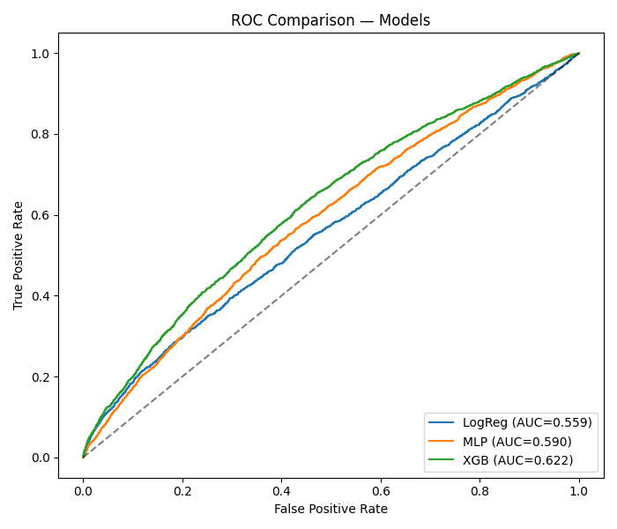
ROC Curve Comparison
XGBoost achieves the highest ROC AUC (0.62), demonstrating superior discriminative ability

Slide 12
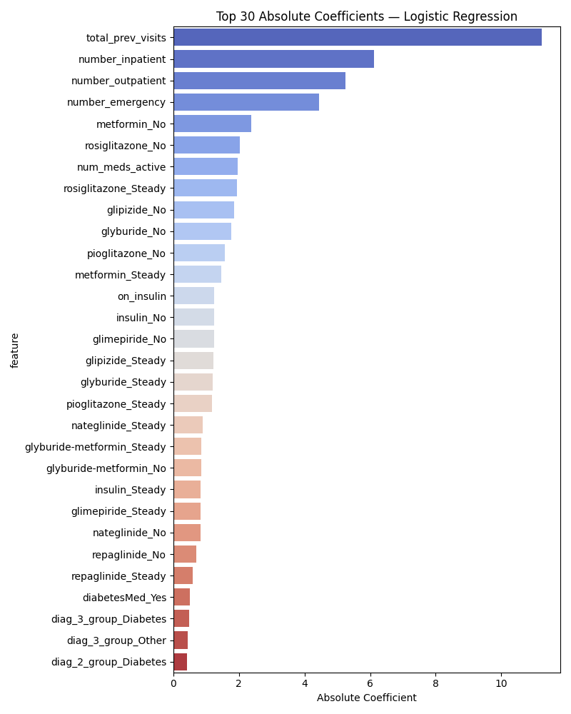
Top Predictive Features
Logistic regression coefficients reveal key risk factors for readmission

Slide 13
Key Insights & Findings
1. Model Trade-offs:
• XGBoost excels at identifying high-risk patients (high precision)
• MLP/LogReg better at not missing at-risk patients (high recall)
2. Feature Insights:
• Number of prior visits strongly predictive
• Medication changes indicate severity
• Lab procedures correlate with complications
3. Class Imbalance Impact:
• SMOTE significantly improved minority class detection
• PR AUC more informative than ROC AUC
4. Clinical Implications:
• Model choice depends on intervention cost vs. missed case cost
• Interpretable features enable clinician trust

Slide 14
Model Interpretation
🔍 Logistic Regression
Strengths:
• Direct coefficient interpretation
• Clinician-friendly explanations
• Fast inference
Limitations:
• Assumes linear relationships
• May miss complex interactions
🧠 Neural Network (MLP)
Strengths:
• Captures nonlinear patterns
• Flexible architecture
Limitations:
• "Black box" nature
• Requires more data
• Longer training time
🌳 XGBoost
Strengths:
• Excellent predictive performance
• Feature importance built-in
• Handles missing data
• Robust to outliers
Limitations:
• Less interpretable than LogReg
• More hyperparameters to tune
• Computationally intensive
💡 Recommendation:
• Use XGBoost for prediction
• Use LogReg for interpretation
• Ensemble approaches possible

Slide 15
Challenges & Solutions
Challenge 1: Severe Class Imbalance (11% positive)
→ Solution: SMOTE + class weighting + threshold tuning
Challenge 2: High-Dimensional Feature Space (100+ features)
→ Solution: Feature selection using XGBoost importance scores
Challenge 3: Missing Data
→ Solution: Strategic imputation + removal of sparse features
Challenge 4: Model Interpretability vs. Performance
→ Solution: Compare multiple model paradigms, document trade-offs
Challenge 5: Evaluation Metric Selection
→ Solution: Report multiple metrics (ROC AUC, PR AUC, F1)

Slide 16
Future Work & Extensions
1. Temporal Modeling
• RNNs/LSTMs for sequential patient histories
• Capture temporal patterns in readmission risk
2. Advanced Techniques
• Deep learning: Transformers for EHR data
• Ensemble methods: Stack multiple models
• Calibration: Platt scaling, isotonic regression
3. Causal Analysis
• Move beyond correlation to causation
• Propensity score matching, instrumental variables
4. Deployment Considerations
• Fairness across demographic groups
• Real-time prediction API
• Integration with hospital EHR systems
• Continuous model monitoring and retraining

Slide 17
Technical Stack & Tools
🐍 Programming:
• Python 3.8+
• Jupyter Notebooks
📚 ML Libraries:
• scikit-learn
• XGBoost
• imbalanced-learn (SMOTE)
📊 Data Processing:
• pandas
• NumPy
📈 Visualization:
• matplotlib
• seaborn
• plotly
🗂️ Project Structure:
• Modular pipeline design
• Separate scripts for each stage
• Reproducible workflows
💾 Model Persistence:
• Pickle files for trained models
• Saved preprocessors & scalers
📝 Documentation:
• README with setup instructions
• Code comments & docstrings
• Project website (GitHub Pages)
🔧 Version Control:
• Git + GitHub
• Clear commit history

Slide 18
Reproducibility & Open Science
✅ Complete Pipeline Available:
• All code on GitHub: github.com/arrdel/patient-readmission-prediction
• requirements.txt for dependencies
• Step-by-step execution instructions
✅ Dataset Accessibility:
• Public UCI ML Repository dataset
• Clear data provenance documentation
✅ Experiment Tracking:
• Saved model checkpoints
• Performance metrics logged
• Visualizations for all experiments
✅ Documentation:
• Comprehensive README
• Project website with interactive results
• Technical report with methodology details

Slide 19
Lessons Learned
1. Domain Knowledge Matters
• Understanding healthcare context crucial for feature engineering
• Clinical input would improve model utility
2. Evaluation is Non-Trivial
• Single metric insufficient for imbalanced problems
• Threshold selection depends on deployment context
3. Interpretability is Valuable
• Black-box models may perform better but harder to trust
• Simpler models often "good enough" and more deployable
4. Data Quality > Fancy Algorithms
• Feature engineering had major impact
• Garbage in, garbage out principle holds
5. Reproducibility Requires Effort
• Documentation and organization take time but pay dividends

Slide 20
Conclusions
✓ Successfully built end-to-end ML pipeline for readmission prediction
✓ Compared three distinct modeling paradigms:
• Logistic Regression: Most interpretable
• MLP: Good balance of performance and complexity
• XGBoost: Best discriminative performance
✓ Demonstrated effective handling of class imbalance via SMOTE
✓ Identified key predictive features with clinical relevance
✓ Highlighted practical trade-offs in model selection
✓ Created fully reproducible, well-documented codebase
➡️ Ready for further research and potential deployment

Slide 21
References & Resources
Dataset:
• Strack et al. (2014). UCI Diabetes 130-US Hospitals Dataset
archive.ics.uci.edu/dataset/296
Methods:
• Chawla et al. (2002). SMOTE: Synthetic Minority Over-sampling Technique
• Chen & Guestrin (2016). XGBoost: A Scalable Tree Boosting System
• Pedregosa et al. (2011). Scikit-learn: Machine Learning in Python
Project Resources:
• Code: github.com/arrdel/patient-readmission-prediction
• Website: [GitHub Pages URL]
• Report: See repository docs/
Contact:
• Adele Chinda, Oumar Diallo, Yusuf Mumin
• Georgia State University

Slide 22
Thank You!
Questions?
Project Repository:
github.com/arrdel/patient-readmission-prediction
Adele Chinda • Oumar Diallo • Yusuf Mumin
Georgia State University

