Slide 1
CS 160 -010 Team 1
Minoriteam:
Josh Church, Sean Marcum, Alex Arreguin

Slide 2
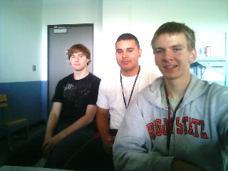

Slide 3
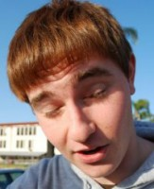
Sean Marcum
i am from San Luis Obispo California. i like the outdoors. and if you want to know more go to my facebook

Slide 4
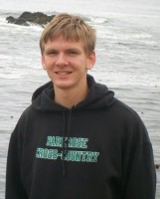
Josh Church
I am from Portland, OR; I went to Parkrose High School. I am half Romanian. I enjoy playing sports, and I am fairly good at tennis. I also produce dubstep and house music.

Slide 5
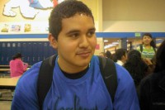
Alex Arreguin
I like to play basketball and listen to music.

