Slide 1
Automatic Minutes of Meeting - MoMBot
- Presented by Team COMBATS
- Vikas Wadhwani
- Priyanka Agrawal
- Aman Chauhan
- Yogesh Gawari
- Rupesh Thopate (QA)

Slide 2
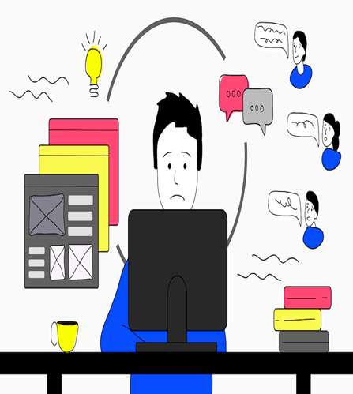
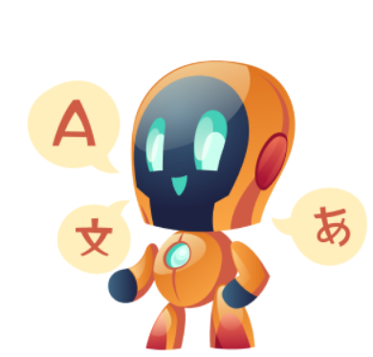
Diverted focus
Can miss on important points, dates, etc.
Efforts and Time Consuming
Timely need to send mail to participants
Completely dependent on understanding of an individual preparing minutes
Decodes speech into meaningful summary
Smart minutes with easy access to recordings
Well formatted pdf auto sent over email
Saves time and effort of team members
Increases Productivity

Slide 3
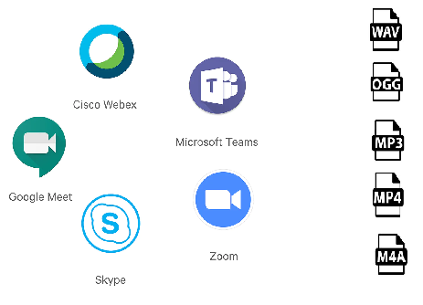

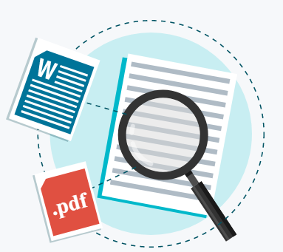


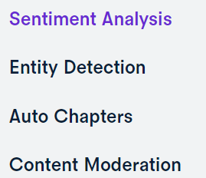
Streamlit GUI (Python module)
AssemblyAI

Slide 4


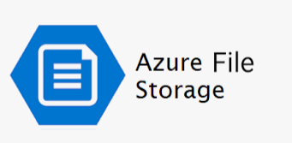



Technology Stack used for MoMBot
AssemblyAI speech-to-text transcription APIs
Streamlit User interface
Various Python Libraries are used.
Integration with Azure file store and MS Teams
GitHub – Code Repository
Additional Requirements:
Azure Account
Azure File Store
Create your free AssemblyAI Account & obtain your API Key.

Slide 5
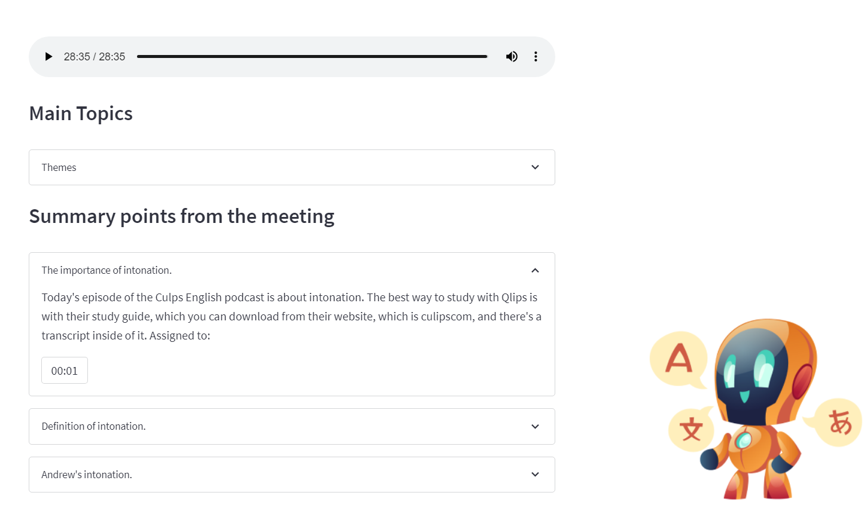
How it works?
1. After MS Team Meeting, recording of the meeting can be configured to saved on Azure file store.
2. MoMBot will fetch this recording from azure shared file with desired secured credentials like storage account key
3. Streamlit UI shows recording in categories, chapters, topics, etc. in drop downs
4. MoMBot transcribes the recording performs speech-to-text transcription leveraging AssemblyAI APIs
5. Generates smart minutes on GUI which includes text summary, as well as it takes us to the time segment where important point was discussed and can replay from that point in the recording.
6. Email pdf doc with minutes to intended participants.

Slide 6
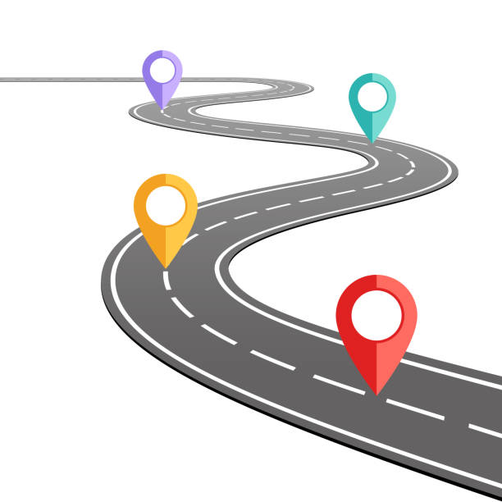
Day 2 – Enhancements (as Rome was not built in 2 days ☺)
Integration with Meeting Apps like MS Teams, Skype, Zoom, google meet, etc.
Natural Lang Processing to fetch Action Items accurately
POC and ETA of a task or point discussed and creating a backlog and can enhance to send reminder for task completion
Performance improvements in case of long meetings using cache
Embedding meeting audio files into the pdf, doc, etc. in order to understand the points with clarity
Internationalizations support by providing speech to text from various languages

Slide 7
Thank You

