Slide 1
Automatic Minutes of Meeting - MoMBot
- Presented by Team COMBATS
- Vikas Wadhwani
- Priyanka Agrawal
- Aman Chauhan
- Yogesh Gawari
- Rupesh Thopate

Slide 2

Bored of manual Minutes of Meeting ??
Issues with Manual MoM:
Focus diverted towards taking notes instead of participating in the meeting.
Can miss on important points, when too much information is discussed by the participants
Time Consuming
Need to work on formatting
Need to manually send mail to participants
Completely dependent on understanding of an individual preparing minutes

Slide 3
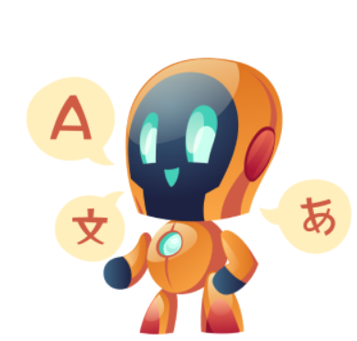
Try our MoMBot
Enables Automatic Minutes of Meeting
Based on Speech recognition
Helps create Minutes Of Meeting with complete details by transcribing audio to meaningful text
Generates smart minutes which includes text summary, as well as it takes us to the time segment where important points being discussed and you can replay from that point.
Sends the minutes (pdf, doc, etc.) over mail to the intended participants.
Saves time and effort of team members
Records and generates document for discussed points
Increases Productivity

Slide 4


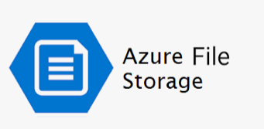



Technology Stack used for MoMBot
AssemblyAI speech-to-text transcription APIs
Streamlit User interface
Various Python Libraries are used.
Integration with Azure file store and MS Teams
GitHub – Code Repository
Additional Requirements:
Azure Account
Azure File Store
Create your free AssemblyAI Account & obtain your API Key.

Slide 5
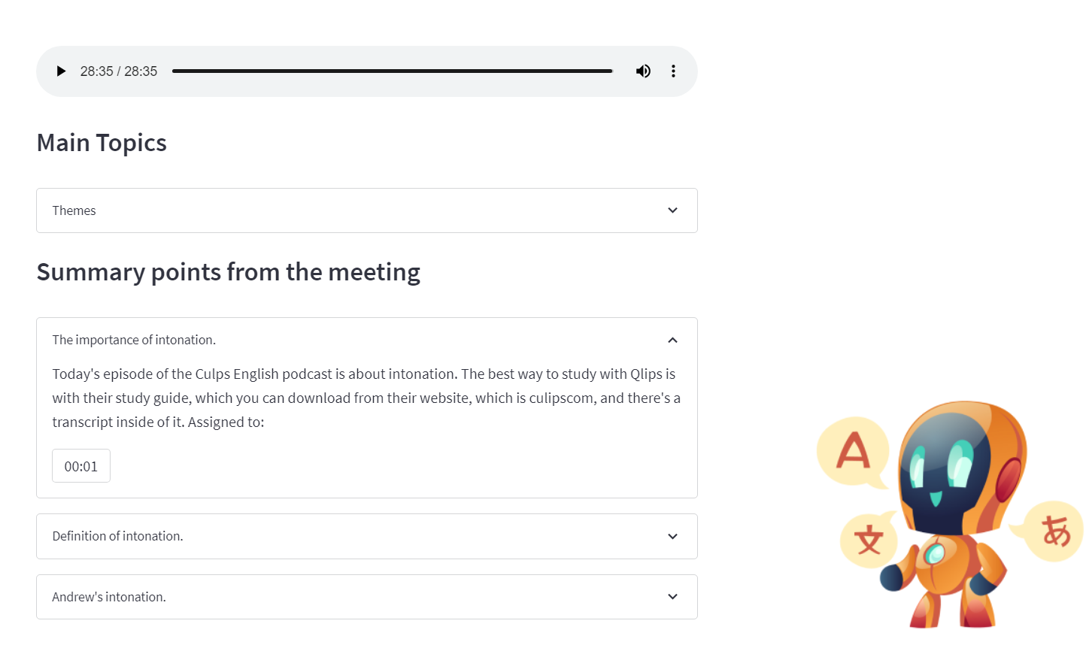
How it works?
1. After MS Team Meeting, recording of the meeting will be uploaded to Azure file store.
2. MoMBot will fetch this recording.
3. Streamlit UI shows recording in categories, chapters, topics drop down.
4. Transcribes the recording, MoMBot performs speech-to-text transcription leveraging AssemblyAI APIs
5. Generates smart minutes on GUI which includes text summary, as well as it takes us to the time segment where important point was discussed and can replay from that point in the recording.
6. Email pdf doc with minutes to intended participants.

Slide 6
Future Enhancements
Integration with Meeting Apps like MS Teams, Skype, Zoom, google meet, etc.
Natural Lang Processing to fetch Action Items accurately
POC and ETA of a task or point discussed and creating a backlog and can enhance to send reminder for task completion
Performance improvements in case of long meetings using cache

Slide 7
Thank You

