Slide 1
Building Blocks for a Fintech World, IBM Cloud-based Services for Building Innovative Fintech Apps
William Bradshaw, Global NLG Advisor, Arria NLG

Slide 2
Before we Start - Accounts
NLG Studio
https://app.studio.arria.com/
IBM Cloud
Instructions on your desk

Slide 3

What is Natural Language Generation?
AI that can write
Anything producing text that could have been written by a human
NLG - Going from Data into Text
NLU – Going from Text into Data
Arria NLG are the leading providers of sophisticated NLG

Slide 4
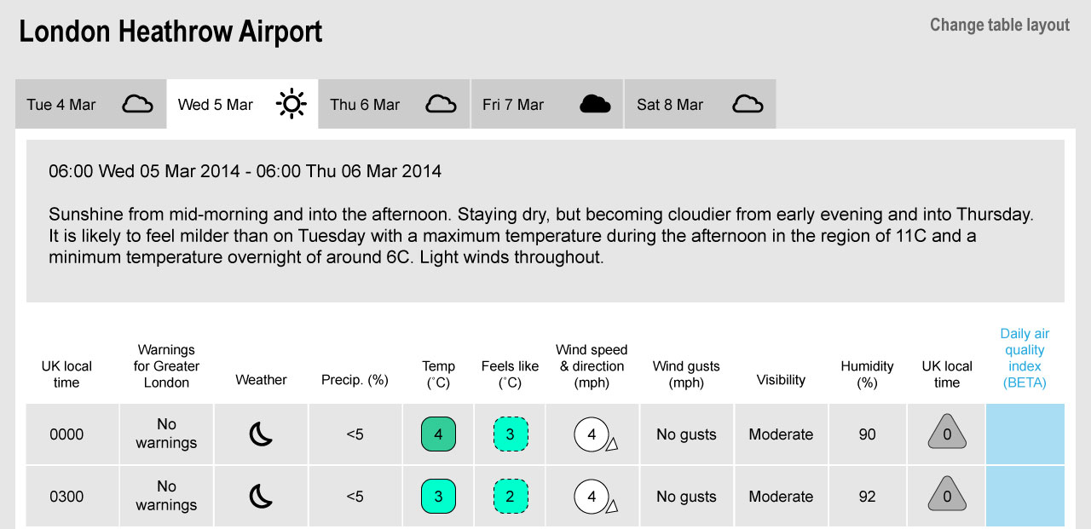
Simple Example: Weather Forecast

Slide 5
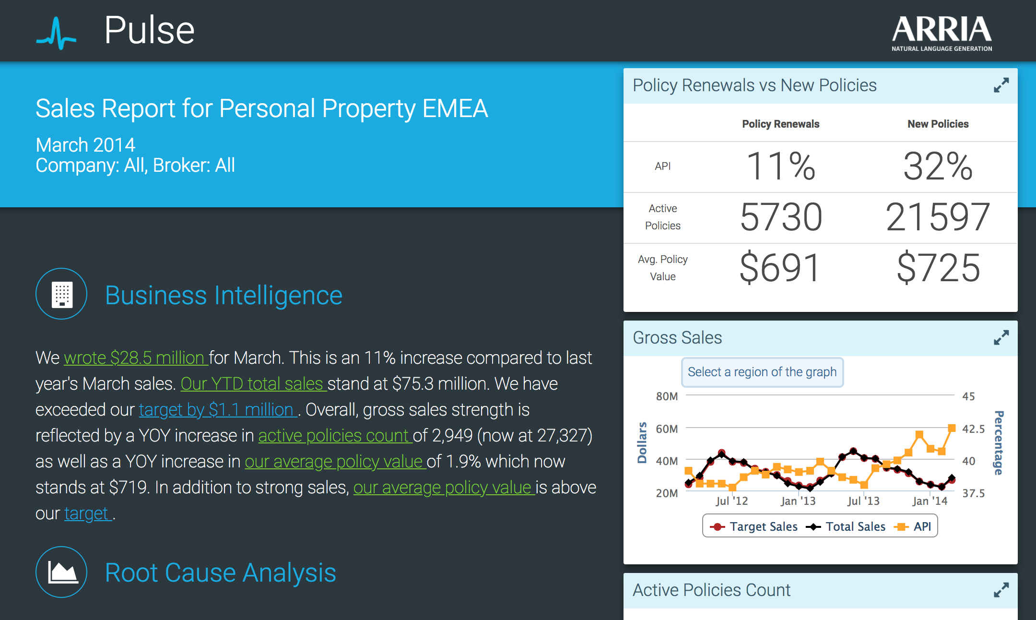
Complex Example: Business Metrics

Slide 6
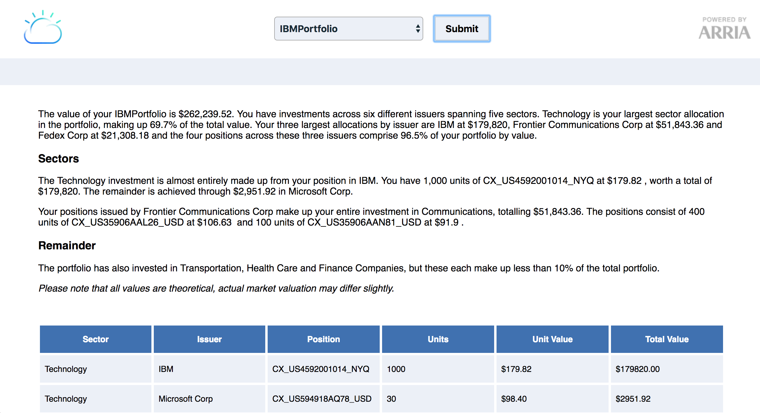
Today’s Application

Slide 7
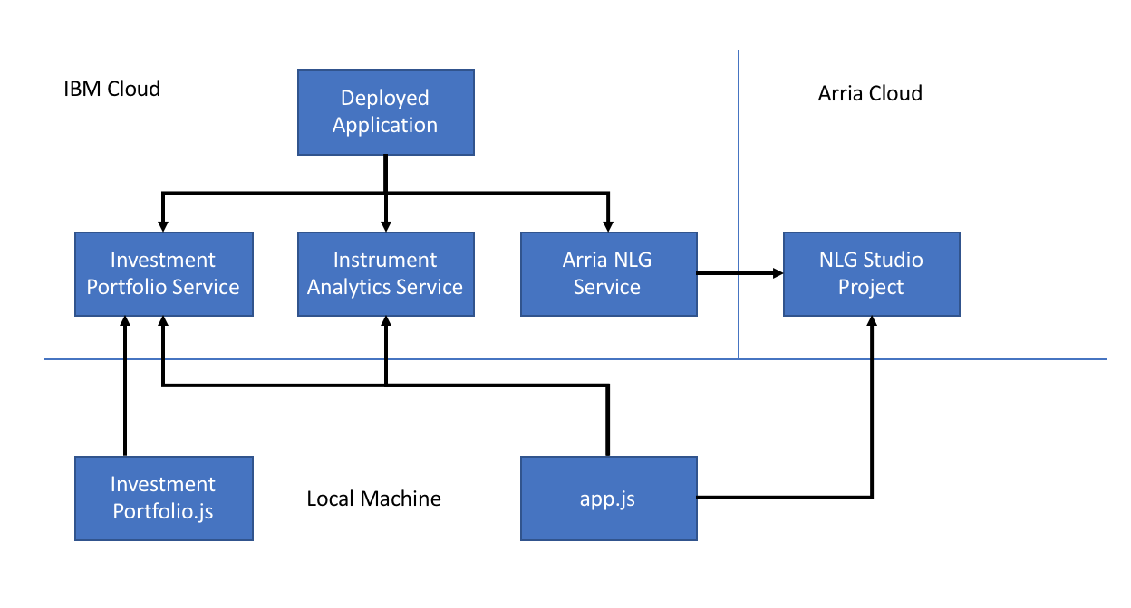
Architecture

Slide 8
Today’s Workshop
https://github.com/arria-nlg/index-arria-workshop
Trying the Application
Setting up the Application
Expanding the Narrative

Slide 9
Arria at Index
Tuesday
12:00 – 2:30
Building Blocks for a Fintech World, IBM Cloud-based Services for Building Innovative Fintech Apps
Wednesday
1:00 – 1:45
Discover how to include natural language generation in your applications
3:00 – 3:30
Twitch Interview with Arria NLG
4:00 – 6:00
Ask Me Anything – Global NLG Advisor, William Bradshaw
Thursday
10:30 – 12:00
Ask Me Anything – Chief Scientist, Professor Ehud Reiter
12:05 – 12:20
Talk to Your Users with Natural Language Generation

Slide 10
Contact Us
support@arria.com william.bradshaw@arria.com
alf@us.ibm.com – Lennart

