Slide 1
Understanding through Code Visualisation
Arrian Purcell (u501666)
Bachelor of Software Engineering

Slide 2
Project
Explore code visualisations
Application to live coding
Addressing code comprehension

Slide 3
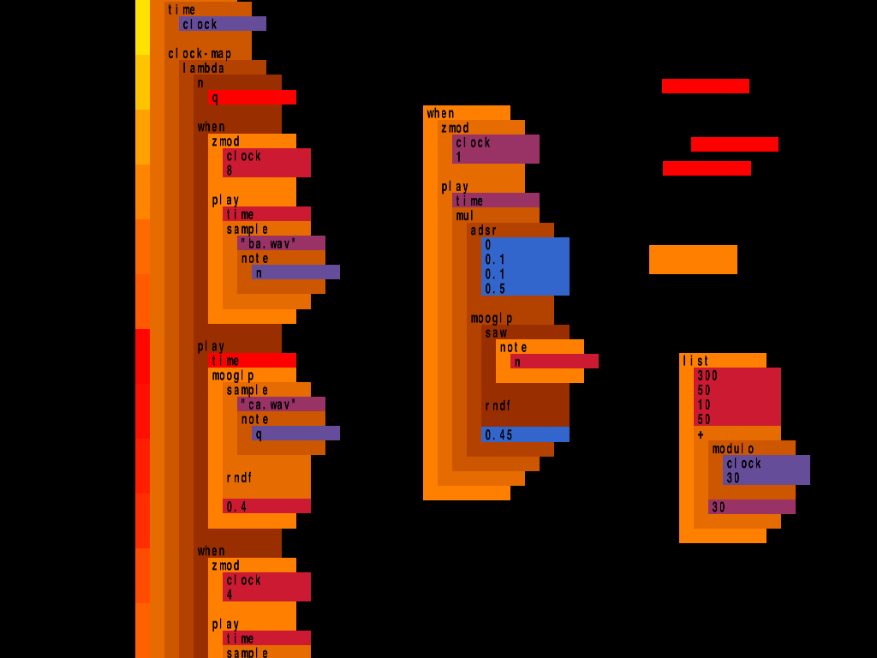
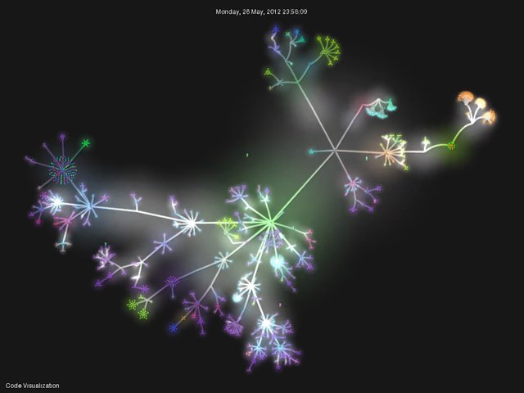
Visualisations (Software)
Gource
Scheme Bricks

Slide 4
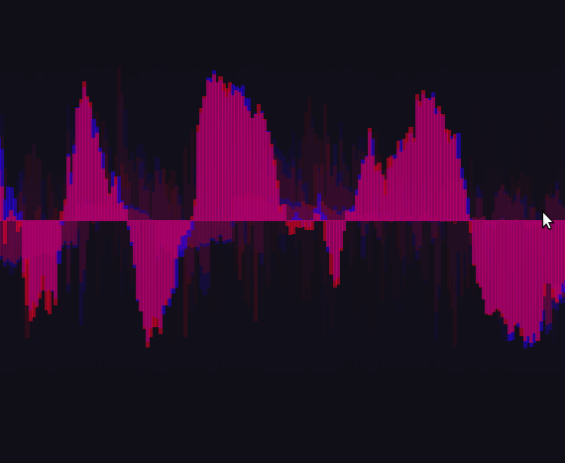
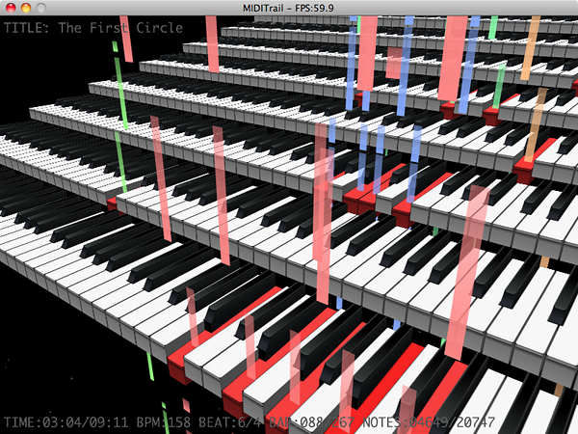
Visualisations (Music)

Slide 5
Question
Can we combine these visualisations in a meaningful way to aid in code comprehension?

Slide 6
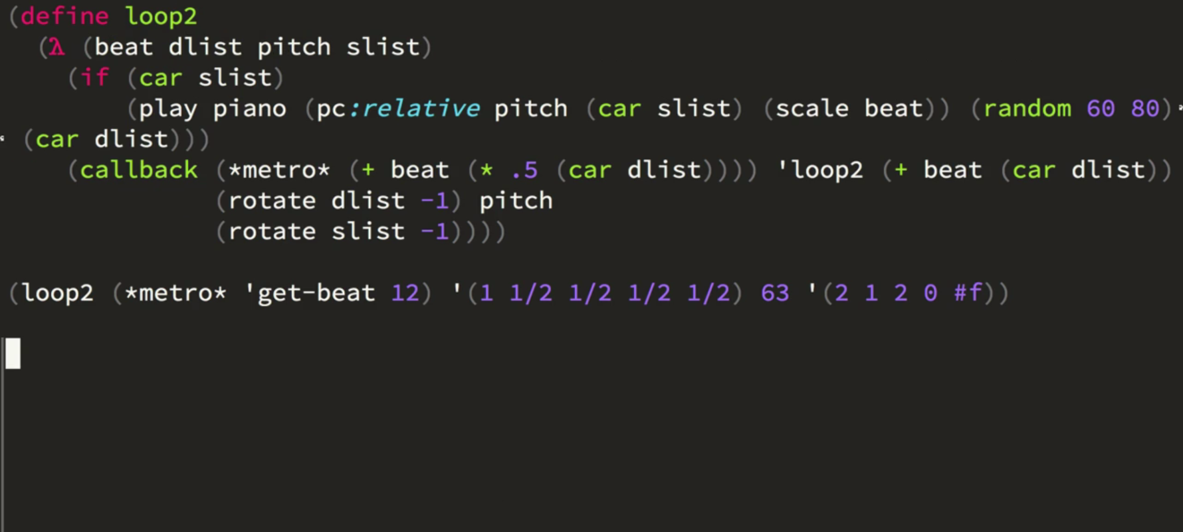
Live Coding

Slide 7
Timeline and Methodology
Tomorrow!
Initial Survey
April
Develop taxonomy and visualisations
Start of May
First lab study
June
Refine visualisations
Start of July
Second lab study

Slide 8
Feasibility
On schedule
Realistic timeline
Good basis in literature
Rich potential

Slide 9
Questions?

