Slide 1
Learning “Python!”
-By Harikrishna

Slide 2

Why Python?
Focuses on optimizing developer time, rather than a computer’s processing time.
Great documentation online:
docs.python.org/3
Large Supporting Community.
Large number of modules for every aspect of programming universe:
Very much affiliated with Data Science and A.I .
Of course easy to learn!!

Slide 3
Why Python?
Python is Interpreted: This means that it is processed at runtime by the interpreter, and you do not need to compile your program before executing it.
Python is Interactive: This means that you can sit at a Python prompt and interact with the interpreter directly to write your programs.
Python is Object-Oriented: This means that Python supports Object-Oriented style or technique of programming that encapsulates code within objects.
Python is Beginner's Language: Python is a great language for the beginner programmers and supports the development of a wide range of applications, from simple text processing to WWW browsers to games.

Slide 4
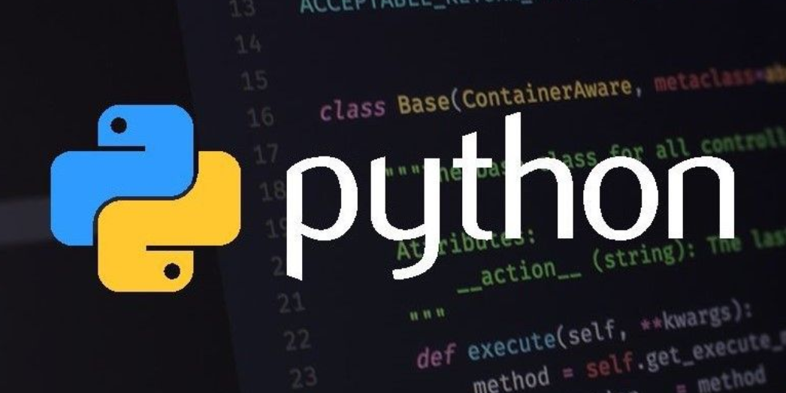
What can you do with Python?
Automate simple tasks
Send Emails, edit PDF’s
Work with Excel Sheets and scrape data from websites
Data Science and Machine Learning
Create ML models
Create AI chat bots
Work in Data Analysis and Analytics.
Create websites
Use web frameworks such as Django and Flask to handle the backend of a website and user data
Create interactive dashboards for users
Basically, most of the stuff out there.

Slide 5
Basic Data Types

Slide 6
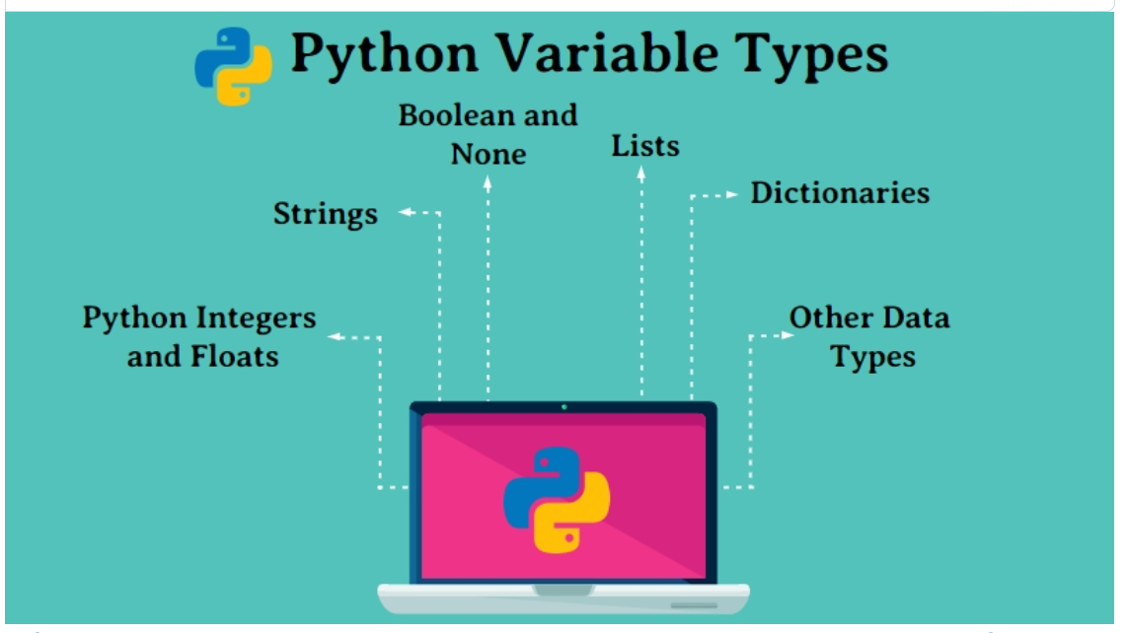
Basic Data Types

Slide 7
Name | Type | Description
Integers | int | Whole numbers, such as: 3 300 200
Float | float | Numbers with a decimal point: 2.3 4.6 100.0
Strings | str | Ordered sequence of characters: "hello" 'Sammy' "2000" "楽しい"
Date | date | Values with date format: “2024-10-24”, “1990/12/11”, “20 November 2023”
Lists | list | Ordered sequence of objects: [10,"hello",200.3]
Dictionaries | dict | Unordered Key:Value pairs: {"mykey" : "value" , "name" : "Frankie"}
Tuples | tup | Ordered immutable sequence of objects: (10,"hello",200.3)
Sets | set | Unordered collection of unique objects: {"a","b"}
Booleans | bool | Logical value indicating True or False

Slide 8
Variable Assignments

Slide 9
A Python identifier is a name used to identify a variable, function, class, module, or other object. An identifier starts with a letter A to Z or a to z or an underscore (_) followed by zero or more letters, underscores, and digits (0 to 9).
Python does not allow punctuation characters such as @, $, and % within identifiers. Python is a case sensitive programming language. Thus, Manpower and manpower are two different identifiers in Python.
String Representation of Python can be done by either ‘ ’ or “ ”.
For Example : ‘string_rep’ is equal to “string_rep”.

Slide 10
Variable assignment:
A Variable can be assigned to a value and can be reused as many times as required.
For example:
a = 7, b = ‘name’, c = ‘7’
Two types of variables can be found:
1) Local Variable (Can be used only within the function once declared)
2) Global Variable (Can be used through out the code once declared)
A Variable once assigned can also be modified later into the same data type or different data type.(Dynamic Typing)
For Example:
a= ‘first value’
a= 5
Once the value is updated the variable prints out only the updated value.
i.e., print(“a”) --> 5

Slide 11
Multiple Variable Assignment:
A value can be assigned to multiple variables in different methods and also multiple values can be assigned to multiple variables.
For Example:
Multiple Variables to single value --- a=b=3
Multiple Variables to Multiple Values ----- a,b = 1,2
Rules for variable names
Names can not start with a number.
There can be no spaces in the name, use _ instead.
Can't use any of these symbols :'",<>/?|\()!@#$%^&*~-+

Slide 12
Numbers

Slide 13
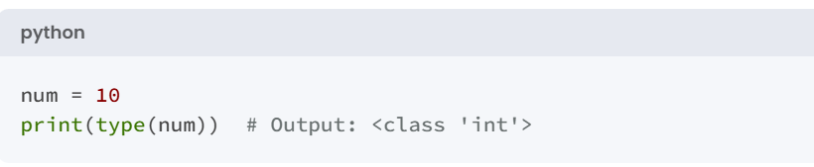
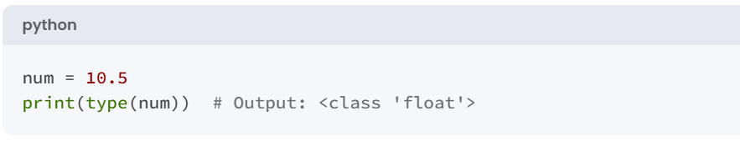
There are two main number types we will work with:
Integers which are whole numbers.
Floating Point numbers which are numbers with a decimal.
For example:
int_num= 2
int_float = 4.5

Slide 14
Numeric Operators

Slide 15
Arithmetic Operators
Operator | Description | Example | Result
+ | Addition | 5 + 3 | 8
- | Subtraction | 5 - 3 | 2
* | Multiplication | 5 * 3 | 15
/ | Division (float result) | 5 / 3 | 1.6667
// | Floor Division | 5 // 3 | 1
% | Modulus (remainder) | 5 % 3 | 2
** | Exponentiation | 5 ** 3 | 125

Slide 16
Comparison Operators
Operator | Description | Example | Result
== | Equal to | 5 == 3 | False
!= | Not equal to | 5 != 3 | True
> | Greater than | 5 > 3 | True
< | Less than | 5 < 3 | False
>= | Greater than or equal | 5 >= 3 | True
<= | Less than or equal | 5 <= 3 | False

Slide 17
Assignment Operators
Operator | Description | Example | Result (if x = 5)
= | Assign | x = 5 | x = 5
+= | Add and assign | x += 3 | x = 8
-= | Subtract and assign | x -= 3 | x = 2
*= | Multiply and assign | x *= 3 | x = 15
/= | Divide and assign | x /= 3 | x = 1.6667
//= | Floor divide and assign | x //= 3 | x = 1
%= | Modulus and assign | x %= 3 | x = 2
**= | Exponentiate and assign | x **= 3 | x = 125

Slide 18
Logical Operators
Operator | Description | Example | Result
and | Logical AND | (5 > 3) and (5 < 10) | True
or | Logical OR | (5 > 3) or (5 > 10) | True
not | Logical NOT | not(5 > 3) | False

Slide 19
Membership Operators
Operator | Description | Example | Result
In | Checks membership | 5 in [1, 2, 3, 4, 5] | True
Not in | Checks absence of membership | 6 not in [1, 2, 3] | True

Slide 20
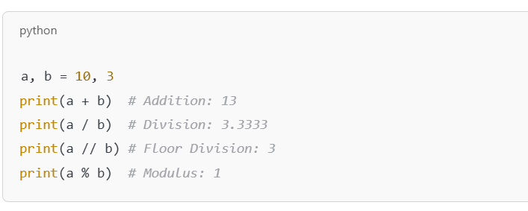
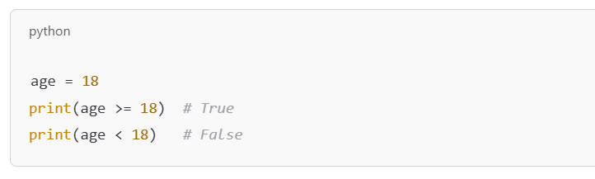
Examples with Explanations
Basic Arithmetic:
Comparison:

Slide 21
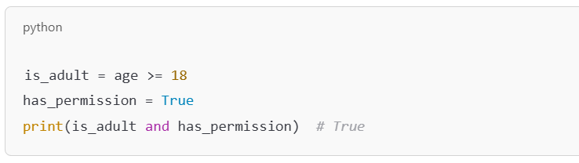
Logical:

Slide 22
Integer Methods
Method/Function | Description | Example
abs() | Returns the absolute value of an integer. | x = abs(-5) → 5
str() | Converts the integer to a string. | x = str(5) → '5'
int() | Converts a string or float to an integer. | x = int('5') → 5, x = int(5.9) → 5
round() | Rounds a floating-point number to the nearest integer. | x = round(5.5) → 6
bin() | Converts an integer to a binary string. | x = bin(5) → '0b101'
oct() | Converts an integer to an octal string. | x = oct(5) → '0o5'
hex() | Converts an integer to a hexadecimal string. | x = hex(5) → '0x5'
isnumeric() | Checks if a string consists only of numeric characters (not for int directly, but useful for string conversions). | '123'.isnumeric() → True
pow() | Raises an integer to a power. | x = pow(2, 3) → 8
max() | Returns the largest integer from a list or iterable. | x = max(1, 2, 3, 4, 5) → 5
min() | Returns the smallest integer from a list or iterable. | x = min(1, 2, 3, 4, 5) → 1
sum() | Returns the sum of all integers in an iterable. | x = sum([1, 2, 3, 4, 5]) → 15
divmod() | Returns the quotient and remainder of a division as a tuple. | x = divmod(7, 3) → (2, 1)

Slide 23
Strings

Slide 24
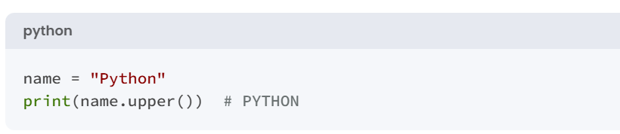
Strings are sequences of characters, using the syntax of either single quotes or double quotes:
'hello’ "Hello“ " I don't do that "
Because strings are ordered sequences it means we can use indexing and slicing to grab sub-sections of the string.
Indexing notation uses [ ] notation after the string (or variable assigned the string).
Indexing allows us to grab a single character from the string.

Slide 25
String Indexing
and Slicing

Slide 26
These actions use [ ] square brackets and a number index to indicate positions of what you wish to grab.
Character : h e l l o
Index : 0 1 2 3 4
These actions use [ ] square brackets and a number index to indicate positions of what you wish to grab.
Character : h e l l o
Index : 0 1 2 3 4
Reverse Index: 0 -4 -3 -2 -1

Slide 27
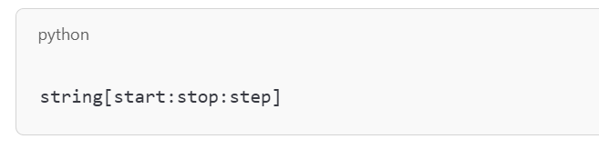
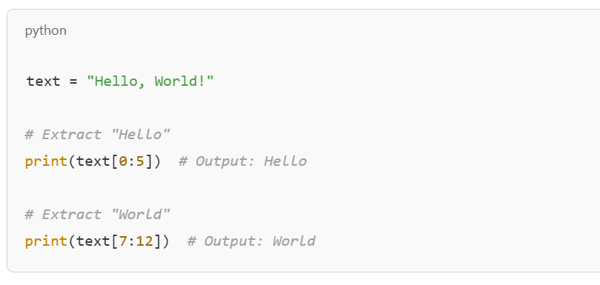
Parameters:
start: The index to begin slicing (inclusive).
stop: The index to end slicing (exclusive).
step: The interval between indices (default is 1).

Slide 28
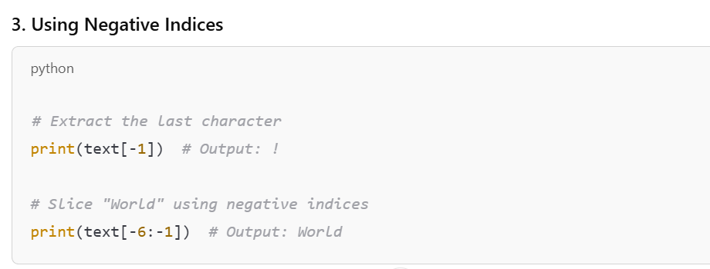
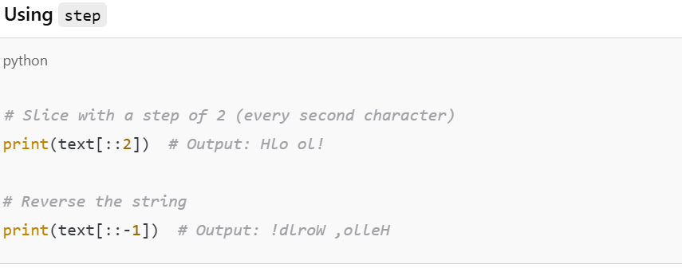

Slide 29
String Interpolation
We can “inject” a variable into the string for printing. For example:
my_name = “James Bond”
print(“Hello ” + my_name) ----> “Hello James Bond”.
There are multiple ways to format strings for printing variables in them.
This is known as string interpolation.
Let’s explore two methods for this:
.format() method
f-strings (formatted string literals)

Slide 30
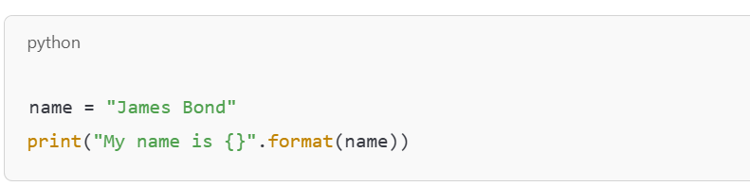
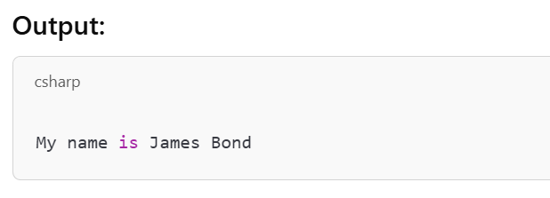
Method 1) .format() method
name = “ James Bond”
print(“ My name is {}”.format(name)”)
output:: “My name is James Bond”

Slide 31
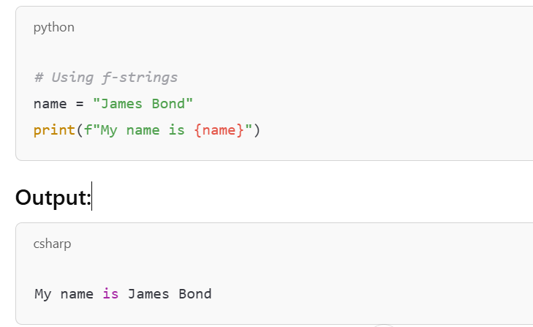
Method 2) f-strings (formatted string literals)
name = “James Bond”
print(f“My name is {name}”)
output:: “My name is James Bond”

Slide 32
Common String Methods

Slide 33
1. Changing Case
Method | Description | Example
lower() | Converts all characters to lowercase | "HELLO".lower() → "hello"
upper() | Converts all characters to uppercase | "hello".upper() → "HELLO"
title() | Converts the first character of each word to uppercase | "hello world".title() → "Hello World"
capitalize() | Converts the first character to uppercase | "hello".capitalize() → "Hello"
swapcase() | Swaps the case of all characters | "HeLLo".swapcase() → "hEllO"

Slide 34
2. Checking Content
Method | Description | Example
isalpha() | Checks if all characters are alphabets | "hello".isalpha() → True
isdigit() | Checks if all characters are digits | "12345".isdigit() → True
isalnum() | Checks if all characters are alphanumeric | "hello123".isalnum() → True
isspace() | Checks if all characters are whitespace | " ".isspace() → True
startswith() | Checks if string starts with a substring | "hello".startswith("he") → True
endswith() | Checks if string ends with a substring | "hello".endswith("lo") → True

Slide 35
3. Modifying Strings
Method | Description | Example
strip() | Removes leading and trailing whitespace | " hello ".strip() → "hello"
lstrip() | Removes leading whitespace | " hello".lstrip() → "hello"
rstrip() | Removes trailing whitespace | "hello ".rstrip() → "hello"
replace() | Replaces all occurrences of a substring | "hello".replace("l", "p") → "heppo"
split() | Splits string into a list based on a delimiter | "a,b,c".split(",") → ['a', 'b', 'c']
join() | Joins elements of a list into a string | " ".join(["a", "b", "c"]) → "a b c"
zfill() | Pads string with zeros | "42".zfill(5) → "00042"

Slide 36
4. Finding and Counting
Method | Description | Example
find() | Returns the first occurrence index of substring | "hello".find("l") → 2
rfind() | Returns the last occurrence index of substring | "hello".rfind("l") → 3
count() | Counts the occurrences of a substring | "hello".count("l") → 2

Slide 37
5. Formatting Strings
Method | Description | Example
format() | Inserts values into placeholders | "Hello, {}".format("John") → "Hello, John"
f-string | Inserts values directly using f syntax | name = "John"; f"Hello, {name}" → "Hello, John"
center() | Centers the string within a specified width | "hello".center(10) → " hello "
ljust() | Left-aligns the string within a specified width | "hello".ljust(10) → "hello "
rjust() | Right-aligns the string within a specified width | "hello".rjust(10) → " hello"

Slide 38
Membership Operators
Operator | Description | Example | Result
In | Checks membership | ‘a’ in ‘learning’ | True
Not in | Checks absence of membership | ‘a’ not in ‘Python’ | True

Slide 39
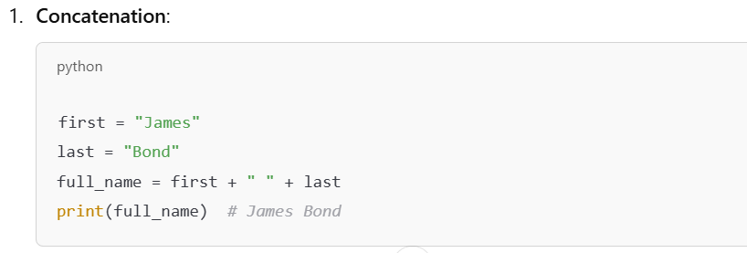
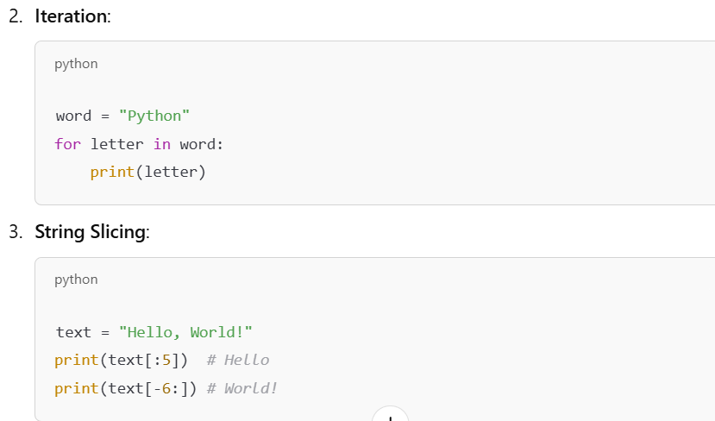

Slide 40
Date Format

Slide 41
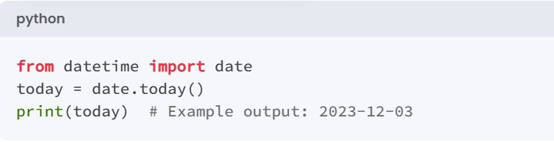
Date: Dates can be handled using the datetime module.

Slide 42
Common Date Formats
Code | Meaning | Example
%d | Day of the month (01-31) | 5
%m | Month as a number (01-12) | 7
%b | Abbreviated month name | Jul
%B | Full month name | July
%y | Year without century (00-99) | 23
%Y | Year with century | 2023
%H | Hour (00-23) (24-hour clock) | 14
%I | Hour (01-12) (12-hour clock) | 2
%p | AM or PM | PM
%M | Minute (00-59) | 30
%S | Second (00-59) | 45
%a | Abbreviated weekday name | Mon
%A | Full weekday name | Monday
%w | Weekday as a number (0-6) | 1 (Monday)
%j | Day of the year (001-366) | 186
%W | Week number of the year | 27
%z | UTC offset | 530
%c | Local date and time | Mon Jul 3 14:30:00 2023
%x | Local date | 7/3/2023
%X | Local time | 14:30:00

Slide 43
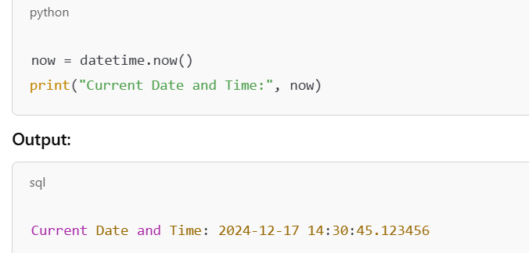
Module:: datetime
from datetime import datetime

Slide 44
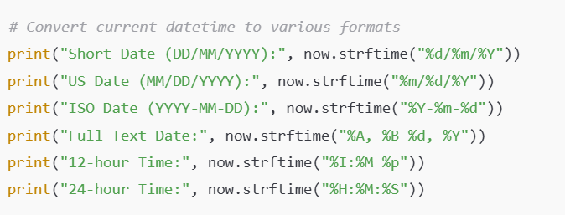
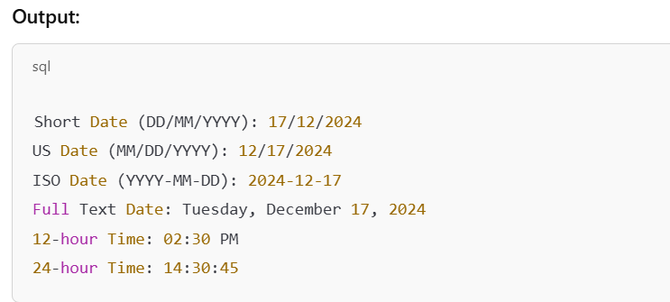
Examples of Formatting

Slide 45
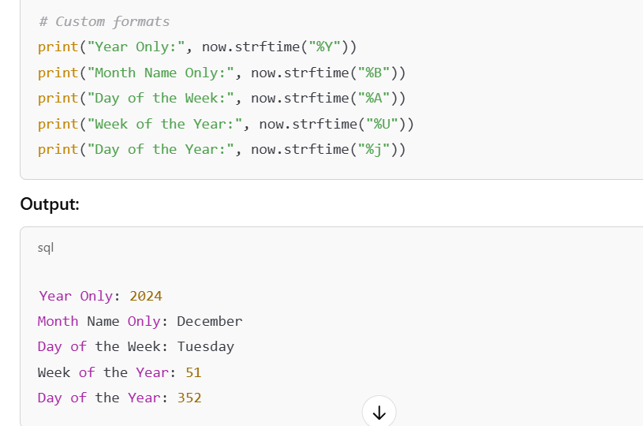
Custom Date Formats

Slide 46
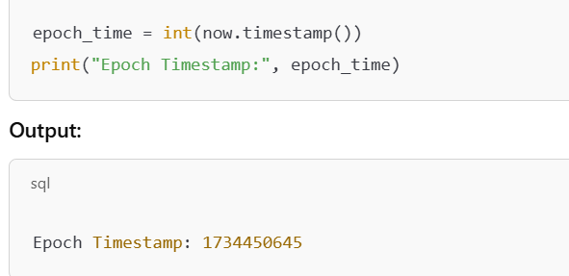
Convert to Epoch Timestamp

Slide 47
BOOLEAN

Slide 48
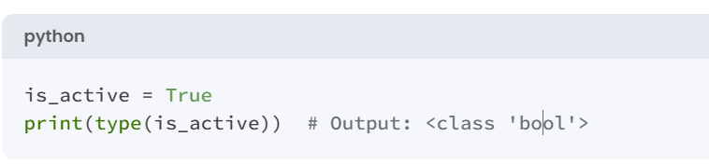
Boolean: Represents `True` or `False`.
Booleans are a subtype of integers (int) in Python.
True is equivalent to 1
False is equivalent to 0

Slide 49
Lists

Slide 50
Lists in Python
A list in Python is a built-in data structure that is used to store multiple items in a single variable. It is one of the most commonly used data types for storing collections of data.
List1=[1,2,3,4] List2= [‘A’, ‘B’, ‘C’, ‘D’]
Key Characteristics of Lists
Ordered: Elements in a list have a defined order and can be accessed by their index.
Mutable: You can add, remove, or change items after the list is created.
Heterogeneous: Lists can contain items of different data types.
Dynamic Size: Lists can grow or shrink dynamically as needed.
Allows Duplicates: Lists can contain duplicate items.

Slide 51
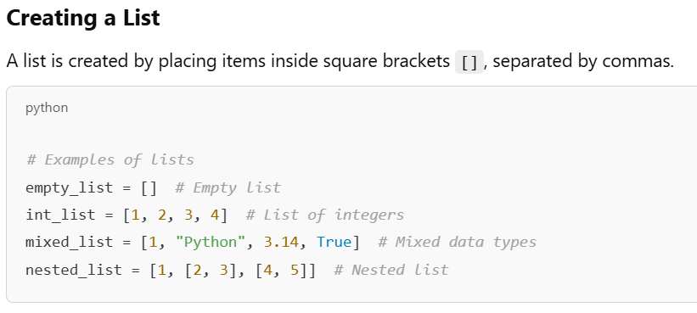

Slide 52
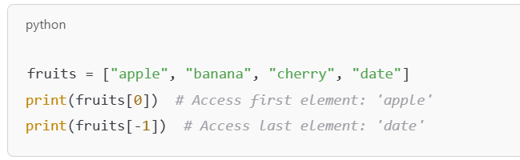
Accessing List Elements
Using Indexing
Index starts at 0 for the first element.
Negative indices access elements from the end.
fruits = [‘apple’, ‘banana’, ‘cherry’, ‘date’]
Index 0 1 2 3
Negative Index 0 -3 -2 -1

Slide 53
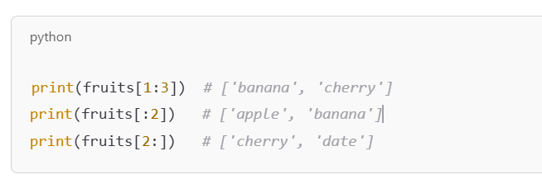
2. Using Slicing
Use start:end to get a subset of the list.
The end index is exclusive.

Slide 54
List Operations
Category | Operation | Syntax/Method | Description | Example
Accessing Elements | Indexing | list[index] | Access an element by its index. | my_list[1] → Access second element.
 | Slicing | list[start:end:step] | Access a portion of the list. | my_list[1:3] → Elements from index 1 to 2.
Adding Elements | Append | list.append(x) | Add an element to the end. | my_list.append(50) → [10, 20, 30, 40, 50]
 | Insert | list.insert(i, x) | Insert an element at a specific index. | my_list.insert(2, 25) → [10, 20, 25, 30, 40]
 | Extend | list.extend(iterable) | Add multiple elements to the end. | my_list.extend([60, 70]) → [10, 20, 30, 40, 60, 70]

Slide 55
Category | Operation | Syntax/Method | Description | Example
Removing Elements | Remove | list.remove(x) | Remove the first occurrence of a value. | my_list.remove(30) → [10, 20, 40]
 | Pop | list.pop(i) | Remove and return an element by index. | my_list.pop(1) → 20, my_list → [10, 30, 40]
 | Clear | list.clear() | Remove all elements. | my_list.clear() → []
Updating Elements | Replace by Index | list[index] = value | Update a specific element. | my_list[2] = 35 → [10, 20, 35, 40]
 | Replace via Slicing | list[start:end] = values | Update multiple elements using slicing. | my_list[1:3] = [25, 30] → [10, 25, 30, 40]

Slide 56
Category | Operation | Syntax/Method | Description | Example
Searching Elements | Index | list.index(x) | Find the index of the first occurrence of a value. | my_list.index(30) → 2
 | Count | list.count(x) | Count the occurrences of a value. | my_list.count(30) → 1
Sorting and Reversing | Sort | list.sort() | Sort the list in ascending order. | my_list.sort() → [10, 20, 30, 40]
 | Reverse | list.reverse() | Reverse the elements of the list. | my_list.reverse() → [40, 30, 20, 10]
Copying | Copy | list.copy() | Create a shallow copy of the list. | new_list = my_list.copy() → new_list = [10, 20, 30, 40]
Combining Lists | Concatenation | list1 + list2 | Combine two lists into one. | [10, 20] + [30, 40] → [10, 20, 30, 40]
 | Repetition | list * n | Repeat the list n times. | [10, 20] * 2 → [10, 20, 10, 20]

Slide 57
Membership Operators
Operator | Description | Example | Result
In | Checks membership | 5 in [1, 2, 3, 4, 5] | True
Not in | Checks absence of membership | 6 not in [1, 2, 3] | True

Slide 58
Tuples

Slide 59
Tuples in Python
A tuple is a collection of ordered, immutable elements.
Tuples are defined using parentheses () and can hold elements of any data type.
Once a tuple is created, its elements cannot be changed (i.e., they are immutable).
tuple1 = (1,2,3,4)
Key Features of Tuples
Immutable: Tuples cannot be modified after creation.
Ordered: Elements have a defined order and can be accessed using an index.
Allow Duplicates: Tuples can have duplicate elements.
Can Hold Mixed Data Types: Tuples can contain integers, strings, lists, other tuples, etc.

Slide 60
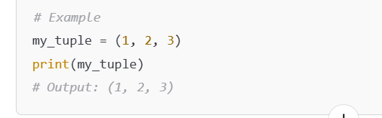
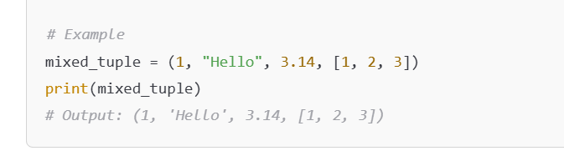
1. Creating a Simple Tuple
2. Tuple with Mixed Data Types

Slide 61
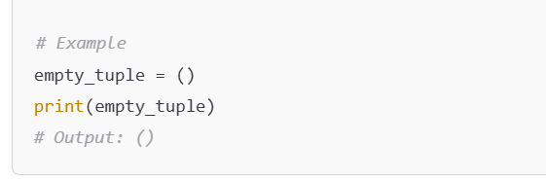
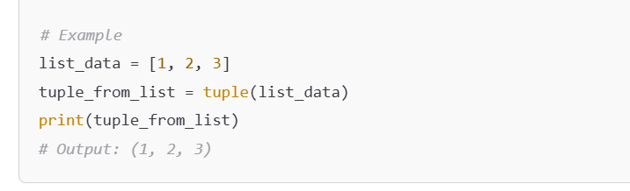
3. Empty Tuple
4. Tuple Using the tuple() Constructor

Slide 62
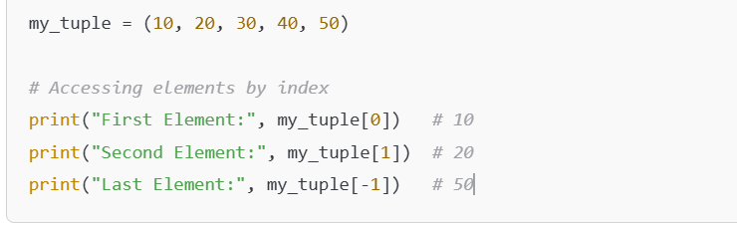
Accessing a Tuple
Using Indexing
Each element in a tuple is assigned an index starting from 0.
You can access elements using square brackets [ ].
my_tuple = ( 10, 20, 30, 40, 50 )
Index 0 1 2 3 4
Negative Index 0 -4 -3 -2 -1

Slide 63
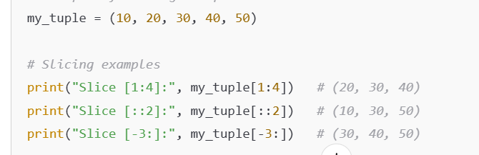
Using Slicing
Slicing allows you to access a range of elements by specifying start, stop, and step.

Slide 64
Tuple Operations

Slide 65
Operation | Example | Description | Output
Access by Index | t = (1, 2, 3); t[0] | Access the first element. | 1
Negative Indexing | t = (1, 2, 3); t[-1] | Access the last element. | 3
Slicing | t = (1, 2, 3, 4); t[1:3] | Access a range of elements (start inclusive, end exclusive). | (2, 3)
Length of Tuple | len((1, 2, 3)) | Returns the number of elements in the tuple. | 3
Concatenation | (1, 2) + (3, 4) | Joins two tuples. | (1, 2, 3, 4)
Repetition | (1, 2) * 2 | Repeats the tuple n times. | (1, 2, 1, 2)
Membership Test | 2 in (1, 2, 3) | Checks if an element exists in the tuple. | TRUE
Iterating through Tuple | for x in (1, 2, 3): print(x) | Loops through each element of the tuple. | 1 2 3

Slide 66
Operation | Example | Description | Output
Count Occurrences | (1, 2, 2).count(2) | Counts the occurrences of an element in the tuple. | 2
Find Index | (1, 2, 3).index(2) | Returns the index of the first occurrence of an element. | 1
Immutable Nature | t = (1, 2); t[0] = 10 | Attempt to modify a tuple element. | TypeError
Sorting | sorted((3, 1, 2)) | Returns a sorted list (tuple itself is not modified). | [1, 2, 3]
Tuple Unpacking | a, b = (1, 2) | Assigns tuple elements to variables. | a=1, b=2
Nested Tuple Access | t = ((1, 2), (3, 4)); t[1][0] | Access an element from a nested tuple. | 3
Conversion to List | list((1, 2, 3)) | Converts a tuple to a list. | [1, 2, 3]
Conversion from List | tuple([1, 2, 3]) | Converts a list to a tuple. | (1, 2, 3)

Slide 67
Membership Operators
Operator | Description | Example | Result
In | Checks membership | 5 in (1, 2, 3, 4, 5) | True
Not in | Checks absence of membership | 6 not in (1, 2, 3) | True

Slide 68
SETS

Slide 69
What Are Sets?
A set is an unordered collection of unique and immutable elements.
Sets are defined using curly braces {} or the set() constructor.
{1,2,3, ‘A’, ‘b’}
Key Features
Unordered: Items do not have a specific order.
Unique: No duplicate elements.
Mutable: Elements can be added or removed, but the set itself must contain immutable objects.

Slide 70
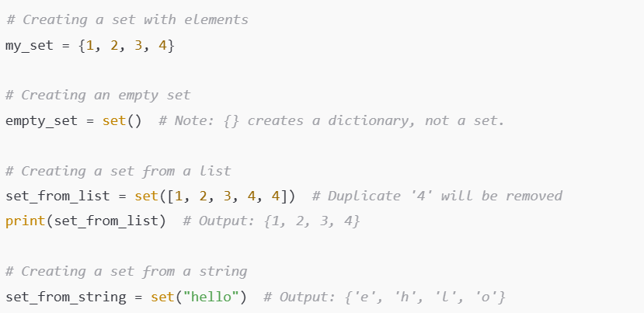

Slide 71
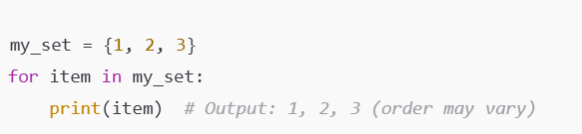
Accessing Elements in Sets
Direct access is not possible due to the unordered nature of sets.
You can iterate through a set using loops.

Slide 72
Method | Description
add(item) | Adds an element to the set.
update(iterable) | Adds multiple elements from an iterable.
remove(item) | Removes an element; raises KeyError if not found.
discard(item) | Removes an element; does not raise an error if not found.
pop() | Removes and returns an arbitrary element.
clear() | Removes all elements from the set.

Slide 73
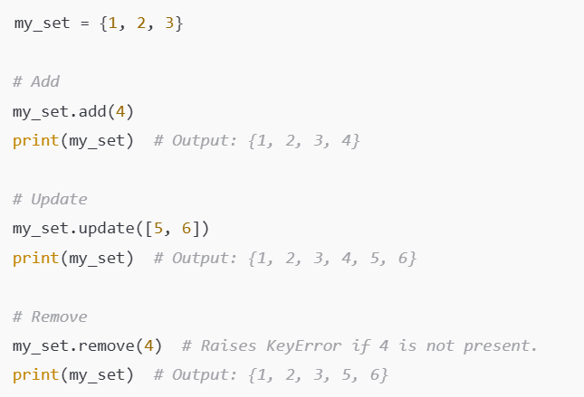
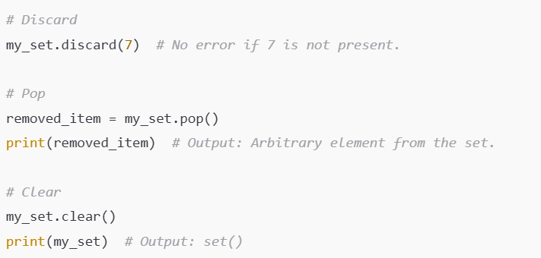

Slide 74
SET OPERATIONS
Operation | Syntax | Description
Union | `A | BorA.union(B)`
Intersection | A & B or A.intersection(B) | Finds common elements.
Difference | A - B or A.difference(B) | Elements in A but not in B.
Symmetric Difference | A ^ B or A.symmetric_difference(B) | Elements in either A or B, but not both.
Subset | A <= B or A.issubset(B) | Checks if A is a subset of B.
Superset | A >= B or A.issuperset(B) | Checks if A is a superset of B.
Disjoint | A.isdisjoint(B) | Checks if A and B have no elements in common.

Slide 75
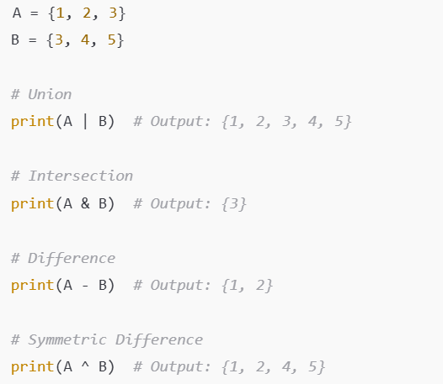
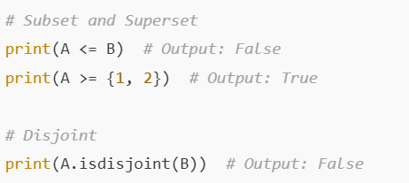

Slide 76
Method | Description
copy() | Returns a shallow copy of the set.
len(set) | Returns the number of elements in the set.
in | Checks if an element exists in the set.
not in | Checks if an element does not exist in the set.

Slide 77
Membership Operators
Operator | Description | Example | Result
In | Checks membership | 5 in {1, 2, 3, 4, 5} | True
Not in | Checks absence of membership | 6 not in {1, 2, 3} | True

Slide 78
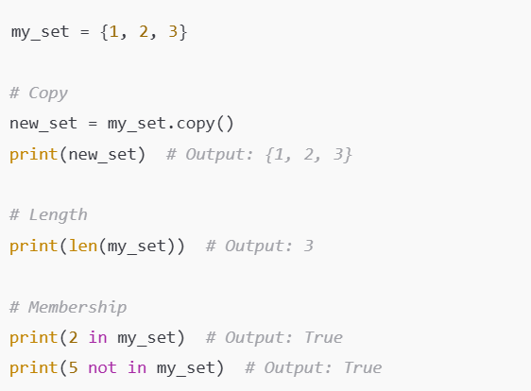

Slide 79
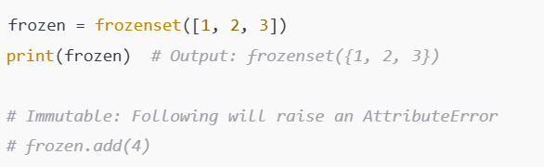
Frozen Sets

Slide 80
Dictionaries

Slide 81
Dictionaries in Python
A dictionary in Python is a collection of key-value pairs where each key is unique, and values can
be of any data type.
Dictionaries are mutable and unordered (prior to Python 3.7).
They are defined using curly braces {}.
my_dict = {"name": "Alice", "age": 25, "city": "New York"}
Key Points About Dictionaries
Keys must be unique and immutable: They can be strings, numbers, or tuples.
Values can be any data type: Lists, other dictionaries, strings, etc.
Dictionaries are unordered (until Python 3.6): From Python 3.7 onwards, they maintain insertion order.

Slide 82
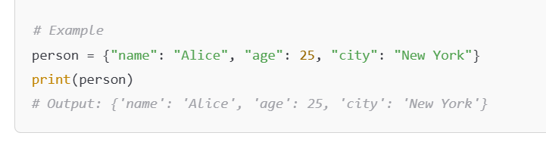
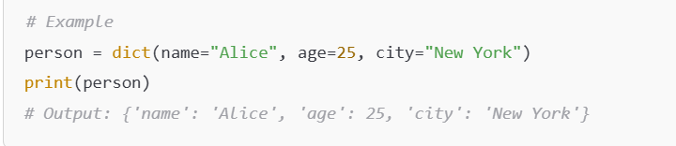
Creating a Dictionary
1. Using Curly Braces
2. Using the dict() Constructor

Slide 83
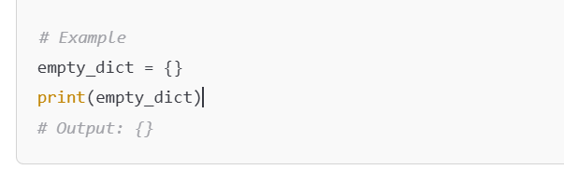
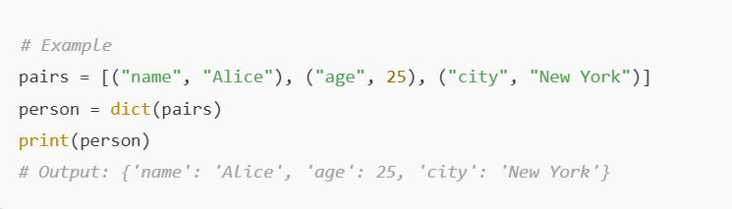
3. Creating an Empty Dictionary
4. Using a List of Tuples

Slide 84
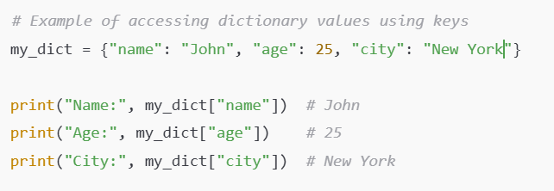
Accessing Elements in a Dictionary
Access Using Keys
Use square brackets [ ] with the key to access the corresponding value.
If the key does not exist, it raises a KeyError.

Slide 85
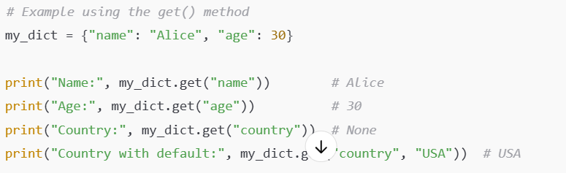
Using the get() Method
Use the get() method to access values.
If the key does not exist, it returns None or a default value (if specified).

Slide 86
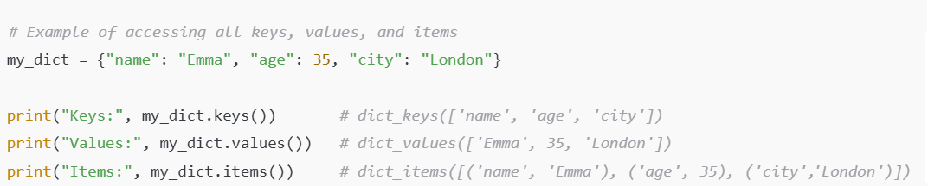
Access All Keys, Values, or Key-Value Pairs
Use the methods keys(), values(), and items() to retrieve keys, values, or both.

Slide 87
Dictionary Operations

Slide 88
Category | Operation | Syntax/Method | Description | Example
Accessing Values | Get value by key | dict[key] | Access the value associated with a key. | my_dict["name"] → "Alice"
 | Get value safely | dict.get(key, default) | Get value by key; return default if key not found. | my_dict.get("age", 0) → 25, my_dict.get("salary", 0) → 0
Adding/Updating | Add/Update key-value | dict[key] = value | Add or update a key-value pair. | my_dict["country"] = "USA" → {"name": "Alice", "age": 25, "city": "New York", "country": "USA"}
Removing Items | Remove key | dict.pop(key, default) | Remove a key and return its value; return default if key not found. | my_dict.pop("city") → "New York"
 | Remove last item | dict.popitem() | Remove and return the last key-value pair (Python 3.7+). | my_dict.popitem() → ("city", "New York")
 | Delete key | del dict[key] | Remove a key-value pair. | del my_dict["age"] → {"name": "Alice"}
 | Clear dictionary | dict.clear() | Remove all key-value pairs. | my_dict.clear() → {}

Slide 89
Category | Operation | Syntax/Method | Description | Example
Combining Dictionaries | Merge dictionaries | dict1.update(dict2) | Add key-value pairs from one dictionary to another. | dict1.update({"state": "NY"}) → {"name": "Alice", "state": "NY"}
Keys and Values | Get all keys | dict.keys() | Return all keys in the dictionary. | list(my_dict.keys()) → ["name", "age", "city"]
 | Get all values | dict.values() | Return all values in the dictionary. | list(my_dict.values()) → ["Alice", 25, "New York"]
 | Get all items | dict.items() | Return all key-value pairs as tuples. | list(my_dict.items()) → [("name", "Alice"), ("age", 25), ("city", "New York")]
Checking Existence | Check if key exists | key in dict | Return True if the key exists in the dictionary. | "name" in my_dict → True
 | Check if key not exists | key not in dict | Return True if the key does not exist. | "salary" not in my_dict → True

Slide 90
Category | Operation | Syntax/Method | Description | Example
Iterating | Iterate keys | for key in dict: | Loop through all keys. | for key in my_dict: print(key)
 | Iterate values | for value in dict.values(): | Loop through all values. | for value in my_dict.values(): print(value)
 | Iterate items | for key, value in dict.items(): | Loop through all key-value pairs. | for key, value in my_dict.items(): print(key, value)
Copying | Shallow copy | dict.copy() | Create a shallow copy of the dictionary. | new_dict = my_dict.copy() → {"name": "Alice", "age": 25, "city": "New York"}
Set Default | Add if not exists | dict.setdefault(key, default) | Get value for the key; add key with default value if absent. | my_dict.setdefault("gender", "Female") → {"name": "Alice", "age": 25, "city": "New York", "gender": "Female"}
Sorting | Sort by keys | sorted(dict) | Return a sorted list of keys. | sorted(my_dict) → ["age", "city", "name"]
 | Sort by values | sorted(dict.items(), key=lambda x: x[1]) | Sort by values using custom key. | sorted(my_dict.items(), key=lambda x: x[1]) → [("name", "Alice"), ("city", "New York"), ("age", 25)]

Slide 91
Membership Operators
my_dict = {"name": "Alice", "age": 25, "city": "New York"}
Operator | Description | Example | Result
In | Checks membership | ‘age’ in my_dict.keys() | True
Not in | Checks absence of membership | 6 not in my_dict.keys() | True

Slide 92
Numpy Arrays

Slide 93
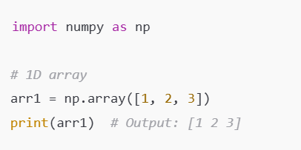
Numpy Arrays
NumPy arrays are a powerful N-dimensional array object in Python. They provide fast and efficient operations for numerical computations.
Syntax: np.array(list_of_values)

Slide 94
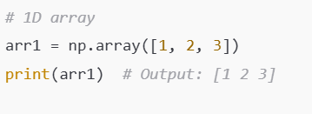


1D Array:
2D Array:
3D Array:

Slide 95

Accessing Numpy Array Elements

Slide 96

Broadcasting
NumPy allows operations between arrays of different shapes using broadcasting.

Slide 97


Array Operations

Slide 98

Concatenation and Splitting

Slide 99
NumPy Array Properties
Property | Description | Example Code | Output
shape | Returns the dimensions of the array | arr.shape | (2, 3)
ndim | Returns the number of dimensions | arr.ndim | 2
dtype | Returns the data type of array elements | arr.dtype | int64 (or similar)
size | Returns the total number of elements | arr.size | 6
itemsize | Returns the size (in bytes) of one array element | arr.itemsize | 8
nbytes | Returns the total memory consumed by the array | arr.nbytes | 48

Slide 100
NumPy Array Operations
Array1 = [[1,2],[3,4]]
Operation | Description | Example Code | Output
Element-wise addition | Adds a scalar to all elements | arr + 2 | [[3, 4], [5, 6]]
Element-wise subtraction | Subtracts a scalar from all elements | arr - 2 | [[-1, 0], [1, 2]]
Element-wise multiplication | Multiplies all elements by a scalar | arr * 2 | [[2, 4], [6, 8]]
Element-wise division | Divides all elements by a scalar | arr / 2 | [[0.5, 1.0], [1.5, 2.0]]
Matrix multiplication | Performs dot product between arrays | np.dot(arr, arr) | [[7, 10], [15, 22]]

Slide 101
Operation | Description | Example Code | Output
Transpose | Flips the rows and columns | arr.T | [[1, 3], [2, 4]]
Summation | Adds all elements of the array | arr.sum() | 10
Mean | Computes the average value of the array | arr.mean() | 2.5
Maximum | Finds the largest element in the array | arr.max() | 4
Minimum | Finds the smallest element in the array | arr.min() | 1
Unique Elements | Returns unique elements in the array | np.unique(arr) | [1, 2, 3, 4]
Concatenate (vertically) | Joins two arrays along rows | np.vstack((arr1, arr2)) | [[1, 2], [3, 4], [5, 6]]

Slide 102
Operation | Description | Example Code | Output
Concatenate (horizontally) | Joins two arrays along columns | np.hstack((arr1, arr2.T)) | [[1, 2, 5], [3, 4, 6]]
Reshape | Reshapes the array to the specified dimensions | arr.reshape((3, 2)) | [[1, 2], [3, 4]]
Flatten | Converts a multi-dimensional array into a 1D array | arr.flatten() | [1, 2, 3, 4]
Boolean Masking | Filters elements based on conditions | arr[arr > 2] | [3, 4]
Replace Missing Values | Replaces NaN values with a specified value | arr[np.isnan(arr)] = 0 | [1.0, 2.0, 0.0, 4.0]

Slide 103
CONDITIONAL CLAUSES

Slide 104

if Statement
The if statement checks a condition. If the condition evaluates to True, the block of code inside the if is executed. Otherwise, the code skips to the next section.
IF:
The IF statement checks a condition. IF the condition evaluates to True, the block of code inside the if is executed. Otherwise, the code skips to the next section.
Syntax:
if condition:
# Code to execute if the condition is True

Slide 105
if-else:
The if-else statement provides an alternative block of code to execute if the condition evaluates to False.
Syntax:
if condition:
# Code to execute if the condition is True
else:
# Code to execute if the condition is False

Slide 106


Slide 107
if-elif-else:
For checking multiple conditions, use elif (short for "else if").
This prevents the need for nested if statements.
Syntax:
if condition:
# Code to execute if the condition is True
elif:
# Code to execute if the condition is True
else:
# Code to execute if the condition is False

Slide 108


Slide 109


Nested if Statements
An if statement can be nested within another if for more specific conditions.

Slide 110

Taking Input from the User
In Python, you can take input from the user using the input() function
1. Basic Input (String)
By default, the input() function takes user input as a string.

Slide 111

2. Integer Input
To take integer input, convert the string input to an integer using int().

Slide 112

3. Float Input
For floating-point numbers, convert the input using float().

Slide 113

4. Multiple Inputs (Space-Separated)
Use split() to take multiple inputs in a single line.

Slide 114

5. Multiple Inputs (Converted to Integers)
Use map() to convert the inputs to integers or other types.

Slide 115
Advances Problems on IF ELSE
1. Grade Categorization
Create a program that accepts a score between 0 and 100 and categorizes the grade based on the following:
90-100: "A"
80-89: "B"
70-79: "C"
60-69: "D"
<60: "F"
But include bonus conditions:
If the score is divisible by 5 and ends with a 5, add a message: "Bonus achieved!"
If the score is below 50, add a warning: "You need to retake the course."

Slide 116

2) Calculate Average
Take N numbers as input (space-separated), calculate their average, and determine whether the average is greater than 50 or not.

Slide 117

3. Triangle Type Checker
Write a program that accepts three integers as the lengths of a triangle and determines:
If it’s a valid triangle.
If valid, categorize it as:
Equilateral (all sides equal)
Isosceles (two sides equal)
Scalene (all sides unequal)

Slide 118

4. Odd-Even Index Pattern
Write a program to generate a list of numbers (e.g., from 1 to n) and modify it based on the following conditions:
If the number is odd and divisible by 3, replace it with "Fizz".
If the number is even and divisible by 4, replace it with "Buzz".
If it meets both conditions, replace it with "FizzBuzz".
Otherwise, keep the number as is.

Slide 119

5. Digital Number Mirror
Write a program that accepts a number with 4 digits and determines if its mirrored digits match when reversed (e.g., “9669" stays"9669", "8768" becomes “8678"). Include these valid digit pairs:
7787 <-> 7877
9999 <-> 9999
0101 <-> 1010
1001<-> 1001

Slide 120
SOLUTIONS for IF ELSE Problems

Slide 121

1. Grade Categorization

Slide 122

2) Calculate Average

Slide 123

3. Triangle Type Checker

Slide 124

4. Odd-Even Index Pattern

Slide 125

5. Digital Number Mirror

Slide 126

5. Password Strength Checker
Write a program to check the strength of a password based on the following:
If the length < 6, output "Very Weak".
If it has only alphabets or numbers, output "Weak".
If it has at least one uppercase, one lowercase, and one digit, output "Strong".
If it also contains special characters, output "Very Strong".

Slide 127

5. Password Strength Checker

Slide 128
ERRORS and ERROR HANDLING

Slide 129

Error handling in Python is a critical concept for building robust and maintainable code.
Here's a comprehensive guide covering the essentials, advanced topics, and best practices:
Python uses exceptions to handle errors. Exceptions can be caught and handled using
try-except blocks.

Slide 130


Types of Exceptions
Python has a hierarchy of built-in exceptions.

Slide 131


Catching Multiple Exceptions
You can handle multiple exceptions in a single block or separate blocks.

Slide 132

try-except-else Block

Slide 133


try-except-else-finally Block

Slide 134
LOOPS

Slide 135

FOR LOOP in Python
The for loop is used to iterate over a sequence (like a list, tuple, string, dictionary, or range).

Slide 136


Slide 137


Slide 138

Advanced Features of FOR LOOP:

Slide 139


Slide 140

WHILE LOOP in Python
The while loop executes as long as a given condition is True.

Slide 141


Slide 142


Slide 143
Break, Continue, and Pass

Slide 144


Break
The break statement is used to terminate the loop prematurely.
When break is executed, the program exits the current loop immediately, even if the loop condition is still true.

Slide 145


2. Continue
The continue statement is used to skip the current iteration of the loop and move to the next iteration. The loop itself does not terminate but skips the rest of the code in the loop body for the current iteration.

Slide 146


3. Pass
The pass statement does nothing; it acts as a placeholder. It is used when a statement is syntactically required but no code needs to be executed.
This is useful in creating empty blocks for future development or as a placeholder for testing.

Slide 147
Key Differences
Keyword | Behavior | Use Case
break | Exits the loop completely. | Stop a loop when a condition is met.
continue | Skips the current iteration and proceeds to the next. | Skip specific iterations in a loop.
pass | Does nothing; acts as a placeholder. | Write syntactically valid but empty code blocks.
Summary
break: Ends the loop immediately.
continue: Skips to the next iteration.
pass: Does nothing, used as a placeholder.

Slide 148

Advanced Features of WHILE LOOP:

Slide 149


Slide 150
Key Differences Between FOR and WHILE Loops
Feature | for Loop | while Loop
Purpose | Iterates over a sequence | Repeats based on a condition
When to Use | Known number of iterations | Unknown number of iterations
Termination | Ends when sequence ends | Ends when condition becomes False

Slide 151

Loop Optimization Tips

