Slide 1

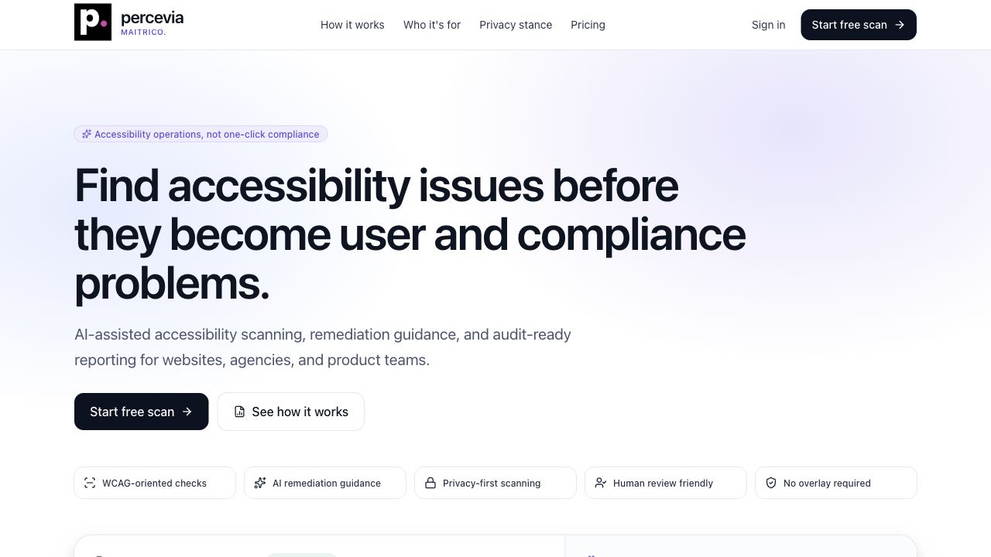
percevia
MAITRICO.
PRIVACY-FIRST ACCESSIBILITY OPERATIONS
Percevia AI
Project scope and technical architecture presentation
Prepared from the English technical report
Review date: June 23, 2026
Official corporate deck | English
01

Slide 2
percevia
MAITRICO.
30-SECOND PITCH
Executive summary
Percevia AI turns web accessibility from a one-time audit into a repeatable operational process.
33
323
analysis variants
passing tests
- Scans real pages with Playwright, Chromium, and axe-core.
- Tests desktop, tablet, mobile, and key interactive states.
- Groups repeated defects by likely root cause.
- Creates remediation tasks, reports, comparisons, and monitor schedules.
- Keeps AI and visual evidence opt-in, bounded, and auditable.
- Avoids certification language and does not guarantee legal compliance.
Max per page.
Unit and integration checks.
4
5
export formats
plan tiers
HTML, PDF, CSV, and JSON.
Free through Enterprise.
maitrico Percevia AI | Project scope and technical architecture
02

Slide 3
percevia
MAITRICO.
MARKET AND WORKFLOW CONTEXT
The problem Percevia AI solves
01
Tools produce noise
02
Teams lack priority
03
Reports are fragmented
Accessibility scanners often return hundreds of repeated findings without explaining shared root causes.
Developers, PMs, and auditors need severity, risk, affected pages, and owner-ready tasks.
Executives need a clear risk story while developers need technical evidence, WCAG tags, and selectors.
04
Audits do not stick
05
Privacy is unclear
06
Compliance claims are risky
One-time audits miss regressions unless teams can re-scan, compare, and monitor over time.
Screenshots, HTML samples, AI processing, and retention must be controlled with explicit consent.
Automated results must support decisions without implying certification or legal guarantees.
maitrico Percevia AI | Project scope and technical architecture
03

Slide 4
percevia
MAITRICO.
FROM DETECTION TO OPERATIONS
Product approach
Percevia AI is designed as an accessibility operations loop, not just a scanner.
1
2
3
4
5
Detect
>
Group
>
Prioritize
>
Assign
>
Verify
Run real-browser scans across pages, states, and viewports.
Normalize axe results and merge repeated defects by root cause.
Calculate score, risk, impact, and affected scope.
Convert findings or groups into remediation tasks.
Re-scan, compare, report, and monitor for regressions.
Operating principle: automated analysis is decision support. Human review remains part of the accessibility process.
maitrico Percevia AI | Project scope and technical architecture
04

Slide 5
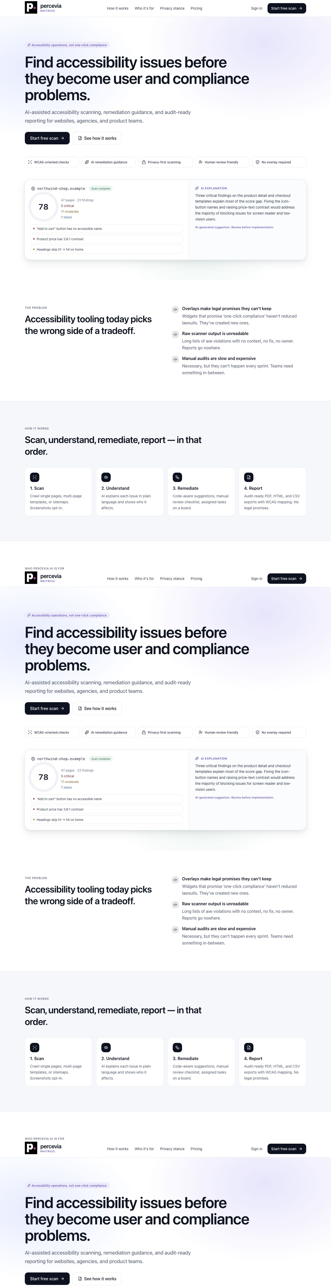
percevia
MAITRICO.
CURRENT PRODUCT SURFACE
Capability map
Scanning
Analysis
Single, multi-page, sitemap, and manual URL list modes.
axe-core normalization, WCAG tags, severity, review flags.
Operations
AI
Statuses, root-cause groups, remediation tasks, comparison.
Opt-in explanations, code suggestions, and project assistant.
Evidence
Reporting
Opt-in screenshots, selector metadata, redaction, expiry.
Executive, technical, CSV, PDF, JSON, and public links.
Monitoring
Governance
Plan-based recurring scans with stored thresholds.
Roles, privacy center, audit logs, export, deletion.
maitrico Percevia AI | Project scope and technical architecture
05

Slide 6
percevia
MAITRICO.
WHO THE PLATFORM SERVES
Audience and role model
01
Product managers
02
Developers
03
Auditors
Visibility into risk, scope, roadmap, and progress.
Selectors, failing HTML, WCAG tags, code guidance, tasks.
Review flags, false-positive states, manual checklist support.
04
Agencies
05
Executives
06
Privacy teams
Multi-client reporting, client viewers, branded exports.
Readable risk summaries without low-level technical noise.
AI consent, screenshots, retention, deletion, audit logs.
Roles include owner, admin, developer, auditor, client_viewer, and report_viewer.
Permissions separately control scan creation, AI access, report export, billing, privacy, team management, deletion, and remediation.
maitrico Percevia AI | Project scope and technical architecture
06

Slide 7
percevia
MAITRICO.
IMPLEMENTED, GATED, INCOMPLETE, ROADMAP
Product scope and current status
Implemented
Configuration-dependent
Incomplete
Roadmap
- Auth and onboarding
- Scan creation and results
- Root-cause grouping
- Tasks and statuses
- HTML/CSV/JSON reports
- Privacy center and deletion
- Team invitations
- OpenAI explanations
- Visual evidence storage
- Polar billing
- PDF report generation
- White-label public reports
- Monitor email delivery
- Slack alert delivery
- Some stale UI or docs copy
- Lint quality gate
- Enterprise SSO
- Private scanner agent
- Dedicated regions
- Large inventory
- Jira/Linear/GitHub integrations
The product is feature-rich today, but several commercial and operational features depend on production configuration or near-term follow-through.
maitrico Percevia AI | Project scope and technical architecture
07

Slide 8
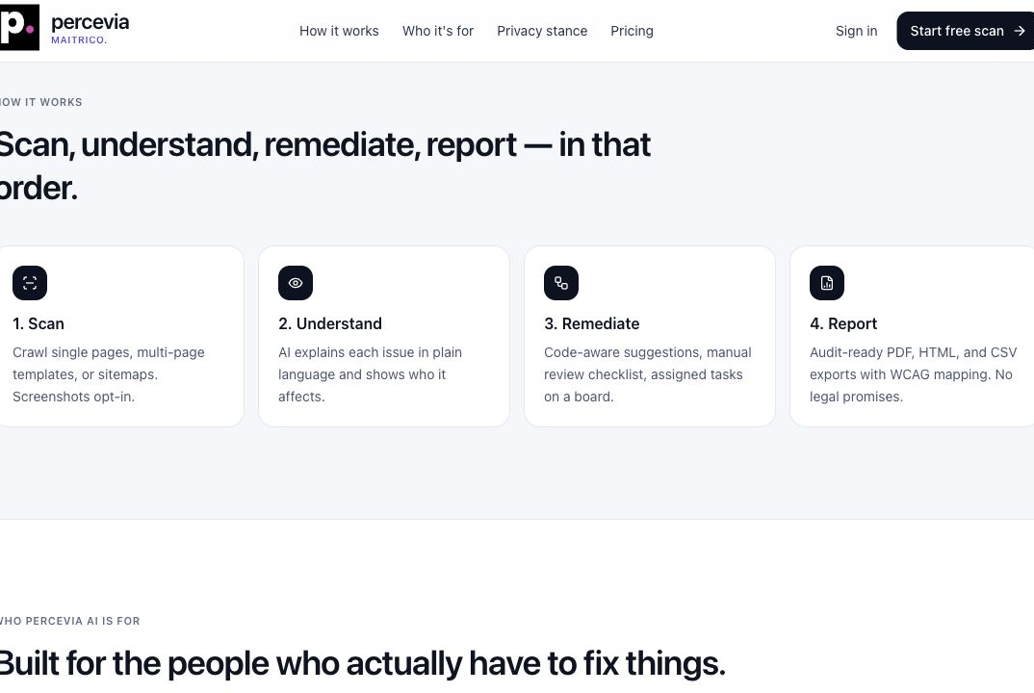
percevia
MAITRICO.
FROM WORKSPACE SETUP TO VERIFICATION
End-to-end user journey
1
2
3
4
Discover
>
Onboard
>
Scan
>
Remediate
Review positioning, pricing, privacy stance, and scan method.
Create workspace, company profile, standard, region preference, and plan.
Choose source, page limit, authorization, AI, and screenshot options.
Review groups, create tasks, assign status, and re-scan.
Reporting loop
Completed scans generate executive, technical, CSV-oriented, and public-shareable outputs. The same scan history supports future comparison and monitoring.
maitrico Percevia AI | Project scope and technical architecture
08

Slide 9
percevia
MAITRICO.
PRODUCTION TOPOLOGY
Current system architecture
User browser
Vercel Next.js 16
Cloud Tasks
Private Cloud Run
Dashboard, scan forms, reports
App Router, API routes, server session
Durable scan activation and retries
Worker service with Chromium
Firebase
Playwright + axe-core
External services
Auth, session cookie verification, Firestore data
Real browser execution and accessibility rules
OpenAI opt-in AI, Polar billing, Sentry/PostHog optional
Production stance
Scan creation does not run Chromium directly. It writes a queued job; Cloud Tasks wakes a private Cloud Run worker to claim, scan, persist, and aggregate results.
maitrico Percevia AI | Project scope and technical architecture
09

Slide 10
percevia
MAITRICO.
ASYNCHRONOUS WORKER MODEL
Scan processing pipeline
1
2
3
4
5
POST /api/scans
>
Queue job
>
Claim
>
Page jobs
>
Aggregate
Validate URL, plan, quota, concurrency, consent, and worker configuration.
Persist scans/{id} with status=queued and enqueue a Cloud Task.
Cloud Run worker atomically claims the job through Firestore.
Resolve URLs, create pageJobs, run page-level scanning and retries.
Write summaries, groups, scores, evidence metadata, and terminal state.
Scan phases
Page-job states
Recovery behavior
crawling, scanning, aggregating, completed, completed_with_errors, failed
queued, running, completed, failed. One slow page does not block the full scan.
Heartbeats, stale detection, queue timeout, sweeper, requeue, and aggregation restart.
maitrico Percevia AI | Project scope and technical architecture
10

Slide 11
percevia
MAITRICO.
WHAT IS TESTED
Scan engine technical model
4
3
5
33
scan sources
viewports
interaction types
max variants
single, multi-page, sitemap, manual
desktop, tablet, and mobile
menu, dialog, accordion, tab, form focus
viewport and state matrix
Resource profiles
Execution limits
Static fallback
real loads styles, fonts, and images for better contrast and layout accuracy. minimal reduces cost but lowers accuracy.
Response size cap, navigation timeout, axe timeout, page cap, scan cap, browser health checks.
Limited HTML scan if Chromium fails. It is low-confidence and not equivalent to real-browser analysis.
maitrico Percevia AI | Project scope and technical architecture
11

Slide 12
percevia
MAITRICO.
SAFE HANDLING OF USER-SUPPLIED TARGETS
URL security and SSRF protection
Opening customer-supplied URLs is one of the highest-risk parts of the system. Percevia treats URL validation as a layered security control.
1
Protocol and host
2
Network ranges
HTTP/S only, length limits, no credentials, no fragments, no reserved internal TLDs.
Private, loopback, link-local, multicast, IPv6 special ranges, and metadata IPs are blocked.
3
DNS and redirects
4
Scope control
Every DNS result is validated, worker re-resolves, and final redirect URL is checked.
Manual and sitemap scans enforce same-origin URLs and explicit authorization confirmation.
maitrico Percevia AI | Project scope and technical architecture
12

Slide 13
percevia
MAITRICO.
RAW AXE OUTPUT TO PRODUCT DATA
Finding normalization
1
2
3
4
axe result
>
normalized issue
>
review signal
>
audit event
Rule, impact, help text, tags, nodes, failure summary.
Severity, category, selector, HTML sample, viewport, state.
Human-review requirement and confidence boundaries preserved.
Status changes are recorded for traceability.
Finding statuses
Context retained
Why it matters
to_review, planned, in_progress, needs_human_review, fixed, accepted_risk, false_positive
Viewport, interaction state, page URL, selector, failing HTML, and WCAG tags.
Developers receive actionable detail while PMs can track status and progress.
maitrico Percevia AI | Project scope and technical architecture
13

Slide 14
percevia
MAITRICO.
REDUCING OPERATIONAL NOISE
Root-cause grouping
The system groups repeated defects into remediation targets so teams fix the underlying component rather than every repeated instance.
category + standard type + axe rule + normalized selector
Special case: contrast
Separation rules
Stored group data
Color-contrast issues can be grouped by foreground and background color pair.
Human-review findings, WCAG findings, and best-practice findings remain distinct.
Rule, title, worst severity, instance count, WCAG tag, remediation, and priority score.
maitrico Percevia AI | Project scope and technical architecture
14

Slide 15
percevia
MAITRICO.
PERCEVIA-SCORE-V1
Scoring and risk model
10
6
3
1
2
critical
serious
moderate
minor
review
highest impact weight
strong penalty
medium penalty
low penalty
manual-review weight
Occurrence factor
Page normalization
Outputs
Repeated findings use a logarithmic multiplier with an upper bound, avoiding runaway scores.
Total penalty is normalized with page count so larger scans are compared more fairly.
0-100 score, A-F grade, risk level, page scores, category scores, WCAG count, best-practice count, review count.
Important: the score supports prioritization and trend analysis. It is not a legal compliance score.
maitrico Percevia AI | Project scope and technical architecture
15

Slide 16
percevia
MAITRICO.
FROM FINDING TO OWNED WORK
Remediation management
1
2
3
4
Select finding
>
Create task
>
Assign
>
Verify
Open a finding or root-cause group with technical evidence.
Generate a remediation item linked to scan, page, rule, and group.
Set owner, priority, status, due date, project key, and notes.
Re-scan and compare to determine whether the issue is resolved.
Task data model
Project organization
title, description, status, priority, assignee, due date, notes, axe rule, severity, source URL, scan and group relationships.
Tasks can be organized by project or site domain, allowing one workspace to manage multiple websites or clients.
maitrico Percevia AI | Project scope and technical architecture
16

Slide 17
percevia
MAITRICO.
PRESENTATION-READY OUTPUTS
Reporting and public sharing
Report types
Mandatory limits
Full, executive, and CSV-oriented configurations.
Scope and legal-limitation notice cannot be removed.
Export formats
Public links
HTML, PDF, CSV, and JSON. PDF depends on Chromium availability.
Random token, revocable, no-store, noindex, and gated by report export permission.
Agency, Team, and Enterprise plans can use workspace branding for shared reports.
maitrico Percevia AI | Project scope and technical architecture
17

Slide 18
percevia
MAITRICO.
CONTROLLED ASSISTANCE, NOT AUTOMATION THEATER
AI layer
AI features are useful, but deliberately gated. The product treats AI as reviewable guidance, not an automatic compliance engine.
Use cases
Privacy limits
Output safety
Issue explanation, remediation summary, code example, framework-specific guidance, verification steps, client-friendly copy.
Workspace consent required, HTML samples limited to 2 KB, no cookies, no form values, no screenshots.
No certification claims, no legal guarantees, no 100% compliance claims, no overlay-as-substitute advice.
Default model: gpt-5.3-codex, configurable through environment variables. Every AI operation is rate-limited and written to audit logs.
maitrico Percevia AI | Project scope and technical architecture
18

Slide 19
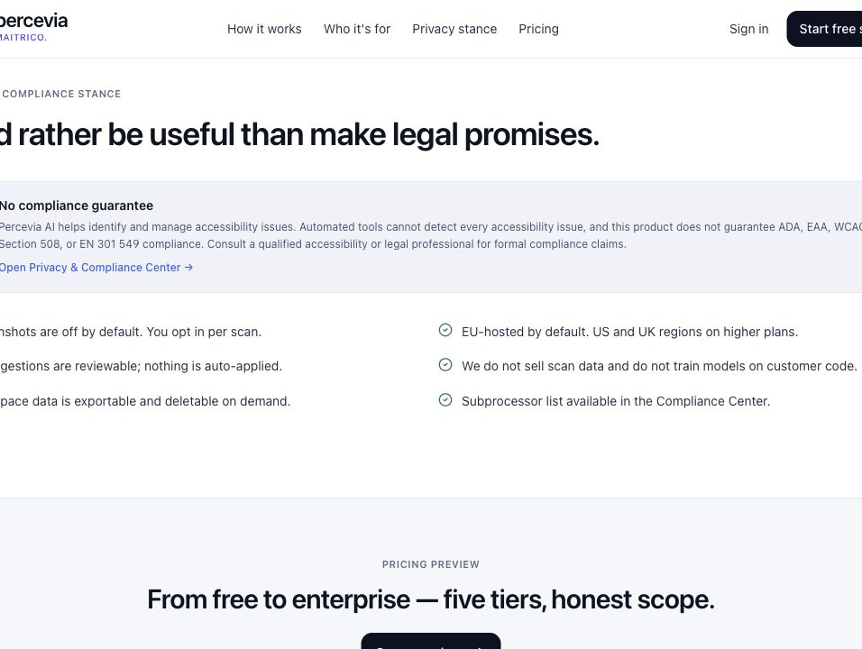
percevia
MAITRICO.
CONSENT, RETENTION, EXPORT, DELETION
Privacy and data management
Two-level screenshots
Evidence controls
Workspace consent plus per-scan selection before visual evidence is captured.
Selector, viewport, state, bounding box, redaction, expiry, and 650 KB persistence cap.
Data export
Verified deletion
Workspace, privacy settings, scans, findings, tasks, reports, audit logs, and export timestamp.
Async job deletes scan-related records and performs a final zero-residue verification pass.
V1 stores visual-evidence images as Base64 in Firestore. This simplifies infrastructure but is a known scaling constraint.
maitrico Percevia AI | Project scope and technical architecture
19

Slide 20
percevia
MAITRICO.
RECURRING SCANS BY PLAN
Continuous monitoring
Free
0
monitors
none
How it runs
Starter
3
monitors
weekly
Cloud Scheduler checks due monitors every five minutes by default. Due monitors reuse the standard scan pipeline.
Agency
25
monitors
daily, every 3 days, weekly
Team
100
monitors
daily, every 3 days, weekly
Stored thresholds
New critical findings and score drops can be configured along with email and Slack channel settings.
Enterprise
500
monitors
daily, every 3 days, weekly
Current gap
The delivery layer for actual email and Slack alerts is not implemented yet.
maitrico Percevia AI | Project scope and technical architecture
20

Slide 21
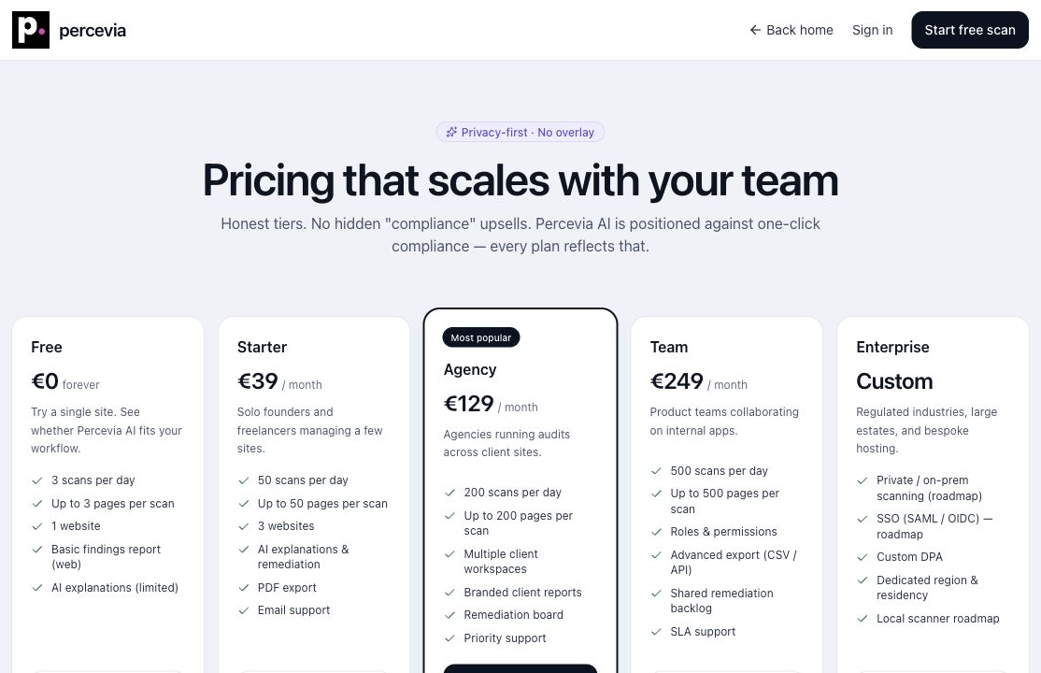
percevia
MAITRICO.
POLAR BILLING AND PLAN LIMITS
Subscription and entitlement model
Plans
Entitlements
Free, Starter, Agency, Team, and Enterprise.
Daily scans, pages per scan, evidence limits, seats, roles, monitors, white-label reports.
Polar integration
Production safety
Checkout, customer portal, signed webhooks, active/trialing subscription grants paid access.
Only verified Polar webhooks can assign paid plans in production.
Default scan limits range from Free 3 scans/day and 3 pages/scan to Enterprise 1000 scans/day and 1000 pages/scan.
maitrico Percevia AI | Project scope and technical architecture
21

Slide 22
percevia
MAITRICO.
TENANT BOUNDARY AND ENTITIES
Core data model
1
Workspace boundary
2
Scan domain
Workspace, WorkspaceMember, UsageLimits, PrivacySettings
ScanJob, PageJob, ScanPage, AccessibilityIssue, IssueGroup, ScanSummary
3
Operations
4
Global services
VisualEvidence, RemediationTask, Report, Monitor, AuditLog
publicReportShares, invitations, deletion jobs, rateLimits, workerHeartbeats
Firestore workspace subcollections provide tenant separation; selected global collections handle sharing, invitations, deletion jobs, limits, and worker health.
maitrico Percevia AI | Project scope and technical architecture
22

Slide 23
percevia
MAITRICO.
CONTROLS ACROSS APP, WORKER, AI, BILLING, AND DATA
Security posture
HTTP-only Firebase session cookie
Server-side membership checks
Role and permission matrix
Zod API validation
SSRF and redirect validation
Atomic Firestore job claims
Private Cloud Run with OIDC
Worker shared secret
Scheduler bearer secret
Polar signature verification
Cryptographic share tokens
Distributed rate limiting
Audit logs
AI data minimization
Evidence redaction and expiry
Encrypted local secrets
Rate limiting currently fails open if Firestore is unavailable. Platform-level abuse controls are recommended as a complementary layer.
maitrico Percevia AI | Project scope and technical architecture
23

Slide 24
percevia
MAITRICO.
HOW THE SYSTEM STAYS RECOVERABLE
Resilience and deployment
Atomic claims
Heartbeats and sweeper
Chromium lifecycle
Firestore transactions ensure that only one worker owns a scan or page job even when multiple workers compete.
15s worker heartbeat, 20s page-job heartbeat, stale recovery, timeout failure, and aggregation restart.
One browser process per worker, isolated contexts, concurrency 2 by default, memory recycling, crash relaunch.
Scale-to-zero
Deployment
Firestore ops
Cloud Run can idle to zero. Asynchronous queueing prevents cold starts from blocking user requests.
Vercel web app, Cloud Run worker, Cloud Tasks queue, Cloud Scheduler sweeps and monitors.
Composite indexes, TTL for rate limits, TTL for worker heartbeats, and operational runbooks.
maitrico Percevia AI | Project scope and technical architecture
24

Slide 25
percevia
MAITRICO.
REVIEW RESULTS ON JUNE 23, 2026
Quality and test status
52
323
37.3k
60
test files passed
tests passed
TS/TSX lines
spec files
1 skipped
4 skipped
source and worker code
unit, integration, E2E
Passed
Failed
Not run
npm test, npm run typecheck, and npm run worker:typecheck all completed successfully.
npm run lint failed with 6 errors and 2 warnings, mainly hook state updates and explicit any usage.
Authenticated E2E tests and live production smoke testing were not run during this review.
maitrico Percevia AI | Project scope and technical architecture
25

Slide 26
percevia
MAITRICO.
PRIORITIZED CURRENT-STATE ASSESSMENT
Open risks and technical debt
P0
Accessibility statement security and claims
P1
Lint quality gate failing
Stored XSS risk from unescaped fields; remove verified, conformant, and legal-protection language.
Typecheck and tests pass, but lint can block CI if enforced.
P1
Monitor alert delivery incomplete
P1
PDF runtime dependency
Scheduler creates scans, but email and Slack alert delivery is not implemented.
Web runtime must launch Chromium; moving PDF rendering to the worker is safer.
P2
Firestore Base64 evidence
P2
Region preference caveat
The 650 KB cap helps, but Cloud Storage is better for scale and cost.
UI preference is not the same as physical data residency without deployment-level controls.
maitrico Percevia AI | Project scope and technical architecture
26

Slide 27
percevia
MAITRICO.
SHORT, MEDIUM, AND LONG TERM
Recommended roadmap
Short term
Medium term
Long term
- Escape statement fields
- Remove risky claims
- Fix lint failures
- Add monitor alert delivery
- Clean stale docs and labels
- Move PDF generation to worker
- Move evidence to Cloud Storage
- Add monitor trends
- Email and Slack delivery
- Brand/language report templates
- Polar usage metrics
- Staging authenticated E2E CI
- Enterprise SSO
- Dedicated data regions
- Private scanner agent
- Large asset inventory
- SLA and regression analytics
- Jira, Linear, GitHub, GitLab integrations
The roadmap strengthens trust first, then scalability, then enterprise expansion.
maitrico Percevia AI | Project scope and technical architecture
27

Slide 28
percevia
MAITRICO.
RECOMMENDED TALK TRACK
What to emphasize in the presentation
1. Operational value
2. Trust posture
3. Technical maturity
The core value is measurable, trackable, repeatable accessibility work, not simply finding more defects.
AI, screenshots, retention, public sharing, and legal language are governed explicitly.
Async worker separation, SSRF defense, page jobs, retries, heartbeats, and tests show serious engineering.
4. Current honesty
5. Commercial path
6. Future expansion
The deck should clearly name the statement risk, lint gap, alert gap, and PDF runtime dependency.
Polar subscriptions, team seats, monitor capacity, and report branding create a monetizable SaaS structure.
SSO, private scanning, data residency, inventory, trend analytics, and integrations map to enterprise buyers.
maitrico Percevia AI | Project scope and technical architecture
28

Slide 29
percevia
MAITRICO.
Percevia AI's value is not merely finding more defects.
It makes accessibility work measurable, trackable, governable, and repeatable.
1
2
3
4
Measure
>
Track
>
Govern
>
Repeat
Scores, categories, pages, groups
Tasks, statuses, comparisons
Consent, audit, retention, deletion
Monitors, schedules, roadmaps
Questions
maitrico Percevia AI | Project scope and technical architecture
29

