Slide 2
Build Machine Learning Solutions in Azure Data Lake with R, Python and Big Cognition
Wei Guo, Data Scientist
Esin Saka, Senior Software Engineer
Michael Rys, Principal Program Manager

Slide 3
Session Goals
Get familiar with Azure Data Lake and U-SQL
Learn to use R in Azure Data Lake
Learn to use Python in Azure Data Lake
Learn to use Big Cognition Services to analyze text and image data

Slide 4
Agenda
Overview of Azure Data Lake and U-SQL
Introduction of Python, R and cognition capabilities in Azure Data Lake
Hands-on lab tasks:
Explore and summarize the data using R and Python
Train a model using R and Python
Make predictions using R and Python
Cognitive extension: Extract key phrases from the books
Cognitive extension : Use Image Processing OCR
Cognitive extension : Find potentially related images and books
R, Python, Cognitive extension together
Q & A

Slide 5


Azure Data Lake
HDInsight
(“managed clusters”)
Analytics
Azure Data Lake Analytics
(ADLA)
Azure Data Lake Storage
Storage
(ADLS)
Notes:
In a nutshell, Azure Data Lake is a Microsoft Big data platform. It has two components, one is storage, the other one is analytics service.
Azure Data Lake Storage is a distributed, parallel file system in the cloud.
It is performance tuned and optimized for analytics.
ADLS does not have any limit on the size of your file and the type of your file. You can put files as large as you want, in any format, either text, video, image, or regular CSV’s.
It provides Web HDFS API that can be connected to products from Hortonworks, MapR, and Cloudera.
Analytics part has two components: Azure Data Lake Analytics and HD Insight. They target the same scenario, tools, and customers. They complement each other. ADLA is our focus today. It enables customers to leverage existing experience with C#, SQL (which is U-SQL, introduced later), and PowerShell. It offers convenient, efficient, automatic scale job management service. While HD Insight is for developers familiar with Open Source: Java, Eclipse, and Hive etc. It provides more customization, control and flexibility in a managed Hadoop cluster.
ADLA
Distributed, parallel analytics framework
U-SQL (based on C# and SQL)
Dial for scale
Hides infrastructure complexity
Visual Studio integration
Instant scale on demand
Reduced learning curve
ADLA complements HDInsight Target the same scenarios, tools, and customers
ADLA
Enables customers to leverage existing experience with C#, SQL & PowerShell
Offers convenience, efficiency, automatic scale, and management in a “job service” form factor
HDInsight
For developers familiar with the Open Source: Java, Eclipse, Hive, etc.
Clusters offer customization, control, and flexibility in a managed Hadoop cluster
ADLS
Distributed, parallel file system in the cloud
Performance-tuned and optimized for analytics
No fixed size limits
Stores all data types
Highly available with local & geo redundant storage
WebHDFS REST API
Supported by leading Hadoop distros
Role-based security
Low latency and high throughput workloads

Slide 6
The Intelligent Data Lake
Azure Data Lake Store - A No Limits Data Lake that powers Big Data Analytics
Petabyte sized files and trillions of objects
Scalability for massively parallel analytics Azure HDInsight
Azure Data Lake Analytics - A On-Demand Analytics Job Service to power intelligent action
Start in seconds, scale instantly, pay per job
Develop massively parallel analytic programs with simplicity
Run Big Cognition at Petabyte Scale
Notes:
https://azure.microsoft.com/en-us/blog/the-intelligent-data-lake/

Slide 7
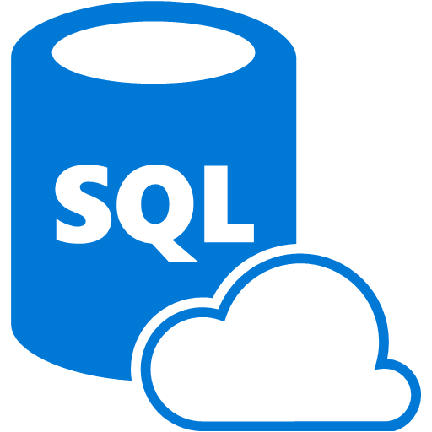

ADLA: Work across all cloud data
Azure Data Lake Analytics
Azure Data Lake Store
Azure Storage Blobs
SQL DB in an Azure VM
Azure SQL DW
Azure SQL DB
Notes:
ADLA allows you to compute on data anywhere and a join data from multiple cloud sources.

Slide 8




A highly scalable, distributed, parallel file system in the cloud specifically designed to work with multiple analytic frameworks
ADLS: work with multiple analytic frameworks
Devices
Social
ADL Analytics
LOB Applications
Video
ADL Store
HDInsight
R
Web
Sensors
Spark
Relational
Clickstream
Machine Learning
Notes:
Azure Data Lake Store is designed to work with multiple analytics frameworks including ADLA, HD Insight, R, Spark, AML, etc. Please note some of those features may still under development.

Slide 9

What is U-SQL?
Next generation large-scale data processing language combining
The declarative, optimizable and parallelizability of SQL
The extensibility, expressiveness and familiarity of C#
U-SQL
SCOPE
Hive
T-SQL
High performance
Scalable
Affordable
Easy to program
Secure
Notes:
Our title says build e2e solution using U-SQL in Azure Data Lake. So what is U-SQL? It is the next generation large scale data processing language! It extends the capability of SQL with C#. It combines SQL, Scope, which is Microsoft internal big data language in cosmos, and some Hive features.
A hyper-scalable, highly extensible language for preparing, transforming and analyzing all data
Built on familiar languages (SQL and C#) and supported by a fully integrated development environment
Built for data developers & scientists

Slide 10

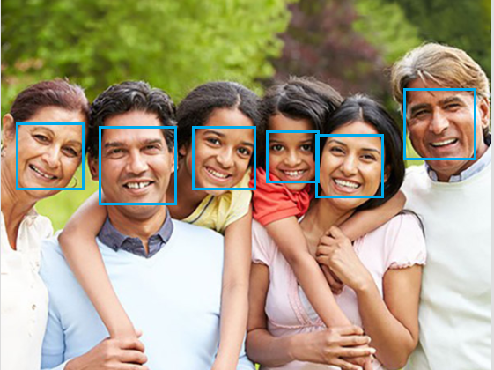



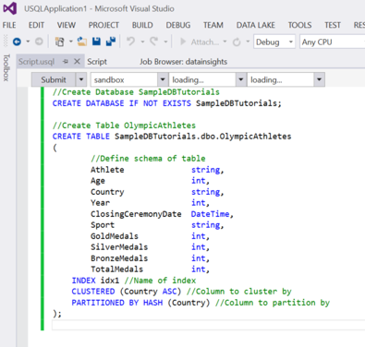
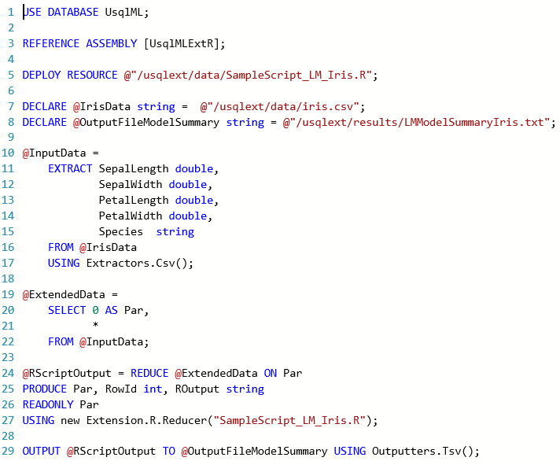
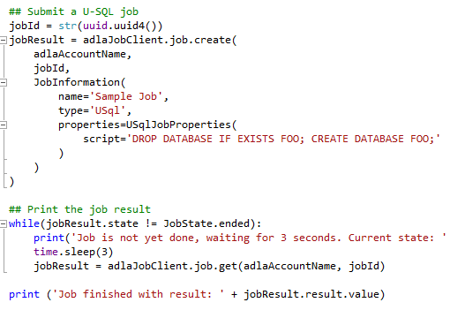
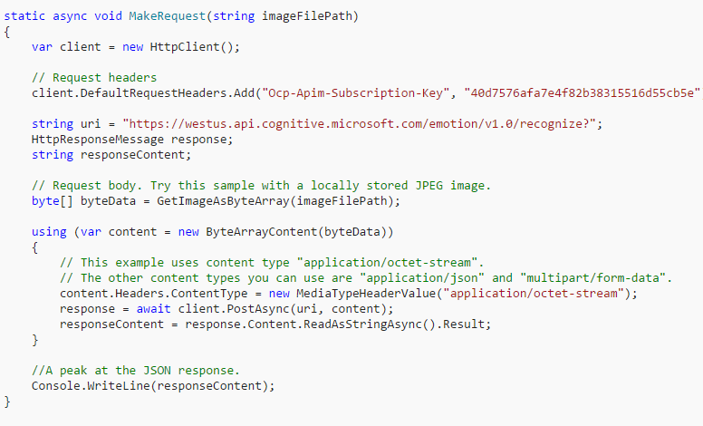
Data Scientists friendly Data Lake
U-SQL
Notes:
Last week at Microsoft’s Connect 2016 conference, we announced the General Availability of Azure Data Lake Analytics. As part of the announcement we revealed that U-SQL now includes built-in support for Advanced Analytics scenarios. This includes:
The ability to perform massively distributed analytics using Python
The ability to perform massively distributed analytics using R
Built-in Cognitive capabilities (such as image object detection, sentiment analysis, etc.)

Slide 11
Let’s set up the lab environment
https://tinyurl.com/ybbwfdpk

Slide 12
Let’s get started with R
Notes:
R running in U-SQL and Azure Data Lake
Use the REFERENCE ASSEMBLY statement to enable R extensions for the U-SQL Script.
Use the REDUCE operation to partition the input data on a key.
The R extensions for U-SQL include a built-in reducer (Extension.R.Reducer) that runs R code on each vertex assigned to the reducer.
Usage of dedicated named data frames called inputFromUSQL and outputToUSQL respectively to pass data between USQL and R. Input and output DataFrame identifier names are fixed (that is, users cannot change these predefined names of input and output DataFrame identifiers).

Slide 13
Exercise 1:
Summarize data

Slide 14
Exercise 2:
Train a linear model

Slide 15
Exercise 3:
Make predictions using trained R model

Slide 16
Let’s do some Python
Notes:
Python Extensions for U-SQL enable developers to perform massively parallel execution of Python code. The following example illustrates the basic steps:
Use the REFERENCE ASSEMBLY statement to enable Python extensions for the U-SQL Script
Using the REDUCE operation to partition the input data on a key
The Python extensions for U-SQL include a built-in reducer (Extension.Python.Reducer) that runs Python code on each vertex assigned to the reducer
The U-SQL script contains the embedded Python code that has a function called usqlml_main that accepts a pandas DataFrame as input and returns a pandas DataFrame as output.

Slide 17
Exercise 1:
Summarize data

Slide 18
Exercise 2:

Slide 19
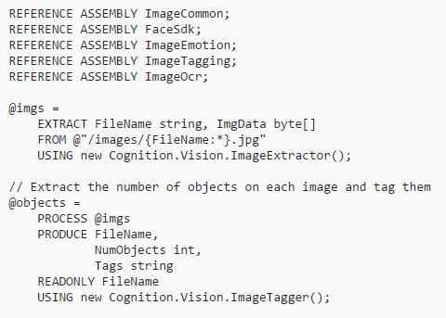
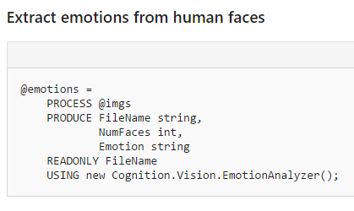
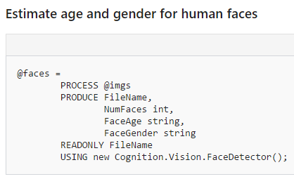
Cognitive capabilities
Enable developers to use put intelligence in their big data programs. The overall process in simple:
Use the REFERENCE ASSEMBLY statement to enable the cognitive features for the U-SQL Script
Using the PROCESS operation to use the Cognitive capabilities
It has Text and Image scenarios (what are included?)
Notes:
https://docs.microsoft.com/en-us/azure/data-lake-analytics/data-lake-analytics-u-sql-cognitive

Slide 20
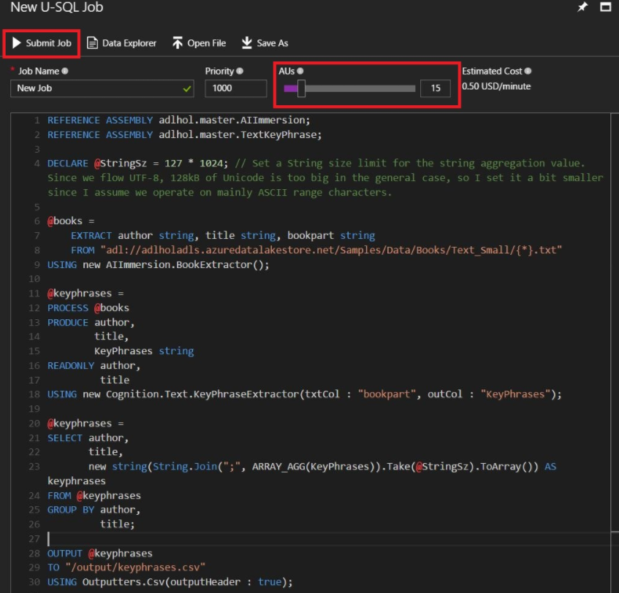
Exercise 1: Extracting key phrases from the books

Slide 21
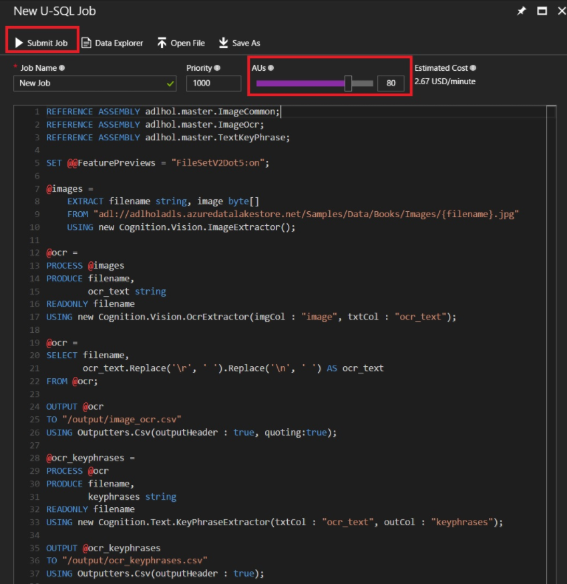
Exercise 2: Using Image Processing OCR

Slide 22
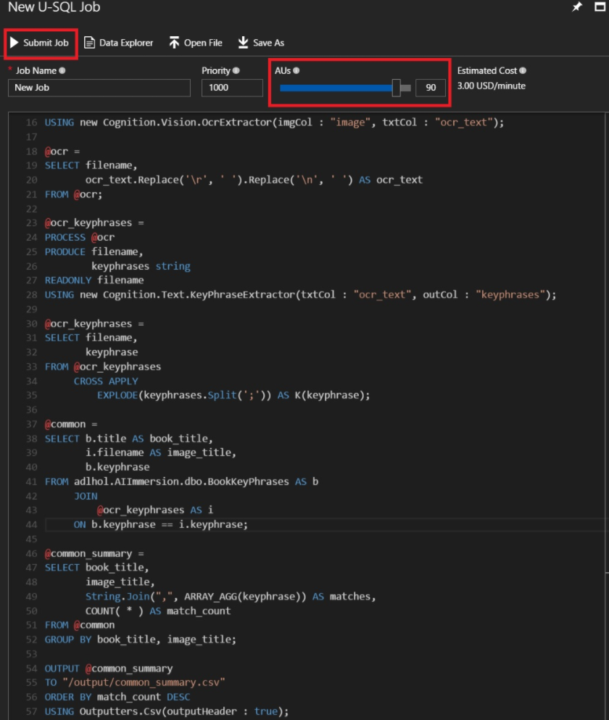
Exercise 3: Finding potentially related images and books

Slide 23
Put R, Python, Cognition service together

Slide 24
Q&A
Any questions?
scopeml@
adldisc@

