Slide 2
Build Machine Learning Solutions in Azure Data Lake with R, Python and Big Cognition
Wei Guo, Data Scientist
Esin Saka, Senior Software Engineer
Michael Rys, Principal Program Manager

Slide 3
Session Goals
Get familiar with Azure Data Lake and U-SQL
Learn to use R in Azure Data Lake
Learn to use Python in Azure Data Lake
Learn to use Big Cognition Services to analyze text and image data

Slide 4
Agenda
Brief introduction of Azure Data Lake and its analytics capabilities
Hands-on lab tasks:
Explore and summarize the data using R and Python
Train a model using R and Python
Make predictions using R and Python
Cognitive extension: key phrases extraction and image processing
R, Python, Cognitive extension together
Q & A

Slide 5


Azure Data Lake
HDInsight
(“managed clusters”)
Analytics
Azure Data Lake Analytics
(ADLA)
Azure Data Lake Storage
Storage
(ADLS)
Notes:
In a nutshell, Azure Data Lake is a Microsoft Big data platform. It has two components, one is storage, the other one is analytics service.
Azure Data Lake Storage is a distributed, parallel file system in the cloud.
It is performance tuned and optimized for analytics.
ADLS does not have any limit on the size of your file and the type of your file. You can put files as large as you want, in any format, either text, video, image, or regular CSV’s.
It provides Web HDFS API that can be connected to products from Hortonworks, MapR, and Cloudera.
Analytics part has two components: Azure Data Lake Analytics and HD Insight. They target the same scenario, tools, and customers. They complement each other. ADLA is our focus today. It enables customers to leverage existing experience with C#, SQL (which is U-SQL, introduced later), and PowerShell. It offers convenient, efficient, automatic scale job management service. While HD Insight is for developers familiar with Open Source: Java, Eclipse, and Hive etc. It provides more customization, control and flexibility in a managed Hadoop cluster.
Azure Data Lake Store - A No Limits Data Lake that powers Big Data Analytics
Petabyte sized files and trillions of objects
Scalability for massively parallel analytics Azure HDInsight
Azure Data Lake Analytics - A On-Demand Analytics Job Service to power intelligent action
Start in seconds, scale instantly, pay per job
Develop massively parallel analytic programs with simplicity
Run Big Cognition at Petabyte Scale
ADLA
Distributed, parallel analytics framework
U-SQL (based on C# and SQL)
Dial for scale
Hides infrastructure complexity
Visual Studio integration
Instant scale on demand
Reduced learning curve
ADLA complements HDInsight Target the same scenarios, tools, and customers
ADLA
Enables customers to leverage existing experience with C#, SQL & PowerShell
Offers convenience, efficiency, automatic scale, and management in a “job service” form factor
HDInsight
For developers familiar with the Open Source: Java, Eclipse, Hive, etc.
Clusters offer customization, control, and flexibility in a managed Hadoop cluster
ADLS
Distributed, parallel file system in the cloud
Performance-tuned and optimized for analytics
No fixed size limits
Stores all data types
Highly available with local & geo redundant storage
WebHDFS REST API
Supported by leading Hadoop distros
Role-based security
Low latency and high throughput workloads

Slide 6
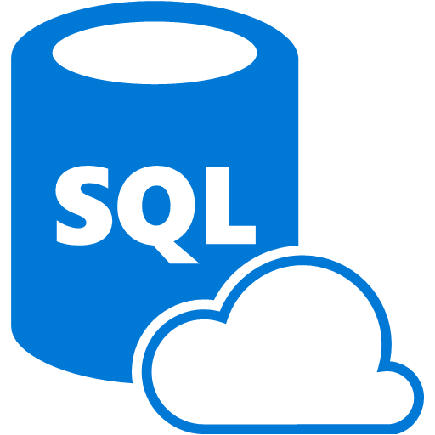

ADLA: Work across all cloud data
Azure Data Lake Analytics
Azure Data Lake Store
Azure Storage Blobs
SQL DB in an Azure VM
Azure SQL DW
Azure SQL DB
Notes:
ADLA allows you to compute on data anywhere and a join data from multiple cloud sources.

Slide 7





A highly scalable, distributed, parallel file system in the cloud specifically designed to work with multiple analytic frameworks
ADLS: work with multiple analytic frameworks
Devices
Social
ADL Analytics
LOB Applications
Video
ADL Store
HDInsight
R
Web
Sensors
Spark
Relational
Clickstream
Machine Learning
Python
Notes:
Azure Data Lake Store is designed to work with multiple analytics frameworks including ADLA, HD Insight, R, Spark, AML, etc. Please note some of those features may still under development.

Slide 8



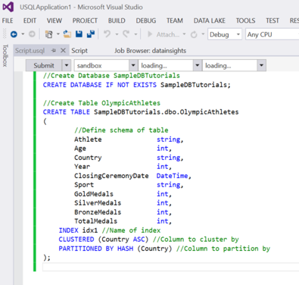
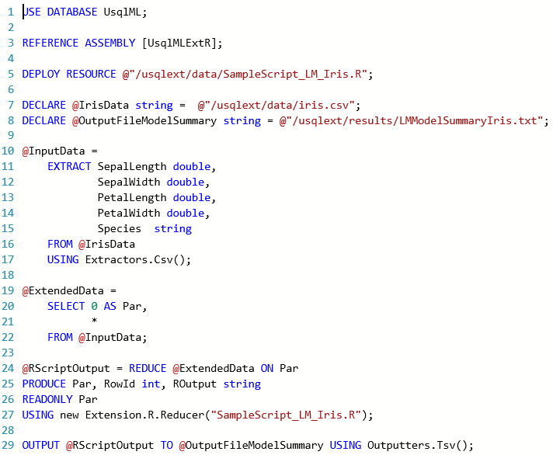
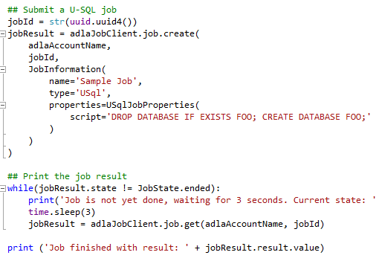
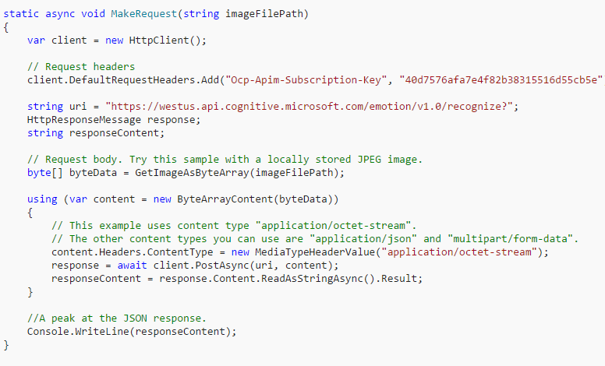
Data Scientists friendly Data Lake
U-SQL
Notes:
So what is U-SQL? It is the next generation large scale data processing language! It extends the capability of SQL with C#. It combines SQL, Scope, which is Microsoft internal big data language in cosmos, and some Hive features.
A hyper-scalable, highly extensible language for preparing, transforming and analyzing all data
Built on familiar languages (SQL and C#) and supported by a fully integrated development environment
Built for data developers & scientists
Microsoft’s Connect 2016 conference, we announced the General Availability of Azure Data Lake Analytics. As part of the announcement we revealed that U-SQL now includes built-in support for Advanced Analytics scenarios. This includes:
The ability to perform massively distributed analytics using Python
The ability to perform massively distributed analytics using R
Built-in Cognitive capabilities (such as image object detection, sentiment analysis, etc.)

Slide 9
Let’s go to the hands-on lab!
https://tinyurl.com/ybbwfdpk

Slide 10
Any questions?
scopeml@
adldisc@
weig@
esaka@
mrys@

