Slide 1
Google PlayStore Data Analysis
Presented By: Aditya Verma

Slide 2
About Dataset
This Dataset downloaded from Kaggle is a web scraped data of nearly 10K PlayStore apps for analyzing the Android Market.
It consists of 10841 rows and 13 columns.
Some of the key features used for analysis are Category(of App), Rating, Reviews, Type(Free or Paid), Genres, Last Updated, Current Version, etc.

Slide 3
Problem Statement
How the performance of the apps can be improved from the reviews obtained and different patterns that could be found to get more business value out of the same (using the dataset).

Slide 4
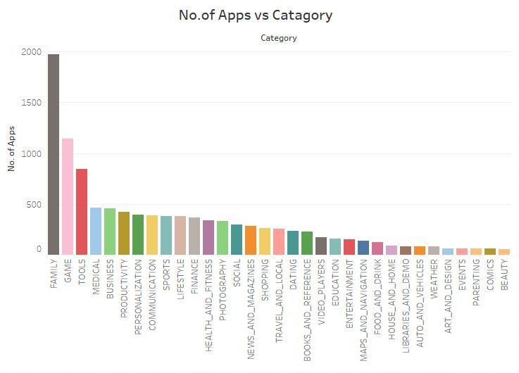
No. Of Applications per Catagory
Family, Games and Tools are some of the applications that are mostly downloaded

Slide 5
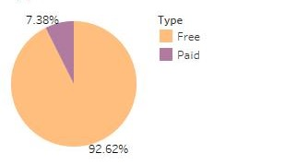
Percentage of Paid Vs Free Applications
The Percentage of applications that were Free and Paid.
This Factor effects the Installation of applications the most.
Because the user generally tend to download free apps more compared to the paid one.

Slide 6
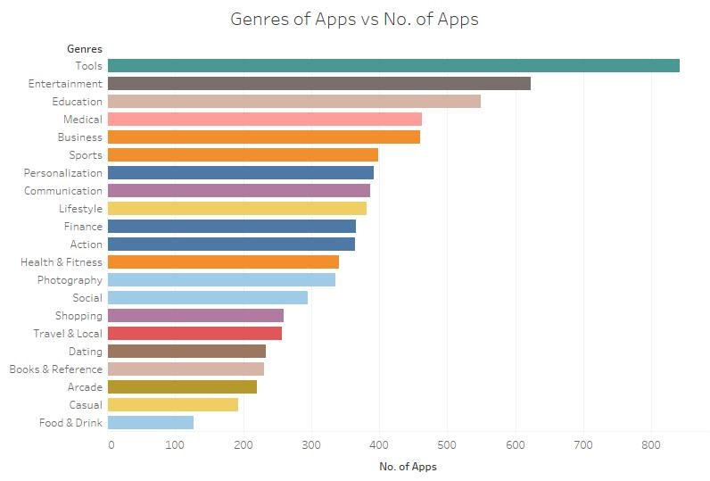
No. Of Applications according to their Genre
Via Genre of the Apps we can predict that Tools, Entertainment and Education are the most liked Applications, or downloaded as the needs of the users.

Slide 7
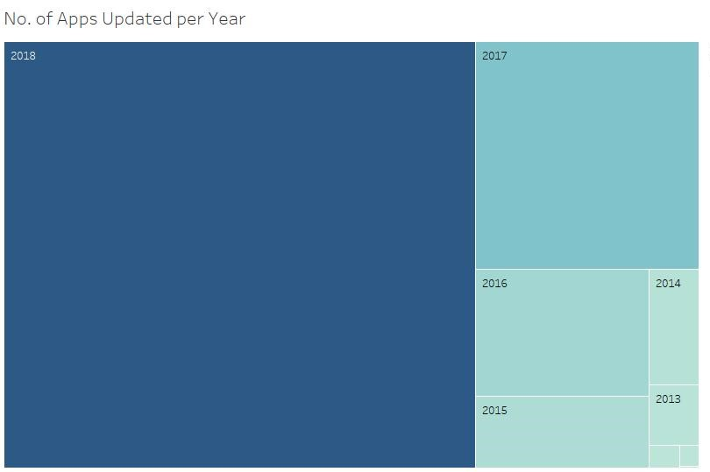
No. Of Applications Updated Per Year
This Tree Map helps to identify the current Status of the Updated Applications & their usage after being Installed.

Slide 8
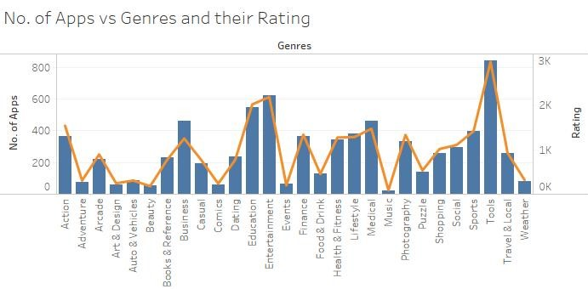
No. of Applications depending on their Genres & Ratings
The Dual-Axis graph shows multiple & detailed information in a single view.
Line, from above graph it is clear that Tools & Entertainment apps are downloaded the most and also have the highest ratings.

Slide 9
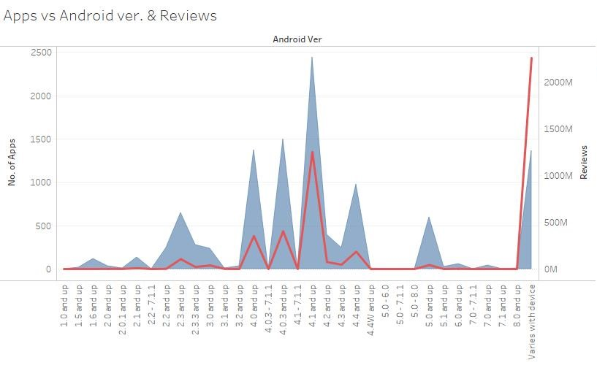
Applications used on which Android Version with Reviews
This graph shows the no. Of apps & no. Of reviews given by the user to the apps downloaded in different Android Versions stated in the graph.

Slide 10
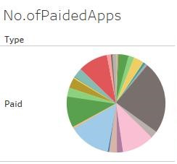
No. Of Paid Applications
Through this Pie Chart we can depict the number of Paid Applications and in which Category they lie.

Slide 11
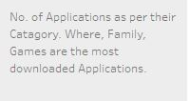
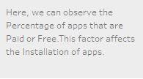
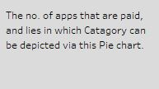
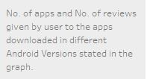
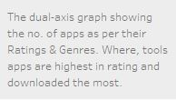
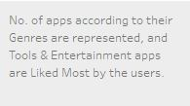
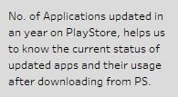
Story line of Data to Analyze PlayStore Dataset

Slide 12
Conclusion
Talking about the conclusion we can conclude the dataset we have used contains immense possibilities to improve business values and have a positive impact.
We can also use this analysis to identify the Categories and Stats of the most installed applications on the PlayStore.

Slide 13
Thank You
Contact: verma.adiya3636@gmail.com

