Slide 1
Analysis hidden mutation positions of the SARS-CoV-2 basing on machine learning
Li Yin
Supervisor: Dr Efi Psomopoulou

Slide 2


1
2
3
4
Introduction
Data Source
Methods
&
Results
Conclusion

Slide 3
1
Introduction

Slide 4
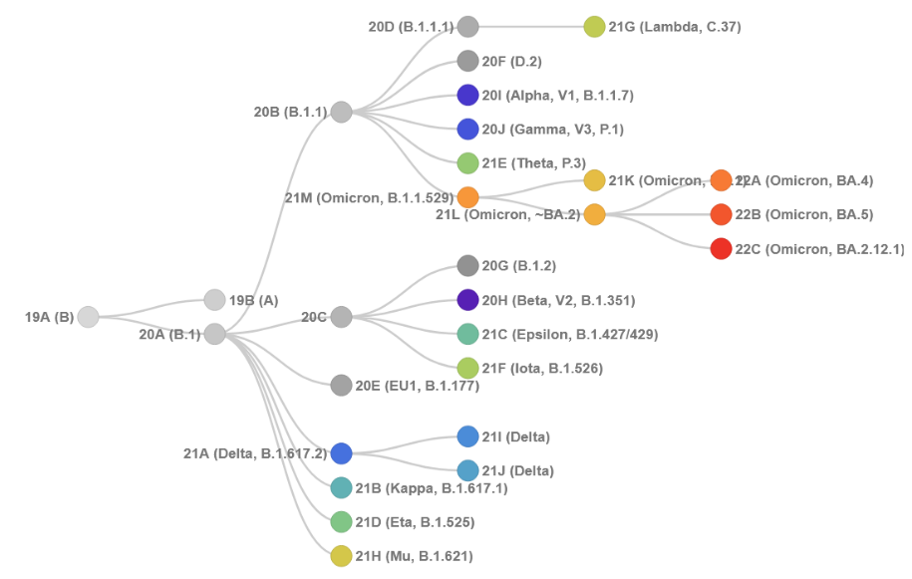
Introduction
Machine learning:
Supervised feature selection
Unsupervised feature selection

Slide 5
2
Data Source

Slide 6
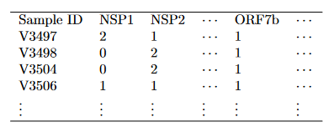
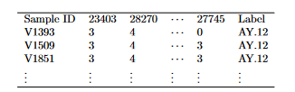
Data Source
Five different variants: B.1.1.7, B.1.617.2, AY.4, AY.9 and AY.12
Advantage:
1. Retain the genes type information
2. Less dimensions
Disadvantages:
1. Loss a lot of mutation positions’ information
Advantage:
1. Retain all of mutation positions’ information
Disadvantages:
1. Huge amount of features

Slide 7
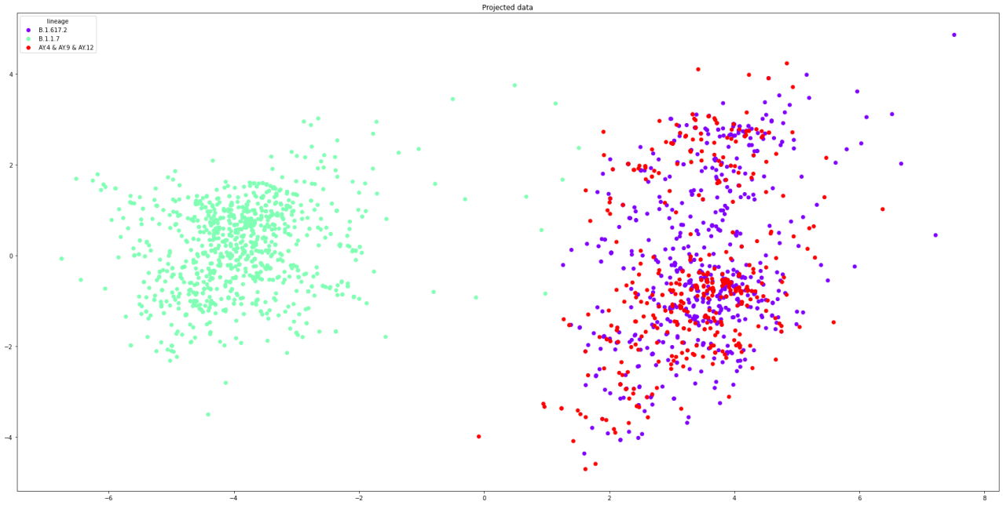
Data Source

Slide 8
3
Methods
&
Results

Slide 9

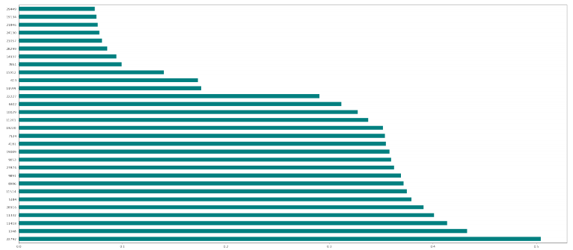
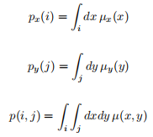
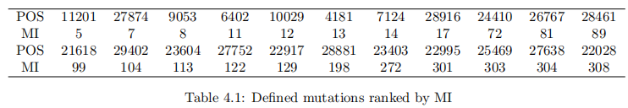
Methods & Results
Supervised feature selection - Mutual Information

Slide 10
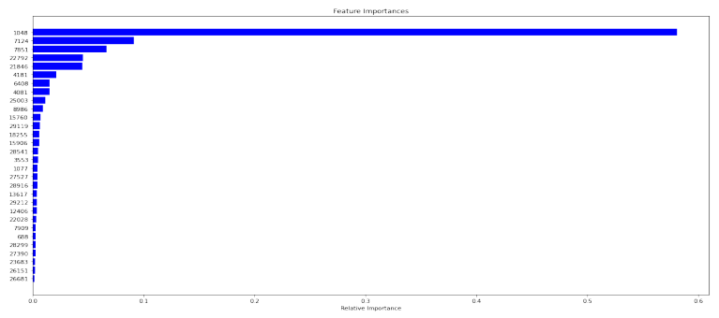
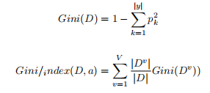
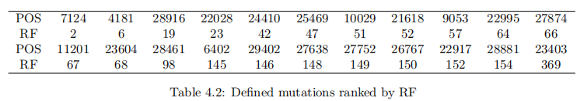
Methods & Results
Supervised feature selection - Random Forest

Slide 11
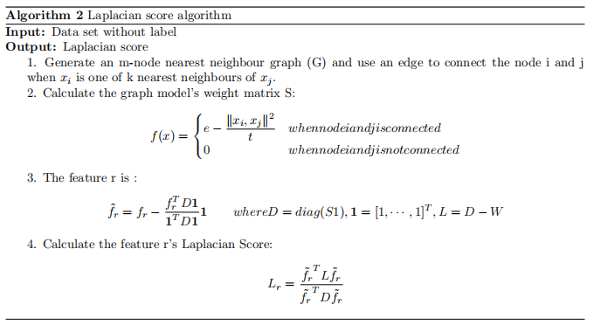
Methods & Results
Unsupervised feature selection - Laplacian Score

Slide 12
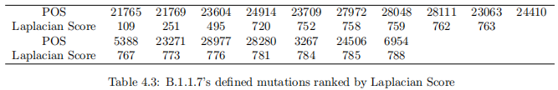
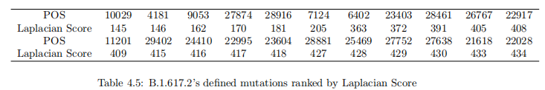
Methods & Results
Unsupervised feature selection - Laplacian Score

Slide 13
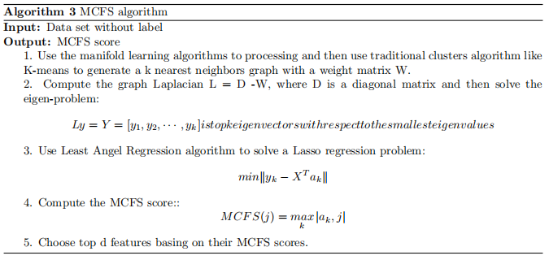
Methods & Results
Unsupervised feature selection - MCFS

Slide 14
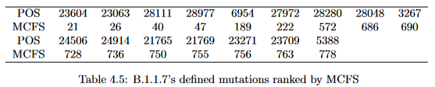
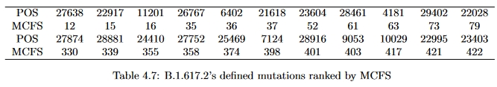
Methods & Results
Unsupervised feature selection - MCFS

Slide 15
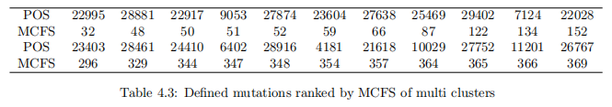
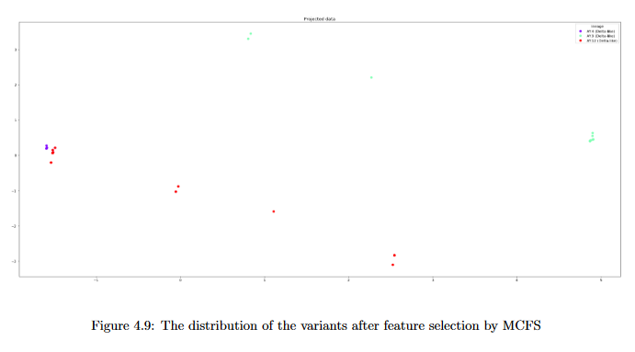
Methods & Results
Unsupervised feature selection - MCFS

Slide 16
4
Conclusion

Slide 17
THANK YOU

