Slide 1
Data Science at the Command Line Igor Arambasic

Slide 2
About myself…
• Data Scientist (10+ years)
• Project Manager (5+ years)
• Big Data (4+ years)
• PhD in Telecommunications Science, Universidad Politécnica de Madrid, 2008
• Languages: English, Spanish, Croatian

Slide 3
What’s on the menu for today?
Introduction to Data science @ Command line
Command Line Environment, Tools types, Pipelining, Redirecting, Quoting…
File utilities (ls, touch, find )
Content utilities (cat, less, echo, head, tail )
Sorting and counting utilities (sort, uniq, wc )
Regular expressions
Processing and filtering utilities (sed, grep, tr, cut )
Working with compressed Files (tar, gz, bz2)
Appendix ( Operators in Shell, Flow Control (if-else, for, while, until) )

Slide 4
Data science
Data science Practical definition by Mason & Wiggins (2010) in five steps:
obtaining data,
scrubbing data,
exploring data,
modeling data
interpreting data.
Together, these steps form the OSEMN model (which is pronounced as awesome).

Slide 5
Data science
In “Data Jujitsu: The Art of Turning Data Into Product” DJ Patil states that “80% of the work in any data project is in cleaning the data” (2012).
Common scrubbing operations include:
Filtering lines
Extracting certain columns
Replacing values
Extracting words
Handling missing values
Converting data from one format to another

Slide 6
Data science @ Command line
Today, data scientists can choose from an overwhelming collection of exciting technologies and programming languages. Python, R, Hadoop, Julia, Pig, Hive, and Spark are but a few examples.
So… How can an old technology be of any use to a field that’s only a few years young? What does the command line have to offer that these other technologies and programming languages do not?
The command line itself was invented over 40 years ago.
Its core functionality has largely remained unchanged, but the tools, which are the workhorses of the command line, are being developed on a daily basis.
most command-line tools adhere the Unix philosophy, they are designed to do only one thing, and do it really well
The command line itself is language agnostic (independent of any specific programming language)
command-line tools can work together, which makes the command line very flexible.
The open source community is producing many free and high-quality command-line tools that we can use for data science.
Notes:
Language agnostic refers to aspects of programming that are independent of any specific programming language. At least, that's how I've heard it used for the last thirty years.
The world "agnostic" is derived from the ancient Greek for "don't know". So something which is "language agnostic" doesn't need to know about computer languages; it means the same thing aslanguage independent.

Slide 7
Data science @ Command line
And… there is more…
Command line allows you to be agile as it provides a so-called read-eval-print-loop (REPL). This means that you type in a command, press <Enter>, and the command is evaluated immediately. A REPL is often much more convenient for doing data science than the edit-compile-run-debug cycle associated with scripts, large programs, and, say, Hadoop jobs.
The executing commands may be stopped at will, and can be changed quickly. This short iteration cycle really allows you to play with your data.
The command line integrates well with other technologies. On the one hand, you can often employ the command line from your own environment. Python and R, for instance, allow you to run command-line tools and capture their output
Everything that you type manually on the command line, can also be automated through scripts and tools.
According to an article on Top 500 Supercomputer Sites, 95% of the top 500 supercomputers are running GNU/Linux. So, if you ever get your hands on one of those supercomputers (or if you ever find yourself in Jurassic Park with the door locks not working), you better know your way around the command line!
Microsoft is adding the Linux command line to Windows 10 (http://www.theverge.com/2016/3/30/11331014/microsoft-windows-linux-ubuntu-bash)

Slide 8
The Environment
The environment is roughly defined by four layer in this order from the top down:
Command-line tools - We use them by typing their corresponding commands.
Terminal - is the application where we type our commands in. You do not type the dollar sign. It’s just there to serve as a prompt and let you know that you can type this command.
Shell –is a program that interprets the command. Once we have typed in our command and pressed <Enter>, the terminal sends that command to the shell..
Operating system - The fourth layer is the operating system, which is GNU/Linux in our case.
GNU which is a recursive acronym for “GNU’s Not Unix”, refers to free operating system with totally free tools. “GNU” is pronounced “g'noo”, as one syllable, like saying “grew” but replacing the r with n.
The heart of any Unix-like is kernel which allocates machine resources and talks to the hardware
GNU is typically used with a kernel called Linux (which is a free clone of Unix kernel).
Notes:
Unix is an operating system created by researchers for AT&T in the 1970s. It was designed as a multi-user operating system. Other well-known operating systems included Windows, Macintosh System 7, and MSDOS. GNU is an attempt to create a totally free operating system with totally free tools. In tools they succeeded beyond all expectations, but the core of the operating system (called the kernel) wasn't ready and was overshadowed by free Unix and Linux, both of which use GNU tools extensively. Linux is a free clone of the UNIX kernel, and like GNU tools has succeeded beyond all expectations.
Linux distributions combine the Linux kernel with the extensive suite of GNU tools and other software to provide a complete computing environment largely indistinguishable from a Unix environment.
Both Ubuntu and Debian are distributions of Linux. A distribution is made by someone (anyone who wants to, either just for fun or anywhere up to making one for sale) by taking the main core of Linux (called the kernel) and adding any tools, programs, user interfaces, etc. they deem useful / preferable / or any other reason. Some distributions may even fiddle a bit with the kernel especially if they intend to make a "Linux" version to run on something "strange" - e.g. this is how Google made Android (which also originated as a Linux though it's arguably mutated quite a bit from there). Actually Ubuntu started from Debian and then built on top of what Debian already added to the base Linux by adding and modifying things they felt would suit better. E.g. (one major difference) their entire desktop (i.e. the graphical user interface where you start programs from) is "re-invented" to the Ubuntu Unity desktop, whereas Debian (by default) would tend to install KDE desktop instead.

Slide 9
Unix vs Linux (Distributions)
Unix was a proprietary (non-free) operating system (created by researchers for AT&T in the 1970s)
The GNU project set out to create a free (open source) clone of Unix, but they did not have a kernel ready.
Linus Torvalds wrote the Linux kernel as a hobby, releasing it under the GPL (general public license). The Linux kernel was similar to Unix, but not exactly the same.
Linux kernel, coupled with the GNU applications, forms the basis for the many distributions we know today, generically referred to as 'Linux'.
A distribution is made by someone (anyone who wants to, either just for fun or anywhere up to making one for sale) by taking the main core of Linux (called the kernel) and adding any tools, programs, user interfaces, etc. they deem useful / preferable / or any other reason.
Some distributions may even fiddle a bit with the kernel especially if they intend to make a "Linux" version to run on something "strange" - e.g. this is how Google made Android (which also originated as a Linux though it's arguably mutated quite a bit from there).
Both Ubuntu and Debian are distributions of Linux.
Ubuntu started from Debian and then built on top of what Debian already added to the base Linux by adding and modifying things they felt would suit better.
E.g. (one major difference) their entire desktop (i.e. the graphical user interface where you start programs from) is "re-invented" to the Ubuntu Unity desktop, whereas Debian (by default) would tend to install KDE desktop instead.
Notes:
Distribution:
cat /etc/*-release
Kernel:
uname –a
uname -mrs

Slide 10

Command Line Tools basics
each command is usually preceded with a dollar sign ($) or some other sign. In this case it is %.
This is called the prompt.
The prompt shows more information, namely
the username (iaramba),
the hostname (localhost),
and the current working directory (dev) under the home directory
These 3 information can also be obtained with commands: whoami, hostname, pwd

Slide 11
Command Line Tools types
We use it as an umbrella term for anything that can be executed from the command line. Under the hood, each command-line tool is one of the following five types:
binary executable
shell builtin
interpreted script
shell function
Alias
The command-line tools that come pre-installed with our Fedora VM mostly comprise the first two types (binary executable and shell builtin).
The other three types (interpreted script, shell function, and alias) allow us to further build up our own data science toolbox and become more efficient and more productive data scientists.

Slide 12
Command Line Tools types
Binary executable - programs in the classical sense. A binary executable is created by compiling source code to machine code. This means that when you open the file in a text editor you cannot read its source code.
Shell builtin - command-line tools provided by the shell, which is Bash in our case. Examples include cd and help. These cannot be changed. Shell builtins may differ between shells. Like binary executables, they cannot be easily inspected or changed.
Interpreted script - text file that is executed by a binary executable. The script is interpreted correctly not because of the file extension, but because the first line of the script that specifies the binary that should execute it (Examples include: Python, R, and Bash scripts).
Shell function - function that is executed by the shell itself; They provide similar functionality to a Bash script, but they are usually (though not necessarily) smaller than scripts. They also tend to be more personal. The file ~/.bashrc or ~/.zshrc, which is a configuration file for Bash/Zsh shell, is a good place to define your shell functions so that they are always available.
Alias - are like macros. They are simpler than shell functions as they don’t allow parameters. If you often find yourself executing a certain command with the same parameters (or a part of it), you can define an alias for this. Aliases are also very useful when you continue to misspell a certain command (alias moer=more). To see all aliases currently defined, you simply run alias without arguments.
You can find out the type of a command-line tool with type.
Notes:
$ type -a pwd
pwd is a shell builtin
pwd is /bin/pwd
the first reported command-line tool is used when you type pwd
$ type -a cd
cd is a shell builtin
$ type ll
ll is an alias for ls –lhX
type -a chmod chmod is /bin/chmod
chmod is /usr/bin/chmod

Slide 13
How many of these are aliases?
… taken from /home/dsc/.history or ~/.history
cd
pwd
ls
ll
cat
less
rm
man
mkdir
head
sed
tail
sort
uniq
chmod
wc
grep
echo
Notes:
Which are alias?
ls, ll,

Slide 14
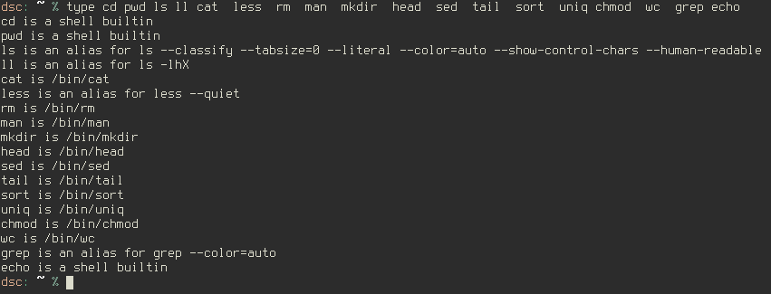
How many of these are aliases?
Notes:
dsc: ~ % type cd pwd ls ll cat less rm man mkdir head sed tail sort uniq chmod wc grep ~ 0 23:31:48
cd is a shell builtin
pwd is a shell builtin
ls is an alias for ls --classify --tabsize=0 --literal --color=auto --show-control-chars --human-readable
ll is an alias for ls -lhX
cat is /bin/cat
less is an alias for less --quiet
rm is /bin/rm
man is /bin/man
mkdir is /bin/mkdir
head is /bin/head
sed is /bin/sed
tail is /bin/tail
sort is /bin/sort
uniq is /bin/uniq
chmod is /bin/chmod
wc is /bin/wc
grep is an alias for grep --color=auto

Slide 15


The pipe
The most common way of combining command-line tools is through a so-called pipe. The output from the first tool is passed to the second tool. There are virtually no limits to this.
Program 1
Program 2
stdin
stdout
stdin
stdout
*stderr
*stderr
The output of a command-line tool is by default passed on to the terminal, which displays it on our screen. We can pipe the output of one command to the input of the second tool by using “|”

Slide 16
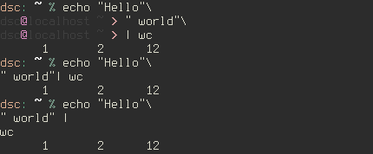
The really long pipeline
Sometimes we use commands and pipelines that are too long to fit on the page.
A long command can be broken up with either a backslash (\) or a pipe symbol (|) .
The greater-than sign (>) is the continuation prompt, which indicates that this line is a continuation of the previous one. Be sure to first match any quotation marks (" and ').
The following command is exactly the same as the previous one:

Slide 17


Standard input/output and Redirecting
By default, the output of the last command-line tool in the pipeline is outputted to the terminal.
You can also save this output to a file with “>” . This is called output redirection:
If this file does not exist yet, it is created. If this file already did exist, its contents would have been overwritten.
You can also append the output to a file with “>>”, meaning the output is put after the original contents:
< - Take stdin from file
<() - take stdin from the evaluation of the expression within the parenthesis

Slide 18



Standard input/output and Redirecting
< - takes stdin from file
This way you are directly passing the file to the standard input of wc without running an additional process.
The same can be achieved if the tool accepts files as command line arguments:
The third option includes additional tool that read the file and pipes it to wc:

Slide 19
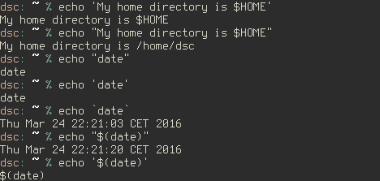
Quoting
’ ’ - Single quotes: do not touch this text
“ ” - Double quotes: Perform shell variable expansion
` ` - evaluate and replace (command substitution)
ASCII code 96 or 60 in hexadecimal
$(command)
Notes:
echo `date`

Slide 20
Command line basics (review)
… taken from /home/dsc/.history or ~/.history
cd
pwd
ls
ll
cat
less
rm
man
mkdir
head
sed
tail
sort
uniq
chmod
wc
grep
echo
Notes:
Which are alias?
ls, ll,

Slide 21
Command line basics (review)
… taken from /home/dsc/.history or ~/.history
cd
pwd
ls
ll
rm
chmod
mkdir
man
sed
grep
head
echo
cat
less
tail
sort
uniq
wc
File utilities
Content utilities
Sorting and counting
Help utilities
Processing and filtering
Notes:
Which are alias?
ls, ll,

Slide 22
File utilities
cd - navigate to a different directory
The part after cd specifies to which directory you want to navigate to.
The two dots refer to the parent directory (cd ..)
Hidden directories start with dot (/home/dsc/.config)
with minus you go to previous directory (cd -)
wth tilde you point to your home directory (cd ~) or with just cd without arguments
pwd - prints the name of the current directory
ls – prints the contents of the current directory
-a, -all : do not ignore hidden files (entries starting with .)
-h, --human-readable
-l : use a long listing format
-1 : print 1 item per line
-s : return size
-S : sort by file size
-r, --reverse: reverse order while sorting
-t : sort by modification time, newest first
-X : sort alphabetically by entry extension
ll – alias “ls –lhX”

Slide 23
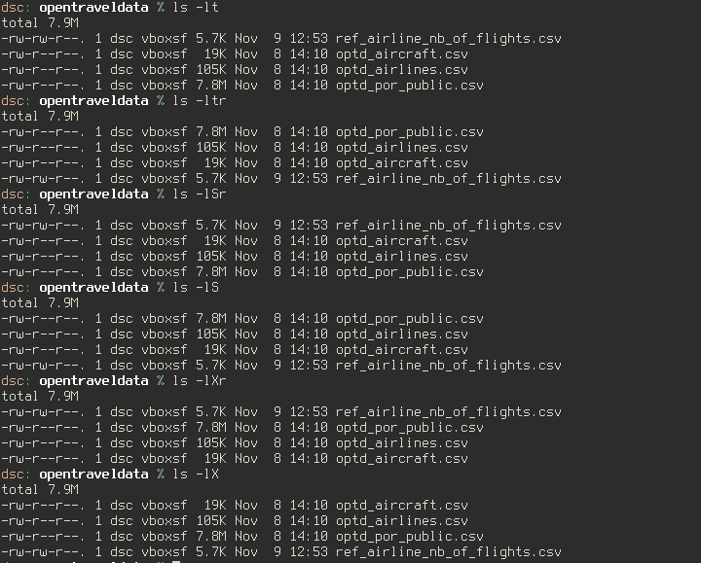
File utilities
Notes:
List just directories : ls -ld *(/)
*/ is a pattern that matches all of the subdirectories in the current directory (* would match all files and subdirectories; the / restricts it to directories).
ls -ld *(/)
*(/) is a pattern that matches all of the subdirectories in the current directory (* would match all files and subdirectories; the / restricts it to directories).
ls -l *(.)
ls -al *(^/) – any pattern that doesn’t have “/” inside
ls –l (.)* for hidden file
ls -l *(D-.) for hidden file and regular files
Use this for absolute path dirs:
ls -d -1 $PWD/**
this for files:
ls -d -1 $PWD/*.*
this for everything:
ls -d -1 $PWD/**/*

Slide 24
File utilities
touch – creates an empty file or updates the access and modification time of existing file
mkdir – make a directory
mv – move and/or rename files/directory
cp – copy a file/ directory SINTAX: cp [options] source destination
-r : recursive mode used for directories
-i : interactive confirm file overwriting
-v : verbose see copy progress
-p: preserve the file permission and other attributes/metadata
rm – eliminate files. (Careful! No recycle bin in Unix!)
-f, --force : ignore nonexistent files and arguments, never prompt
-r, -i, -v : the same as in cp
chmod – change file read/write/execute permissions Example: chmod u+r,g+xwe file
ugo = user/group/other
rwx= read/write/execute
chmod 777 = chmod guo+xwr

Slide 25
File utilities
find – search for files in a directory hierarchy. SINTAX: find [pathnames] [conditions]
-name : find file by name
-iname : find file by name ignoring case
-type c: specifies file type: f=file, d=directory
-maxdepth : max levels of directories below the starting-points (1 is current directory, 0 is the command line)
-mindepth : min levels of directories below the starting-points
-size n : file is of size n, +/-n = larger/smaller than n
-not : inverting the match (exclamation can also be used “!” for inverting the match)
-empty : find empty files
-newer “file”: all files which are modified after the “file”
-anewer / cnewer : accessed or changed after the modification of a given “file”
-mmin -N : find the files which are modified within N minutes
-mtime -N : find the files which are modified within N days
-newermt YYYY-MM-dd : files modified after date (including the day of the date)
amin/atime/cmin/ctime : accessed or changed within last minutes or days
-perm p : the file's access mode is p (where p is an integer)
-exec cmd : execute command cmd on a file EXAMPLE : -exec rm -r {} \;
-ok cmd : prompt before executing the command cmd on a file
Notes:
maxdepth 0 means only apply the tests and actions to the command line arguments
In other words, -maxdepth 0 means do not search directories or subdirectories. Instead only look for a matching file among those explicitly listed on the command line.
http://unix.stackexchange.com/questions/162411/find-maxdepth-0-not-returning-me-any-output
suppose that we have file1 in the current directory. Then:
$ find . -maxdepth 0 -name "file1"
$ find . file1 -maxdepth 0 -name "file1"
File1f
In my first example above, only the directory . is listed on the command line. Since . does not have the name file1, nothing is listed in the output. In my second example above, both . and file1 are listed on the command line and, because file1 matches -name "file1", it was returned in the output

Slide 26
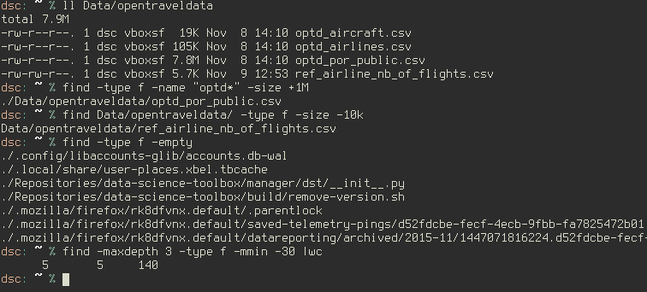
File utilities

Slide 27
File utilities - Quick exercises
Create a directory in you home folder, and an empty file in it with execute permissions to group users, and write permissions to other users.
Create two subdirectories. Copy the file into one subdirectory and move the file into another subdirectory.
Make third subdirectory as a copy of first subdirectory. Change file name to *.backup and change permissions so that everyone has read-write-execute permissions. Make a hidden copy of this file.
Go back to your home folder. Find the files that were created today.
Find all empty files ONLY in subdirectories of the home directory which have been modified in last 60min
Find all empty files which do NOT have read-write-excute permissions given to all users
Expand previous command to grant these permissions using “ok cmd” option.
Notes:
chmod – change file read/write/execute permissions Example: chmod u+r,g+xwe file
ugo = user/group/other
rwx= read/write/execute
chmod 777 = chmod guo+xwr
chmod o+w,g+x test
4) find -type f -newermt 2016-03-23
find -mindepth 1 -type f -empty -newermt 2016-03-30
5) find -mindepth 1 -type f -empty -mmin -60
6) find -type f -mmin -60 -empty ! -perm 777
7) find -type f -mmin -60 -empty ! -perm 777 -ok chmod 777 {} \;
echo (.)* | tr " " "\n" |wc
find . -maxdepth -1 -type f -name ".*“ | sort
find -type f -name ".*" -exec ls -s {} \;

Slide 28
Command line Tools
cd
pwd
ls
ll
rm
chmod
mkdir
man
sed
grep
head
echo
cat
less
tail
sort
uniq
wc
File utilities
Content utilities
Sorting and counting
Help utilities
Processing and filtering
Notes:
Which are alias?
ls, ll,

Slide 29
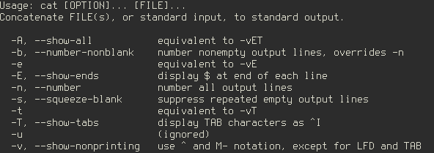
Help utilities
man – short for manual
not every command has its manual
man bash
use “/” inside manual for search
use “N” for backward and “n” for forward movement within the search results
Sometimes command line tools lack a man page. In that case, your best bet is to invoke the tool with the -h or --help option.
cat --help

Slide 30
Help utilities - Quick exercises
Use help to find out how to get the list of subdirectories limited to 2 sublevels by using “tree” command
Find which option to use with “csvlook” to read csv file without the header
Notes:
tree –L 2
csvlook –H
(-h = help)

Slide 31
Command line Tools
cd
pwd
ls
ll
rm
chmod
mkdir
man
sed
grep
head
echo
cat
less
tail
sort
uniq
wc
File utilities
Content utilities
Sorting and counting
Help utilities
Processing and filtering

Slide 32
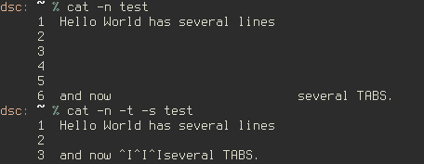
Content utilities
echo - send argument to stdout
-n : do not output the trailing newline
cat– send contents of file to stdout
-n, --number : number all output lines
-s, --squeeze-blank : suppress repeated empty output lines
-T, --show-tabs : display TAB characters as ^I
zcat– same thing as cat, but with compressed files

Slide 33
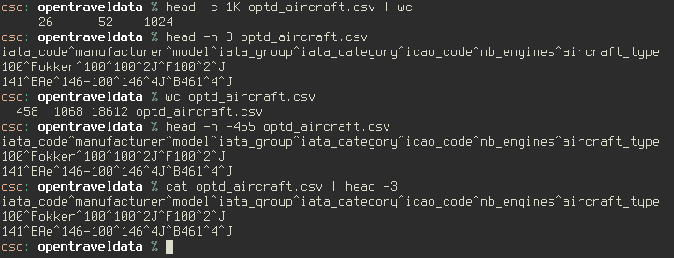
Content utilities
head – show first lines of file
-c, --bytes=[-]K : print the first K bytes of each file; with the leading '-', print all but the last K bytes of each file
-n, --lines=[-]K : print the first K lines instead of the first 10; with the leading '-', print all but the last K lines of each file
tail – show last lines of the file

Slide 34
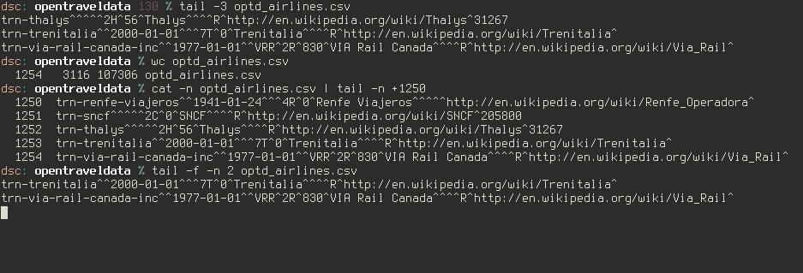
Content utilities
tail– show last lines of file
-c, --bytes=K : output the last K bytes; or use -c +K to output bytes starting with the Kth of each file
-n, --lines=K: output the last K lines, instead of the last 10; or use -n +K to output starting with the Kth
-f : output appended data as the file grows;
-s, --sleep-interval=N : with -f, sleep for approximately N seconds (default 1.0) between iterations

Slide 35
Content utilities
less – show contents of a file, interactively
-E : Causes less to automatically exit the first time it reaches end-of-file.
-N : Causes a line number to be displayed at the beginning of each line in the display.
-s : Causes consecutive blank lines to be squeezed into a single blank line.
-S : lines longer than the screen width are truncated rather than wrapped. The default is to wrap long lines; that is, display the remainder on the next line.
G/g (while reading) : go to end/beginning of file
Interactive search pattern:
Forward Search “/”
n – for next match in forward
N – for previous match in backward
Backward Search “?”
n – for next match in backward direction
N – for previous match in forward direction
^pattern : pattern is at the beginning of line
pattern$ : patter is at the end of line

Slide 36
Content utilities - Quick exercises
Create new directory and a dummy file inside with this command : seq -f "Line %g" 20 > 20lines.txt
Give write permissions of 10lines.txt to everyone
Print file content except first 2 and last 3 lines.
Go to ~/Data/opentraveldata. Get only the header of one of the files in there.
Open ~/Data/optd_aircraft.csv with interactive content reader. Search for “Canada” and then search for “Puma”
Execute: curl -s http://www.gutenberg.org/cache/epub/76/pg76.txt > Finn.txt
Use less to locate the lines starting with “The”
Find the lines ending with “works”

Slide 37
Command line Tools
cd
pwd
ls
ll
rm
chmod
mkdir
man
sed
grep
head
echo
cat
less
tail
sort
uniq
wc
File utilities
Content utilities
Sorting and counting
Help utilities
Processing and filtering
Notes:
Which are alias?
ls, ll,

Slide 38
Sorting and Counting Utilities
wc – print newline, word, and byte counts for each file
-c, --bytes : print the byte counts
-m, --chars : print the character counts
-l, --lines : print the newline counts
-w, --words : print the word counts
uniq – report or omit repeated lines
-c, --count : prefix lines by the number of occurrences
-d, --repeated : only print duplicate lines, one for each group
-f, --skip-fields=N : avoid comparing the first N fields
-s, --skip-chars=N : avoid comparing the first N characters
-w, --check-chars=N compare no more than N characters in lines
Note: 'uniq' does not detect repeated lines unless they are adjacent.
You may want to sort the input first, or use 'sort -u' without 'uniq'.

Slide 39
Sorting and Counting Utilities
sort – sort lines of text files
-d, --dictionary-order : consider only blanks and alphanumeric characters
-f, --ignore-case : fold lower case to upper case characters
-g, --general-numeric-sort : compare according to general numerical value
-h, --human-numeric-sort : compare human readable numbers (e.g., 2K 1G)
-n, --numeric-sort : compare according to string numerical value
-r, --reverse : reverse the result of comparisons
-u, --unique : output just unique lines
-t “d” : file has a delimiter which is “d”
For a file which has fields delimited by a space or a tab, there is no need to specify the "-t" option
white space is the delimiter by default in sort.
-k M,N : sort on keys starting with M and ending with N
sort -t"," -k1,2 -k3n,3 file = sort a file based on the 1st and 2nd field, and numerically on 3rd field
sort -t"," -k1,1 -u file = Remove duplicates from the file based on 1st field

Slide 40
Sorting and Counting - Quick exercises
Find number of files in your home directory (including the subdirectories) which have been modified in the last 60min
Find top 10 files by size in your home directory including the subdirectories. Sort them by size and print the result including the size and the name of the file
Print all non empty hidden files in your home directory (no subdirectories included) sorted by size from smallest to largest
Create a dummy file with this command : seq 15> 20lines.txt; seq 9 1 20 >> 20lines.txt; echo"20\n20" >> 20lines.txt; (check the content of file first)
Sort the lines of file based on alphanumeric characters
Sort the lines of file based on numeric values and eliminate the duplicates
Print all duplicated lines of the file
Print the line which has most repetitions
Print all lines with the number of repetitions sorted by the number of repetitions from lowest to highest
Create another file with this command : seq 0 2 40 > 20lines2.txt
Create 3rd file from the first two but without duplicates
Merge the first two files, get each line with the number of duplicates and sort the lines based on line content
Go to ~/Data/opentraveldata. Get the line with the highest number of engines using sort.
Notes:
1) find ~ -type f -mmin -60 | wc –l
2) find ~ -type f -size +10M -exec ls -sh {} \; | sort -nr | head
3) find ~ -maxdepth 1 -type f ! -empty -name ".*" -exec ls -s {} \; | sort -n
4a) sort -d 20lines.txt
4b) sort -nu 20lines.txt
4c) sort -n 20lines.txt | uniq –d
4d) sort -n 20lines.txt | uniq -d -c | sort -nr | head -1
4e) sort -n 20lines.txt | uniq -c | sort -n
5) sort -nu 20lines.txt 20lines2.txt > 20files_no_dupl.txt
5b) sort 20lines2.txt 20lines.txt | uniq -c | sort -k 2n,2
6) sort -t "^" -k 7nr,7 optd_aircraft.csv |head -1

Slide 41
Command line Tools
cd
pwd
ls
ll
rm
chmod
mkdir
man
sed
grep
head
echo
cat
less
tail
sort
uniq
wc
File utilities
Content utilities
Sorting and counting
Help utilities
Processing and filtering
Notes:
Which are alias?
ls, ll,

Slide 42
Regular expressions
A regular expression is a pattern that describes a set of strings.
They are constructed analogously to arithmetic expressions, by using various operators to combine smaller expressions.
Can be used with grep, less, sed, and many other utilities, including your favorite text editor
Character classes
. any character except newline
\w \d \s word, digit, whitespace
\W \D \S not word, digit, whitespace
[abc] any of a, b, or c
[^abc] not a, b, or c
[a-g] character between a & g
Anchoring:
^ : caret; matches the beginning of line
$: matches the end of a line.
b : word boundary
\< and \> respectively match the empty string at the beginning and end of a word
Notes:
[A-Z]: word with capital letters
[0-9]:any number

Slide 43
Regular expressions
A regular expression may be followed by one of several repetition operators:
? The preceding item is optional and matched at most once.
* zero or more ocurrences.
+ one or more ocurrences.
{n} n number of ocurrences.
{n,} min number of ocurrences.
{,m} max number of ocurrences.
{n,m} min- max number of ocurrences
ab|cd match ab or cd
Escaped special characters
\. \* \\ escaped special characters
\t \n \r tab, linefeed, carriage return
Notes:
a* a+ a? 0 or more, 1 or more, 0 or 1
a+? a{2,}? match as few as possible
a{5} a{2,} exactly five, two or more
a{1,3} between one & three

Slide 44
Regular expressions Practicing
Execute: curl -s http://www.gutenberg.org/cache/epub/76/pg76.txt > Finn.txt. Open it with less command.
Find pattern when two consecutive words start with capital letters
Find pattern with capital letter in the middle of the word
Find a lines not ending with “.”
2. Go to ~/Data/opentraveldata and use less command to:
(optd_aircraft.csv): locate all 7x7 (Boeing) planes
(optd_aircraft.csv): locate all 3xx models
(optd_airlines.csv): locate the lines that have the word (not prefix) “Air”in their name?
(optd_airlines.csv): locate the line which have 197x or 198x
(optd_airlines.csv): locate all d=the dates of YYYY-MM-dd format
Notes:
1a) [A-Z]+\w [A-Z]+\w
1b) [a-z]+[A-Z][a-z]+\w
1c) .*[^\.]$
2a) 7[0-9]7
2b) 3[0-9]{2}
2c) (.)+air
2d) 19[7-8]
2e) [0-9]{4}-[0-9]{2}-[0-9]{2}

Slide 45
Command line Tools
Regular expressions
cd
pwd
ls
ll
rm
chmod
mkdir
man
sed
grep
head
echo
cat
less
tail
sort
uniq
wc
File utilities
Content utilities
Sorting and counting
Help utilities
Processing and filtering
Notes:
Which are alias?
ls, ll,

Slide 46
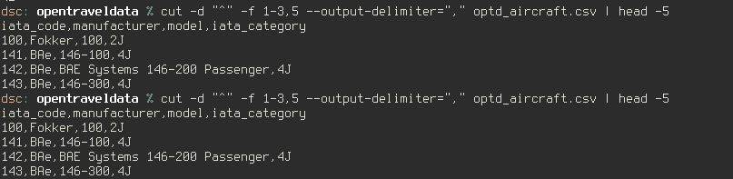
Processing and filtering
cut – slice lines
-d, --delimiter=DELIM : use DELIM instead of TAB for field delimiter
-f, --fields=LIST : select only these fields;
-c, --characters=LIST : select only characters at this positions of each line
--output-delimiter=STRING : use STRING as the output delimiter the default is to use the input delimiter

Slide 47
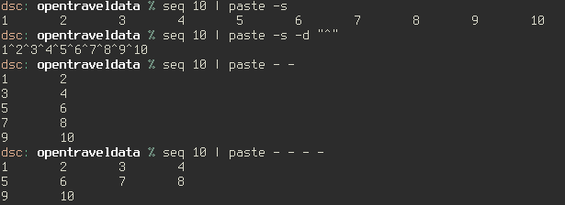
Processing and filtering
paste – Concatenate horizontally; Merge lines of files
without any options is as good as the cat command when operated on a single file
default delimiter tab is used to separate the columns
-d, --delimiters=LIST : reuse characters from LIST instead of TABs
-s, --serial: joins all the lines in a file
- - - … - : number of columns of the output

Slide 48
Processing and filtering
tr –translate or delete characters SINTAX: tr [OPTION]... SET1 [SET2]
-d, --delete : delete characters in SET1, do not translate
-s, --squeeze-repeats : replace each input sequence of a repeated character that is listed in SET1 with a single occurrence of that character
-t, --truncate-set1 : first truncate SET1 to length of SET2
-c : remove all characters except the ones set with –d option
Can be used with predefined classes of characters which are:
[:alnum:] all letters and digits
[:alpha:] all letters
[:blank:] all horizontal whitespace
[:cntrl:] all control characters
[:digit:] all digits
[:graph:] all printable characters, not including space
[:lower:] all lower case letters
[:print:] all printable characters, including space
[:punct:] all punctuation characters
[:space:] all horizontal or vertical whitespace
[:upper:] all upper case letters
[:xdigit:] all hexadecimal digits

Slide 49
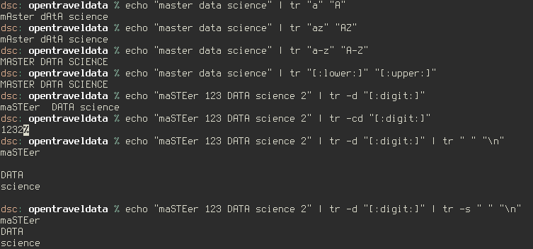
Processing and filtering

Slide 50
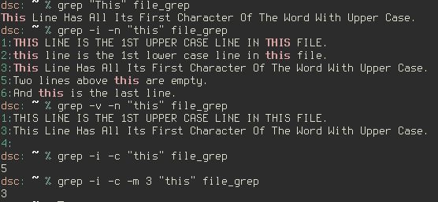
Processing and filtering
grep – print lines matching a pattern SINTAX: grep “STRING" [file_pattern]
-i : case insensitive in both the PATTERN and the input files.
-v : Invert the sense of matching, to select non-matching lines.
-c : print count of matching lines for each input file. With the -v option it counts non-matching lines.
-n : Prefix each line of output with the 1-based line number within its input file.
-m NUM, --max-count=NUM : Stop reading a file after NUM matching lines.
Notes:
THE per-line filter

Slide 51
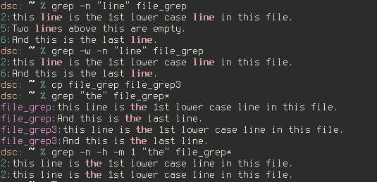
Processing and filtering
grep – print lines matching a pattern SINTAX: grep “STRING" [file_pattern]
-h, --no-filename : Suppress the prefixing of file names on output. Default when there is only one file (or only standard input) to search.
-H : Print the file name for each match.
-w : Select only those lines containing matches that form whole words.
-x : Select only those matches that exactly match the whole line.
Notes:
dsc: ~ % cp file_grep file_grep3 ~ 0 23:12:46
dsc: ~ % grep "the" file_grep* ~ 0 23:13:05
file_grep:this line is the 1st lower case line in this file.
file_grep:And this is the last line.
file_grep3:this line is the 1st lower case line in this file.
file_grep3:And this is the last line.
dsc: ~ % grep -n -h -m 1 "the" file_grep* ~ 0 23:13:26
2:this line is the 1st lower case line in this file.
2:this line is the 1st lower case line in this file.

Slide 52
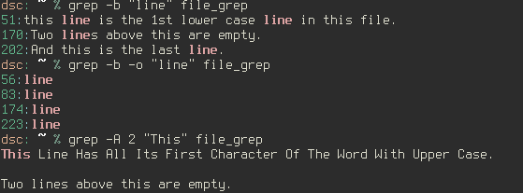
Processing and filtering
grep – print lines matching a pattern SINTAX: grep “STRING" [file_pattern]
-o : show just the pattern matched
-b : show the byte offset in the whole file of the starting point of output
Displaying lines before/after/around the match using grep -A, -B and -C
grep -A 3 -i "example" demo_text

Slide 53

Processing and filtering
grep – print lines matching a pattern SINTAX: grep “STRING" [file_pattern]
WORKS with regular expressions!
-E : enable regular expression
Notes:
grep -E "P{2}" file_grep
-E, --extended-regexp : Interpret PATTERN as an extended regular expression.
-F, --fixed-strings : Interpret PATTERN as a list of fixed strings, separated by newlines, any of which is to be matched.
-G, --basic-regexp : Interpret PATTERN as a basic regular expression. This is the default.

Slide 54
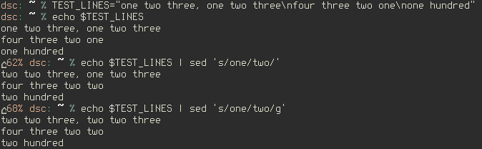
Processing and filtering
Do not Panic! It is not your fault you don't understand sed.
sed – stream editor for filtering and transforming text
s Substitute command
/../../ Delimiter (by convention)
day Regular Expression Pattern Search Pattern
night Replacement string
sed is line oriented
The first line had "one" twice, but only the first occurrence was changed. That is the default behavior.
g - global replacement
Notes:
echo day | sed s/day/night/
TEST_LINES="one two three, one two three\nfour three two one\none hundred"
You can prevent the shell from interpreting a character by placing a backslash ("\") in front of it. Here is a shell script that can delete any files that contain an asterisk:
echo This script removes all files that echo contain an asterisk in the name. echo echo Are you sure you want to remove these files\? rm -i *\** The backslash was also necessary before the question mark, which is also a shell meta-character.
dsc: ~ % echo a\ \ \ \ \ \ \ b ~ 0 1:41:50
a b
dsc: ~ % echo a b ~ 0 1:43:13
a b
dsc: ~ % echo 'a b' ~ 0 1:43:26
a b

Slide 55
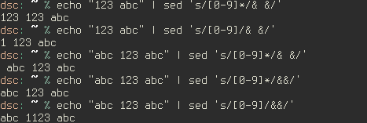
Processing and filtering
sed – stream editor for filtering and transforming text
The character after the s is the delimiter
Delimiter can be changed!!!
& : the matched string; It corresponds to the pattern found
Use case: you want to search for a pattern and do some processing on or around it
sed 's/abc/(abc)/'
sed 's/[a-z]*/(&)/‘ (*= zero or more)
Notes:
echo day | sed s/day/night/
http://www.grymoire.com/Unix/Sed.html#uh-1

Slide 56
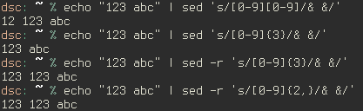
Processing and filtering
sed – stream editor for filtering and transforming text
-r, --regexp-extended : use extended regular expressions in the script.
-i : edit files in place

Slide 57
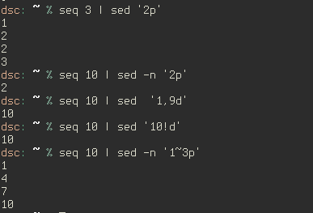
Processing and filtering
sed – stream editor for filtering and transforming text
p = print the current pattern space (used to detect content in lines)
d : delete pattern space.
-n = suppress automatic printing of pattern space. By default, sed prints every line. If it makes a substitution, the new text is printed instead of the old one. When the "-n" option is used, the "p" flag will cause the modified line to be printed.
-! : reverse the restriction
Notes:
sed -n 's/pattern/&/p' <file == grep pattern

Slide 58
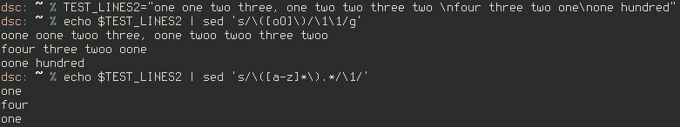
Processing and filtering
sed – stream editor for filtering and transforming text
Remembering patterns with \(, \) and \1
If you wanted to search for lines that had two identical words, You need a way of remembering what you found, and seeing if the same pattern occurred again.
You can mark part of a pattern using "\(" and "\)". You can recall the remembered pattern with "\" followed by a single digit.
You can have 9 different remembered patterns. Each occurrence of "\(" starts a new pattern.
to keep the first word of a line, and delete the rest of the line, mark the important part with the parenthesis:
sed 's / \( [a-z]* \).* / \1 /‘
sed 's/\([a-z]*\).*/\1/'
Notes:
TEST_LINES2="one one two three, one two two three two \nfour three two one\none hundred“

Slide 59
Processing and filtering - Quick exercises
Go to ~/Data/opentraveldata
(optd_aircraft.csv): Extract all 7x7 (Boeing) and all 3xx model numbers to stdout or a separate file
(optd_airlines.csv): How many airlines have the word (not prefix) “Air”, “airlines”, or the prefix “aero” in their name?
(optd_airlines.csv): How many airlines where active before 1960?
(optd_airlines.csv) What is the airline with the most flights?
(optd_airlines.csv) What is the alliance with the most airlines?
Notes:
1) grep -E "3[0-9]{2}|7[0-9]7" optd_aircraft.csv
2) cat optd_airlines.csv | cut -d "^" -f 8 | grep -E "(.)+Air|(.)+airlines|^Aero"|wc –l
3) cat optd_airlines.csv | cut -d "^" -f 3 | grep -E "1[8-9][0-5][0-9]"| wc –l
4) cat optd_airlines.csv | cut -d "^" -f 8,14 | sort -t "^" -k 2nr,2 |head -1
5) cat optd_airlines.csv | cut -d "^" -f 10 | grep -E "[^\^\n]"| sort | uniq -c |sort -nr | head -1

Slide 60
Processing and filtering - Quick exercises
Go to ~/Data/us_dot/otp
(T100): What are the column numbers of columns having “carrier” in the name ”? (don't count!) (hint: type “seq 10” in your terminal)
(T100) Print to screen, one field per line, the header and first line of the T100 file, side by side.
(T100): what airline flies the most destinations?
Notes:
6) paste <(seq 110) <(zcat ./On_Time_On_Time_Performance_2015_1.zip | head -n 1 | tr "," "\n")|grep -i "carrier"
7) paste <(seq 110) <(zcat ./On_Time_On_Time_Performance_2015_1.zip | head -n 1 | tr "," "\n") <(zcat ./On_Time_On_Time_Performance_2015_1.zip | head -n 2 | tail -1 | tr "," "\n")
8) paste <(seq 110) <(zcat ./T100_SEGMENT_ALL_CARRIER_2015.zip | head -n 1 | tr "," "\n")|grep -i "des“ “
paste <(seq 110) <(zcat ./T100_SEGMENT_ALL_CARRIER_2015.zip | head -n 1 | tr "," "\n")|grep -i "air“
paste <(seq 110) <(zcat ./T100_SEGMENT_ALL_CARRIER_2015.zip | head -n 1 | tr "," "\n")|grep -Ei "des|car|air"
^\".*\",[0-9]+$
sed -E '/^\".*\",[0-9]+$/d‘
cat ./914310910_T_T100_SEGMENT_ALL_CARRIER_2014_All.csv | cut -d "," -f 17,35| sort -u | sed -E '/^\".*\",[0-9]+$/d' | cut -d "," -f 1 | uniq -c -d | sort -nr | head

Slide 61
Some Interesting commands
bc - a calculator on the command line where you can pipe an equation to
expr - evaluates the given expression.
column – put list into columns
split - split a file into pieces
diff - compare files line by line
md5sum - compute and check MD5 message digest
tree - list contents of directories in a tree-like format
date - print or set the system date and time
seq - print a sequence of numbers
uname -a : display system info
fg/bg/ & = background/foreground processing
du -h --max-depth=1 : disc usage of current directory
df -kh : disc usage in human redable form
Notes:
http://linux.101hacks.com/unix/expr/

Slide 62
Command line Tools
Regular expressions
cd
pwd
ls
ll
rm
chmod
mkdir
man
sed
grep
head
echo
cat
less
tail
sort
uniq
wc
File utilities
Content utilities
Sorting and counting
Help utilities
Processing and filtering
Notes:
Which are alias?
ls, ll,

Slide 63
Working with compressed Files
Common file extensions of compressed archives are: .tar, .tar.gz, .gz, .zip, bz, bz2
gzip, gunzip, zcat, zless, zgrep – works with zip and gz
gzip : -d = decompress
-l = list compression info of gz file
-t = test the gz file integrity
bzip2, bzcat, bzless, bzgrep – works with bz and bz2
Hadoop read, manipulate, and slice these files in blocks (1 block =64/128MB)
bzip2 -d file = uncompress (use tab to get more options)
tar, untar – works with tar
tar : -c = create
-x = extract
-r = add
-t = list/view
-f = file archive
-z = zip
-j = bzip2
-C -destination = make extract to destination directory
-v : verbose
Notes:
bzcat | less –S
head .. descomprime llega a 10 y stop
tail... descomprimdo hasta final-10

Slide 64
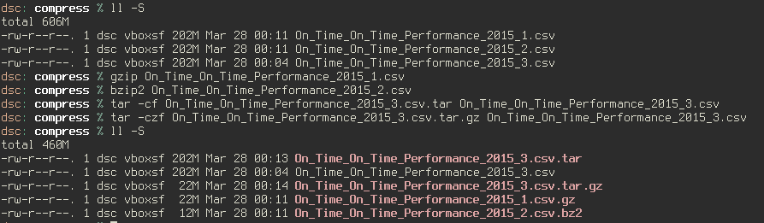
Working with compressed Files

Slide 65
Exercises
Go to ~/Data/us_dot/otp. Show the contents of one of the files.
Use head/tail together with zcat command. Any difference in time execution?

Slide 66
Command line Tools
Regular expressions
cd
pwd
ls
ll
rm
chmod
mkdir
man
sed
grep
head
echo
cat
less
tail
sort
uniq
wc
File utilities
Content utilities
Sorting and counting
Help utilities
Processing and filtering
Compressed Files
Notes:
Which are alias?
ls, ll,

Slide 67
Command line Tools
Shell scripting
Regular expressions
cd
pwd
ls
ll
rm
chmod
mkdir
man
sed
grep
head
echo
cat
less
tail
sort
uniq
wc
File utilities
Content utilities
Sorting and counting
Help utilities
Processing and filtering
Compressed Files
Notes:
Which are alias?
ls, ll,

Slide 68
References
Data Science at the command line by Jeroen Janssens, O'Reilly Media
http://www.theunixschool.com/
www.thegeekstuff.com
http://www.grymoire.com/Unix/index.html : the single best resource for almost anything Unix
http://regexr.com/
http://linuxcommand.org/ : extremely well explained, extensive, and practical tutorial on everything shell
http://www.tutorialspoint.com/unix/unix-basic-operators.htm
https://kb.iu.edu/d/admm

Slide 69
The purpose of a command-line tool is to make your life on the command line easier, and to make you a more productive and more efficient data scientist.

Slide 70
Appendix
Line endings : \n, \r\n http://www.cs.toronto.edu/~krueger/csc209h/tut/line-endings.html
Run the last command starting with “abc” : !abc
Rerun the last command with sudo on the Linux shell : sudo !!
Unix system administration
htop
kill
pgrep
pkill
Notes:
'$0' will give you 'current' shell '$SHELL' will give you your 'login' shell

Slide 71
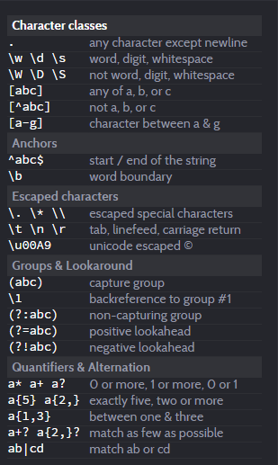
Appendix Regular expressions
Notes:
http://regexr.com/

Slide 72
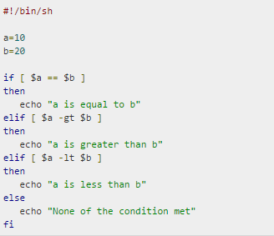
Appendix Flow Control – Decision making
It is very important to note here that all the conditional expressions would be put inside square braces with one spaces around them, for example [ $a == $b ] is correct where as [$a==$b] is incorrect.
Notes:
#!/bin/sh
a=10
b=20
if [ $a == $b ]
then
echo "a is equal to b"
elif [ $a -gt $b ]
then
echo "a is greater than b"
elif [ $a -lt $b ]
then
echo "a is less than b"
else
echo "None of the condition met"
Fi
http://www.tutorialspoint.com/unix/if-elif-statement.htm

Slide 73
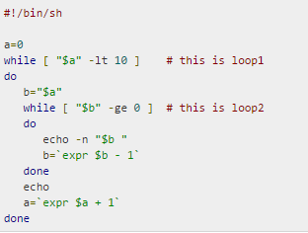
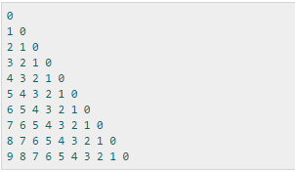
Appendix Flow Control – While Loops
echo -n option let echo to avoid printing a new line character
Notes:
#!/bin/sh
a=0
while [ "$a" -lt 10 ] # this is loop1
do
b="$a"
while [ "$b" -ge 0 ] # this is loop2
do
echo -n "$b “
b=`expr $b - 1`
done
echo
a=`expr $a + 1`
done
http://www.tutorialspoint.com/unix/while-loop.htm

Slide 74
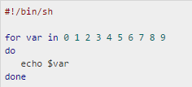
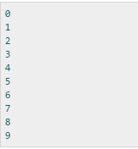
Appendix Flow Control – For Loops
for var in word1 word2 ... wordN
do
Statement(s) to be executed for every word.
done
Here var is the name of a variable and word1 to wordN are sequences of characters separated by spaces (words). Each time the for loop executes, the value of the variable var is set to the next word in the list of words, word1 to wordN.
echo -n option let echo to avoid printing a new line character

Slide 75
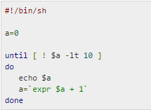
Appendix Flow Control – Until Loops
until command
do
Statement(s) to be executed until command is true
done
Here Shell command is evaluated. If the resulting value is false, given statement(s) are executed. If command is true then no statement would be not executed and program would jump to the next line after done statement.
echo -n option let echo to avoid printing a new line character
Notes:
#!/bin/sh
a=0
until [ ! $a -lt 10 ]
do
echo $a
a=`expr $a + 1`
done

Slide 76
Appendix Relational operators
Assume variable a holds 10 and variable b holds 20 then
Bourne Shell supports following relational operators which are specific to numeric values. These operators would not work for string values unless their value is numeric.
For example, following operators would work to check a relation between 10 and 20 as well as in between "10" and "20" but not in between "ten" and "twenty".
Operator | Description | Example
-eq | Checks if the value of two operands are equal or not, if yes then condition becomes true. | [ $a -eq $b ] is not true.
-ne | Checks if the value of two operands are equal or not, if values are not equal then condition becomes true. | [ $a -ne $b ] is true.
-gt | Checks if the value of left operand is greater than the value of right operand, if yes then condition becomes true. | [ $a -gt $b ] is not true.
-lt | Checks if the value of left operand is less than the value of right operand, if yes then condition becomes true. | [ $a -lt $b ] is true.
-ge | Checks if the value of left operand is greater than or equal to the value of right operand, if yes then condition becomes true. | [ $a -ge $b ] is not true.
-le | Checks if the value of left operand is less than or equal to the value of right operand, if yes then condition becomes true. | [ $a -le $b ] is true.

Slide 77
Appendix Boolean Operators
Assume variable a holds 10 and variable b holds 20 then
Operator | Description | Example
! | This is logical negation. This inverts a true condition into false and vice versa. | [ ! false ] is true.
-o | This is logical OR. If one of the operands is true then condition would be true. | [ $a -lt 20 -o $b -gt 100 ] is true.
-a | This is logical AND. If both the operands are true then condition would be true otherwise it would be false. | [ $a -lt 20 -a $b -gt 100 ] is false.

Slide 78
Appendix String Operators
There are following string operators supported by Bourne Shell.
Assume variable a holds "abc" and variable b holds "efg" then
Operator | Description | Example
= | Checks if the value of two operands are equal or not, if yes then condition becomes true. | [ $a = $b ] is not true.
!= | Checks if the value of two operands are equal or not, if values are not equal then condition becomes true. | [ $a != $b ] is true.
-z | Checks if the given string operand size is zero. If it is zero length then it returns true. | [ -z $a ] is not true.
-n | Checks if the given string operand size is non-zero. If it is non-zero length then it returns true. | [ -z $a ] is not false.
str | Check if str is not the empty string. If it is empty then it returns false. | [ $a ] is not false.

Slide 79
Appendix File Test Operators
Assume a variable file holds an existing file name "test" whose size is 100 bytes and has read, write and execute permission on
Operator | Description | Example
-b file | Checks if file is a block special file if yes then condition becomes true. | [ -b $file ] is false.
-c file | Checks if file is a character special file if yes then condition becomes true. | [ -c $file ] is false.
-d file | Check if file is a directory if yes then condition becomes true. | [ -d $file ] is not true.
-f file | Check if file is an ordinary file as opposed to a directory or special file if yes then condition becomes true. | [ -f $file ] is true.
-g file | Checks if file has its set group ID (SGID) bit set if yes then condition becomes true. | [ -g $file ] is false.
-k file | Checks if file has its sticky bit set if yes then condition becomes true. | [ -k $file ] is false.
-p file | Checks if file is a named pipe if yes then condition becomes true. | [ -p $file ] is false.

Slide 80
Appendix File Test Operators
Assume a variable file holds an existing file name "test" whose size is 100 bytes and has read, write and execute permission on
Operator | Description | Example
-t file | Checks if file descriptor is open and associated with a terminal if yes then condition becomes true. | [ -t $file ] is false.
-u file | Checks if file has its set user id (SUID) bit set if yes then condition becomes true. | [ -u $file ] is false.
-r file | Checks if file is readable if yes then condition becomes true. | [ -r $file ] is true.
-w file | Check if file is writable if yes then condition becomes true. | [ -w $file ] is true.
-x file | Check if file is execute if yes then condition becomes true. | [ -x $file ] is true.
-s file | Check if file has size greater than 0 if yes then condition becomes true. | [ -s $file ] is true.
-e file | Check if file exists. Is true even if file is a directory but exists. | [ -e $file ] is true.
Notes:
sudo mount -t vboxsf WinHome $HOME/WinHome

Slide 81
Appendix Shell Script
Creating Reusable Command-Line Tools
building block that can be part of something bigger
turn a one-liner into a reusable command-line tool
EXAMPLE finding top 10 common words in a file
cat textfile | tr '[:upper:]' '[:lower:]' | grep -oE '\w+' | sort | uniq -c | sort -nr | head 10
Convert the entire text to lowercase using tr.
Extract all the words using grep and put each word on a separate line.
Sorting these words in alphabetical order using sort.
Removing all the duplicates and count how often each word appears in the list using uniq.
Sorting this list of unique words by their count in descending order using sort.
Keeping only the top 10 lines (i.e., words) using head.
( get text file with: curl -s http://www.gutenberg.org/cache/epub/76/pg76.txt > Finn.txt)

Slide 82
Appendix Shell Script
To turn this one-liner into a reusable command-line tool, we’ll pass through the following six steps:
1. Copy and paste the one-liner into a file.
2. Add execute permissions.
3. Define a so-called shebang.
4. Remove the fixed input part.
5. Add a parameter.
6. Optionally extend your PATH.

Slide 83
Appendix Shell Script
Step 1: Copy and Paste
Create top-words-1.sh with the command inside
using the file extension .sh to make clear that we’re creating a shell script. However command-line tools do not need to have an extension.
Execute top-words-1.sh to test the output
bash ~/book/ch04/top-words-1.sh
Step 2: Add Permission to Execute
chmod u+x top-words-2.sh
Execute : top-words-2.sh
Step 3: Define Shebang
The shebang is a special line in the script that instructs the system which executable should be used to interpret the commands
The name shebang comes from the first two characters in the line: a hash (she) and an exclamation mark (bang).
In our case, we want to use bash to interpret our commands : #!/usr/bin/env bash
Step 4: Remove Fixed Input
in general, better to let the user take care of saving data and reading data
tr '[:upper:]' '[:lower:]' | grep -oE '\w+' | sort | uniq -c | sort -nr | head -n 10
cat textfile | top-words-4.sh
Notes:
Here is a nice little command-line trick. On the command-line, !!
will be substituted with the command you just ran. So, if you realize
you needed superuser privileges for the previous command,
you can run sudo !! (Miller, 2013).
Moreover, if you want to save the previous command to a file without having to copy and paste
it, you can run echo "!!" > scriptname. Be sure to check the contents
of the file scriptname for correctness before executing it
because it may not always work when your command has quotes
Sometimes you will come across scripts that have a shebang in the
form of !/usr/bin/bash or !/usr/bin/python (in the case of
Python, as we will see in the next section). While this generally
works, if the bash or python (Python Software Foundation, 2014)
executables are installed in a different location than /usr/bin, then
the script does not work anymore.
It’s better to use the form presented
here, namely !/usr/bin/env bash and !/usr/bin/env python,
because the env (Mlynarik & MacKenzie, 2012) command-line tool
is aware where bash and python are installed. In short, using env
makes your scripts more portable.

Slide 84
Appendix Shell Script
Step 5: Parameterize
NUM_WORDS="$1"
tr '[:upper:]' '[:lower:]' | grep -oE '\w+' | sort | uniq -c | sort -nr | head -n $NUM_WORDS
The variable NUM_WORDS is set to the value of $1, which is a special variable in Bash. It holds the value of the first command-line argument passed to our command-line tool.
cat textifile | top-words-5.sh 5
Step 6: Extend your PATH
This optional step ensures that you can execute your command-line tools from everywhere.
PATH is an environment variable that holds a list of directories
echo $PATH | tr : '\n' | sort
To change the PATH permanently, you’ll need to edit the .bashrc or .profile file located in your home directory.
If you put all your custom command-line tools into one directory, say, ~/tools, then you’ll only need to change the PATH once.
echo ‘export PATH=$PATH:~/tools’>>~/.zshrc

Slide 85
Appendix Shell Script Exercises
Make the script that will test if the file exists all return the file size in case it exists.
test_if_file_exists.sh ~/ .test.tx
Notes:
#!/usr/bin/env bash
FILE=$1
if [ -e $FILE ]
then
ls -l $FILE
else
echo “$FILE does not exist"
fi

Slide 86
Grep example file
THIS LINE IS THE 1ST UPPER CASE LINE IN THIS FILE.
this line is the 1st lower case line in this file.
This Line Has All Its First Character Of The Word With Upper Case.
Two lines above this are empty.
And this is the last line.

