Slide 1
Topic: Illustrate Agile Software Development and Its Core Principles
NAME: SK ARIF HOSSAIN STUDENT CODE: BWU/BCA/23/425
DEPT: CSS(BCA)
COURSE NAME: SOFTWARE ENGINEERING
COURSE CODE: BCA50114

Slide 2
Contents:
Introduction
Diagram
Agile Methodology
Agile Frameworks
Advantages
Conclusion

Slide 3
Introduction
Agile Software Development is a modern approach to building software that focuses on flexibility, teamwork, and customer satisfaction. The Agile Software Development Model is a way of creating software step by step. The Agile Software Development Model breaks a project into small, manageable parts called iterations or sprints. After each iteration, a working version of the software is presented to the customer, allowing the team to incorporate feedback rapidly and enhance the product as they progress.
This approach allows developers to respond effectively to changes in requirements, priorities, or market conditions. By delivering small, functional increments of software frequently, Agile reduces time-to-market while ensuring that the final product meets user needs. Teams work collaboratively and adaptively, continuously learning from each iteration and improving both the product and their processes. Agile empowers teams to innovate, maintain high quality, and provide tangible value to customers throughout the development cycle.

Slide 4
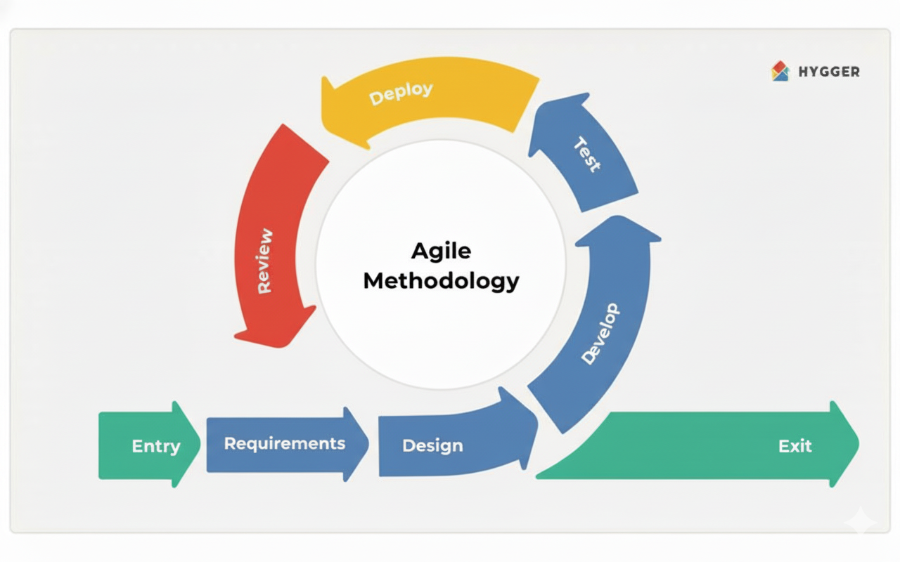
Diagram

Slide 5
Agile Methodology
1. Entry: This is the starting point of the Agile process. 2. Requirements: In this stage, the team gathers and analyzes requirements. 3. Design: Based on the requirements, the team designs how the system will look and function. This includes creating system architecture and planning user interfaces.
4. Develop: The actual coding starts here. Developers build the software in small, manageable parts (iterations) so progress can be tested and improved quickly.
5. Test: After development, each part is tested to find and fix errors. 6. Deploy: Once testing is complete, the working version of the product is deployed or released for use.
7. Review :After deployment, feedback is collected from users and stakeholders. This feedback helps improve the product in the next iteration.
8. Exit: When all project goals are achieved, the final version is released, and the project is formally closed.

Slide 6
Agile Frameworks
An Agile Framework is a set of rules and practices that helps teams work together, plan, and deliver software step by step. It guides teams to adapt quickly, improve continuously, and give value to the customer faster.
Scrum: Works in sprints with clear roles — Scrum Master, Product Owner, Development Team.
Kanban: Uses visual boards to track and manage tasks in real time.
Extreme Programming (XP): Focuses on quality code, pair programming, and frequent testing.

Slide 7
Advantages:
Faster and more frequent delivery: Working software is delivered in short iterations, reducing time-to-market.
Higher customer satisfaction: Early and continuous feedback ensures the product meets user needs.
Better communication: Improves efficiency and understanding.
Continuous learning and improvement: Each iteration allows teams to refine processes and enhance quality.
Flexibility : Agile responds effectively to changing requirements without major disruption.
Transparency and predictability: Frequent updates and reviews provide clear visibility into project progress.
Reduced risk: Early testing and feedback help identify and resolve issues sooner.

Slide 8
Conclusion:
Agile Software Development is more than just a methodology—it is a mindset that prioritizes adaptability, collaboration, and customer-centric delivery. By embracing Agile principles, software teams focus on iterative development, delivering small, functional increments of software frequently. This approach ensures that feedback is continuously incorporated, allowing products to evolve in alignment with changing business requirements and user needs.
The core principles of Agile—individuals and interactions over processes, working software over comprehensive documentation, customer collaboration over contract negotiation, and responding to change over following a plan—empower teams to work more efficiently, reduce risks, and maintain high-quality standards.

Slide 9
Thank you
hossainarif8364@gmail.com

