Slide 1

Do institutional quality and its threshold matter in the sensitivity of the renewable energy transition to financial development?
An Analysis of Lower Middle-income economies
SIDHANT PATNAIK . | 2022B3A10297G
Submitted to
Dr. Aswini Kumar Mishra
ROHAN PRIYADARSHI . | 2022B3A40555G
ARYAN SINGHAL . | 2022B3A70204G
AYUSH SUBHASH JOSHI . | 2022B3A70313G
SWASTIK SHARMA . | 2022B3AA0802G
ARRUSH TEKKUMPURATH NAIR . | 2022B3AA0468G
Course: Applied Econometrics (ECON F342)
SHUBHAM SAHOO . | 2022B3A70628G
HARSH DESHWAL . | 2022B3A70920G
SHAAN HASAN . | 2022B3A70328G

Slide 2
OBJECTIVES
To check the relationship between financial development, institutional quality, and renewable energy transition in Lower Middle Income countries.
The main objectives are to:
• Determine the threshold effects of institutional quality;
• Examine the role of financial development in the energy transition;
• Apply strong econometric techniques;
Important queries:
  What is the moderating effect of institutional quality, and how does financial development impact the transition to renewable energy?
  Does the impact of financial development increase with a certain level of institutional quality?
  What obstacles are there, and how can laws overcome them?
  These are some of the objectives for this report.

Slide 3
LITERATURE REVIEW

Slide 4

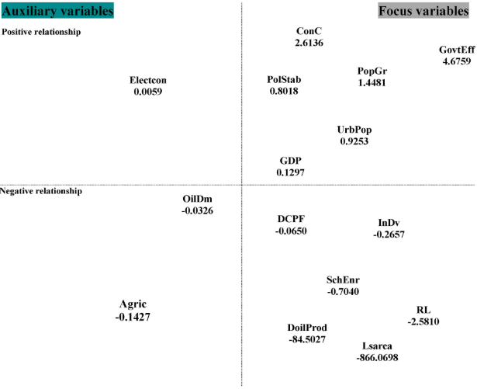
  Researchers investigating renewable energy use in Africa's five most populous nations (1996-2016) discovered several key drivers. Using methods designed to handle uncertainty across different models, they found that increases in population (both total and urban), overall energy and electricity use, and human capital development all contributed positively to higher renewable energy consumption.
  The very idea of powering societies entirely with renewables gained traction in the late 1990s, spurred by studies showing its feasibility in Europe and North Africa. However, what drives renewable energy adoption isn't universal; studies show factors like foreign investment and trade openness were important in China, while specific government policies sometimes hindered it elsewhere.
  Globally, CO2 emissions and trade have been identified as significant factors, though economic growth showed a negative link to renewables in the Balkans.

Slide 5
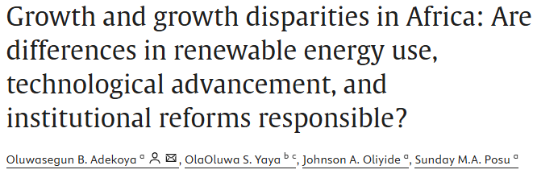
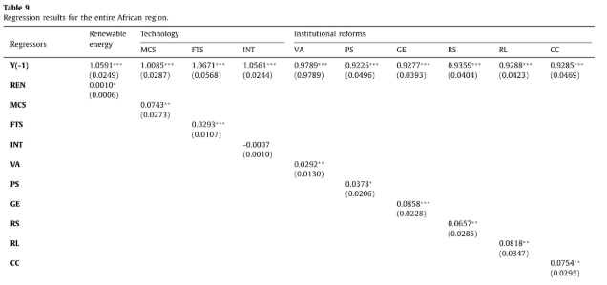
  Examining how renewable energy, technology, and institutional reforms influence economic growth and inequality across Africa. The results painted a complex picture based on income levels. Renewable energy didn't significantly impact growth in middle-income countries but appeared detrimental in low-income nations.
  Technology, however, primarily benefited the upper and middle-income groups, while the effect of institutional quality varied across different income brackets. Earlier work suggested renewables could boost economies by creating jobs and replacing costly energy imports, with many studies confirming positive effects, especially in developing countries.
  The relationship between energy use and economic growth isn't straightforward either, varying by region – some show mutual dependence (Eurasia, Pakistan, MENA), while others find weak or even negative links (Turkey). Technology, particularly ICT, consistently emerges as a growth engine, often having a stronger effect in poorer nations.

Slide 6
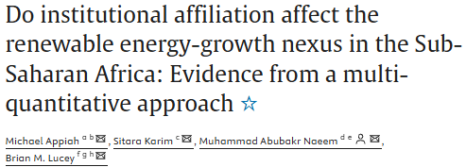
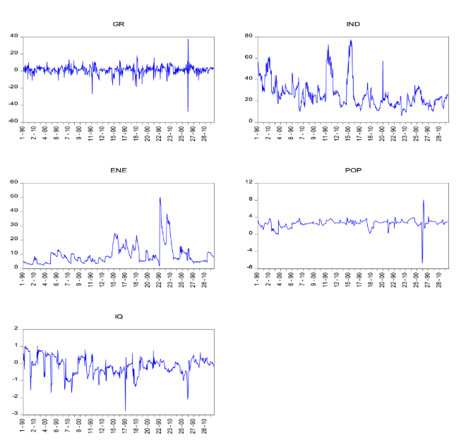
  Focusing specifically on Sub-Saharan Africa (1990-2020), one analysis explored how institutions shape the link between renewable energy and economic growth. It confirmed positive roles for both renewables and institutions in driving growth. Interestingly, while institutions generally helped the economy, stronger institutional quality seemed to weaken the positive impact of renewable energy on growth, suggesting that well-resourced institutions with contingency plans are vital for managing the energy transition effectively.
  Population growth, in this context, had a negative moderating effect. Broader studies have confirmed that both renewable and non-renewable energy can fuel growth, and electricity access is particularly vital for development in many nations. How energy and growth influence each other varies widely: some countries show energy use following development (Peru), others show growth enabling energy conservation (Colombia, Thailand), some show a feedback loop (Greece, South Korea), while many African nations primarily show growth leading to conservation efforts.

Slide 7
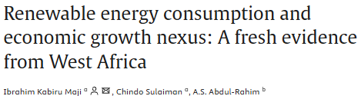
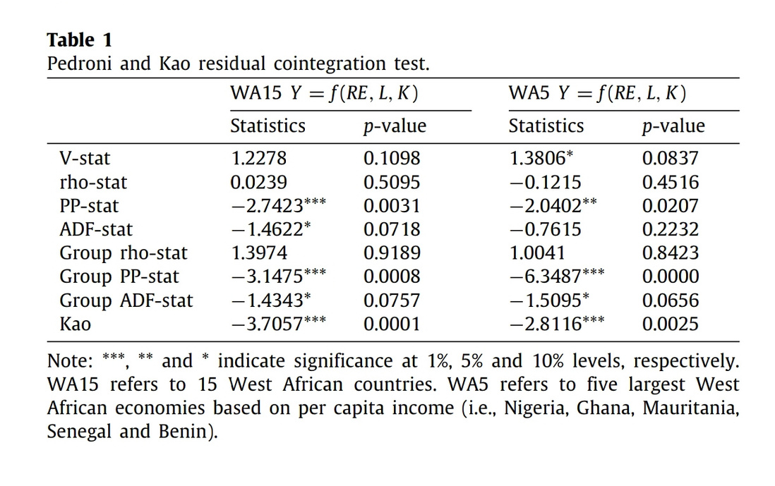
  A specific look at 15 West African countries (1995-2014) delivered a counterintuitive finding: renewable energy consumption actually appeared to slow down economic growth. The researchers attribute this primarily to the widespread use of traditional, often inefficiently burned, wood biomass. This reliance negatively impacts health, productivity, and the environment, overshadowing potential benefits and highlighting the need for cleaner technologies and stronger regional commitment to sustainable renewables.
  This contrasts with some recent studies using broader datasets which found bidirectional links between renewable energy and growth in diverse groups like G7 nations and MENA oil exporters. Biomass, particularly wood fuel, remains the dominant energy source in much of Africa (around 81% in sub-Saharan Africa), despite significant untapped potential for cleaner alternatives.

Slide 8

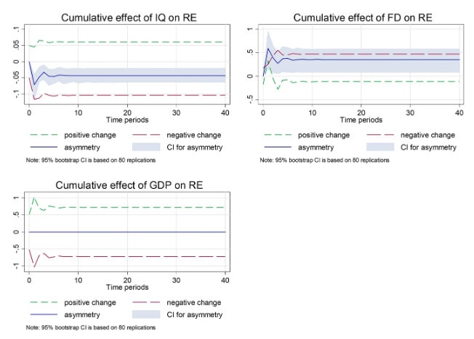
  In Tunisia (1984-2017), the interplay between institutional quality, financial development, economic growth, and renewable energy was examined. Using models sensitive to non-linear relationships, the study found that financial development actually hampered renewable energy uptake, suggesting a need for financial systems better geared towards sustainability. Conversely, economic growth and better institutions both encouraged renewable energy use, with influences running in both directions between these factors.
  Historically, research has categorized the energy-growth link into four main types: feedback, conservation, neutrality, or growth-led, with economic and environmental factors initially seen as the main drivers for renewable demand. Good institutions are often shown to help renewable transitions (as seen in developing countries, MENA, and globally), but the role of finance is mixed – beneficial in developed markets but sometimes negative elsewhere (like Ghana).

Slide 9
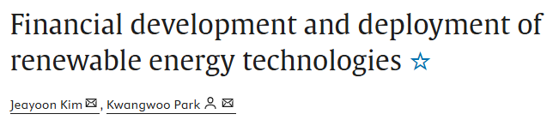
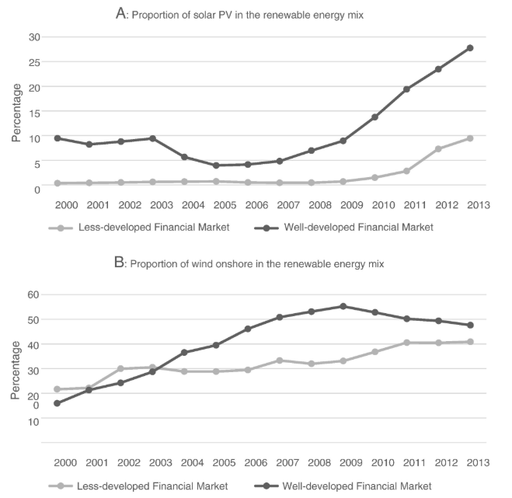
  Research across 30 countries (2000-2013)
  Renewable energy sectors needing significant debt or equity financing grew notably faster in countries with more developed financial markets. This supports the idea that financial development helps reduce CO2 emissions by making it easier to fund and deploy renewable energy. Equity markets contribute by providing clear price signals, reducing risk, facilitating corporate changes, and supporting high-tech ventures.
  Similarly, developed credit markets help through banks' expertise in project selection and monitoring, lower information costs, and staged financing suitable for innovative projects. Essentially, well-rounded financial market development appears crucial for accelerating the shift to renewable energy.

Slide 10
RESEARCH METHODOLOGY
AND MAJOR FINDINGS

Slide 11
Sources of Data and Variables
The panel dataset spans 22 years (2000–2021) and includes 27 lower-middle-income economies
Indicator | Description | Measurement/Unit | Source
REN (Renewable Energy) | Share of renewable energy in total final energy consumption | Percentage (%) | World Development Indicators (WDI), World Bank (2020)
FD (Financial Development) | Composite index reflecting financial institutions and markets in terms of depth, access, and efficiency | Index (0 to 1 scale) | IMF Financial Statistics Database
INST (Institutional Quality) | Composite index measuring corruption control and stability | Index (0 to 1 scale) | International Country Risk Guide (ICRG)
RGDPPC (GDP per capita) | Economic output per person adjusted for inflation | Constant 2015 US dollars | WDI, World Bank (2020)
FDI (Foreign Direct Investment) | Foreign capital inflow as a share of GDP | Percentage(%) of GDP | WDI, World Bank (2020)
POP (Population) | Total population of a country | Count (people) | WDI, World Bank (2020)

Slide 12
Table Number | Test/Estimation Method | Description
5 | Variance Inflation Factor (VIF) Test | Detects multicollinearity among explanatory variables.
6 | Pesaran’s CD Test (in series) | Tests for cross-sectional dependence in panel data series.
7 | Regression-Based CD Tests (Pesaran LM, Frees, Friedman) | Tests for cross-sectional dependence in panel regression residuals.
8 | Pesaran–Yamagata Slope Homogeneity Test | Tests whether slope coefficients are homogeneous across cross-sections.
9 | CIPS Unit Root Test (Intercept Only) | Tests for stationarity (unit roots) at level and first difference, without deterministic trend.
10 | CIPS Unit Root Test (Intercept and Trend) | Same as Table 9, but includes deterministic trend.
11 | Westerlund ECM Panel Cointegration Test | Tests for long-run relationships using an error correction framework, accounting for cross-dependence.
12 | Kao Cointegration Test | Tests for cointegration in panel data assuming homogeneity.
13 | System GMM Estimation (w/ and w/o interaction term) | Controls for endogeneity and dynamics using lagged instruments.
13 | Driscoll–Kraay Estimator | Robust to heteroskedasticity, autocorrelation, and cross-sectional dependence.
14 | FMOLS and DOLS Estimators | Panel cointegration estimators accounting for serial correlation and endogeneity.
15 | Pooled Mean Group (PMG) Estimator | Allows short-run heterogeneity and long-run homogeneity across units.
15 | Augmented Mean Group (AMG) Estimator | Accounts for cross-sectional dependence and heterogeneity.
15 | Common Correlated Effects Mean Group (CCEMG) Estimator | Handles unobserved common factors in panel regressions.
16 | Panel Threshold Regression | Tests for nonlinear effects in the finance-renewable energy relationship.
16 | Threshold Effect Test (Bootstrap) | Assesses significance of identified thresholds using bootstrap methods.
16 | Fixed-Effects Threshold Regression | Estimates effects within countries across different threshold regimes.

Slide 13
Table | Methodology | Key Observations | Interpretation
5. VIF (Multicollinearity) | Variance Inflation Factor (VIF) analysis on regression: renew = f(fd, inst, fd_inst, lrgdppc, fdi, lpop) | fd_inst: VIF = 54.71 fd: VIF = 47.62 inst: 3.94 Mean VIF: 18.67 | Severe multicollinearity between fd and fd_inst; inflates standard errors
6. Cross-Sectional Dependence | Pesaran’s CD test, Frees’ Q, Friedman’s test on regression residuals | - Significant CD for renew, fd, inst, fd_inst, lrgdppc, fdi (p < 0.01)- lpop not significant | Strong cross-sectional dependence in most variables
7. Regression CD & Slope Homogeneity | Random-effects GLS regression; Pesaran-Yamagata test for slope homogeneity | Within R² = 0.6335 INST: -19.06 Slope heterogeneity confirmed (Wald chi²(6) = 35.02***) | Institutional quality consistently negative; strong country effects; slopes differ across countries, so pooled models may mislead.

Slide 14
Table | Methodology | Key Observations | Interpretation
8. Slope Homogeneity (MG Estimator) | Mean Group estimator (xtmg) across countries | INST: -129.36 FD: -336.61 Interaction term insignificant | Institutional frameworks hinder renewable transitions; no moderating effect of INST on FD.
9. Panel Unit Root (Intercept Only) | Pesaran’s CIPS test, intercept only, 1 lag | All variables I(1) except fdi (stationary at level) First differences: all stationary (p = 0.000) | Most variables are non-stationary in levels but stationary after differencing; cointegration tests justified.
10. Panel Unit Root (Intercept + Trend) | Pesaran’s CIPS test, intercept and trend, 1 lag | All variables I(1); first differences stationary lrgdppc stationary after differencing (p = 0.004) | Adding trend does not alter stationarity conclusions; supports use of ECM or first-difference models.
11. Westerlund ECM Cointegration | Westerlund ECM test (group and panel statistics), lags(0), constant trend | All p-values = 1.000 Positive Z-values | No evidence of cointegration among variables; contradicts original study. Possible causes: scaling, CD, model misspecification.

Slide 15
Table | Methodology | Key Observations | Interpretation
12. Kao Cointegration Test | Kao residual-based test, assumes homogeneous cointegrating vector | All p-values > 0.05 (fail to reject H₀) Weakest p = 0.1046 | No long-run equilibrium relationship, conflicts with original study. Likely due to scaling, CD, or heterogeneity.
13. System GMM | Dynamic panel model controlling for endogeneity, lagged dependent variable | Lagged renew: ~0.93 FD/INST not significant Instrument proliferation (375–434) | Renewable energy is highly persistent; FD/INST effects unstable and insignificant; reliability undermined by instrument overload.
14. Driscoll-Kraay FE Regression | Fixed-effects regression with Driscoll-Kraay SEs (robust to CD) | FD: -17.35 (p = 0.311) INST: -18.00 (p = 0.061) fd_inst: 2.97 (p = 0.933) | Negative effect of FD contradicts original INST nearly significant interaction term not significant model robust to CD.
15. PMG/AMG/CCEMG | Panel time-series estimators: PMG (long-run), AMG, CCEMG | PMG ECM: -0.1535 INST: -139.65 FD: -132.20 (p = 0.067) | Significant error correction (13.5%/year) INST consistently hinders renewables; FD effect negative or marginal; cross-sectional dependence addressed.

Slide 16
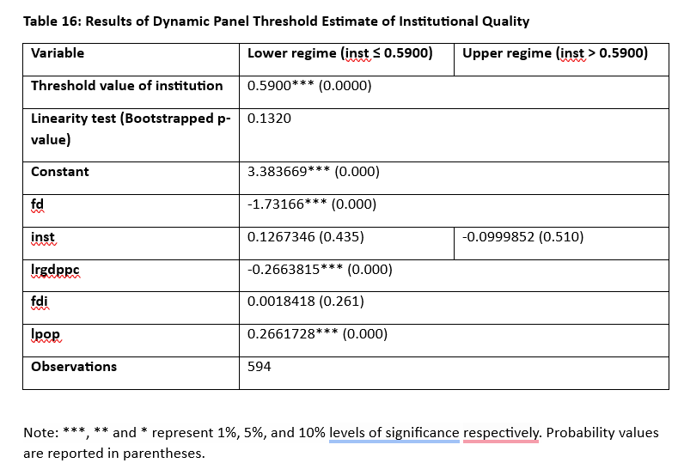

Slide 17
Major Findings
Threshold Effect
The threshold value of institutional quality is estimated to be 0.5900, statistically significant at the 1% level.
Institutional quality must exceed this threshold to strongly stimulate financial development for renewable energy transition.
Linearity Test
p-value = 0.1320, failing to reject the null hypothesis of linearity.

Slide 18
Major Findings
Impact of Financial Development (FD)
Across both regimes (below and above the threshold), financial development has a significant negative impact on renewable energy consumption (coefficient = -1.73166).
Indicates that financial development currently supports non-renewable energy sources more than renewable ones.
Impact of Institutional Quality (INST)
Below threshold: Positive effect (coefficient = 0.1267346), though not statistically significant.
Above threshold: Negative effect (coefficient = -0.0999852), also not statistically significant.
Highlights complexity in the role of institutions in promoting renewable energy.

Slide 19
Policy Implications
Strengthen Institutions: Emphasize governance reforms (e.g., rule of law, corruption control) along with financial development.
Targeted Financial Instruments: Utilize context-specific mechanisms, including finance and green bonds, to finance the growth of renewable energy sources.
Integrated Approach: Harmonize policies among ministries and stakeholders to be implemented collectively.
Regional Cooperation: Support transnational power projects to pool risks and lower costs.
Targeted Reforms: Prioritizing basic institutional capacity prior to the implementation of sophisticated financial or energy policy.
Innovation and Capacity Development: Leverage digital financial products and strengthen institutional capacities to scale up green investment programs.

Slide 20
Conclusion:
The research stresses the fact that robust financial systems but weak institutions hinder the shift toward renewable energy across lower-middle-income countries.
The institutional reforms need to be well-coordinated in conjunction with the financial development so that the progression can be made both inclusive as well as sustainable. Evidence available through the World Economic Forum establishes the above-stated argument based on the inference that more effective circular economy policies significantly enhance the green investments directly, rather than indirectly by decreasing the capital expenses. Henceforth, policymakers will have to allocate more focus areas toward reinforcing institutions along with the financial systems. Future studies need to investigate cross-country time-series data, investigate the influence of external shocks like the COVID-19 pandemic on the shift to renewable energy, and study the emerging role played by digital finance and fintech innovations in rebalancing channels toward adopting renewable energy.

Slide 21


