Slide 2
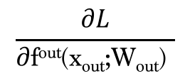
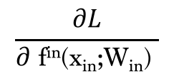


x₁
x₂
x₃
x_{out}
f¹(x₁; W₁)
f²(x₂; W₂)
f³(x₃)
f^{in}(x_{in}; W_{in})
f^{out}(x_{out}; W_{out})
L
$$\frac{∂L}{∂ \text{f}\text{in}\text{(}\text{xin}\text{;}\text{Win}\text{)} }$$
$$\frac{∂L}{∂\text{f}\text{out}\text{(}\text{xout}\text{;}\text{Wout}\text{)} }$$
$\frac{∂L}{∂\text{W}\text{out} }$ = $\frac{∂L}{∂\text{f}\text{out}\text{(}\text{xout}\text{;} \text{W}\text{out}\text{)} } \frac{∂\text{f}\text{out}\text{(}\text{x}\text{out}\text{;} \text{W}\text{out})}{∂\text{W}\text{out} }$
$\frac{∂L}{∂ \text{fin}\text{(}\text{xin}\text{;}\text{Win}\text{)} }$ = $\frac{∂L}{∂\text{f}\text{out}\text{(}\text{xout}\text{; }\text{W}\text{out}\text{)} }$ $\frac{∂\text{f}\text{out}\text{(}\text{xout}\text{; }\text{W}\text{out}\text{)}}{∂ \text{fin}\text{(}\text{xin}\text{;}\text{Win}\text{)}}$

Slide 3
Cat
1
Id(Cat)
Cat
1
6
2
1
0
3
2
2
0, …, K
The domestic cat is a little tiger ....
x₁
x₂
x_{n}
h_{n}
y_{n}
x_{n}
h_{n}
y_{n}
W_{x}
W_{y}
W_{x}
W_{y}
L
The domestic cat is a little tiger ....
x_{n}
W_{h}
W_{h}

Slide 4
L_{t-1}
L_{t}
L_{t+1}
y_{t-1}
y_{t}
y_{t+1}
y_{t-1}
y_{t}
y_{t+1}
W_{y}
W_{y}
W_{y}
W_{y}
W_{y}
W_{y}
h_{t-1}
W_{h}
h_{t}
W_{h}
h_{t+1}
h_{t-1}
W_{h}
h_{t}
W_{h}
h_{t+1}
W_{x}
W_{x}
W_{x}
W_{x}
W_{x}
W_{x}
x_{t-1}
x_{t}
x_{t+1}
x_{t-1}
x_{t}
x_{t+1}

Slide 5
L_{t-1}
L_{t}
L_{t+1}
y_{t-1}
y_{t}
y_{t+1}
W_{y}
W_{y}
W_{y}
h_{t-1}
W_{h}
h_{t}
W_{h}
h_{t+1}
W_{x}
W_{x}
W_{x}
x_{t-1}
x_{t}
x_{t+1}

Slide 6
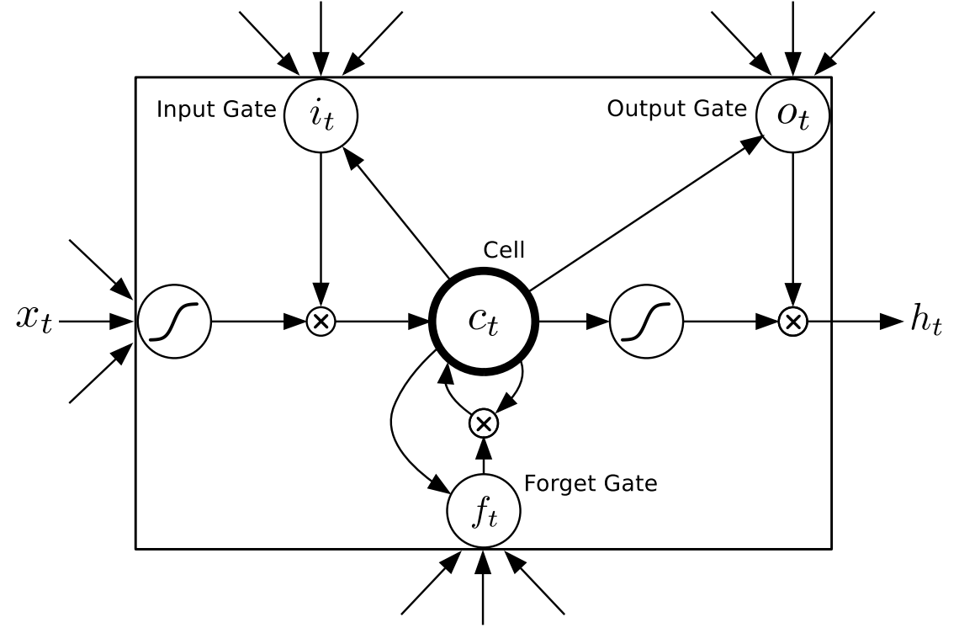

Slide 7
Title
Description
Other Features
Embeding
Embeding
Dense Layer
RNN
RNN
Dense Layer
Concat Layer
Dense Layer
Dense Layer
P(1)

Slide 9
N -Prev Later
Embeding
RNN
Dense Layer
P(A), …, P(Z)

Slide 10
Next word
probabilities
Hidden
States
Embedding
Layer
word id’s
7 18 3 1021 ....
words
is a little tiger ....

