Slide 1
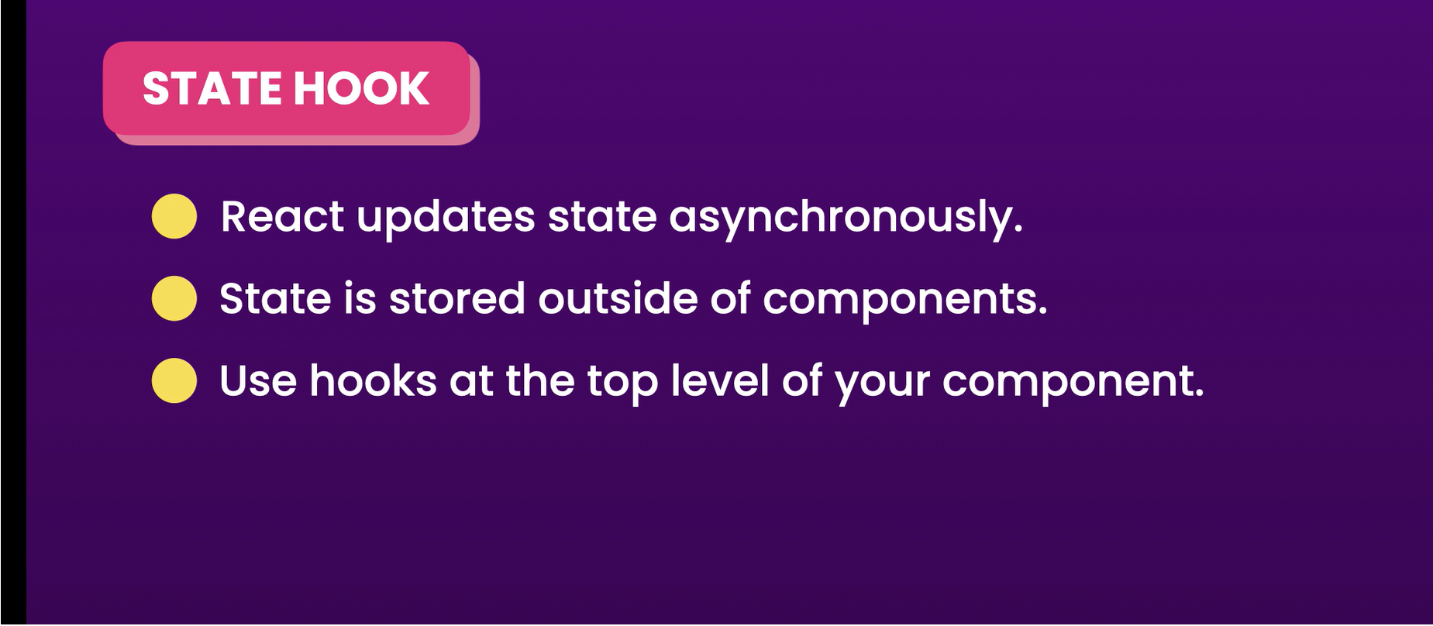
State hook

Slide 2
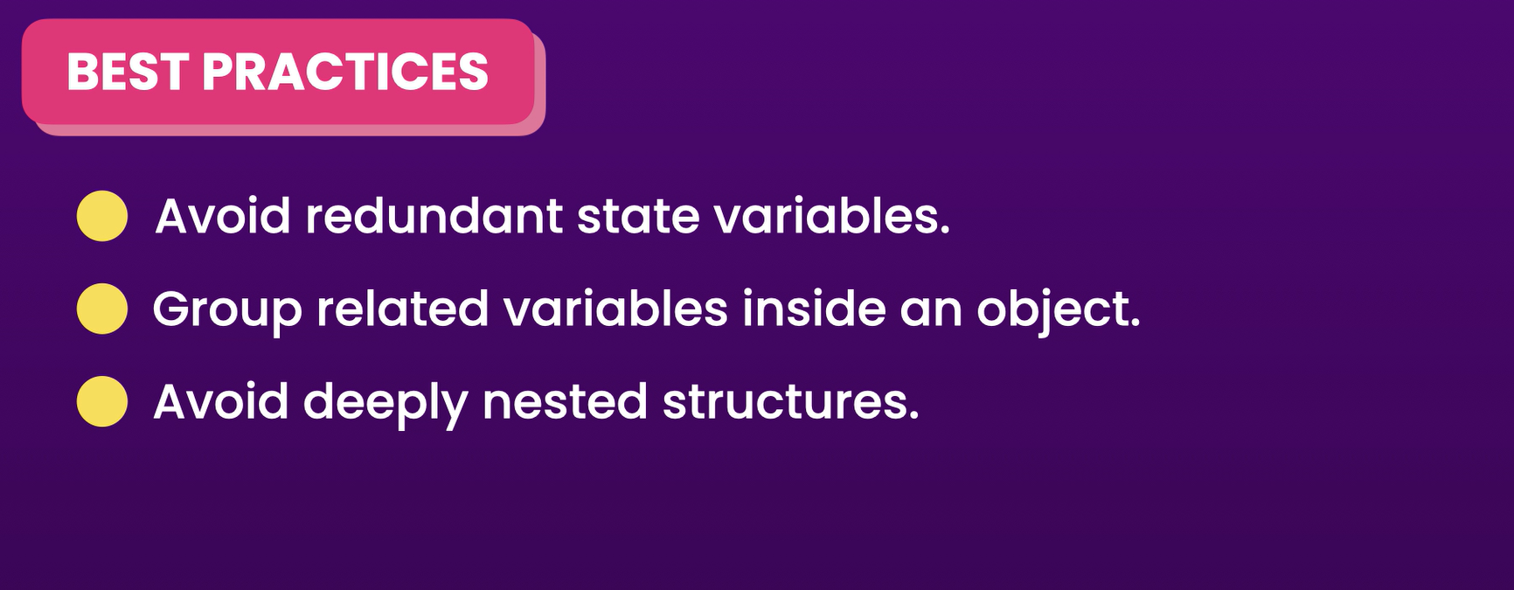
Best Pratices

Slide 3
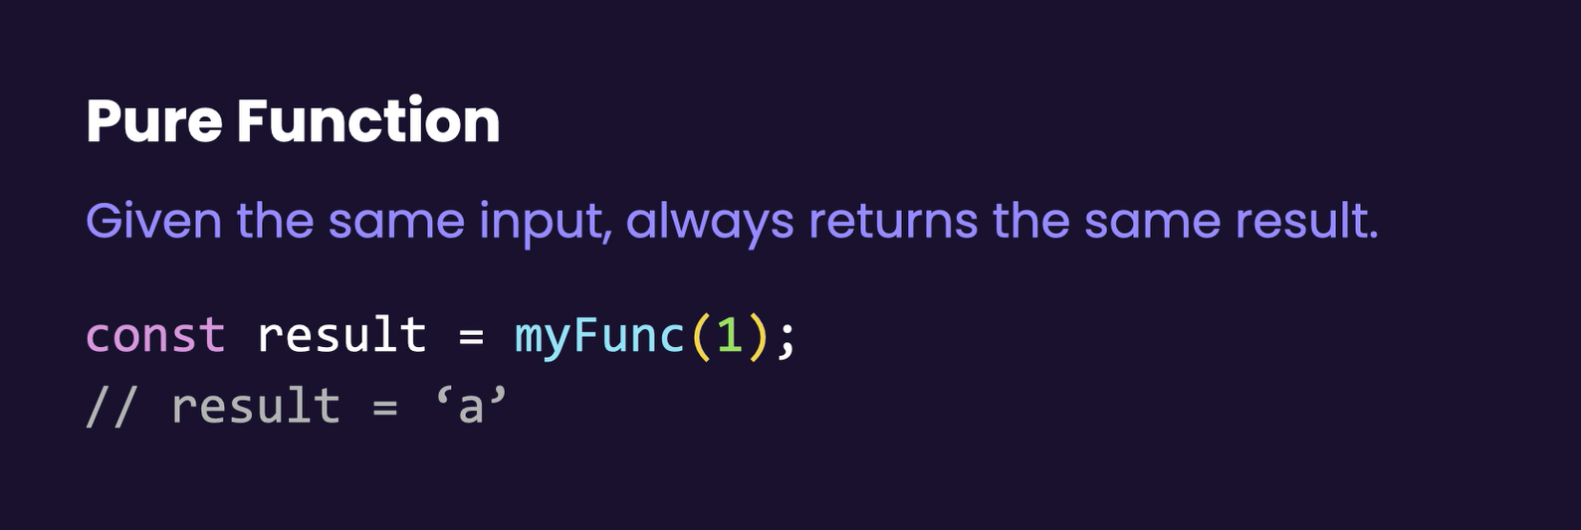
Pure function

Slide 4
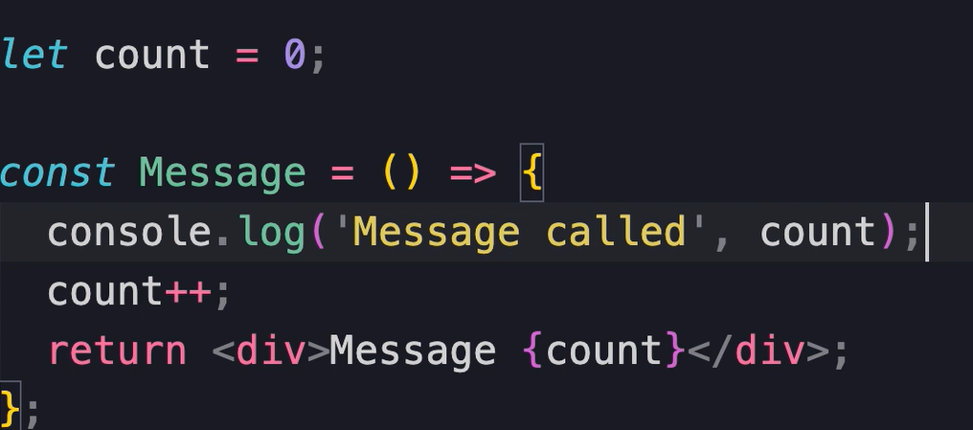

Stricktmode
From react 18 bydefault stricktmode is enabled
React render each component twice on development because of strictmode

Slide 5
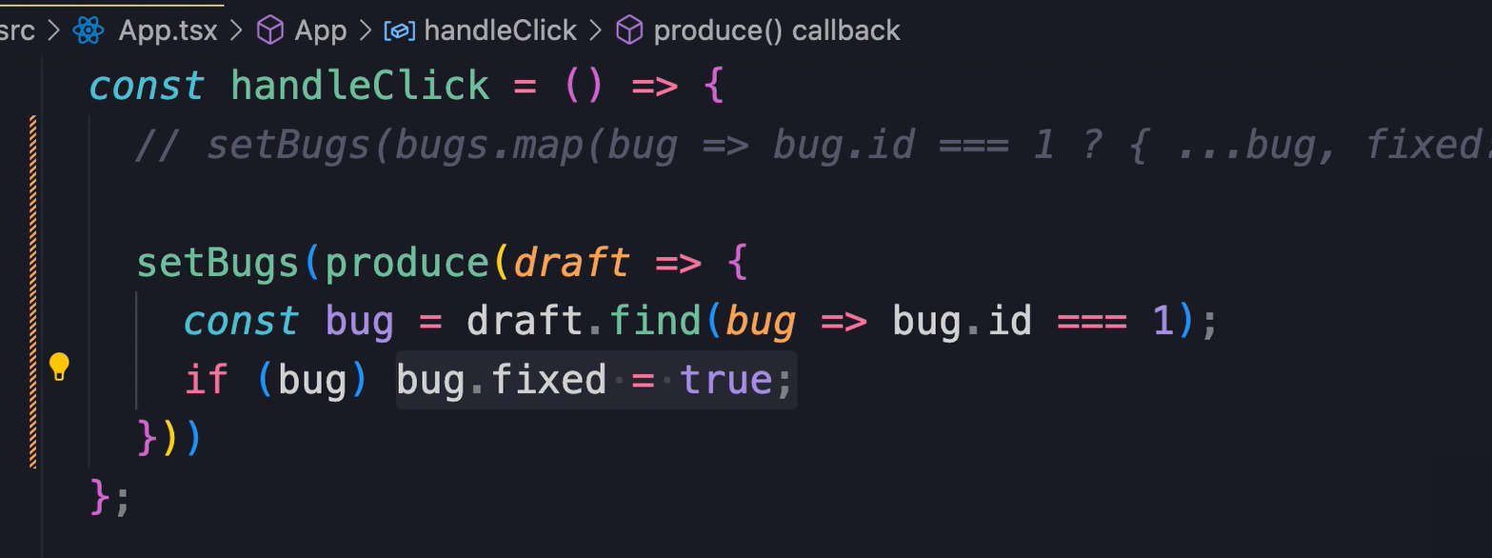
Immer package

Slide 6
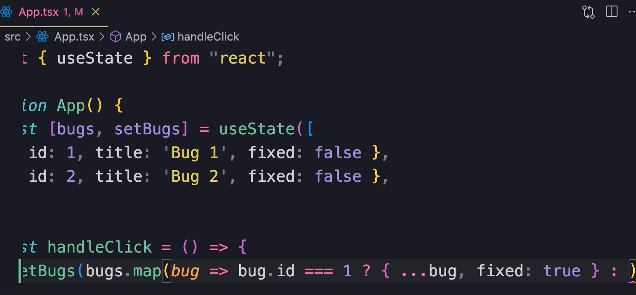
Update array

