Slide 1
EXPERIMENTAL PORTFOLIO PROJECT
01 / 06
CodeGraph
A graph based multi-agent development workspace
A working local experiment that maps application modules, agent roles, file ownership, and validation evidence.
Built to explore the idea, not to claim general autonomous development.

Slide 2
THE IDEA
02 / 06
Software work has structure. The agent workflow should show it.
A request becomes connected modules with clear dependencies. Each module gets an owner, focused tasks, and visible checks.
PROJECT REQUEST
Module graph
Agent graph
Shared memory
Validation history

Slide 3
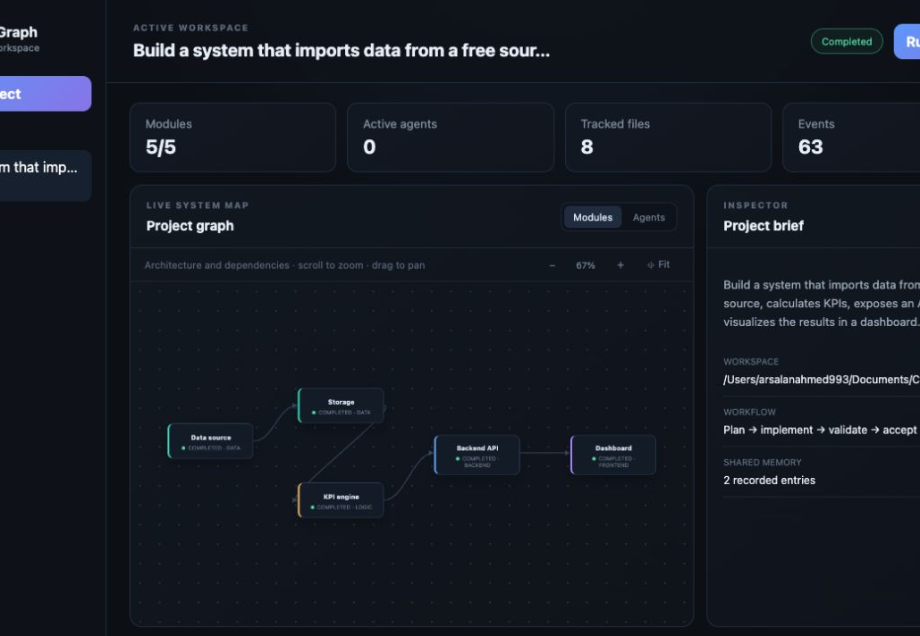
MODULE VIEW
03 / 06
The application becomes a living dependency map
Modules show ownership, status, and how data moves through the project.
Zoom, pan, inspect, and watch the graph change as features are added.

Slide 4
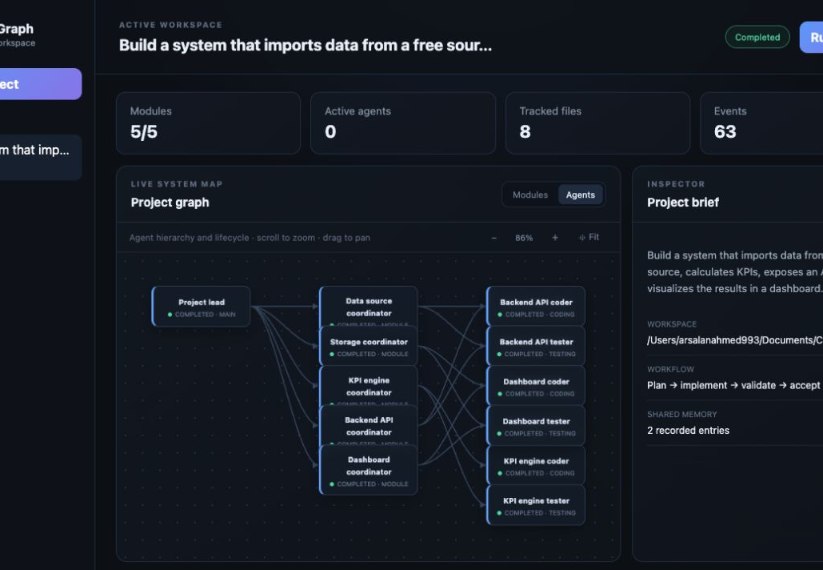
AGENT VIEW
04 / 06
Every active role stays visible
The project lead coordinates module owners. Coding and testing agents handle focused work and publish results back to the project.
Agent creation, progress, completion, failure, and cancellation appear in the event stream.

Slide 5
VALIDATION GATE
05 / 06
Generated code needs evidence before acceptance
The orchestration layer controls file access and keeps changes inside the project workspace.
01
Compile the source
02
Run automated tests
03
Record files, hashes, and results
A failed check blocks the module and returns useful diagnostics to the workflow.

Slide 6
CURRENT MVP
06 / 06
A focused experiment with a working end-to-end loop
Python and SQLite power the local engine. The browser dashboard uses plain JavaScript. A deterministic demo provider lets the workflow run without paid model access.
Current boundary
One generated application pattern and sequential module execution
Next experiment
Constrained model-generated patches behind the same validation gate

